Slide 1
Expected Utility, Mean-Variance and Risk Aversion
Lecture VII

Slide 2
Mean-Variance and Expected Utility
Under certain assumptions, the Mean-Variance solution and the Expected Utility solution are the same.
  If the utility function is quadratic, any distribution will yield a Mean-Variance equivalence.
  Taking the distribution of the utility function that only has two moments such as a quadratic distribution function.

Slide 3
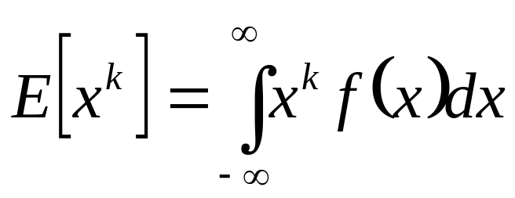
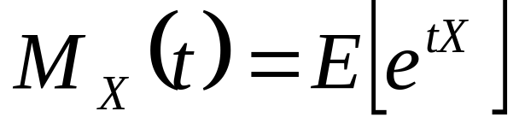
  Any distribution function can be characterized using its moment generating function. The moment of a random variable is defined as
  The moment generating function is defined as:

Slide 4
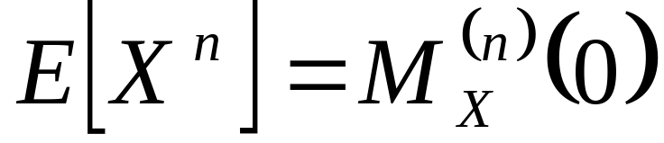
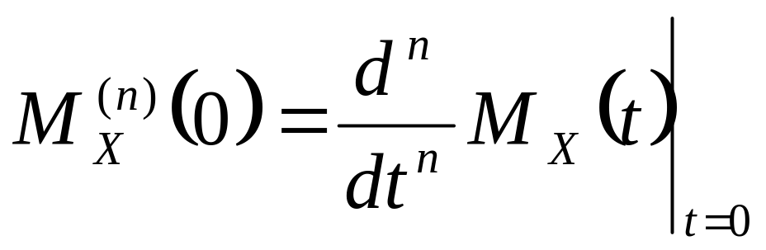
  If X has mgf M_{X}(t), then
  where we define

Slide 5
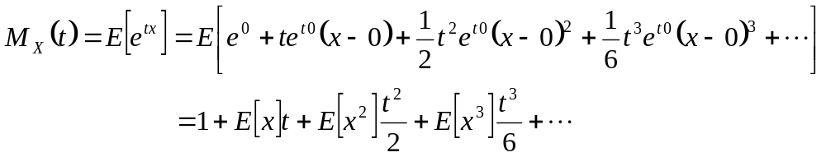
  First note that e^{tx} can be approximated around zero using a Taylor series expansion:

Slide 6
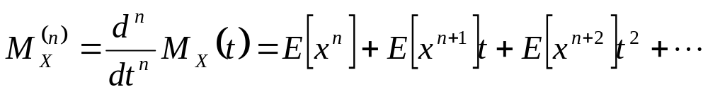
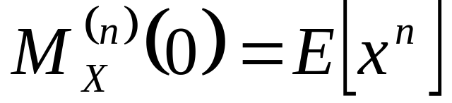
  Note for any moment n:
  Thus, as t→0

Slide 7
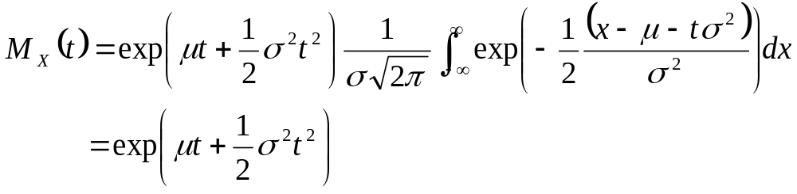
The moment generating function for the normal distribution can be defined as:

Slide 8
Since the normal distribution is completely defined by its first two moments, the expectation of any distribution function is a function of the mean and variance.

Slide 9
A specific solution involves the use of the normal distribution function with the negative exponential utility function. Under these assumptions the expected utility has a specific form that relates the expected utility to the mean, variance, and risk aversion.

Slide 10
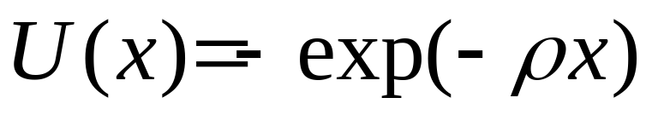
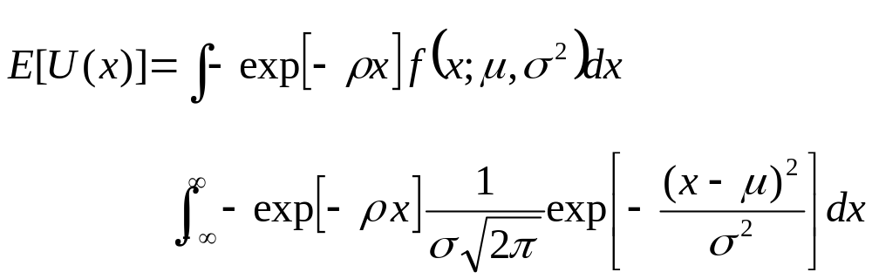
Starting with the negative exponential utility function
The expected utility can then be written as

Slide 11
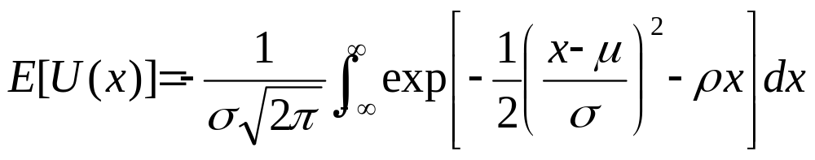
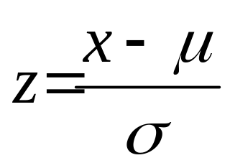
Combining the exponential terms and taking the constants outside the integral yields:
Next we propose the following transformation of variables:

Slide 12
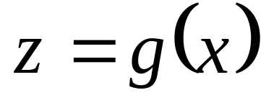
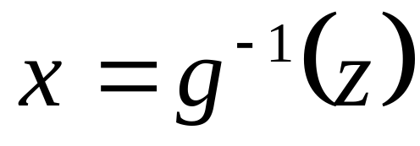
The distribution of a transformation of a random variable can be derived, given that the transformation is a one-to-one mapping.
If the mapping is one-to-one, the inverse function can be defined

Slide 13
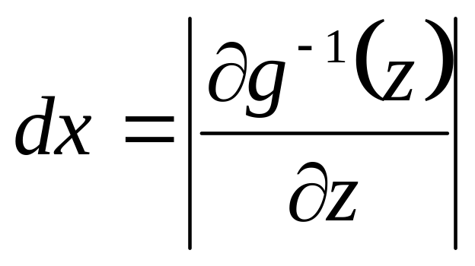
Given this inverse mapping we know what x leads to each z. The only required modification is the Jacobian, or the relative change in the mapping

Slide 14
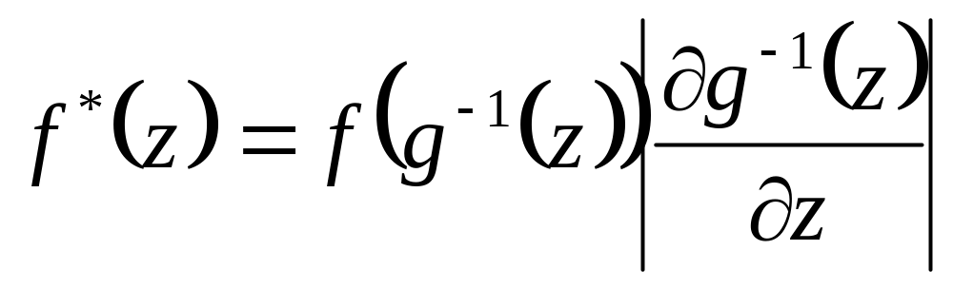
Putting the pieces together, assume that we have a distribution function f(x) and a transformation z=g(x). The distribution of z can be written as:

Slide 15
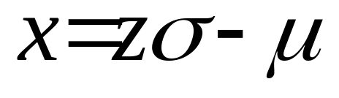
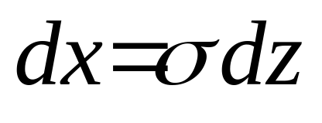
In this particular case, the one-to-one functional mapping is
and the Jacobian is:

Slide 16
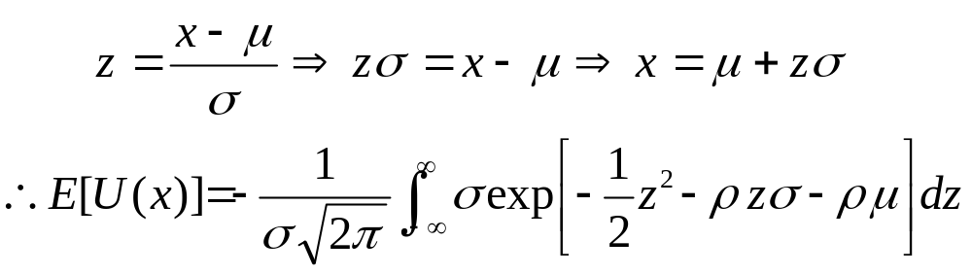
The transformed expectation can then be expressed as

Slide 17
Mean-Variance Versus Direct Utility Maximization
Due to various financial economic models such as the Capital Asset Pricing Model that we will discuss in our discussion of market models, the finance literature relies on the use of mean-variance decision rules rather than direct utility maximization.

Slide 18
In addition, there is a practical aspect for stock-brokers who may want to give clients alternatives between efficient portfolios rather than attempting to directly elicit each individual’s utility function.
Kroll, Levy, and Markowitz examines the acceptability of the Mean-Variance procedure whether the expected utility maximizing choice is contained in the Mean-Variance efficient set.

Slide 19
We assume that the decision maker is faced with allocating a stock portfolio between various investments.

Slide 20
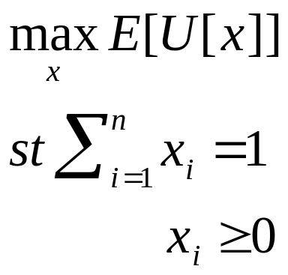
Two approaches for making this problem are to choose between the set of investments to maximize expected utility:

Slide 21
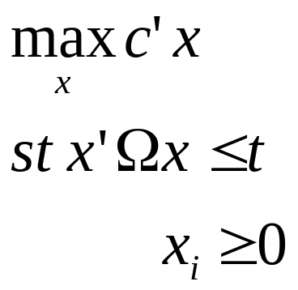
The second alternative is to map out the efficient Mean-Variance space by solving

Slide 22
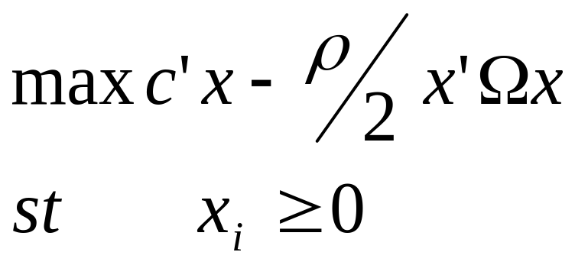
A better formulation of the problem is
And, where ρ is the Arrow Pratt absolute risk aversion coefficient.

Slide 23
Optimal Investment Strategies with Direct Utility Maximization
Utility Function | California | Carpenter | Chrysler | Conelco | Texas Gulf | Average Return | Standard Deviation
-e^{-x} | 44.3 | 34.7 | 0.2 | 5.5 | 15.3 | 22.4 | 27.3
X^{0.1} | 33.2 | 36.0 |  | 13.6 | 17.2 | 23.3 | 32.3
X^{0.5} |  | 42.2 |  | 34.4 | 23.4 | 25.9 | 49.4
ln(X) | 37.9 | 34.8 |  | 11.1 | 16.2 | 23.1 | 29.4

Slide 24
Optimal E-V Portfolios for Various Utility Functions
Utility Function | California | Carpenter | Chrysler | Conelco | Texas Gulf | Average Return | Standard Deviation
-e^{-x} | 39.4 | 38.6 |  | 5.0 | 17.0 | 22.5 | 27.0
X^{0.1} | 28.5 | 43.4 |  | 8.6 | 8.6 | 23.1 | 30.0
X^{0.5} |  | 41.8 |  | 32.1 | 26.1 | 25.7 | 47.3
ln(X) | 32.9 | 41.8 |  | 7.4 | 18.7 | 22.9 | 28.9

