Slide 1
Personality Prediction Using Machine Learning
Thejas. S Anujith K

Slide 2
What we have done till midway
We analyzed the dataset using the methods mentioned in the first reference to obtain a visual representation of the data. Then we used the cleaning and processing tools used in the second reference to obtain a workable dataset.
We implemented an XGboost model
Future Goal
We would like to fine tune our XGmodel to obtain optimum results and do a thorough analysis on where we failed and what improvements can be done.

Slide 3
Dataset
The dataset has tweets from social media of a single person as one attribute and one of the sixteen MBTI personality type. Each of the character of the four characters corresponds to each of the four MBTI classes.
The dataset consists of 8675 rows and 2 columns.
The dataset has no null values in the type attribute or in the posts attribute.
The INFP, INFJ, INTP, INTJ personality types have a greater number of overall posts while the ESTJ, ESFJ, ESFP, ESTP personality types have the lesser number of overall posts in the dataset.

Slide 4
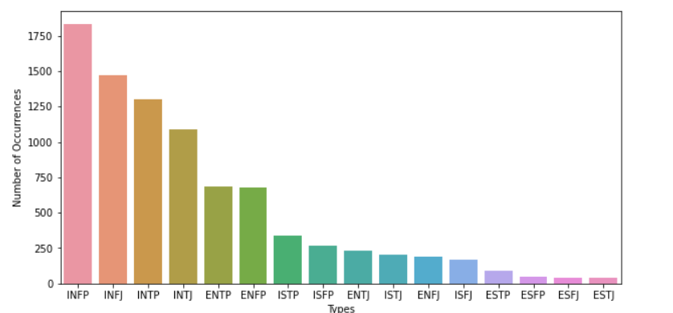
First we plotted a visual representation of personality distribution to get an intuitive idea.
The distribution is a bit skewed but we planned to not normalize with external weightage.

Slide 5
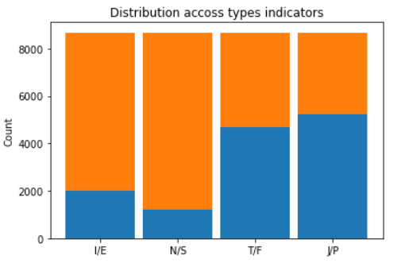
New columns were added for the type Indicators and the distribution was again plotted
Introversion (I) / Extroversion (E): 1999 / 6676
Intuition (N) – Sensing (S): 1197 / 7478
Thinking (T) – Feeling (F): 4694 / 3981
Judging (J) – Perceiving (P): 5241 / 3434

Slide 6
Preparation and Pre-processing of data
The type indicator were converted to binaries for better implementation.
URLs and MTBI strings are removed.
Each words were lemmatized.
Vectorization was done using CountVectorizer and TfidfTransformer.
Words of frequency 10%-70 % are kept and rest are filtered.
Natural Language Toolkit was used to remove the stopwords
(Stop words are a set of commonly used words in a language. Eg: “a”, “the”, “is”, “are” etc.)

Slide 7
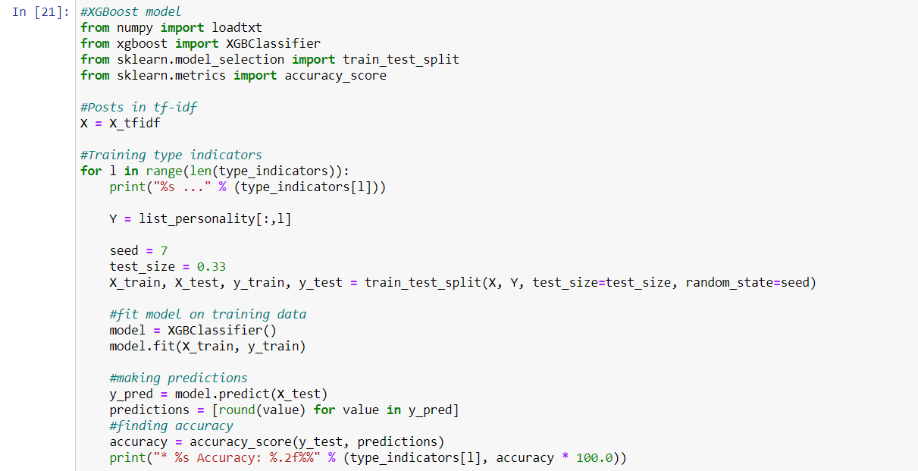
Finally we implemented XGBoost model for the following result:
Introversion (I) / Extroversion (E) Accuracy: 77.33%
Intuition (N) – Sensing (S) Accuracy: 86.13%
Feeling (F) - Thinking (T) Accuracy: 71.74%
Judging (J) – Perceiving (P) Accuracy: 63.74%

Slide 8
Improving Intelligent Personality Prediction using Myers-Briggs Type Indicator and Random Forest Classifier
Paper implements a Random Forest classifier and compares the result with some other references. The data set used is the same as ours, taken from Kaggle.
First stage was exploratory data analysis and based on this, seven additional features were generated such as words per comment, ellipsis per comment, links per comment etc.
The Pearson correlation between words per comment and ellipsis per comment was analyzed to see the differences between the MBTI types.
INFJ, INTP and ENFP showed high correlation and this was used later to train data.
Data was pre-processed, vectorized and the traits were binarized.
Sci-kit learn’s internal module train_test_split () was used to split the data into testing and training.
For model Numpy and sklearn was used to build the Random Forest, Logistic Regression, KNN Neighbor and Support Vector Machine (SVM) models.
Random Forest had 100% accuracy on all types followed by KNN neighbour, Logistic regression and Support vector machine all having overall accuracies less than 41%.

Slide 9
Predicting Myers-Briggs Type Indicator with Text Classification
The second paper also uses the same dataset (from Kaggle) but they clean the data to fit the proportionality of the MBTI types with that of general population. Pre-processing includes selective word removal. Essentially NLTK was used to filter out “stop words” and links to other websites were also removed.
Also if the data set is taken from a website related to MBTI or related sites then, the types are removed to prevent the model from cheating. Then all the words are lemmatized to their root form, and the most common 2500 words are tokenized.
In model building, for the embedding layer, they use a embedding matrix in the form of a dictionary mapping that maps every lemmatized word to a 50 dimensional GloVe representation of the word.
Various Recurrent Neural Networks (RNN) [like simple RNN, GRU, LSTM and bidirectional LSTM] was used and they found LSTM to give the best result.
In the result, user classification was more accurate compared to the post classification. The accuracy of post classification is 8.73% whereas that of user classification is 20.77%.

Slide 10
References
Abidin, N. H. Z., Remli, M. A., Ali, N. M., Phon, D. N. E., Yusoff, N., Adli, H. K., & Busalim, A. H. (2020). Improving Intelligent Personality Prediction using Myers-Briggs Type Indicator and Random Forest Classifier. INTERNATIONAL JOURNAL OF ADVANCED COMPUTER SCIENCE AND APPLICATIONS.
Hernandez, R. K., & Scott, I. (2017). Predicting Myers-Briggs type indicator with text. In 31st Conference on Neural Information Processing Systems (NIPS 2017).

Slide 11
Thank You!

