Slide 1
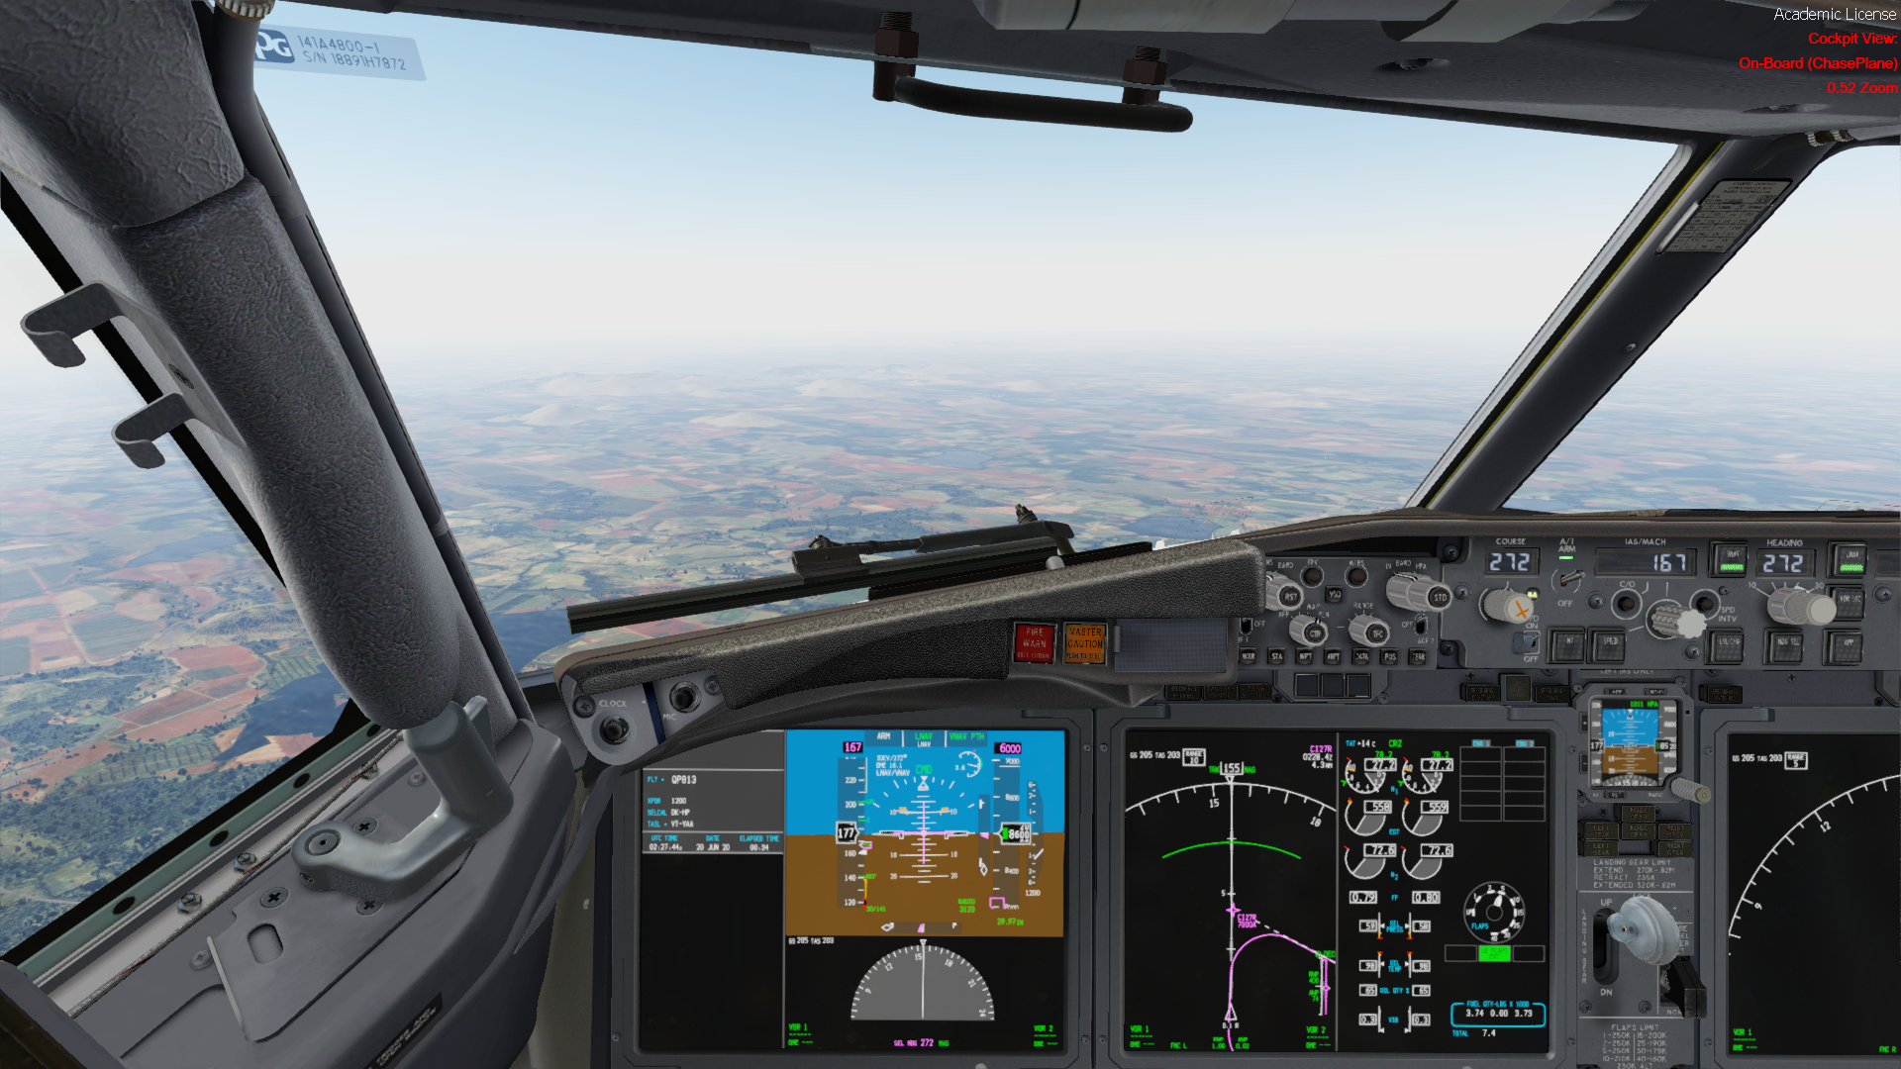

ENGINEERING AR/VR PROJECT
Webcam-Based 3D Head Tracking for Flight Simulation
Real-Time Computer Vision Using Python, OpenTrack and Prepar3D v5.4
[INSERT IMAGE: Prepar3D cockpit screenshot or project setup photograph]
“Turning natural head movement into an immersive virtual cockpit experience.”
Y
Thejas J, Siddanth, Suhana, Anam, Hiba, Sneha
Information Science and Engineering
St. Aloysius (Deemed to be University)
Presented to faculty of ARVR, Ms. Ashwija
X

Slide 2
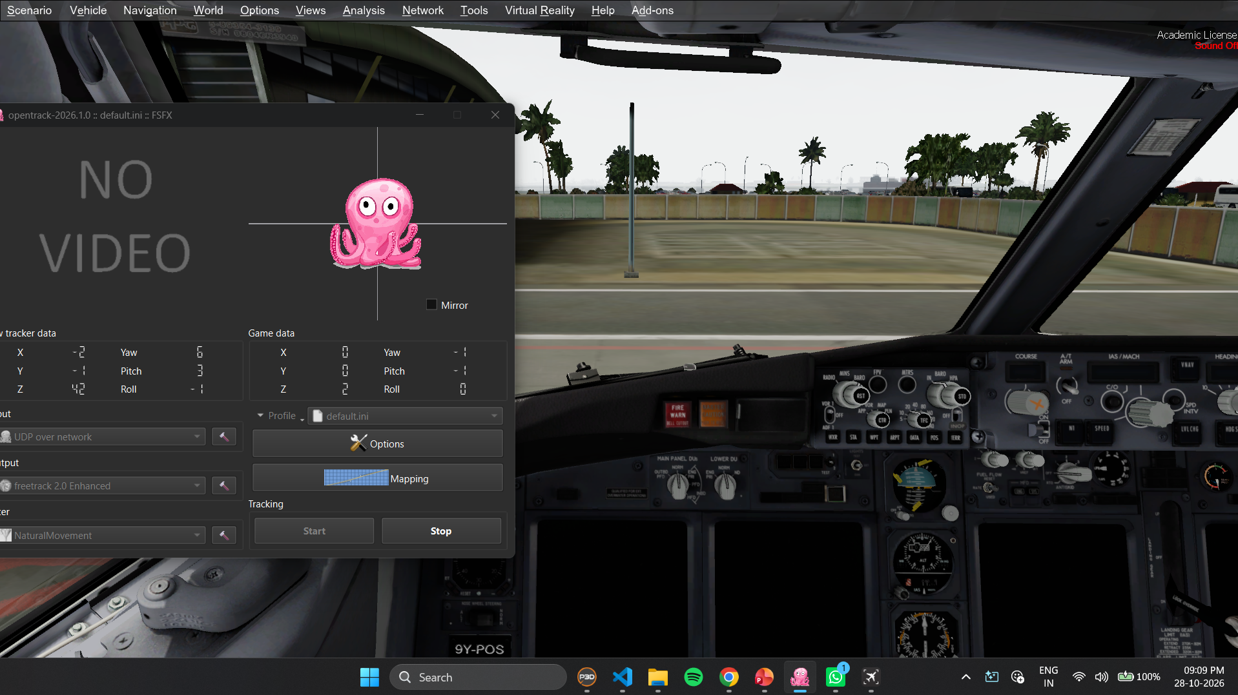
Bringing Natural Head Movement into the Virtual Cockpit
Head Movement
Webcam
Computer Vision
OpenTrack
Prepar3D
Pilot looks around
Captures frames
Estimates head pose
Maps tracking data
Moves the camera
Conventional viewing
Head-tracked viewing
Manual camera controls: mouse, keyboard or view shortcuts
Natural physical movement drives the cockpit view
Fixed viewpoints and key presses interrupt immersion
Head tracking lets the virtual camera follow the pilot’s head
An ordinary webcam and computer vision estimate position and orientation in real time
[INSERT SCREENSHOT: Prepar3D cockpit before and after head tracking]
It enhances the viewing experience; it does not replace other simulator controls.

Slide 3
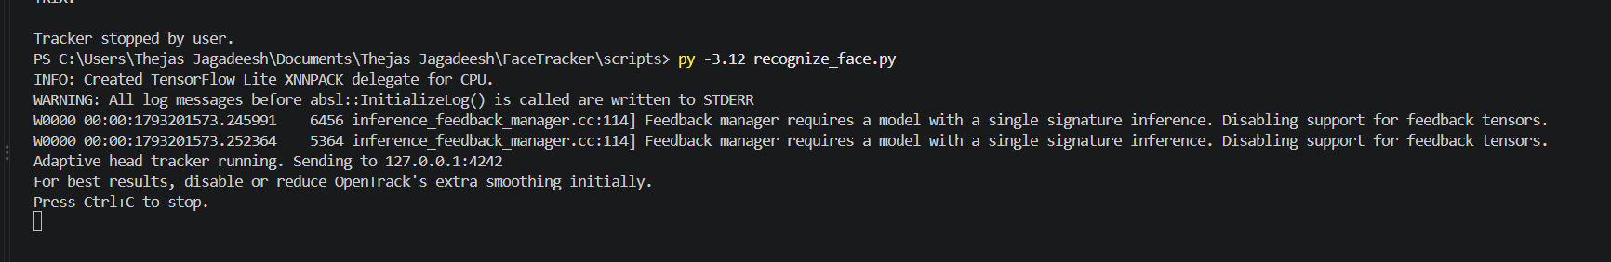
The Technology Behind the Tracker
CUSTOM PYTHON APPLICATION
Python
OpenCV
Core logic, pose processing, filtering, communication
Webcam capture, calibration parameters, solvePnP pose estimation
OpenTrack
Prepar3D v5.4
Receives data, applies mappings and curves, outputs camera movement
Target simulator with head-tracked viewing
MediaPipe Face Mesh
NumPy
UDP · 6 floats
Detects facial landmarks in each frame
Matrix maths, vectors and filtering
Python + OpenCV + MediaPipe + NumPy form the vision pipeline
UDP carries six tracking values to OpenTrack
OpenTrack handles mapping and simulator output
[INSERT SCREENSHOT: Python tracker console or application]

Slide 4
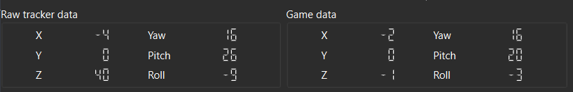
Why Build a Custom Tracker Instead of Using OpenTrack Alone?
OpenTrack provides
Our Python tracker adds
Framework to receive, filter, map and forward tracking data
Configurable axis mapping and response curves
Compatibility with supported tracking protocols
Output to the simulator through its supported interface
Webcam landmark detection with MediaPipe
Custom 3D head-pose estimation with OpenCV
Adaptive smoothing: jitter vs. responsiveness
Separate handling of rotation and translation
Full control of the algorithm for future changes
Custom Vision & Pose Estimation → UDP Tracking Data → OpenTrack → Prepar3D
OpenTrack already supports several tracking sources, so a custom tracker is not inherently superior. We built one to gain control of the vision algorithm and explore a low-cost, modifiable solution.
“OpenTrack handles the data interface and output; our application implements the vision pipeline.”
[INSERT SCREENSHOT: OpenTrack input/output configuration and raw tracker data]

Slide 5
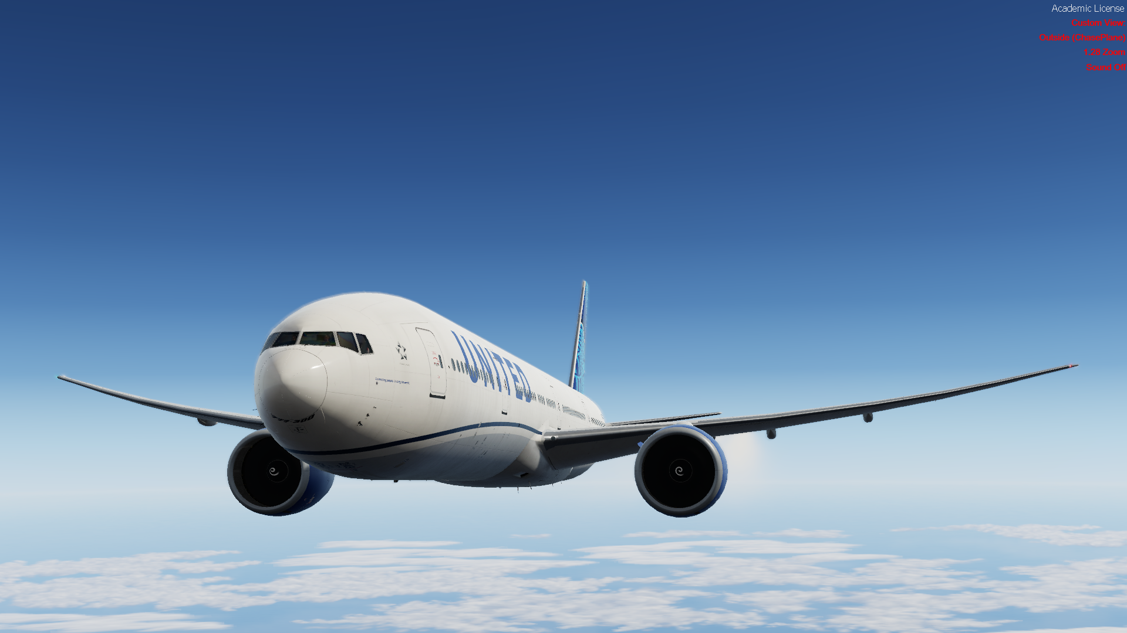
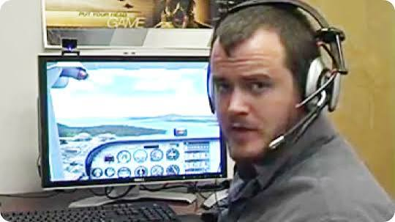
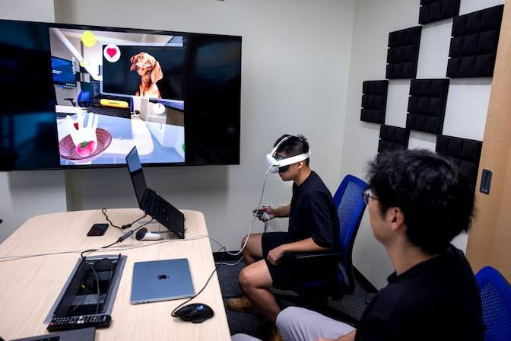
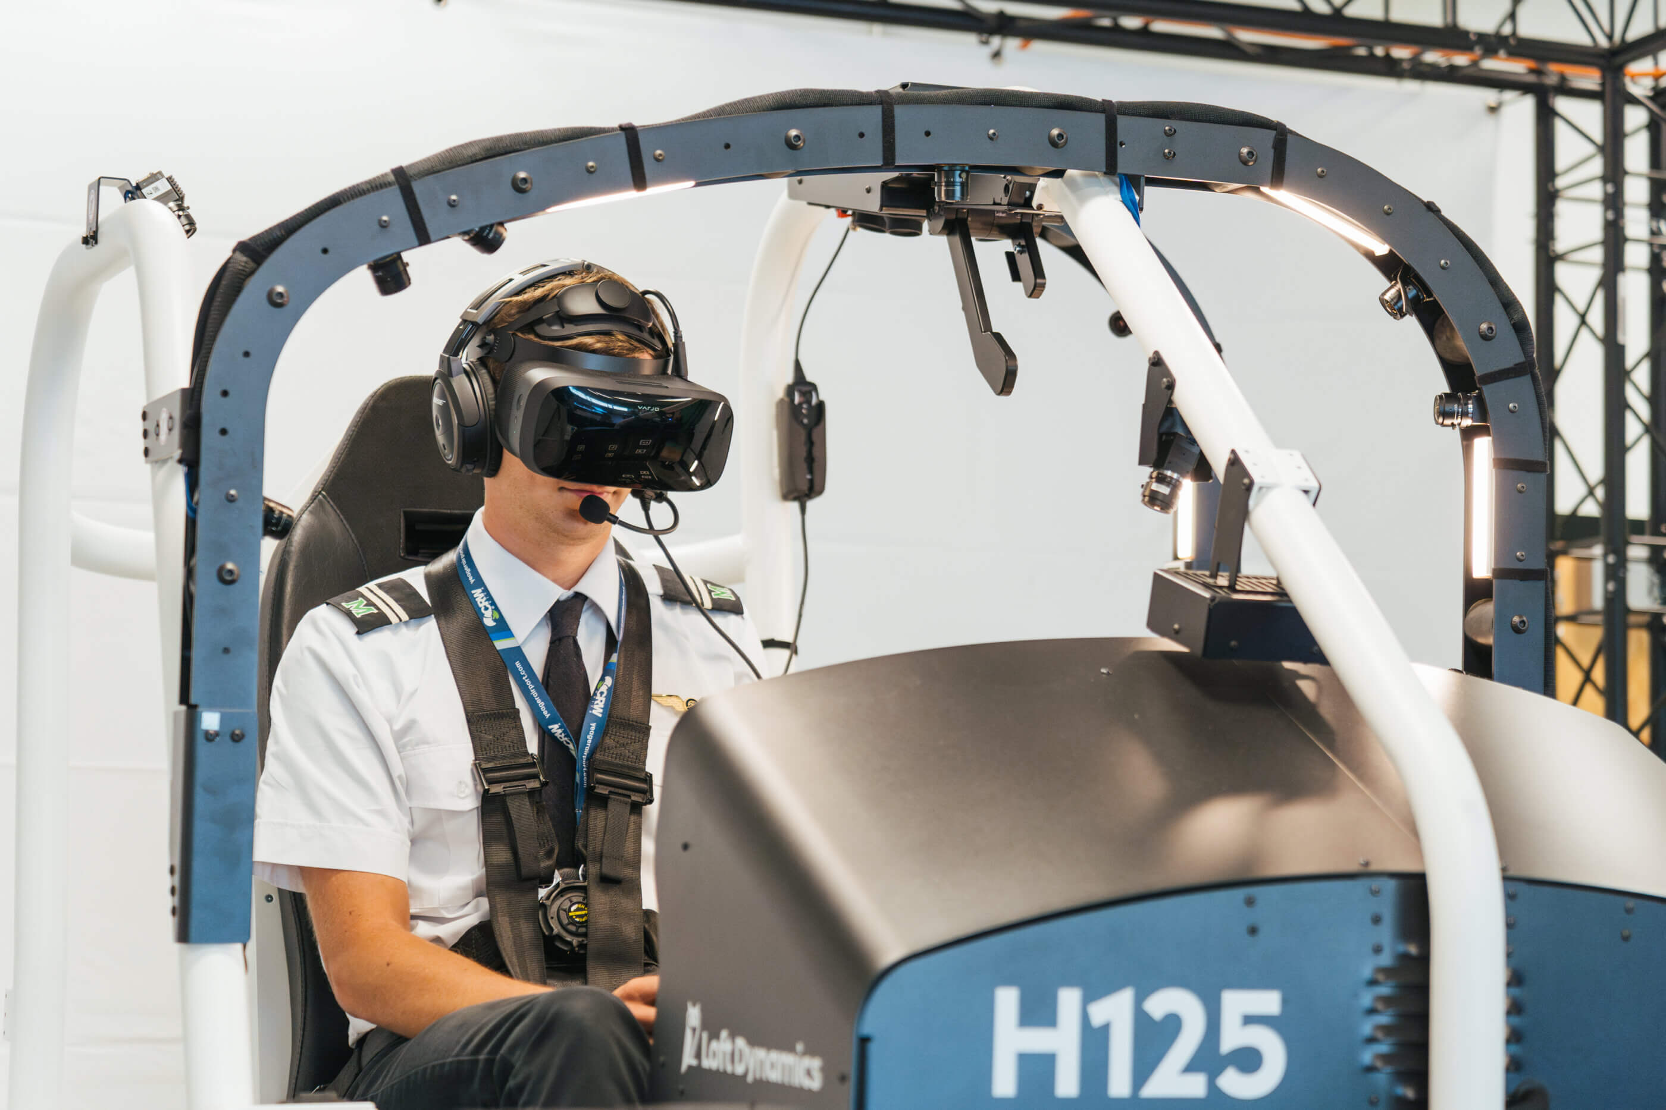
Beyond Flight Simulation: Applications of Webcam-Based Head Tracking
[INSERT IMAGE: Flight simulator cockpit]
[INSERT IMAGE: Head-controlled gaming camera]
[INSERT IMAGE: Hands-free computer interaction]
[INSERT IMAGE: Human-robot interaction]
1. Flight Simulation
2. Gaming & Virtual Cameras
3. Human-Computer Interaction
4. Robotics & Research
DEMONSTRATED
RELATED USE
RELATED USE
RELATED USE
Natural cockpit viewing
Better spatial awareness
Look at instruments, windows, panels
Viewpoint control in supported games
Camera follows natural movement
Hands-free viewpoint control
Possible accessibility scenarios
Low-cost interaction experiments
Prototype robot interfaces
Real-time pose estimation research
Applications depend on the tracking system, software integration, and operating environment.

Slide 6
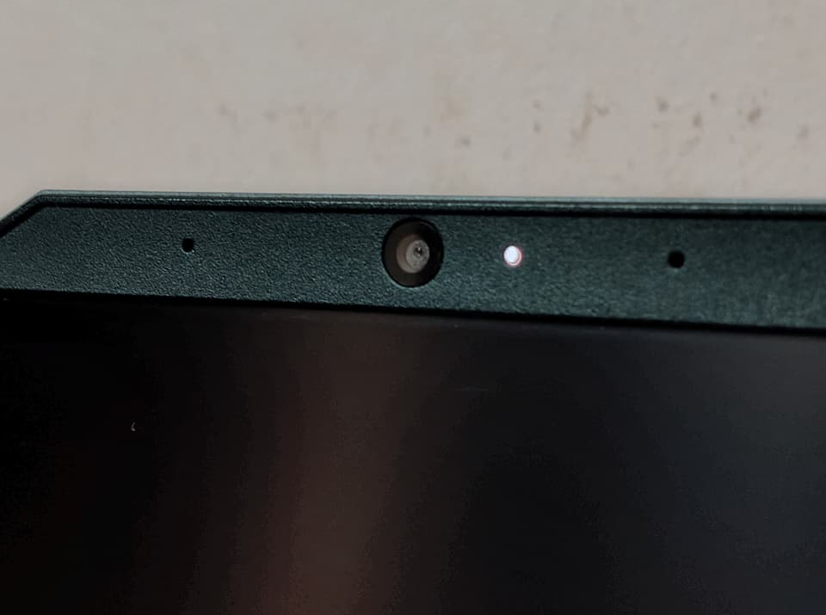
Affordable Head Tracking Using Hardware You Already Own
Factor | Webcam approach | Dedicated hardware
Hardware cost | Low if a webcam already exists | Additional purchase usually required
Software cost | Open-source libraries possible | Depends on product and licence
Setup | Camera position and lighting matter | Device-specific setup
Robustness | Depends on camera, light, algorithm | Depends on sensor and design
Customization | High for a self-built algorithm | Depends on available software
Performance | Depends on hardware and code | Can be optimized for tracking
Minimal incremental hardware cost, but development time and computer processing still matter.
“The project lowers the barrier to entry by using an accessible camera and software, trading some consistency and robustness for affordability and flexibility.”

Slide 7
From Facial Landmarks to Six-Axis Camera Movement
1 Capture
2 Landmarks
3 Head Pose
4 Smooth
5 Six Axes
6 Send
OpenCV reads webcam frames
MediaPipe finds nose, chin, eye and mouth points
solvePnP matches 2D points to a simplified 3D face model
Adaptive exponential filter; rotation and translation separate
Yaw, pitch, roll, X, Y, Z
Six floats in one UDP packet to OpenTrack
Pseudocode
Six degrees of freedom
Slow/tiny motion → stronger smoothing. Fast motion → more responsive.
Capture webcam frame
Detect facial landmarks
Estimate head pose
Apply adaptive smoothing
Extract X,Y,Z,yaw,pitch,roll
Send tracking data via UDP
Rotation Yaw: turn left/right · Pitch: tilt up/down · Roll: tilt sideways
Translation X: left/right · Y: up/down · Z: toward/away from camera
[INSERT SCREENSHOT: MediaPipe landmarks or OpenTrack raw data]
Translation from monocular facial geometry is approximate and can be affected by lighting, camera calibration and head rotation. The system estimates pose from a simplified face model, not a perfect 3D reconstruction. Frame rate depends on the camera and processing power.

Slide 8
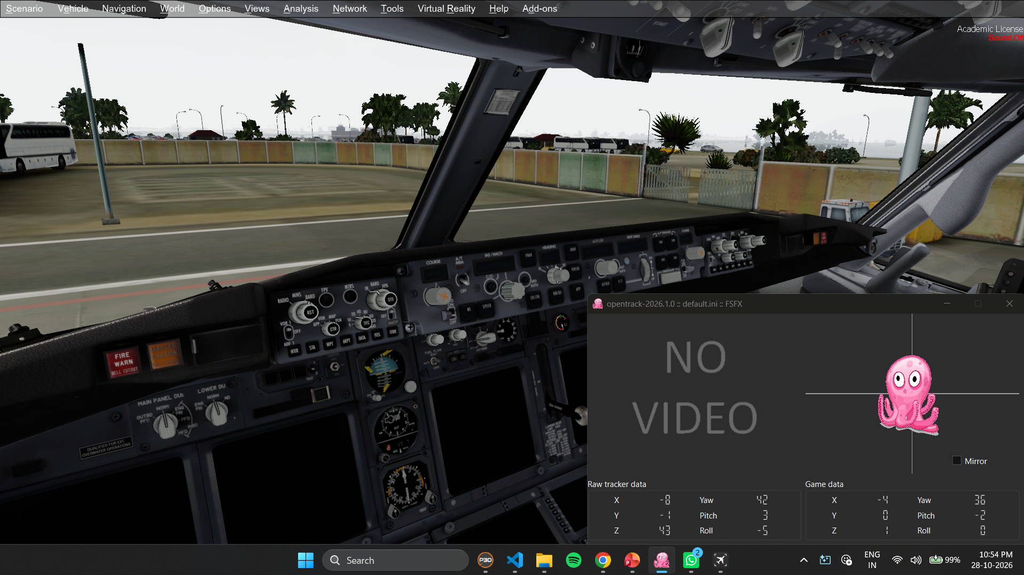
A More Natural View of the Virtual Cockpit
Achievements
Future improvements
Webcam head tracking built in Python
MediaPipe and OpenCV estimate head pose
Adaptive smoothing balances stability and responsiveness
Six-axis data sent to OpenTrack over UDP
Integrated with Prepar3D v5.4
Low-cost alternative to dedicated hardware
Better calibration and translation accuracy
Robustness under varying lighting
Performance profiling and latency optimization
Advanced filtering and tracking-loss recovery
THANK YOU
Questions and Discussion

