Slide 1
SCALABLE TICKET SELLER
A PROJECT BY
THEJAS BARADHWAJ
SURAJ VISVESWARAIYA

Slide 2
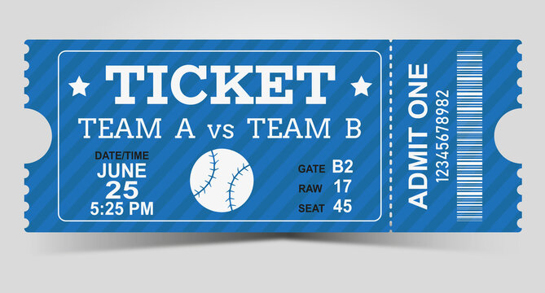
INTRODUCTION
SCALABLE TICKET SELLER’S mission is to sell tickets for sporting events online
We aim to provide seamless ticket buying experience through our ticket agency
We provide services to customers such as browse trending events, buying tickets for an event, cancellation service, peak into order history and many more
Our admin team takes care of managing the events, managing customer accounts, and sell tickets through our platform
COME, LET’S GO BUY TICKETS!!!!

Slide 3






METHODOLOGY
Language: Scala ✅ | Akka HTTP for building RESTful APIs. ✅ | Gatling for Testing ✅ |
Database: PostgreSQL or MySQL for relational data storage. Slick for database access in a reactive manner
Change of Implementation: Cassandra integration with the web application for persistence
CLIENT SERVERS
WEB SERVER - SCALA + ACTORS
CASSANDRA
REQUEST
PERSISTENCE
RESPONSE

Slide 4
DATA SOURCES
1) Event and ticket information from event organizers.
2) User profiles and transaction data from customer interactions.
Note : The data magnitude will vary depending on the number of events and users. We anticipate handling tens of events and millions of user records.
Millions of users? Yes
Thanks to CASSANDRA. Its distributed architectures helps us in persistence and to store huge amounts of customer and ticketing information

Slide 5
MILESTONES/SPRINTS
6–12 Nov.
System Architecture and Designing - Nov 6 - Nov 12 | ✅
12–25 Nov.
Implementation of Actors - Nov 12 - Nov 25 | extended till Nov 29
25–30 Nov.
Test cases development - Nov 25 - Nov 30 | ✅
1 Dec.
Unit Testing - Dec 1 | ✅
2–4 Dec.
Performance Enhancement - Dec 2 - Dec 4 | ✅
5 Dec.
Acceptance Testing - Dec 5 Deployment of the system - Dec 6 | ✅

Slide 6
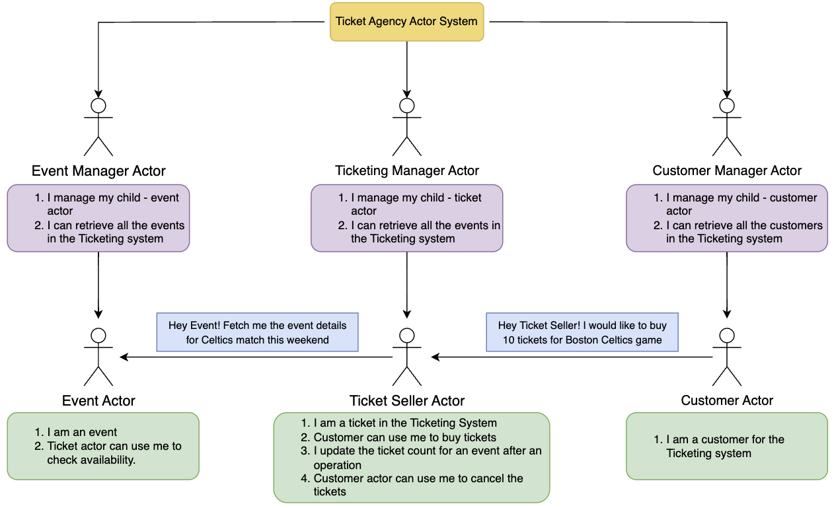
ACTOR SYSTEM ARCHITECTURE

Slide 7
USE CASES – ACTORS AND ACTIONS
This project seeks to address these challenges by leveraging the power of Akka.
EventManager Actor:
Manages information about events, venues, and schedules. ✅
Create new events. ✅
Update event details. ✅
Retrieve event information. ✅
TicketSeller Actor:
Handles ticket sales for a specific event. ✅
Process ticket purchases. ✅
Update available ticket inventory. ✅
Handle refunds or cancellations.✅
Customer Actor:
Represents individual customers interacting with the system.✅
Purchase tickets for events. ✅
Receive order confirmations.✅

Slide 8
USE CASES – ACTORS AND ACTIONS
Notification Actor:
Sends notifications to customers. ✅
Send order confirmations. ✅
Notify customers about all the events. ✅
Change in implementation: Though we haven't implemented a specific Notification Actor, all the functionalities have been implemented through other actors
InventoryManager Actor:
Manages the overall ticket inventory for all events. ✅
Track available tickets. ✅
Handle restocking of tickets ✅

Slide 9
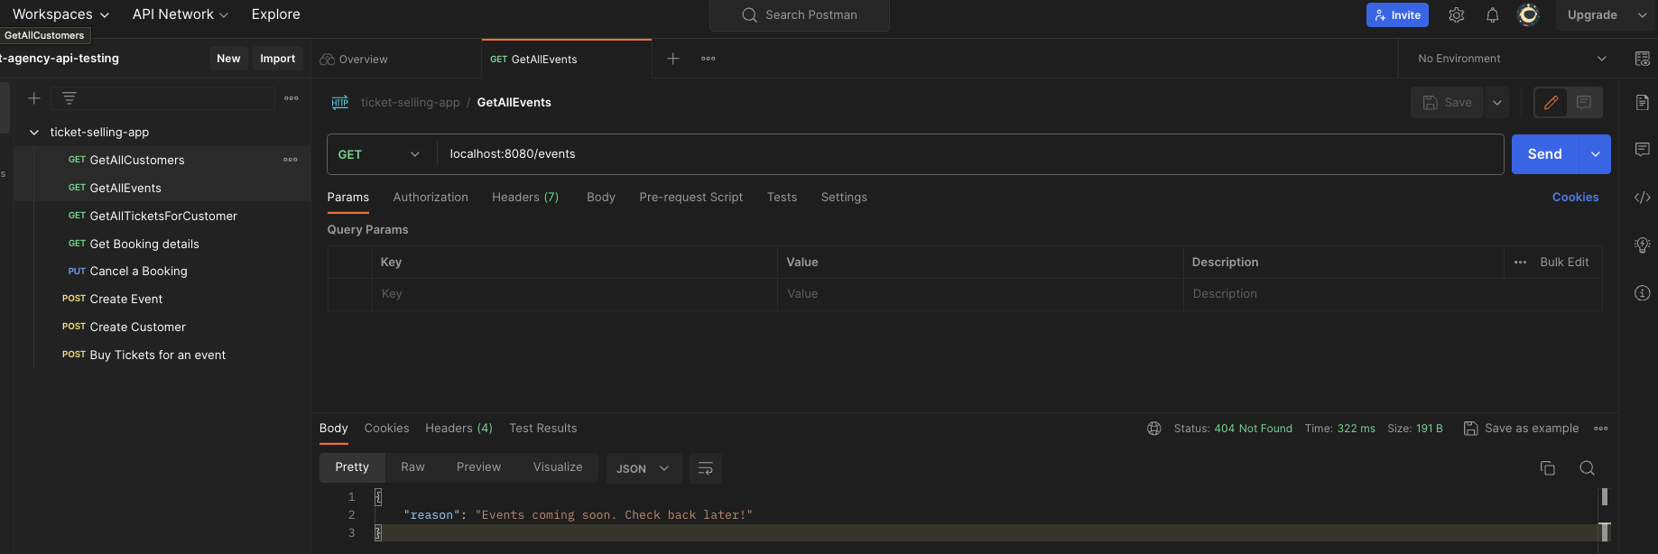

ITS TIME FOR OUR DEMO
Time to hit Postman

Slide 10
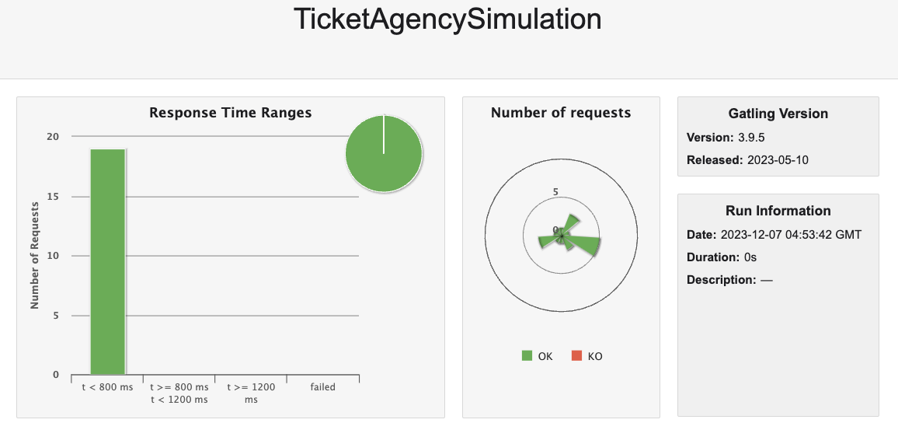
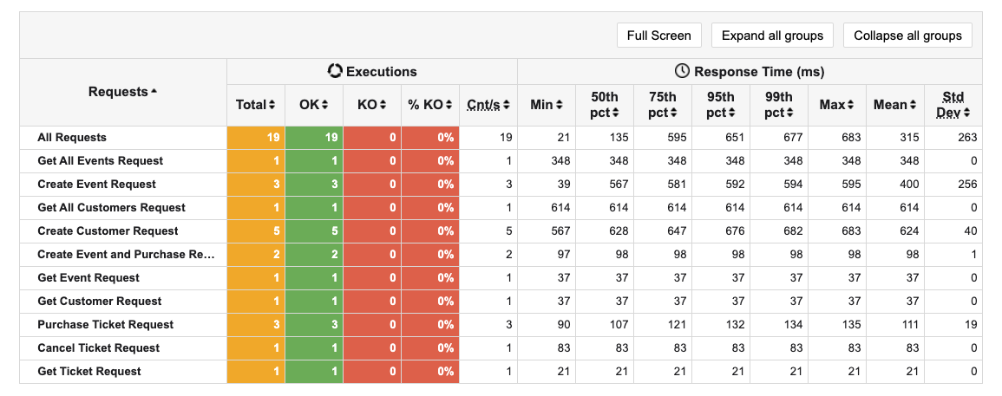
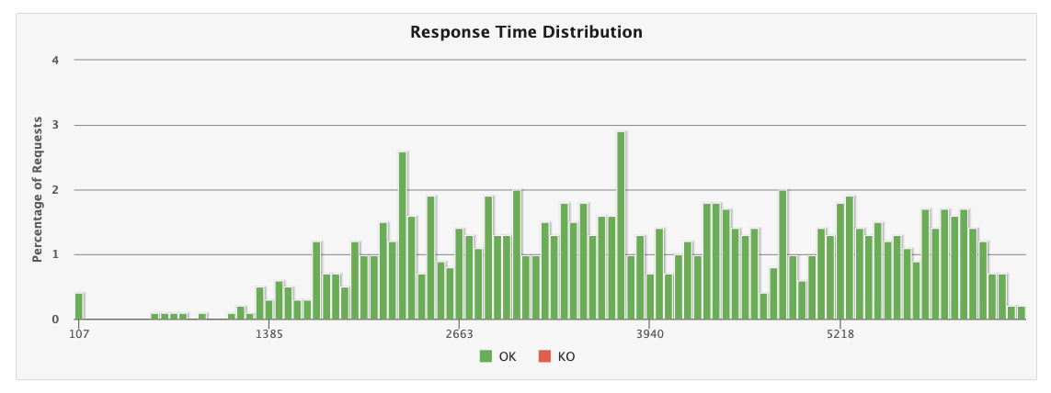
HEAVY LOAD TESTING
Gatling helped us with load testing and achieve the proposed criterions using user simulations.
Response time distribution for 6000 requests at once. With average response time < 2 seconds.

Slide 11
ACCEPTANCE CRITERIA
1) Scalability Criteria:
System can handle events ranging from 1000 till 100000 users ✅
The bottle neck is hardware, and the application can scale amazingly with increased server configurations.
2) Concurrency Criteria:
System should be able to handle a peak load of at least 1,000 concurrent users without performance degradation.✅
Response times should remain under 2 seconds for 90% of concurrent user interactions. ✅
3) Performance Optimization Criteria:
Page load times for event listings, and checkout should not exceed 1 second for 95% of user interactions. ✅
The system should be able to process a minimum of 1,000 transactions per minute during peak periods. ✅
4) User Experience Criteria:
The user interface should be intuitive and easy to navigate, with a user satisfaction rating of at least 4 out of 5.
-No user interface to our system.
Error messages should be descriptive and guide users toward resolving issues effectively.✅

Slide 12
DID WE ACHIEVE OUR PROJECT GOALS?
On board customers/users into our system(10000 users) ✅
Manage Ticket sales(roughly about 100000) ✅
Manage concurrency of the users(700 - 1000) ✅
Users should be able to request for tickets in numbers ✅
Ticket Seller will process user requests Customers will buy tickets on the platform seamlessly ✅
Event Manager/ admin will manage the system and performances ✅
Functional Programming: Absolutely ✅

Slide 13
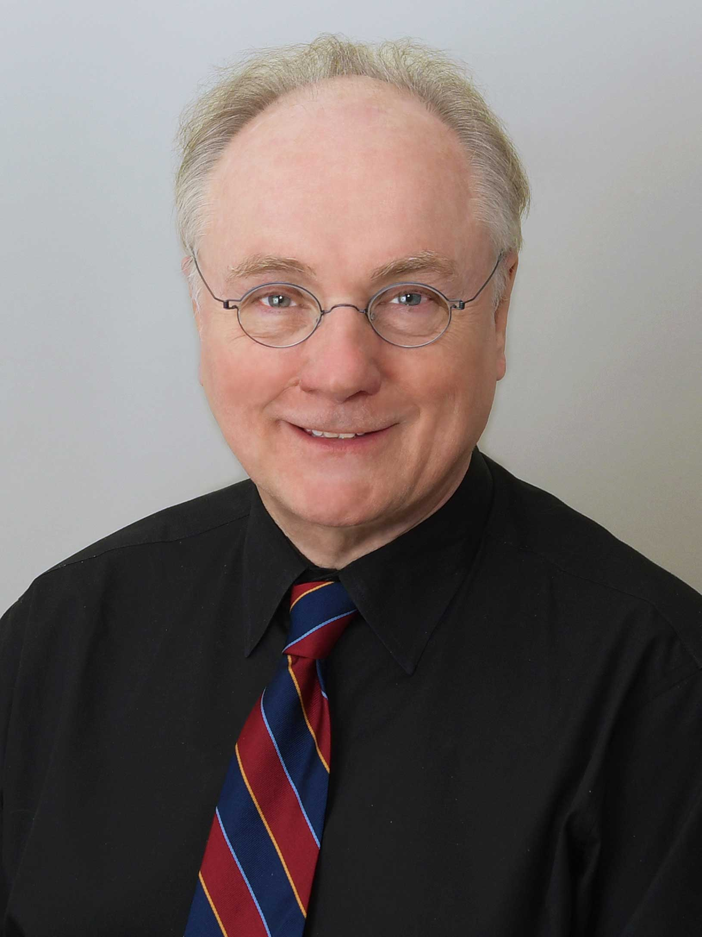
THE ACADEMY AWARDS FOR THE BEST TICKET SELLER GOES TO THE SCALA PROFESSOR.
Ticket Master, Eventbrite, and Seat Geek right now 😂 😂 😂

