Slide 1
Case Study: Music Streaming Application Presented By: Name : N.Thejasree Roll No: 192524438 Course:csa0303-Data structures
EFFICIENT PLAYLIST MANAGEMENT USING DOUBLY LINKED LIST

Slide 2
Problem Statement
Problem Statement:
A music streaming application needs to manage playlists
where users can:
Add new songs dynamically
Remove existing songs
Reorder songs
Navigate to the next and previous songs
Handle playlists of varying sizes
Requirement
The data structure should be:
Dynamic
Flexible
Memory efficient
Fast for insertion and deletion

Slide 3
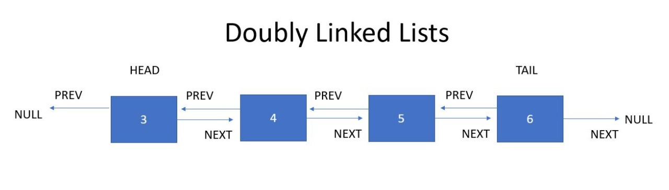
Recommended Data Structure – Doubly Linked List
Definition
A Doubly Linked List (DLL) is a linear data structure where each node contains:
Song data
Pointer to the previous node
Pointer to the next node
Advantages
Supports forward and backward navigation
Efficient insertion and deletion
Easy song reordering
Dynamically adjusts to playlist size

Slide 4
Comparison & Performance
Singly Linked List vs Doubly Linked List
Feature | Singly Linked List | Doubly Linked List
Traversal | Forward only | Forward & Backward
Previous Navigation | ❌ | ✅
Insertion & Deletion | Moderate | Efficient
Memory Usage | Less | More
Best for Music Playlist | ❌ | ✅

Slide 5
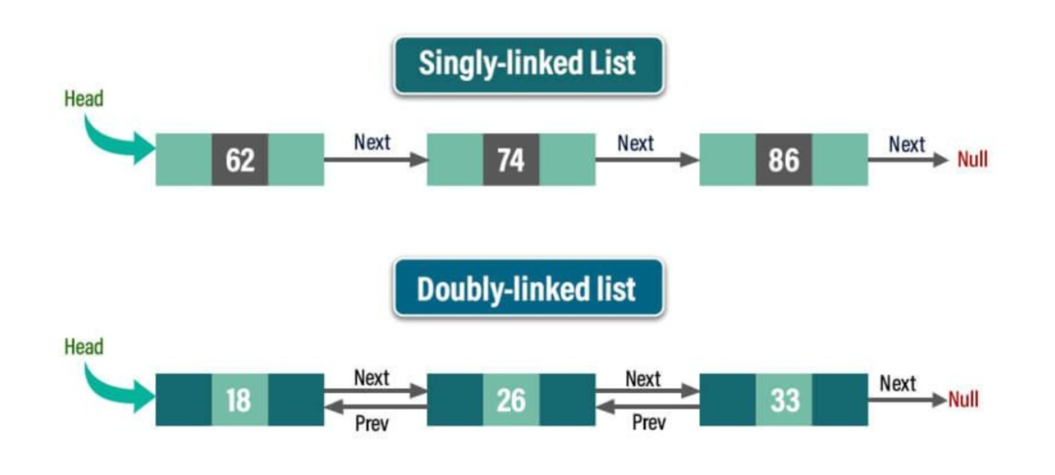
SINGLY AND DOUBLY-LINKED LISTS

Slide 6
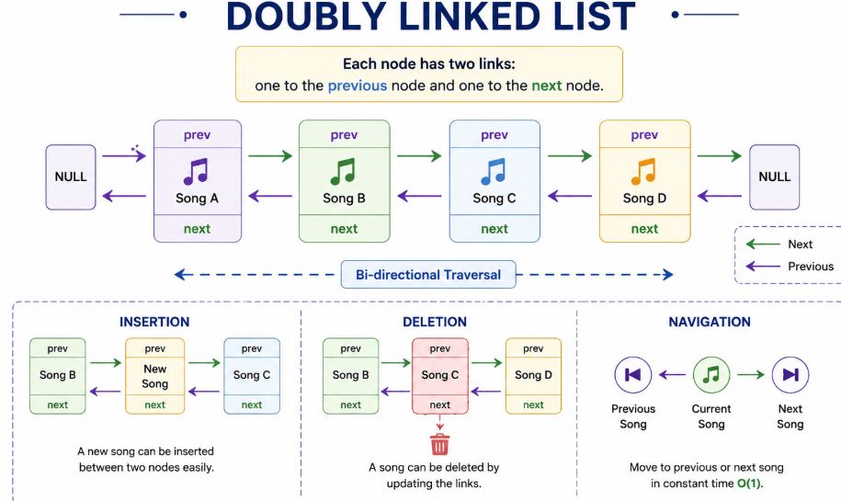
Conclusion
Recommendation
A Doubly Linked List is the most suitable data structure for a music streaming playlist because it:
Supports dynamic playlist updates
Enables efficient insertion and deletion
Allows easy song reordering
Provides both Next and Previous navigation
Improves flexibility and user experience
Applications
Music streaming playlists
Browser history
Undo/Redo systems
Image viewers
Media players

Slide 7
Thank you!

