Slide 1
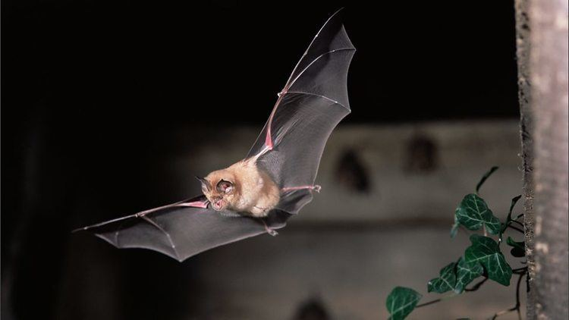
Do bats change their calls in groups?
CF (2
IFM
(1)
tFM (3)

Slide 2
Expected scenarios
No change
In
groups
Some change
in
groups

Slide 3
Data format
Microphone left in a cave and calls recorded continuously over multiple nights
Call part 1 | Call part 2 | Call part 3 | Group status | Recording hour
2.5 | 25 | 3.2 | single | 1
1.2 | 18.5 | 0.4 | multi | 2
... | .. | .. | single | 3
... | .. | .. | single | 3

Slide 4
Analysis strategy
Linear mixed model with:
  Group status as fixed effect
  Recording hour as random effect (random intercept)
Call part ~ group.status + (1|recording hour)

Slide 5
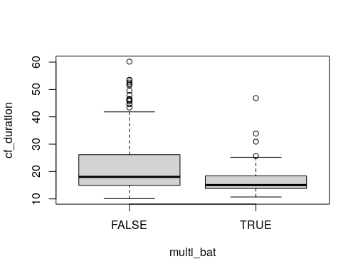
SINGLE BAT
MULTI
BAT

Slide 6
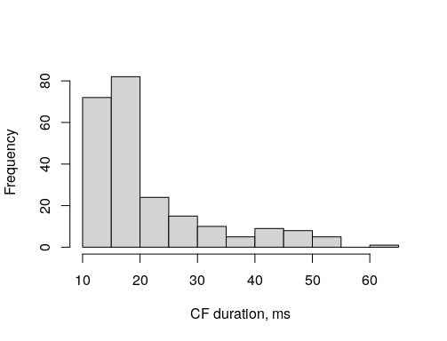
Model diagnosis example
Call part 1 (CF)

Slide 7
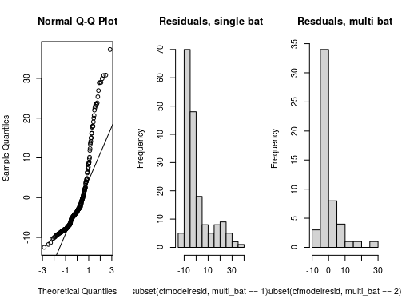
Raw data gives poor fit

Slide 8
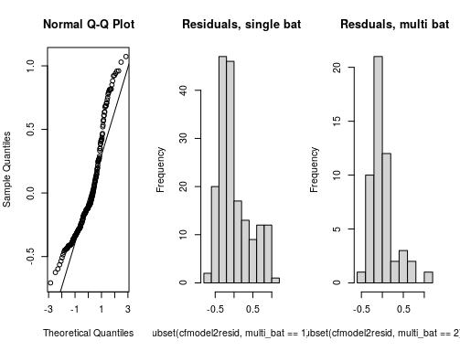
Log-transformed gives better fit
log(Call part) ~ group.status + (1|recording hour)

Slide 9
Linear mixed model fit by REML ['lmerMod']
Formula: logcfdurn ~ multi_bat + (1 | rechour)
Data: cfdurn.nona
REML criterion at convergence: 223.6
Scaled residuals:
Min 1Q Median 3Q Max
-1.833 -0.729 -0.294 0.478 2.782
Random effects:
Groups Name Variance Std.Dev.
rechour (Intercept) 0.0006918 0.0263
Residual 0.1487983 0.3857
Number of obs: 231, groups: rechour, 12
Fixed effects:
Estimate Std. Error t value
(Intercept) 3.01355 0.03024 99.659
multi_batTRUE -0.20624 0.06106 -3.377
Correlation of Fixed Effects:
(Intr)
mult_btTRUE -0.454

Slide 10
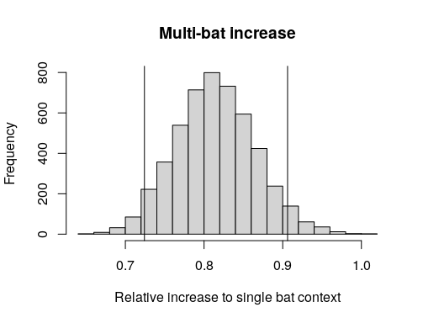
Bats in groups decrease part 2 duration by 0.72-0.91 (93% compat. Interval,*) times that of single bats
In groups
* 5000 simulations of the posterior distribution using sim function)

