Slide 1
A
50ms window
silent window (no calls)
Frequency
50ms
B
Time

Slide 2
iFM
CF
tFM

Slide 3
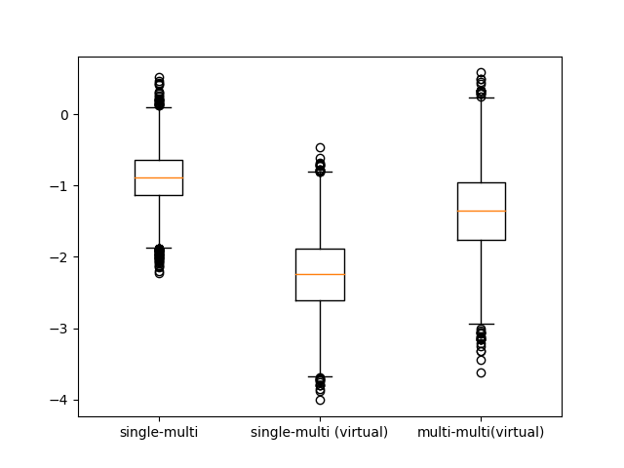
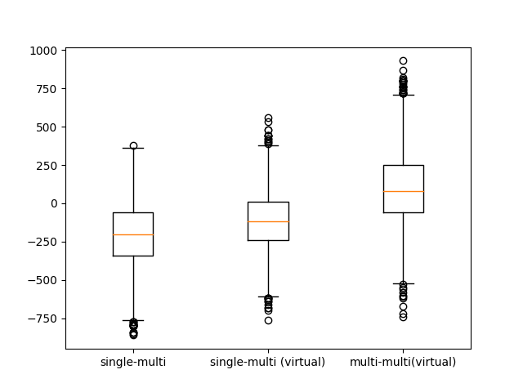
A
Δ median,
Peak amplitude, dB
B
Δ median,
RMS, dB
C
Δ median,
Dominant frequencies

Slide 4
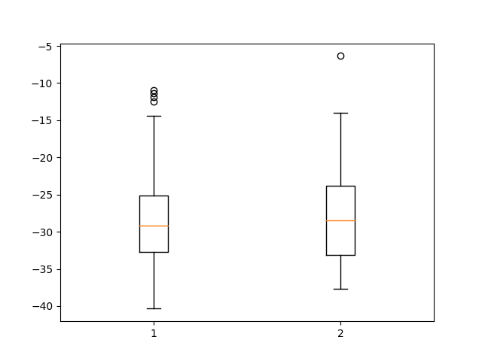
iFM
tFM
CF
Duration
Peak amplitude, dB
RMS,
dB
Lowest
frequency,
(-10 dB peak)
Hz
Peak
frequency,
Hz

