Slide 1
Annotate bat flight events with group size in video
Video annotation
Audio matching
Match audio to annotations
Individual call analysis
Window analysis
Search for a non-overlapped horseshoe bat call that with >=20 dB signal-to-noise ratio
Split each audio files into 50ms windows
Segment each call into iFM, CF and tFM.
Select ‘non-silent’ windows (>= 20dB rms above silent audio).
Measure duration and dB rms of each call component
Also measure CF peak frequency, i/tFM lower frequency (-10 dB component peak frequency)
Measure dominant frequencies, received level and FM terminal frequencies in each window.

Slide 2
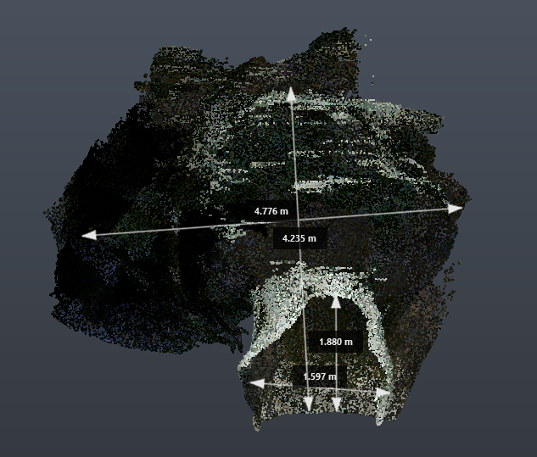
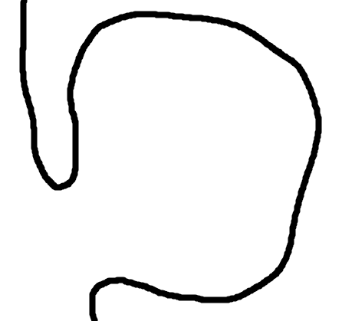


A
Roosting site
B
Roosting site
1
2
1
Roosting site
2
Roosting site
3
3
Entrance/
Exit

