Slide 1
Annotate bat flight events with group size in video
Video annotation
Audio matching
Match audio to annotations
Individual call analysis
Window analysis
Search for a non-overlapped horseshoe bat call that with >=20 dB signal-to-noise ratio
Split each audio files into 50ms windows
Segment each call into iFM, CF and tFM.
Select ‘non-silent’ windows (>= 20dB rms above silent audio).
Measure duration and dB rms of each call component
Also measure CF peak frequency, i/tFM lower frequency (-10 dB component peak frequency)
Measure dominant frequencies, received level and FM terminal frequencies in each window.

Slide 2
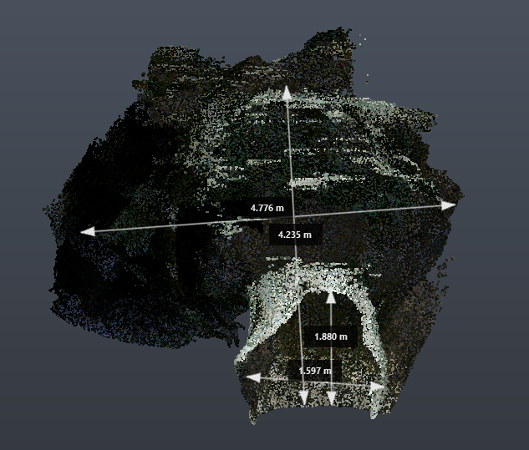
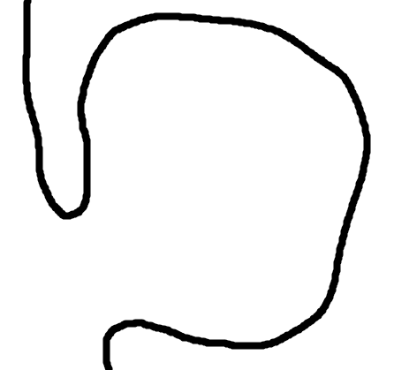


A
B
Roosting site
Roosting site
1
4.24m
2
1
Roosting site
2
4.78m
Roosting site
3
1.90m
Entrance/
Exit
3
1.60m

Slide 3

F_{o}: Acoustic fovea frequency
F_{emit}: Emitted frequency
F_{rec}: Recorded frequency
v: Flight speed
θ: Relative angle to mic
v_{end}
F_{emit}(end)
F_{rec}(end)
θ=135º
θ= 90º
F_{rec} = f(F_{emit}, flight angle, v)
F_{rec}(start)
θ= 45º
F_{emit}(start)
v_{start}

