Slide 1
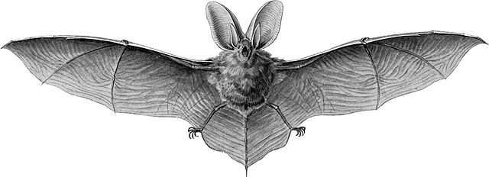
Echo
Neighboring bat call
Secondary echoes

Slide 2
Echo
Neighboring bat call
Secondary echoes

Slide 3
Echo
Neighboring bat call
Secondary echoes

Slide 4
Echo
Neighboring bat call
Secondary echoes

Slide 5
Echo
Neighboring bat call
Secondary echoes

Slide 6
Echo
Neighboring bat call
Secondary echoes

Slide 7
Echo
Neighboring bat call
Secondary echoes

Slide 8
Echo
Neighboring bat call
Secondary echoes

