Slide 1
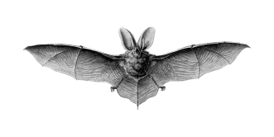
Echo
Neighboring bat call
Secondary echoes

