Slide 1
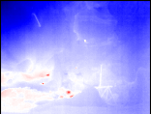
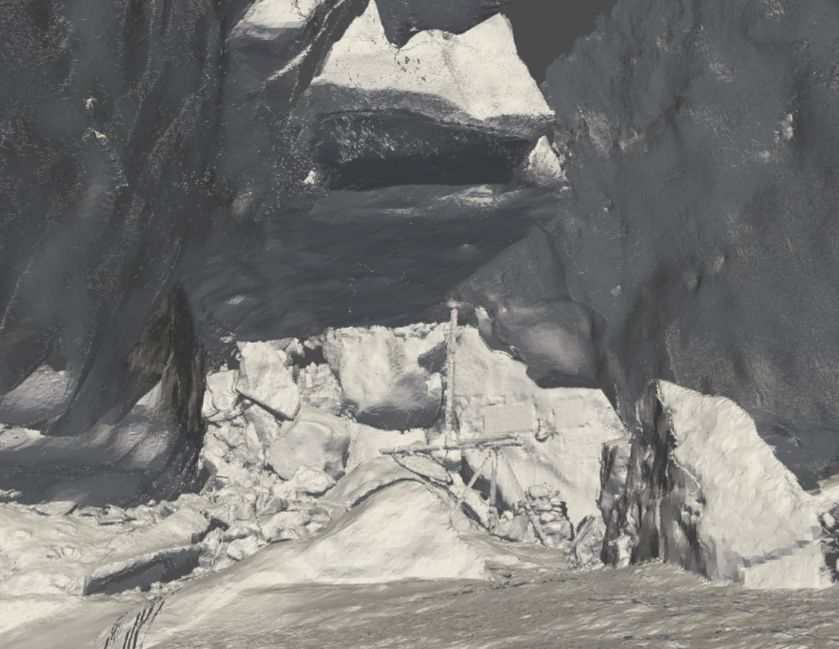
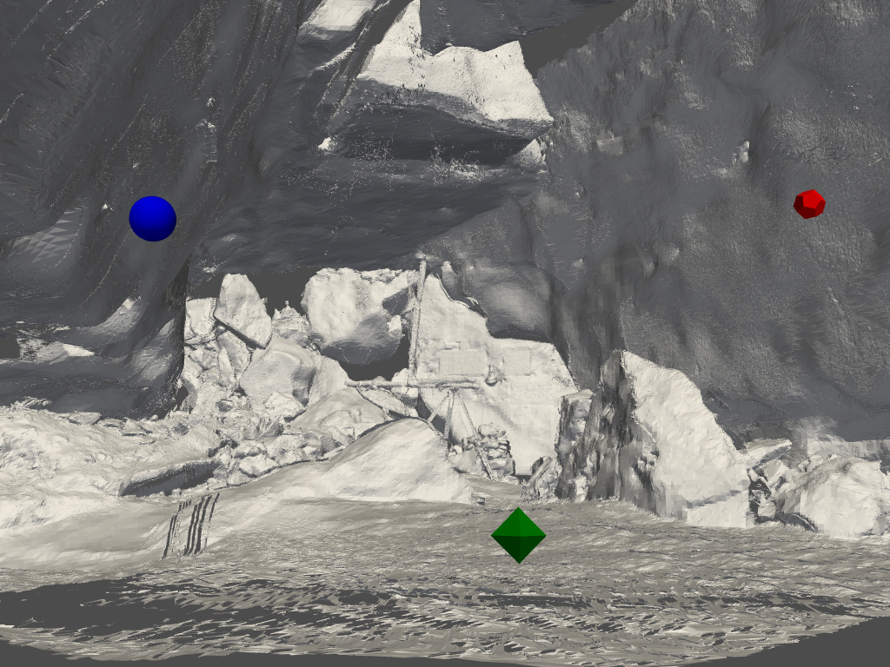
Inputs:
Output:
Thermal image
LiDAR mesh
Camera pose in mesh
+
DMCP

