Slide 1
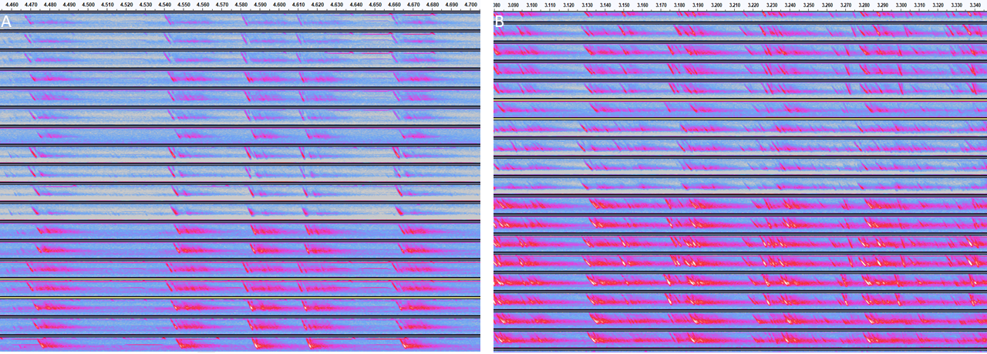

Slide 2


Frequency
1
2
3
4
5
6
7
8
B
Time
5
6
7
8
4
3
2
1
A
C

