Slide 1



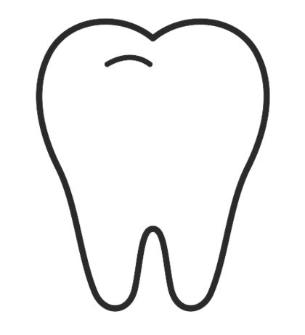

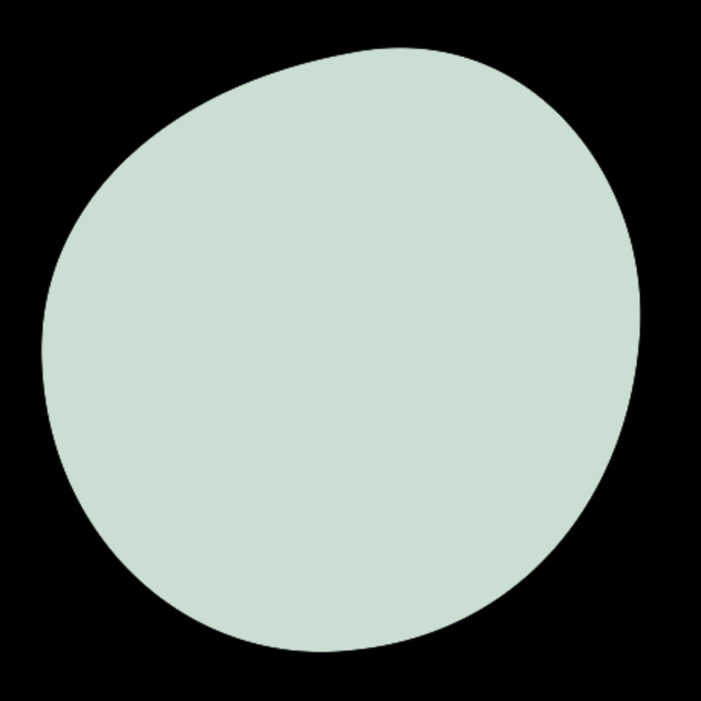

DATA SCIENCE · PROJECT PRESENTATION
Dental Caries/Cavity
Detection
Pixel-level caries segmentation in dental X-rays with a U-Net
Small lesions. Big consequences.
Thejasvini Boorla
Notes:
Hook: dentists miss a meaningful share of early caries on radiographs. I built a model that flags them at pixel level. One-line pipeline: annotated X-ray patches -> U-Net with focal+dice loss -> desktop app that draws a box around the cavity.

Slide 2
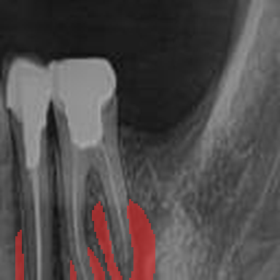
Why hunt for cavities with a neural network?
01
Easy to miss
Early caries are tiny, low-contrast smudges — even trained eyes overlook them on a busy radiograph.
02
Where, not just whether
A yes/no classifier can't be verified. Segmentation shows the dentist exactly which pixels look carious.
03
A complete build
Not just a notebook: dataset → trained model → a small desktop app anyone can run.
a real patch from the dataset — cavity pixels tinted red
02
Notes:
Frame the task: semantic segmentation, not classification. Clinicians need localization they can verify. Decision-support, not a replacement for the dentist.

Slide 3
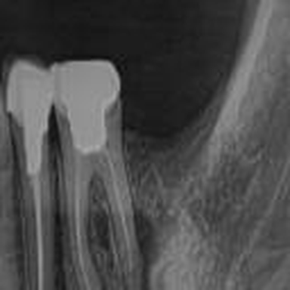
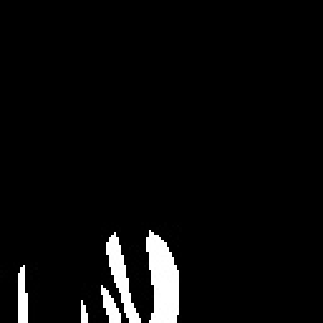
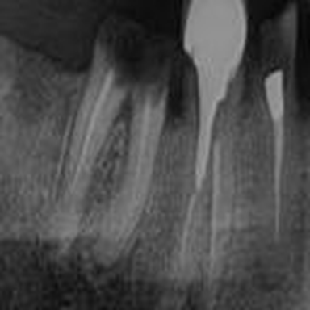
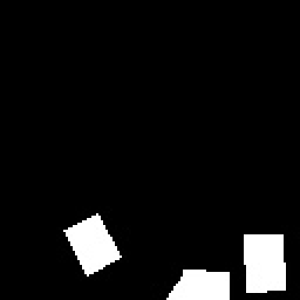
ABOUT DATA
5,156 tiny windows into real mouths
4,426
730
training patches
validation patches
128 × 128
~3%
px, grayscale
of pixels are cavity
Clinical radiographs annotated for caries (Roboflow export), cropped into patches around lesions. Every image ships with a hand-drawn binary mask, paired by filename.
X-ray patch
its cavity mask
03
Notes:
Why patches: cavities are tiny relative to a full X-ray; shrinking a whole radiograph to 128px destroys the lesion. Patching keeps native resolution and multiplies samples. Train/val have zero filename overlap. The 3% imbalance is the key number - it drives the loss design (slide 6).

Slide 4
EDA
Data imbalance , loss function

Slide 5
Getting the data model-ready
1
2
3
4
Read
Normalize
Binarize
Flip
→
→
→
every patch and mask loaded as single-channel grayscale — X-rays carry no colour.
pixel values scaled to [0, 1] so gradients stay well-behaved.
masks forced to strict {0, 1} — resizing leaves gray edge pixels that would poison the loss.
each epoch, every image (and its mask, in sync) may flip horizontally or vertically — free variety, no new labels.
The whole set fits in memory (~300 MB as float32) — no generator gymnastics needed.
04
Notes:
Flips are label-preserving because a cavity patch has no canonical orientation. Augmentation is re-randomized every epoch so the network never sees the exact same tensor twice.

Slide 6
ARCHITECTURE
A compact U-Net (~1.9M parameters)
skip connections — copy fine detail across the U
32 filters · 128px
32 · 128px
64 · 64px
64 · 64px
128 · 32px
128 · 32px
bottleneck · 256 · 16px
ENCODER · learns what
DECODER · recovers where
Each block = two 3×3 convs + ReLU. Down with max-pool, up with upsampling, out through a 1×1 sigmoid conv → a per-pixel cavity probability map.
05
Notes:
Skip connections in one line: deep layers know WHAT they're looking at, shallow layers know WHERE it is; concatenation gives both. Kept small on purpose: 128px inputs, ~5k images, Colab GPU budget. Upsampling+conv instead of transposed conv avoids checkerboard artifacts.

Slide 7
A model can be 97% accurate — and useless
97%
Focal loss
Dice loss
γ = 2, α = 0.25
1 − overlap
is the pixel accuracy of a model that just answers “no cavity, anywhere, ever.” With only ~3% cavity pixels, plain cross-entropy happily converges to exactly that.
Down-weights the millions of easy background pixels so the gradient spends itself on the hard ones — the cavity edges.
Scores the predicted region directly against the true mask. Background pixels can't inflate it — imbalance-proof by construction.
So the loss had to be engineered:
training loss = focal + (1 − dice)
the standard recipe for small-lesion medical segmentation
06
Notes:
This is the technical heart of the talk. Focal: (1-p)^gamma factor means a pixel predicted at 0.9 contributes ~100x less than one at 0.1. Dice: 2*intersection/(sum), smooth epsilon guards empty masks. Sum gives stable pixel-level gradients AND direct optimization of the evaluation metric.

Slide 8
RESULTS
100 epochs on a Colab GPU (~35 min)
0.82
Dice
final training overlap score
0.88
Precision
when it cries cavity, it's usually right
0.79
Recall
the pixels it still misses — my next battle
training log, epochs 42–100 — steady climb, no divergence, still improving at 100
07
Notes:
Quote numbers aloud: dice 0.82, precision 0.88, recall 0.79 at epoch 100 (training metrics; validation evaluation is the roadmap headline). Precision > recall means the model under-segments: few false alarms, but it misses cavity pixels - for screening you'd rather trade the other way, hence threshold tuning in next steps.

Slide 9
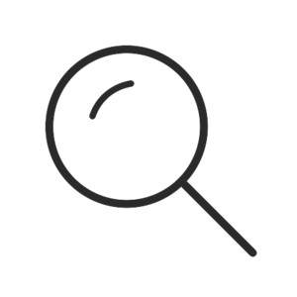
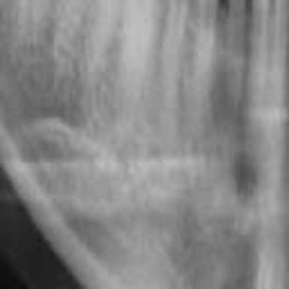
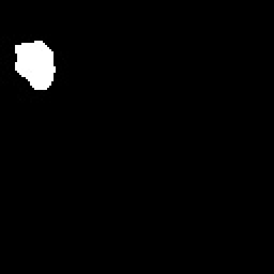
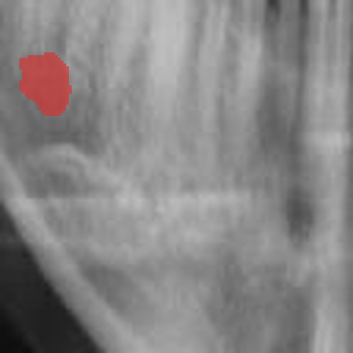

From probability map to “Cavity Detected”
→
→
→
1 · input X-ray
2 · predicted mask
3 · pixels flagged
4 · box drawn
Shipped as a tiny desktop app: pick any X-ray in a file dialog → the U-Net predicts, OpenCV finds the largest contour, filters noise by area, and draws the red verdict — in about a second. Deep learning does the seeing; classical CV makes the call.
pipeline illustrated on a validation sample
08
Notes:
If live demo is allowed, run testing.py here on a VALIDATION image (30 seconds, high impact). Post-processing: threshold 0.5 -> findContours -> largest contour -> area > 100px noise filter -> boundingRect.

Slide 10
What I'd fix next — my own audit
01
Patient-level splits
02
Healthy negatives
Patches from one X-ray must never straddle train and test. My split is patch-level — honest flaw, first fix.
Every training patch contains a cavity. Add cavity-free patches to learn what healthy looks like — and measure false alarms.
03
Validation in the loop
04
Whole-mouth inference
My re-augmentation loop silently reset Keras early-stopping. Rebuilt with tf.data, val Dice becomes the compass.
Slide the 128px window across a full radiograph, stitch the maps — one click from patch model to clinical screen.
Plus the unglamorous truths: de-identify filenames (they carry patient names) and tune that 0.5 threshold.
09
Notes:
Owning these findings preempts the interviewer's trap questions. If asked about the 'testing' folder: it duplicates training images, so it's a demo stash, not a test set - any metric on it would be leakage. Say it before they do.

Slide 11
Thank You!
Notes:
Close on why this is your favorite project: end-to-end ownership, a loss function that HAD to be engineered, and stakes that are real.

