Slide 1

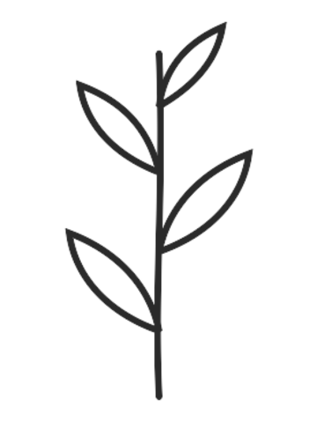

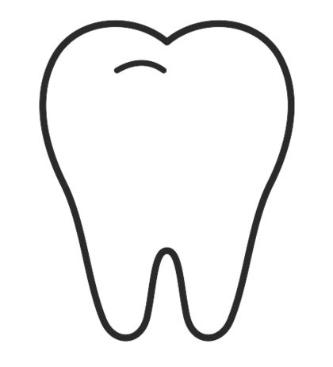
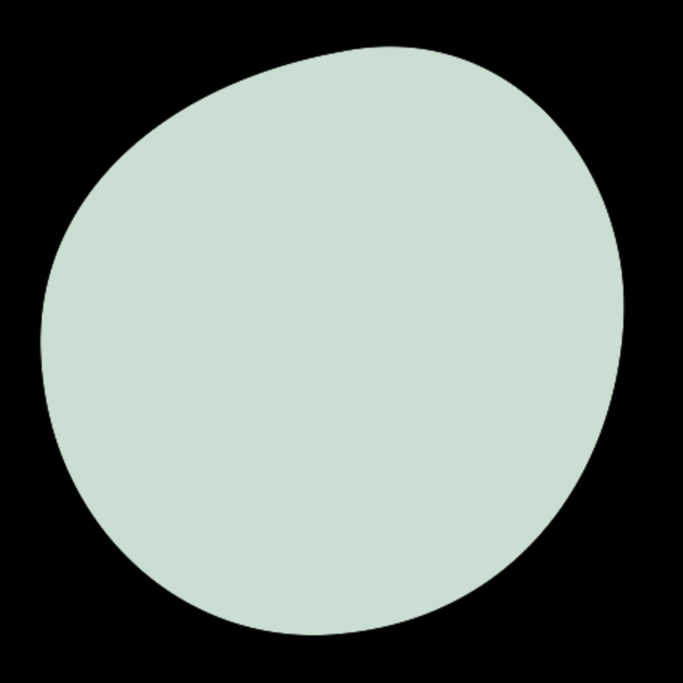

DATA SCIENCE · PROJECT PRESENTATION
Dental Caries
Detection-Segmentation
Pixel-level caries segmentation in dental X-rays with a
U-Net model
Because every cavity leaves a footprint.
Thejasvini Boorla
Notes:
Hook: dentists miss early caries on radiographs. I built a segmentation model that flags them pixel-by-pixel, then evaluated it honestly. Pipeline: annotated X-ray patches -> U-Net (focal+dice) -> desktop app that boxes the cavity.

Slide 2
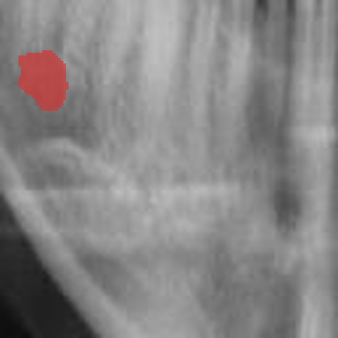
Why hunt for cavities with a neural network?
01
Easy to miss
Early caries are tiny, low-contrast smudges — even trained eyes overlook them on a busy radiograph.
02
Where, not just whether
A yes/no classifier can't be verified. Segmentation shows exactly which pixels look carious.
03
A complete build
Not just a notebook: dataset → trained model → a small desktop app anyone can run.
a real patch — cavity pixels tinted red
02
Notes:
Frame the task: semantic segmentation, not classification. Decision-support, not a replacement for the dentist.

Slide 3
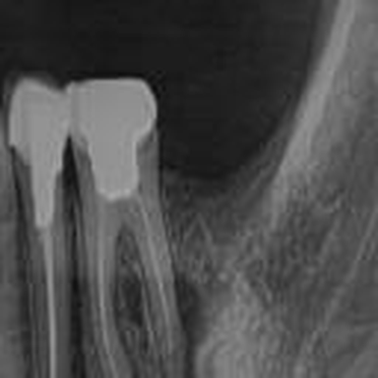
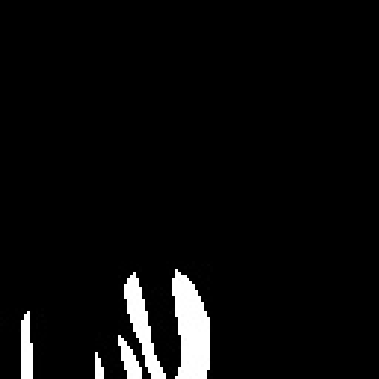
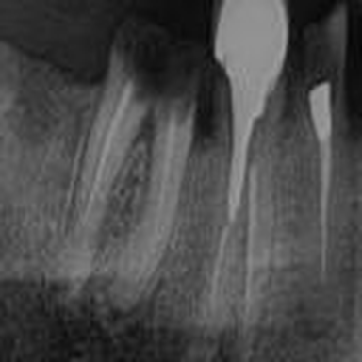
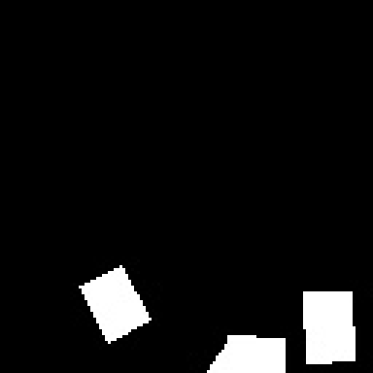
ABOUT DATA
5,156 tiny windows of real x-rays
4,426
730
training patches
validation patches
128 × 128
~3%
px, grayscale
of pixels are cavity
Clinical radiographs annotated for caries (Roboflow export), cropped into patches around lesions. Every image ships with a hand-drawn binary mask, paired by filename.
X-ray patch
its cavity mask
03
Notes:
Why patches: cavities are tiny vs a full X-ray; shrinking the whole radiograph destroys the lesion. Patching keeps resolution and multiplies samples. Zero filename overlap between train/val.

Slide 4
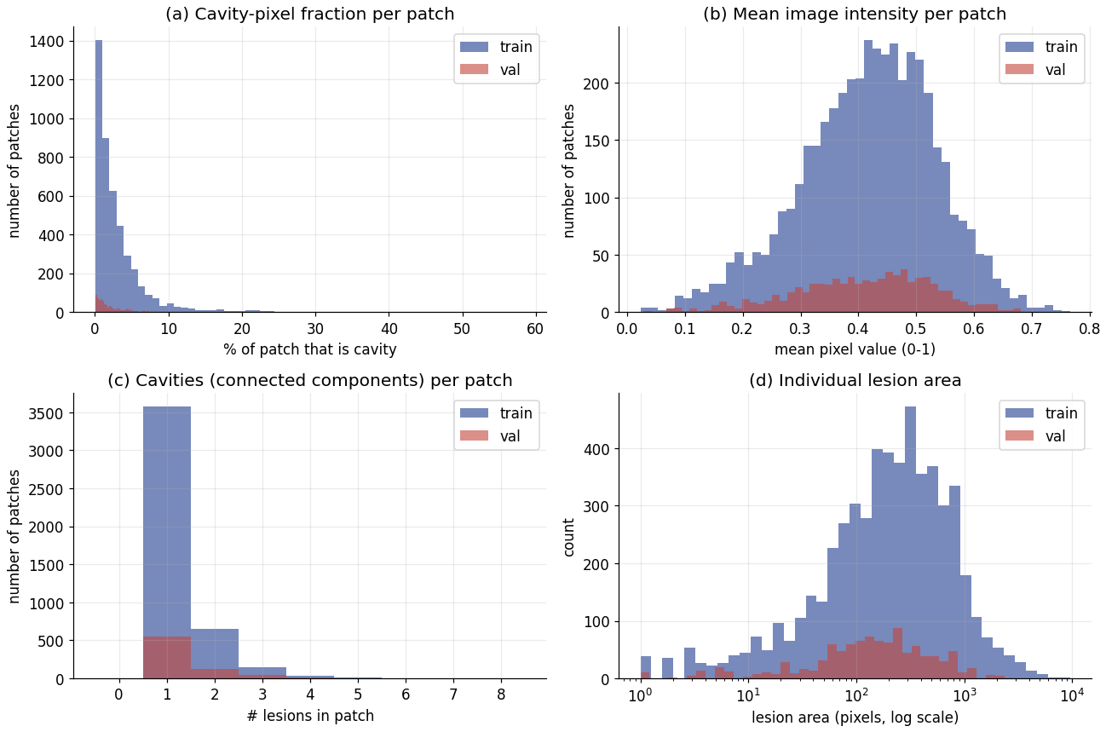
EDA · 1
What the data actually looks like
Cavity fraction piles up near 0% — the imbalance, made visible.
(a)
Image brightness spans 0.2–0.7 — contrast varies a lot across scans.
(b)
Most patches hold one lesion; a few hold several.
(c)
Many lesions are only a few hundred pixels — genuinely small.
(d)
04
Notes:
Walk through the four distributions. The near-zero pile in (a) is the imbalance. (b) motivates contrast normalization. (c)+(d): small, mostly-single lesions are what make this hard.

Slide 5
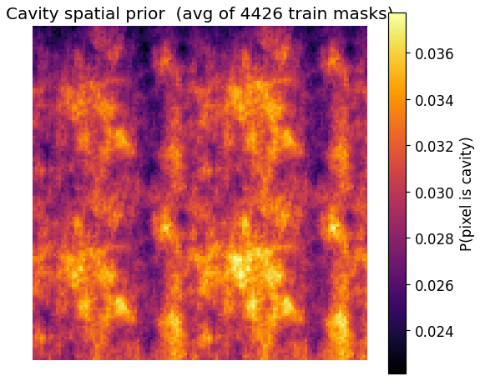
EDA · 2
Reading the data before I modelled it
5,156 paired patches · 0 missing masks · 0 train/val leakage · all 128×128 · masks binary
Severe class imbalance
Only 3.0% (train) / 2.2% (val) of pixels are cavity — a 32:1 and 46:1 background-to-cavity ratio. This is why I use focal + dice loss and report Dice, not accuracy.
Small, scattered lesions
Mostly one lesion per patch, many just a few hundred pixels. The spatial heatmap is diffuse (peak ≈ 0.04) — cavities appear all over, so the model must be position-robust.
A split that foreshadows trouble
Validation is sparser than train (2.2% vs 3.0% cavity). That distribution gap is an early warning for the generalization problem I later measured.
cavity spatial prior
05
Notes:
This is the 'I understood my data' slide. Three takeaways: imbalance drives loss/metrics; lesions are small and everywhere; and val is sparser than train — the seed of the overfitting I found later.

Slide 6

Getting the data model-ready
1
2
3
4
Read
Normalize
Binarize
Flip
→
→
→
every patch and mask loaded as single-channel grayscale — X-rays carry no colour.
pixel values scaled to [0, 1] so gradients stay well-behaved.
masks forced to strict {0, 1} — resizing leaves gray edge pixels that would poison the loss.
each epoch, every image (and mask, in sync) may flip horizontally or vertically — free variety.
The whole set fits in memory (~300 MB as float32) — no data-generator gymnastics needed.
06
Notes:
Flips are label-preserving because a cavity patch has no canonical orientation. Note for later: flips are the ONLY augmentation — thin, which contributes to overfitting.

Slide 7
MODEL CHOICE
Why U-Net — and not the alternatives
Why not the others?
What is U-Net?
Plain CNN classifier — only a yes/no — no location to verify.
An encoder–decoder built for biomedical image segmentation (Ronneberger, 2015).
The encoder compresses the image to learn what; the decoder rebuilds a full-resolution mask to recover where.
Skip connections copy fine detail across the “U”, so tiny lesion edges survive.
Designed to work well with only a few hundred–thousand labelled images.
Mask R-CNN — instance detection; heavy and box-hungry, overkill for one class on 128px patches.
DeepLab (atrous conv) — tuned for large natural scenes — needless complexity here.
Vision Transformers / SAM — data-hungry; ~5k images is far too few to train them well.
07
Notes:
Lead with the fit: U-Net is the proven default for small-data medical segmentation. Skip connections preserve tiny-lesion detail. The alternatives are either too coarse (classifier), too heavy/data-hungry (Mask R-CNN, DeepLab, transformers), or mismatched to 128px single-class patches.

Slide 8
ARCHITECTURE
A compact U-Net (~1.9M parameters)
skip connections — copy fine detail across the U
32 filters · 128px
32 · 128px
64 · 64px
64 · 64px
128 · 32px
128 · 32px
bottleneck · 256 · 16px
ENCODER · learns what
DECODER · recovers where
Each block = two 3×3 convs + ReLU. Down with max-pool, up with upsampling, out through a 1×1 sigmoid conv → a per-pixel cavity probability map.
08
Notes:
Skip connections: deep layers know WHAT, shallow layers know WHERE; concatenation gives both. Kept small on purpose for 128px inputs and ~5k images.

Slide 9
THE FIX
How I handled the class imbalance
32 : 1
Focal loss
Dice loss
γ = 2, α = 0.25
1 − overlap
background-to-cavity pixels (~3% are cavity)
Down-weights the easy background pixels so training focuses on the rare cavity ones.
Scores predicted vs true region directly — background can't inflate it.
Plain cross-entropy just predicts “all background” and scores ~98% — so I could not use it.
Why: Chosen to stop the majority class from drowning the gradient.
Why: Chosen because it optimizes the exact overlap metric I report.
training loss = focal + (1 − dice)
one term fights imbalance, the other optimizes overlap
09
Notes:
This is where I explain the imbalance fix in detail live. Key points: 3% cavity pixels means cross-entropy collapses to all-background. I combined focal (down-weights easy background, gamma=2) with dice (optimizes region overlap, imbalance-proof). Together: one term handles imbalance, the other targets the metric I actually report.

Slide 10
CODE FLOW
Training pipeline — how the code flows
Dataset
load_data()
Tensors
build_unet()
Drive: images + masks
→
gray · resize 128 · /255 · binarize
→
→
X, y held in memory
compile: Adam + focal-dice
↓
per-epoch loop ×100
Callbacks
Loss + Adam
Forward pass
Augment
←
←
←
checkpoint · early-stop · LR
focal-dice → backprop
U-Net → prob map
random flips
→ save unet_cavity_final.h5 + training_history
10
Notes:
Trace the code: Drive -> load_data preprocesses into in-memory tensors -> build+compile U-Net -> the 100x epoch loop (augment, forward, focal-dice loss + Adam backprop, callbacks) -> save model and history. Callbacks monitor val_dice_coef.

Slide 11
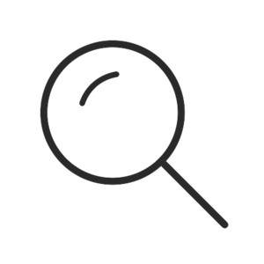
CODE FLOW
Inference — front → back → front
FRONT
1 · User picks an X-ray
→
2 · Preprocess
→
3 · model.predict
Tkinter file dialog
gray · resize 128 · /255
→ probability map
↓
BACK — deep learning sees, classical CV decides
6 · Draw box + label
←
5 · findContours
←
4 · Threshold 0.5
OpenCV rectangle
largest blob, area > 100
→ binary mask, upscaled
↓
FRONT
7 · Show the user
4-panel figure: original · probability · binary mask · boxed result + “CAVITY DETECTED / NOT DETECTED”
11
Notes:
The round trip: FRONT user selects an image; BACK the model predicts and OpenCV post-processes (threshold, contour, area filter, box); FRONT the annotated 4-panel result and verdict return to the user — about one second.

Slide 12
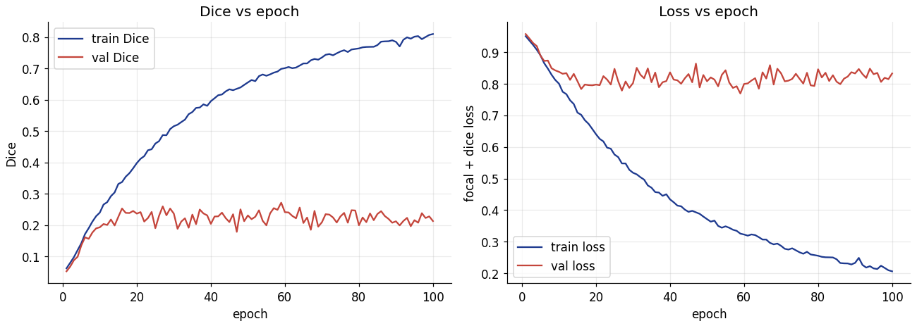
RESULTS
Training looked great — until I checked validation
0.81
train Dice
0.21
val Dice
100 epochs, Colab GPU (~35 min). Train Dice climbs to 0.81; validation Dice flat-lines near 0.22 and val loss never falls.
+0.60
the gap
Diagnosis: the model memorised the training set → overfitting.
12
Notes:
The honest headline. The wide train-vs-val gap (0.81 vs 0.21) is textbook overfitting: train loss falls, val loss stays flat. I present this as a finding I own, not a failure I hide — and the fixes slide addresses it directly.

Slide 13
EVALUATION
Honest validation metrics (held-out set)
Why these, not accuracy
0.25
0.14
Pixel accuracy is 97.9% — and meaningless, because 97% of pixels are background.
Dice / IoU measure actual overlap; precision vs recall expose the behaviour.
High precision, very low recall = the model is timid — it barely predicts cavity, so it misses most of them.
A threshold sweep (0.1–0.9) only nudged Dice to 0.26 — the ceiling is the model, not the cut-off.
Dice
IoU
region overlap with truth
the stricter overlap score
0.51
0.16
Precision
Recall
when it flags cavity, ~half are right
it finds only 16% of cavity pixels
13
Notes:
Report the real held-out numbers and explain WHY they are the right metrics. The precision/recall split tells the story: the model under-predicts cavity badly (recall 16%). Threshold tuning can't rescue it — it's an overfitting/capacity problem.

Slide 14
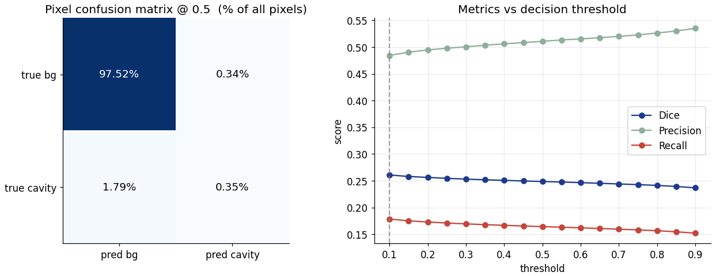
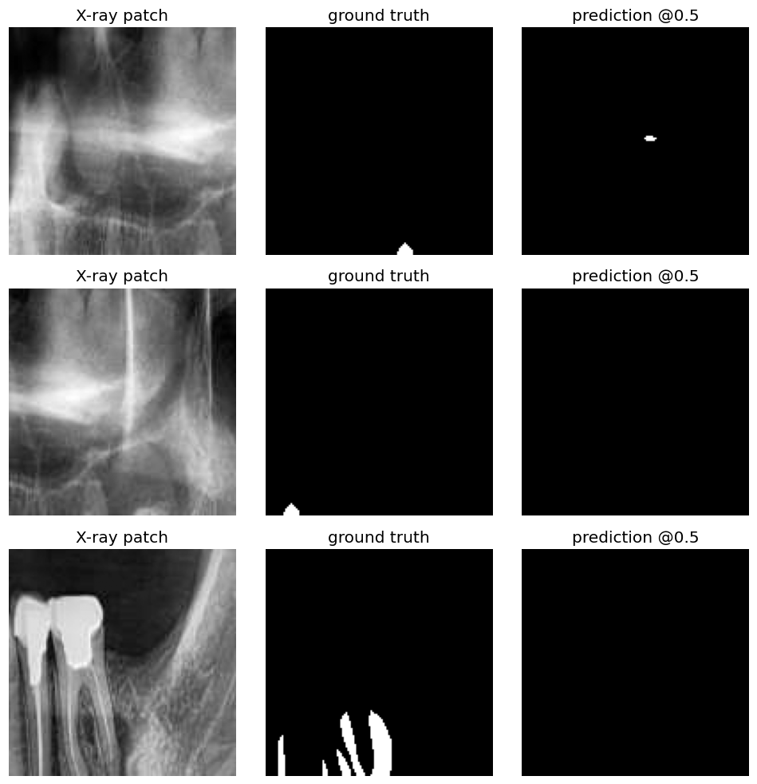
EVALUATION
What the errors tell me
Confusion matrix @ 0.5: the true-cavity row is almost all missed (1.79% vs 0.35%). Precision rises with threshold, recall keeps falling — no cut-off fixes it.
Patch-level sensitivity: 43.7% — it catches a cavity in only 319 of 730 patches.
image · truth · prediction
14
Notes:
The prediction column is mostly blank — the model plays it safe and outputs little. It only nails the easy, large lesion (bottom row). Patch sensitivity 44%. This is a clear, explainable failure mode, not a mystery.

Slide 15
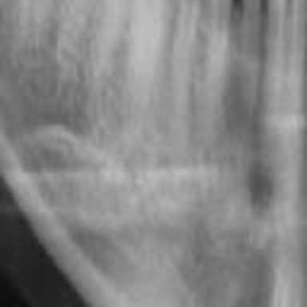
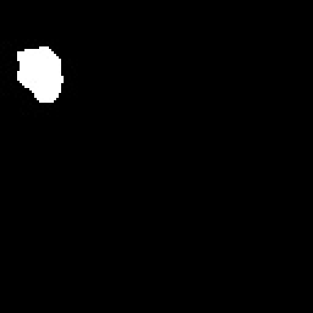

The working demo app
→
→
→
1 · input X-ray
2 · predicted mask
3 · pixels flagged
4 · box drawn
A tiny desktop tool: pick any X-ray → the U-Net predicts, OpenCV finds the largest contour and draws the verdict in ~1 second. Deep learning does the seeing; classical CV makes the call.
shown on a case the model handles well — results vary with lesion size
15
Notes:
Demo on a large, clear lesion (the model's best case). Be honest that small lesions are often missed — consistent with the evaluation.

Slide 16
What I'd change to close the gap
01
Fix overfitting
02
Fix the data splits
Add dropout + batch-norm, weight decay, and far richer augmentation (rotation, brightness, elastic) — flips alone weren't enough.
Group train/val by source X-ray (patient-level) and stratify by cavity load, so val stops being sparser than train.
03
Add negatives & more data
04
Transfer learning
Include cavity-free patches to learn “healthy”, measure false alarms, and grow the ~5k set.
Start from a pretrained encoder (ResNet / EfficientNet U-Net) to generalise from few images; tune threshold, report IoU.
The evaluation didn't fail me — it told me exactly where to look next.
16
Notes:
Every fix maps to a finding: the overfitting gap -> regularization + augmentation + transfer learning; the val distribution shift -> patient-level stratified splits; no negatives -> add cavity-free patches. This is the maturity close.

Slide 17
Thank You!
Questions welcome — especially the hard ones.
“The hard part was never the architecture — it was respecting the data.”
Notes:
Close on why this is your favorite project: end-to-end ownership, a loss you had to engineer, and an honest evaluation that taught you more than a good score would have.

