Slide 1
___________________________________________________________________________
Multi-Layered Dictionary Learning for Face Spoofing Detection
___________________________________________________________________________
Atif Ahmed (aa3931)
Srinidhi Srinivas (ss5145)
Thejaswi Muniyappa (tm2848)
28th April, 2017
COMS 4772: ADVANCED MACHINE LEARNING COLUMBIA UNIVERSITY

Slide 2
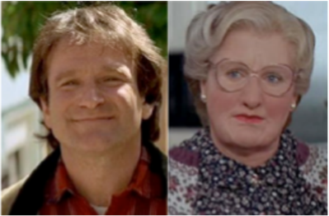

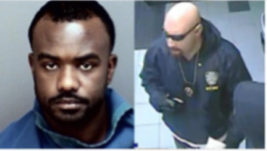
Introduction
Ease of availability of silicone masks has increased the crime related to face spoofing.
Spoofing is difficult to be identified by single-layered pre-defined dictionaries.
Adaptive multi-layered dictionaries for sparse approximation provide a superior performance for such applications.
Motivation: Improve the face spoofing detection using multi-layered dictionaries.
COMS 4772: ADVANCED MACHINE LEARNING COLUMBIA UNIVERSITY

Slide 3
Problem Statement
“Face Spoofing Detection in unconstrained environment”
Given an image, compute the sparse approximation and classify if the image is spoofed.
How to compute the sparse approximation?
Learn the dictionary and sparse approximation of the input dataset of images.
How to classify?
Train the classifier using the sparse representation of the input data.
COMS 4772: ADVANCED MACHINE LEARNING COLUMBIA UNIVERSITY

Slide 4
Literature Survey
Presentation Attack Detection (PAD) algorithms rely on domain knowledge.
Properties like Motion, Texture, Reflectance and Image Quality are considered by PAD.
Image Spoofing is difficult to incorporate texture in Boltzmann machines.
Regularized Sparse Coding is also used for Image Representation
COMS 4772: ADVANCED MACHINE LEARNING COLUMBIA UNIVERSITY

Slide 5
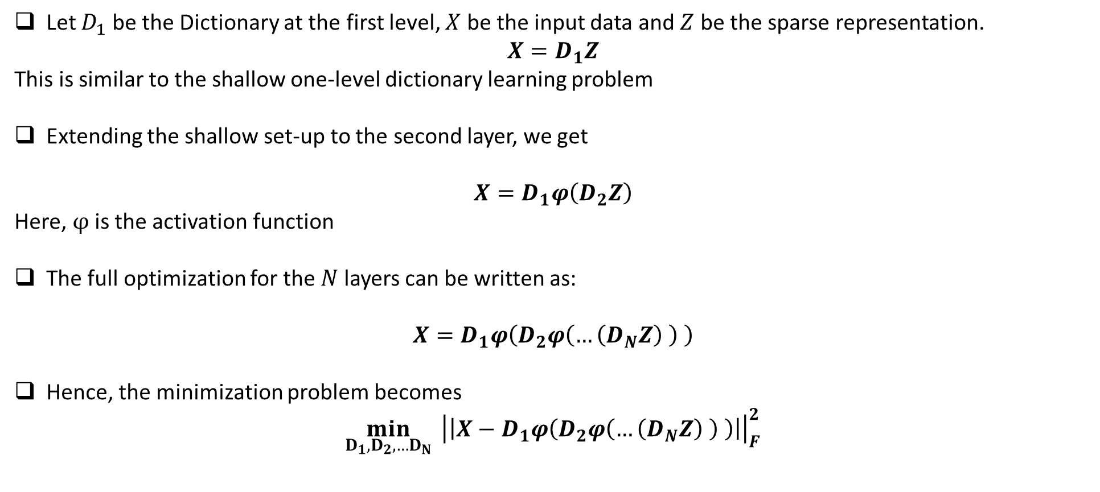
Multi-layered Dictionary Learning
COMS 4772: ADVANCED MACHINE LEARNING COLUMBIA UNIVERSITY

Slide 6
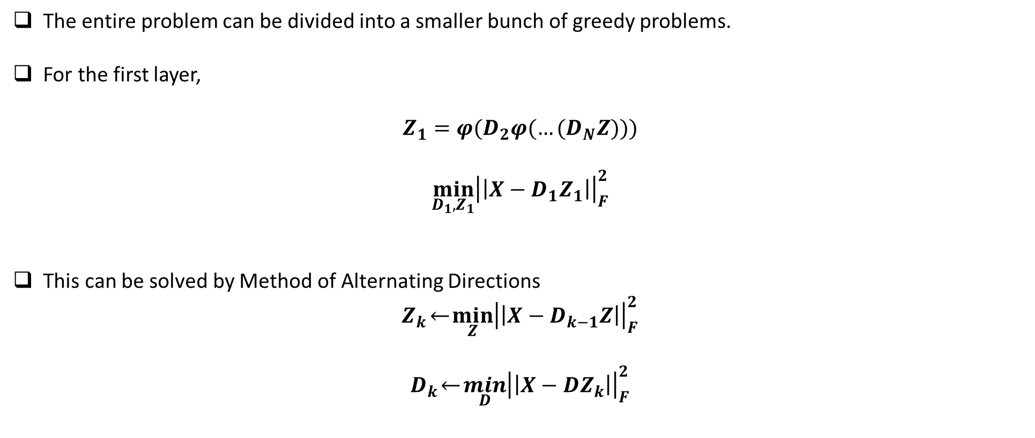
Multi-layered Dictionary Learning via Greedy Algorithm – 1st Layer
COMS 4772: ADVANCED MACHINE LEARNING COLUMBIA UNIVERSITY

Slide 7
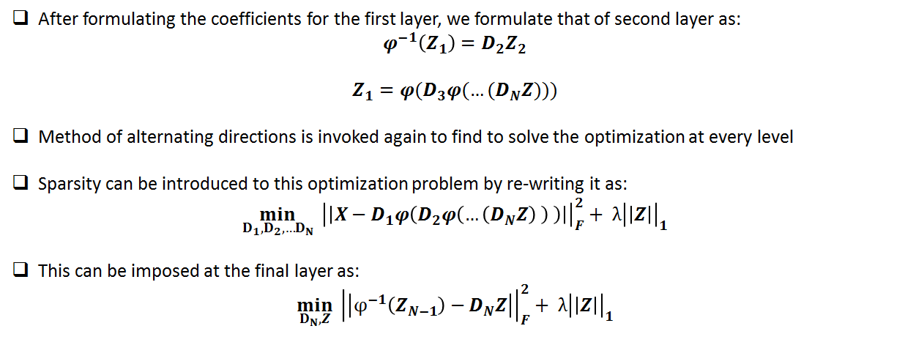
Multi-layered Dictionary Learning via Greedy Algorithm – Continuing it with other layers
COMS 4772: ADVANCED MACHINE LEARNING COLUMBIA UNIVERSITY

Slide 8
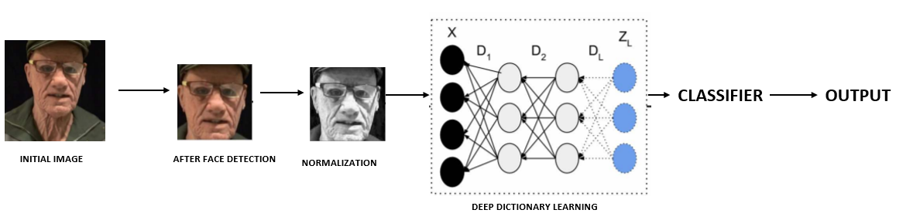
Architecture
COMS 4772: ADVANCED MACHINE LEARNING COLUMBIA UNIVERSITY

Slide 9
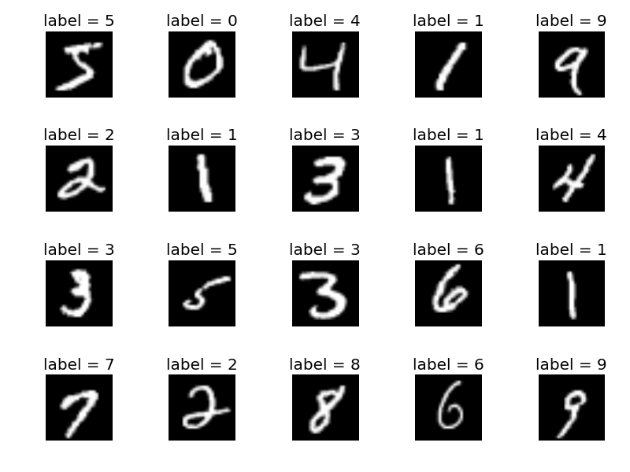
Dataset - Evaluation on MNIST
Dataset of handwritten digits provided by Yann Lecun*.
28 x 28 images for 10 classes
Training | Test
40,000 | 8,000
* http://yann.lecun.com/exdb/mnist/
COMS 4772: ADVANCED MACHINE LEARNING COLUMBIA UNIVERSITY

Slide 10
Dataset - Training on MNIST
First we tried with all features.
Dimensionality Reduction with Dictionary learning.
Dataset | Feature Size | Training Size | Test Size
MNIST | 784 | 40,000 | 8,000
Dataset | Feature Size (1 Layer) | Feature Size (2 Layer) | Feature Size (3 Layer) | Training Size | Test Size
MNIST | 100 | 200 - 100 | 400 - 200 - 100 | 40,000 | 8,000
COMS 4772: ADVANCED MACHINE LEARNING COLUMBIA UNIVERSITY

Slide 11
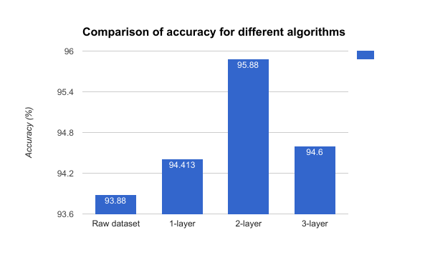
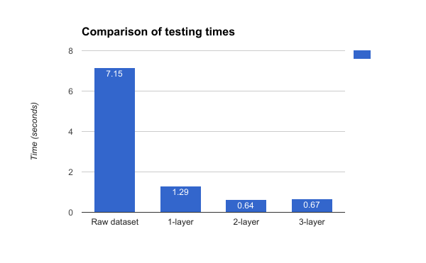
Testing and Results on MNIST
MNIST Dataset | Raw Dataset | Shallow (1-layer) | 2-layer | 3-layer
Accuracy (%) | 93.58 | 94.413 | 95.88 | 94.6
Testing Time (sec.) | 7.15 | 1.29 | 0.64 | 0.67
COMS 4772: ADVANCED MACHINE LEARNING COLUMBIA UNIVERSITY

Slide 12
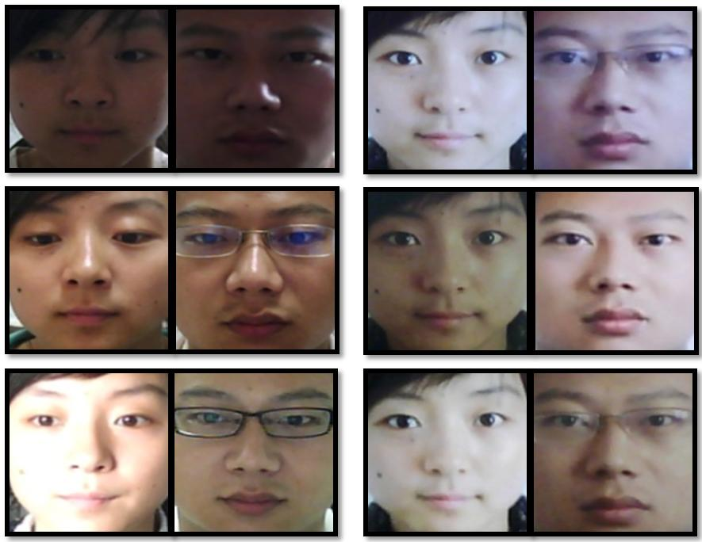
Dataset - NUAA
Evaluation
Database of photograph imposters collected with cheap webcams.
64 x 64 images of 2 classes (client or impostor).
Training | Test
3491 | 9123
COMS 4772: ADVANCED MACHINE LEARNING COLUMBIA UNIVERSITY

Slide 13
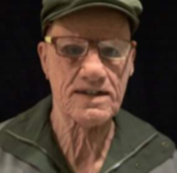


Preprocessing - NUAA
We extract the face using Viola Jones face detection algorithm.
After detecting the face, the image is converted to grayscale and is normalized
All the cropped images are 64 x 64. Hence, every image is represented as a vector of length 4096
Gray scale
and
normalization
Face
Detection
Original Image
COMS 4772: ADVANCED MACHINE LEARNING COLUMBIA UNIVERSITY

Slide 14
Training on NUAA
First we tried with all features.
Dimensionality Reduction with Dictionary learning.
Dataset | Feature Size | Training Size | Test Size
MNIST | 784 | 40,000 | 8,000
NUAA | 4096 | 3,491 | 9123
Dataset | Feature Size (1 Layer) | Feature Size (2 Layer) | Feature Size (3 Layer) | Training Size | Test Size
MNIST | 100 | 200 - 100 | 400 - 200 - 100 | 40,000 | 8,000
NUAA | 512 | 1024 - 512 | 1024 - 512 - 256 | 3,491 | 9123
COMS 4772: ADVANCED MACHINE LEARNING COLUMBIA UNIVERSITY

Slide 15
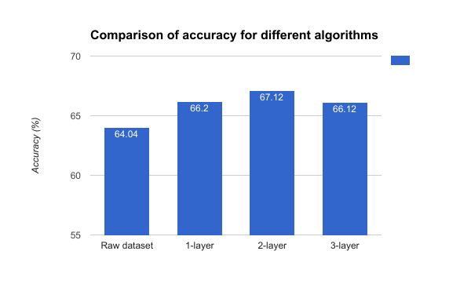
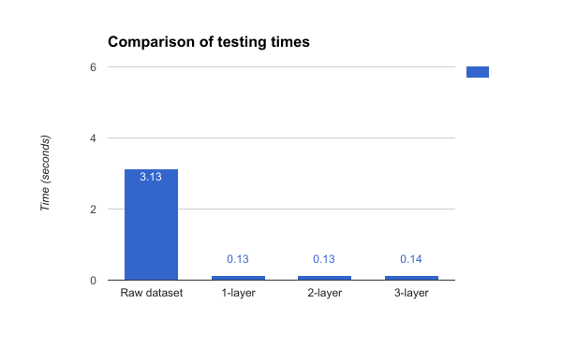
Testing and Results on NUAA
MNIST Dataset | Raw Dataset | Shallow (1-layer) | 2-layer | 3-layer
Accuracy (%) | 64.04 | 66.2 | 67.12 | 66.12
Testing Time (sec.) | 3.13 | 0.13 | 0.13 | 0.14
COMS 4772: ADVANCED MACHINE LEARNING COLUMBIA UNIVERSITY

Slide 16
Effect of various activation functions
The reference paper [2] uses only linear activation functions in all the layers.
We tried with other activation functions also like tanh and sigmoid.
In the algorithm, inverse of the activation functions have to be used.
At each layer we project the values to a specified interval (e.g. [-1, +1] for arctanh).
Layers | 200, 100 | 400, 200 | 50, 25
Accuracy | 63.86 | 51.31 | 60.61
COMS 4772: ADVANCED MACHINE LEARNING COLUMBIA UNIVERSITY

Slide 17
Challenges for multi-layered dictionary learning
Studies have proven the convergence guarantees for single level dictionary learning. These proofs are very hard to replicate for multiple layers.
The number of parameters required to be solved increases when multiple layers of dictionaries are learned simultaneously. With limited training data, this could lead to overfitting.
COMS 4772: ADVANCED MACHINE LEARNING COLUMBIA UNIVERSITY

Slide 18
Conclusion
Multi-layered dictionary gives better results and testing times than shallow dictionary learning.
Learning different levels of dictionaries along with the coefficients is not the same as learning a single (collapsed) dictionary and its corresponding features (even with linear activation functions).
The single-level problem (single level) is a bi-linear problem and 2-level problem is a tri-linear problem
Greedy approach for layer-wise learning ensures the convergence of each layer.
Regularization at final layer can be used to control sparsity and prevent overfitting.
COMS 4772: ADVANCED MACHINE LEARNING COLUMBIA UNIVERSITY

Slide 19
Future Work
Using images in 2D format instead of a vector. The data will then become multi-dimensional which calls for multi-dimensional dictionary learning.
Using other kind of sparsity measures and comparing performance.
Improving performance for nonlinear activation functions.
COMS 4772: ADVANCED MACHINE LEARNING COLUMBIA UNIVERSITY

Slide 20
References
[1] Ishan Manjani, Snigdha Tariyal et. al “Detecting Silicone Mask Based Presentation Attack via Deep Dictionary Learning” IEEE January 2017
[2] Snigdha Tariyal, Angshul Majumdar “Deep Dictionary Learning” IEEE May 2011
[3] Teresa Bufford, Yuxin Chen “When Dictionary Learning Meets Classification” UCLA April 2013
[4] Di Wen, Hu Han “Face Spoof Detection with Image Distortion Analysis” IEEE Transactions on Information Forensics and Security 2015
[5] Miao Zheng, Jiajun Bu “Graph Regularized Sparse Coding for Image Representation” IEEE May 2011
[6] Yang, Jimei, and Ming-Hsuan Yang. "Top-down visual saliency via joint crf and dictionary learning." IEEE Transactions on Pattern Analysis and Machine Intelligence (2016).
[7] X.Tan, Y.Li, J.Liu and L.Jiang “Face Liveness Detection from a single image with sparse low rank bilinear discriminative model ” Proceedings of 11th European Conference on Computer Vision (ECCV 10), Crete, Greece. September 2010
COMS 4772: ADVANCED MACHINE LEARNING COLUMBIA UNIVERSITY

Slide 21
Thank You!
COMS 4772: ADVANCED MACHINE LEARNING COLUMBIA UNIVERSITY

