Slide 1
Module 1
Environment Setup & Introduction to Java

Slide 2



Please ☺

Slide 3
Table of contents
Training Overview
The Toolset
Introduction to Java
Versioning systems – Git
Build systems – Apache Maven
IDE – Intellij IDEA
Introduction to Java
The structure of a Java class
Useful Java modules and classes
Examples revisited

Slide 4
Training Overview
Sesiune | Data | Ora | Trainer
1. Environment setup & Introduction to java | 18.03.2019 | 9.30 - 13.00 | Andreea
2. Literals, assignments and variables | 25.03.2019 | 9.30 - 13.00 | Sorin
3. Flow control | 1.04.2019 | 9.30 - 13.00 | Szabi
4. OO basics - Part 1 | 8.04.2019 | 9.30 - 13.00 | Serby
5. OO basics - Part 2 | 15.04.2019 | 9.30 - 13.00 | Sorin
6. Working with Collections | 6.05.2019 | 9.30 - 13.00 | Andreea
7. Exceptions, exception handling and debugging | 13.05.2019 | 9.30 - 13.00 | Szabi
8. Unit testing and component testing | 20.05.2019 | 9.30 - 13.00 | Seby
9. Recap (short project) | 27.05.2019 | 9.30 - 13.00 | All
10. Evaluation (test) | 3.06.2019 | 9.30 - 13.00 | All

Slide 5
The Tools Java

Slide 6
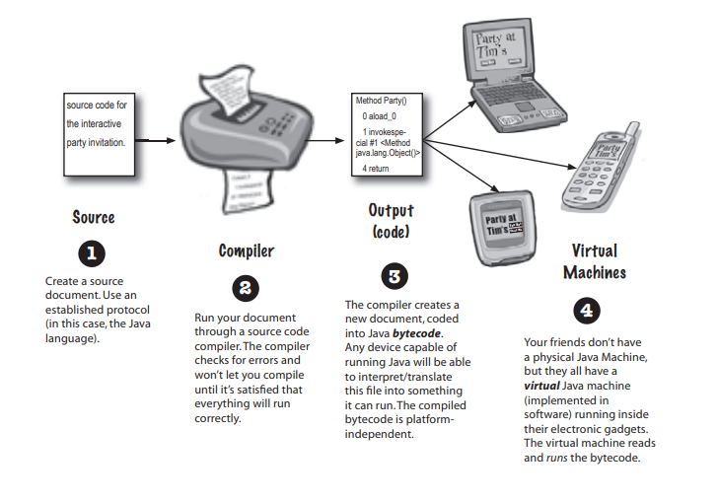
The Java Language
How Java works
Source: Kathy Sierra and Bert Bates. 2005. Head First Java, 2nd Edition. O'Reilly & Associates, Inc., Sebastopol, CA, USA.

Slide 7
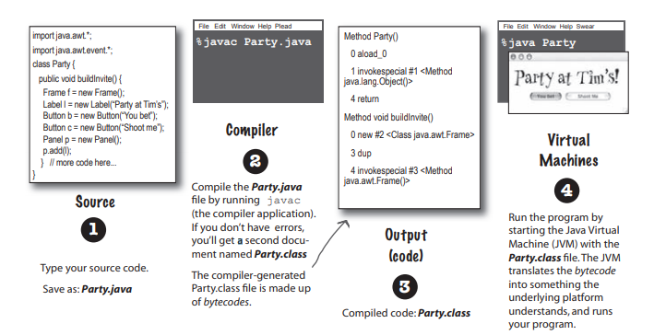
The Java Language
How Java works
Source: Kathy Sierra and Bert Bates. 2005. Head First Java, 2nd Edition. O'Reilly & Associates, Inc., Sebastopol, CA, USA.

Slide 8
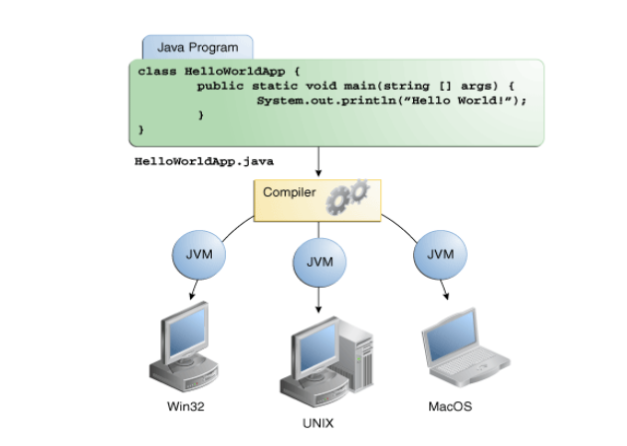
The Java Language
The JVM
The Java Virtual Machine is a program whose purpose is to execute other programs.
Functions:
To allow Java programs to run on any device or operating system (known as the "Write once, run anywhere" principle
to manage and optimize program memory
When developers talk about the JVM, we usually mean the process running on a machine, especially a server, that represents and controls resource usage for a Java application.
Source: https://docs.oracle.com/javase/tutorial/getStarted/intro/definition.html.

Slide 9
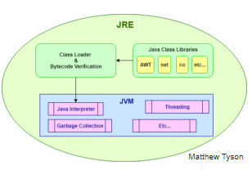
The Java Language
The JRE
A runtime environment is a piece of software that is designed to run other software.
As the runtime environment for Java, the JRE contains
the Java class libraries
the Java class loader - responsible for correctly loading classes and connecting them with the core Java class libraries
the Java Virtual Machine - ensuring Java applications have the resources they need to run and perform well in your device or cloud environment
Source: https://www.javaworld.com/article/3304858/what-is-the-jre-introduction-to-the-java-runtime-environment.html

Slide 10
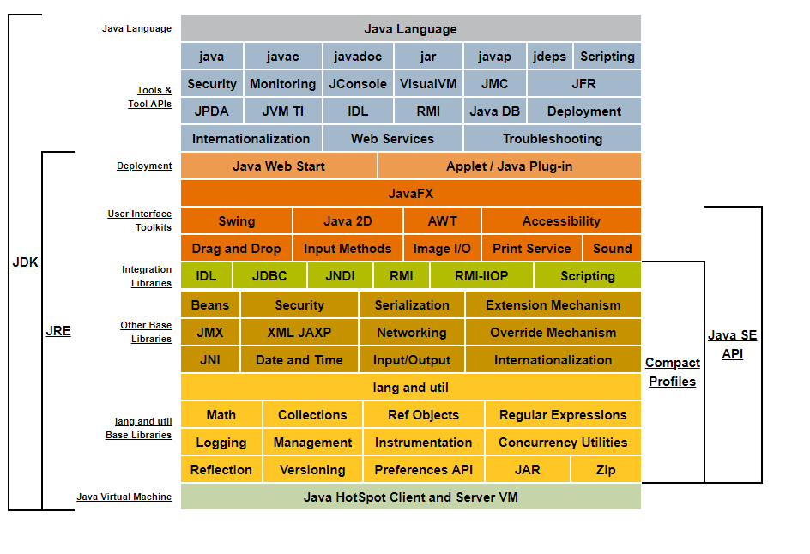
The Java Language
The JDK
The JDK allows developers to create Java programs that can be executed and run by the JVM and JRE.
In addition to the JRE, which is the environment used to run Java applications, every JDK contains a Java compiler.
Some of the more popular JDK utilities include:
javac: This utility is used to compile Java source code into Java bytecode.
jar: This compression utility aggregates a multitude of files into a single Java ARchive (JAR) file.
javadoc: create application programming interface (API) documentation for Java code.
Various tools for monitoring
Source: https://docs.oracle.com/javase/8/docs/index.html

Slide 11
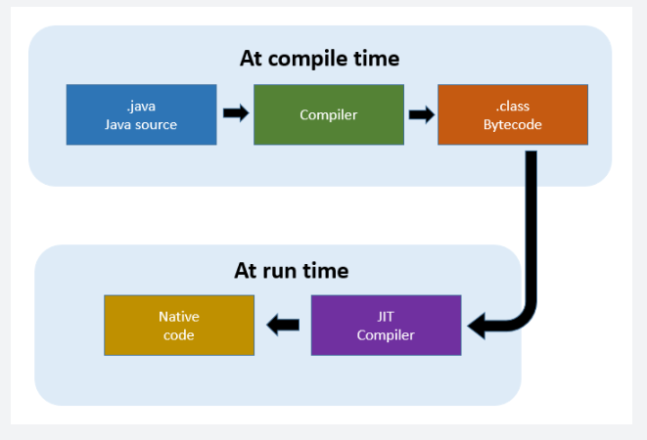
The Java Language
The JIT Compiler

Slide 12
The Java Language
The JIT Compiler
Gathers data about code during execution
invariants
types, constants (e.g. null pointers)
statistics
branches, calls
Gathered data can be used during optimization
Educated guess
Guess can be wrong

Slide 13
The Java Language
The JIT Compiler
Knows a lot about Java program
loaded classes, executed methods, profiling
Makes optimization based on that
May re-optimize if previous assumption was wrong

Slide 14
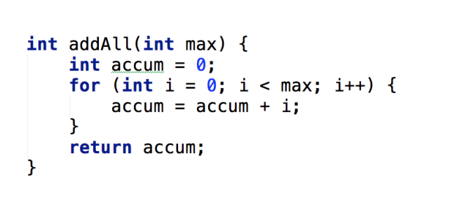
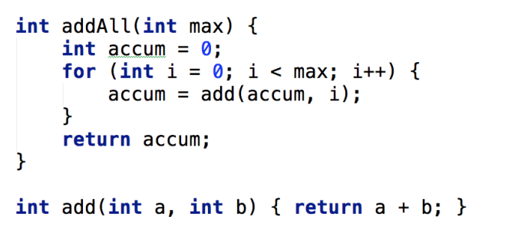
The Java Language
The JIT Compiler - Inlining

Slide 15
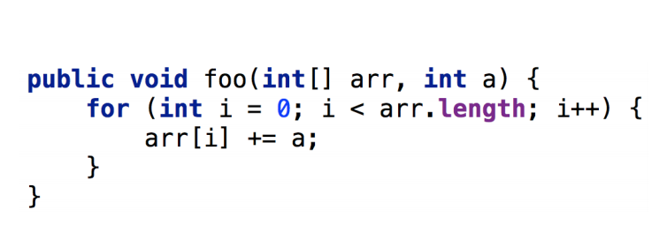
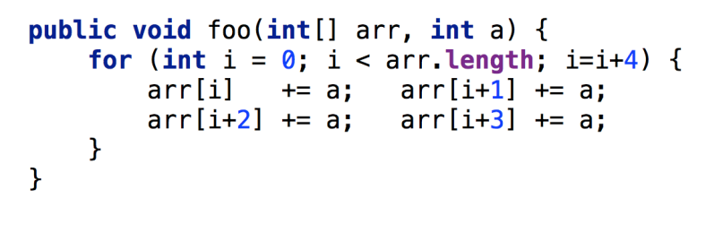
The Java Language
The JIT Compiler – Loop unrolling

Slide 16
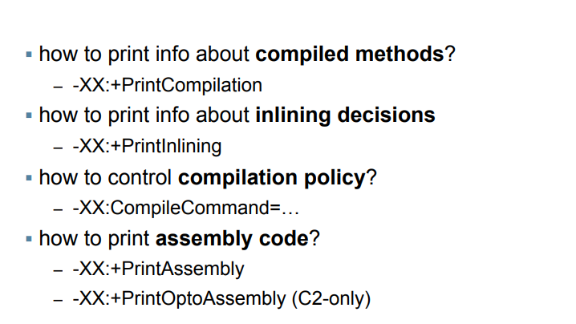
The Java Language
The JIT Compiler – Monitoring

Slide 17
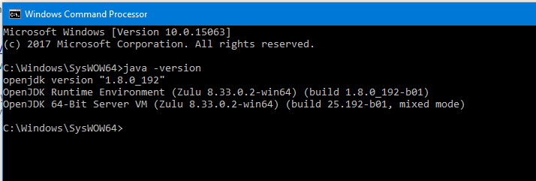
The Java Language
Configuring the JDK
Install the JDK
Make sure that you have the JAVA_HOME variable defined
(eg. C:\Program Files\Java\jdk1.8.0_91)
Add JAVA_HOME/bin to the $PATH environment variable
(eg. C:\Program Files\Java\jdk1.8.0_91\bin)
Open cmd and check the installation. It should look similar to this:

Slide 18
The Java Language
The Hello World Exercise
Create a file named MyFirstApp.java
(Make sure that the extension is really .java, not .txt)
Add content – some standard things in there
Now let’s compile it! Observe the .class.
Let’s run it!
Congrats! You have just created your first java program from scratch.

Slide 19
The Java Language
The First Application with multiple modules
See /Exercises/myFirstComplexApp/
javac
java
See /Exercises/myAppWithJar/
javac AModule.java
jar cf app1.jar AModule.class
javac -cp ".;./another/app1.jar" MyApplication.java
java -cp ".;./another/app1.jar" MyApplication

Slide 20
The Tools GIT

Slide 21
GIT
What is version control
Version control systems are a category of software tools that help a software team manage changes to source code over time.
Such systems: SVN, VCS, GIT, etc.
Keeps track of every modification to the code in a special kind of database
If a mistake is made, developers can turn back the clock and compare earlier versions
The most widely used modern version control system

Slide 22
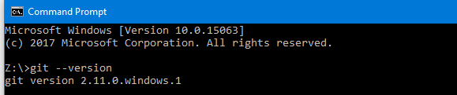
GIT
Setting up git with github account
Check with the following command:
Commands:
git clone https://github.com/thejavatrainer/Module1-IntroductionToJava
git status
git add myFile.txt
git commit –m “message”
git push
For setting the credentials - with administrative rights
git config --global credential.helper manager
git config --global credential.useHttpPath true

Slide 23
Git
GitHub exercise
Clone the repository from thejavatrainer@github
Commit and push a file
Create personal repository
Create a branch
Add exercises
Commit and push

Slide 24
The Tools Maven

Slide 25
Maven
What is maven
Simple explanation: build tool
Simplifies the build process
Produces artifacts – eg: .jar /.zip /.war
Helps us managing dependencies
Managing versions for dependencies
Open source

Slide 26
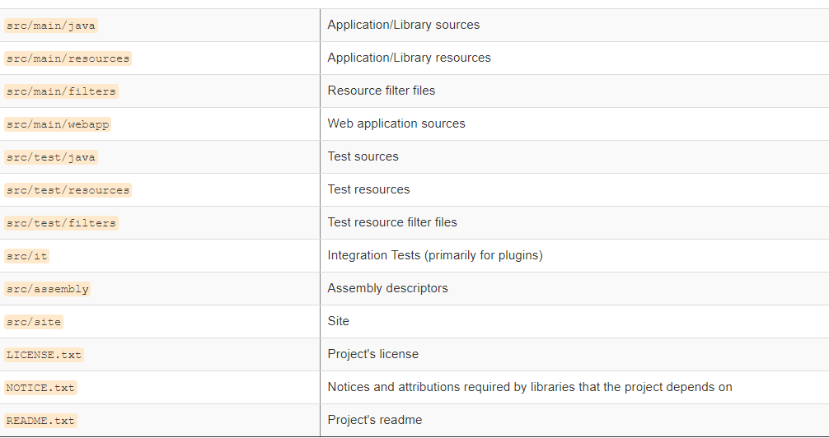
Maven
The project structure
Source: https://maven.apache.org/guides/introduction/introduction-to-the-standard-directory-layout.html

Slide 27
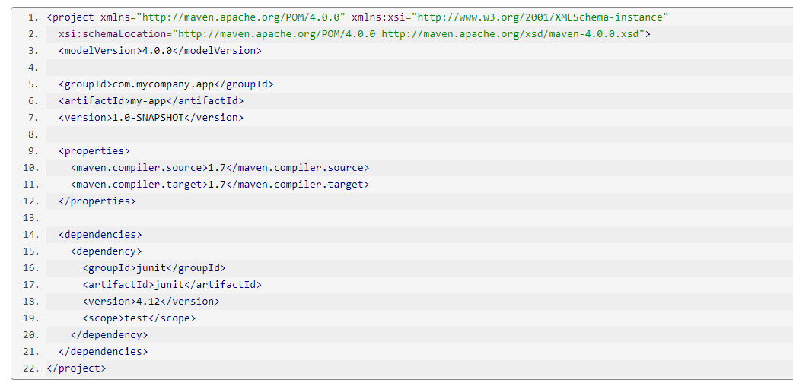
Maven
The pom.xml
A Project Object Model or POM
It is an XML file that contains information about the project and configuration details used by Maven to build the project
Source: https://maven.apache.org/guides/getting-started/maven-in-five-minutes.html#

Slide 28
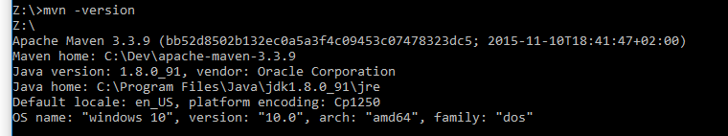
Maven
Configuring Maven
Make sure you have installed or unzipped Maven on your machine
Configure M2 and M2_HOME environment variables and add M2 to the PATH environment variable
M2= C:\Dev\apache-maven-3.3.9\bin
M2_HOME= C:\Dev\apache-maven-3.3.9
Create a folder for the local repository
Configure the settings.xml
The global install: ${maven.home}/conf/settings.xml
A user’s install: ${user.home}/.m2/settings.xml
Check installation

Slide 29
Maven
The first maven project
See \Exercises\maven\my-maven-app\
Run mvn clean install
Observe results
Run application from jar

Slide 30
The Tools Intellij IDEA

Slide 31
Intellij IDEA
IDE Presentation
Java integrated development environment
Features:
Coding assistance
syntax analysis
code navigation
code completion
code generation
refactoring suggestions
Integration with maven and other build tools
Integration with git and other versioning control systems
Supports various plugins

Slide 32
Intellij IDEA
Configuration
Can be configured with Eclipse style shortcuts or default Intellij IDEA shortcuts
Useful shortcuts:
Shift+Ctrl+N : search by file name
Shift+Ctrl+F : find in path(also in content)
Alt+Enter in a class : generate code

Slide 33
Intellij IDEA
IDE Presentation
Load maven project and present main features.

Slide 34
Introduction to Java

Slide 35
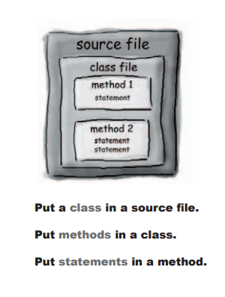
Introduction to Java
The structure of a Java class
Source: Kathy Sierra and Bert Bates. 2005. Head First Java, 2nd Edition. O'Reilly & Associates, Inc., Sebastopol, CA, USA.

Slide 36
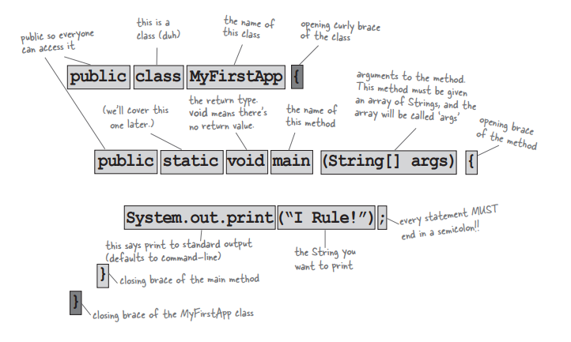
Introduction to Java
The structure of a Java class
Source: Kathy Sierra and Bert Bates. 2005. Head First Java, 2nd Edition. O'Reilly & Associates, Inc., Sebastopol, CA, USA.

Slide 37
Introduction to Java
Source File Declaration Rules
There can be only one public class per source code file.
If there is a public class in a file, the name of the file must match the name of the public class
If the class is part of a package, the package statement must be the first line in the source code file
If there are import statements, they must go between the package statement (if there is one) and the class declaration
A file can have more than one nonpublic class.
import and package statements apply to all classes within a source code file.

Slide 38
Introduction to Java
Class Declaration Rules
class MyClass { }
Modifiers:
Access modifiers (public, protected, private)
Nonaccess modifiers (including strictfp, final, and abstract)

Slide 39
Introduction to Java
Methods
Must be declared inside the class
Contains statements
Can return something or not
Has access modifiers
The main() method

Slide 40
Introduction to Java
Operators
Now that you've learned how to declare and initialize variables, you probably want to know how to do something with them.
Arithmetic operators
Assignment operators
Comparison operators
Logical operators
Bitwise operators

Slide 41
Introduction to Java
Variables
Variables are containers for storing data values
variable naming rules and conventions
basic data types (primitive types, character strings, and arrays)
default values
literals

Slide 42
Introduction to Java
Control Flow Statements
decisions-making, looping, and branching statements that enable your programs to conditionally execute particular blocks of code

Slide 43
Introduction to Java
The Hello World Exercise Revisited
Create a file named MyFirstApp.java
(Make sure that the extension is really .java, not .txt)
Add content – some standard things in there
Observe structure and content

Slide 44
Introduction to Java
Using the Java API
There are some classes that you do not need to import
The java.lang package
String
System
Math
To use a class you have to know how it is named and in which package it is

Slide 45
Introduction to Java
The First Application with Multiple Modules Revisited
See /Exercises/myFirstComplexApp/
See /Exercises/myAppWithJar/

Slide 46
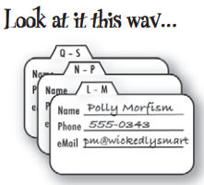
Introduction to Java
What is a Class and How to Use It?
A class is a blueprint for an object.
It tells the JVM how to make an object of that particular type.
Making an object
The new keyword
Objects can contain other objects
Source: Kathy Sierra and Bert Bates. 2005. Head First Java, 2nd Edition. O'Reilly & Associates, Inc., Sebastopol, CA, USA.

Slide 47
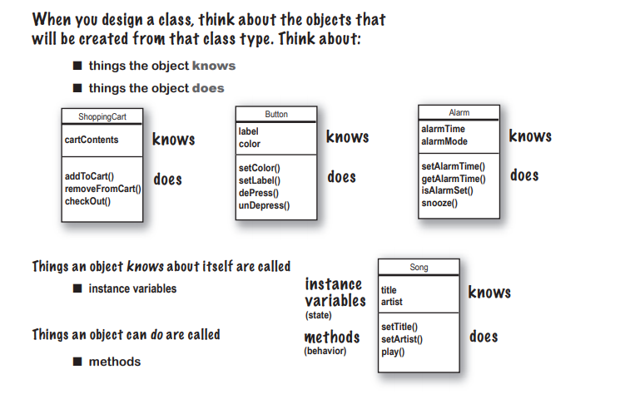
Introduction to Java
What is a Class and How to Use It?
Source: Kathy Sierra and Bert Bates. 2005. Head First Java, 2nd Edition. O'Reilly & Associates, Inc., Sebastopol, CA, USA.

Slide 48
Introduction to Java
What is a Class and How to Use It?
Everything is an object.
Think of an object as a fancy variable; it stores data, but you can “make requests” to that object, asking it to perform operations on itself.
In theory, you can take any conceptual component in the problem you’re trying to solve (dogs, buildings, services, etc.) and represent it as an object in your program.
Source: Thinking In Java

Slide 49
Introduction to Java
What is a Class and How to Use It?
A program is a bunch of objects telling each other what to do by sending messages.
To make a request of an object, you “send a message” to that object. More concretely, you can think of a message as a request to call a method that belongs to a particular object
Source: Thinking In Java

Slide 50
Introduction to Java
What is a Class and How to Use It?
Each object has its own memory made up of other objects.
Put another way, you create a new kind of object by making a package containing existing objects.
Thus, you can build complexity into a program while hiding it behind the simplicity of objects
Source: Thinking In Java

Slide 51
Introduction to Java
What is a Class and How to Use It?
Every object has a type.
Using the parlance, each object is an instance of a class, in which “class” is synonymous with “type.”
The most important distinguishing characteristic of a class is “What messages can you send to it?”
Source: Thinking In Java

Slide 52
Introduction to Java
What is a Class and How to Use It?
All objects of a particular type can receive the same messages.
This is actually a loaded statement, as you will see later. Because an object of type “circle” is also an object of type “shape,” a circle is guaranteed to accept shape messages.
Source: Thinking In Java

Slide 53
Introduction to Java
Exercise – creating a small application
Create a small app that prints in the console the content of a database.
Try to identify classes/objects
Create some instances and add them to the application
Phone book
Employee Database
Books share App

