Slide 1
Module 6
Java Generics

Slide 2
Table of contents
Why Use Generics ?
Generic Types
Generic Methods
Type Parameters
Generics and Inheritance
Type Erasure
Restrictions
Exercises

Slide 3
Why Use Generics ?

Slide 4
Why Use Generics?
Let’s imagine a scenario where we want to create a list in Java to store Integer
We can be tempted to write:
List list = new LinkedList();
list.add(new Integer(1));
Integer i = list.iterator().next();

Slide 5
Why Use Generics?
The compiler will complain about the last line. It doesn’t know what data type is returned.
The compiler will require an explicit casting:
List list = new LinkedList();
list.add(new Integer(1));
Integer i = list.iterator().next();
Integer i = (Integer) list.iterator.next();

Slide 6
Generic Types

Slide 7
Generic Types
Generics enable types (classes and interfaces) to be parameters when defining classes, interfaces and methods.
Type parameters provide a way for you to re-use the same code with different inputs.
Example: Box.java

Slide 8
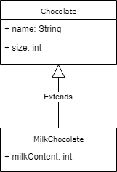


Generic Types
Example

Slide 9
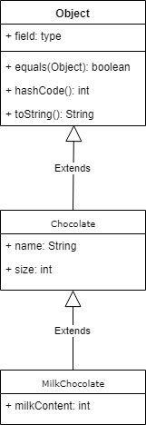
Generic Types
Example

Slide 10
Generic Types
Type Parameter Naming Conventions
By convention, type parameter names are single, uppercase letters
The most commonly used type parameter names are:
E - Element (used extensively by the Java Collections Framework)
K - Key
N - Number
T - Type
V - Value
S,U,V etc. - 2nd, 3rd, 4th types

Slide 11
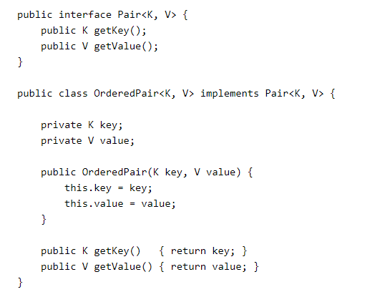
Generic Types
Multiple Type Parameters
A generic class can have multiple type parameters:

Slide 12

Generic Types
The Diamond
To instantiate a generic class, use the new keyword, as usual, but place <Type> between the class name and the parenthesis:
Since Java 7, the second part is no longer needed:
<> is called the diamond operator

Slide 13
Generic Methods

Slide 14
Generic Methods
Generic methods are methods that introduce their own type parameters.
The syntax for a generic method includes a list of type parameters, inside angle brackets, which appears before the method's return type.

Slide 15
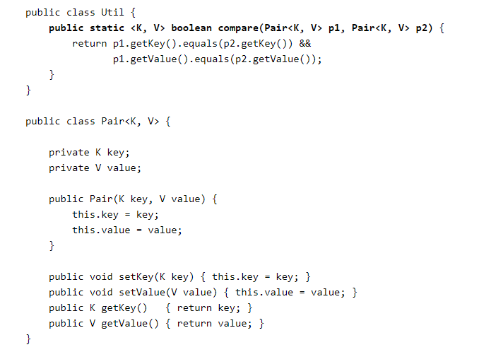
Generic Methods

Slide 16

Generic Methods

Slide 17
Type Parameters

Slide 18
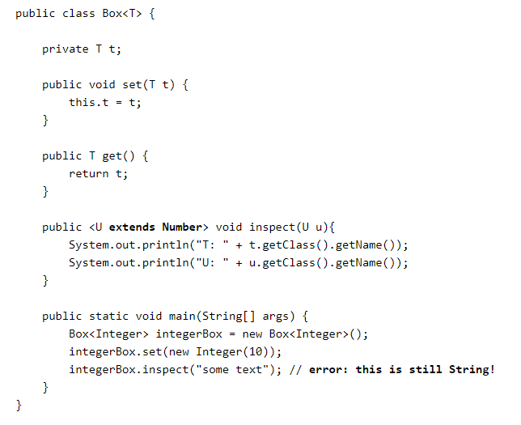
Type Parameters
Bounded Type Parameters
Bounded Type Parameters are used when you want to restrict the types that can be used as parameters in a parameterized type.

Slide 19
Type Parameters
Wildcard
In generic code, the question mark (?), called the wildcard, represents an unknown type
The wildcard can be used in a variety of situations: as the type of a parameter, field, or local variable
The wildcard is never used as a type argument for a generic method invocation, a generic class instance creation, or a supertype.

Slide 20
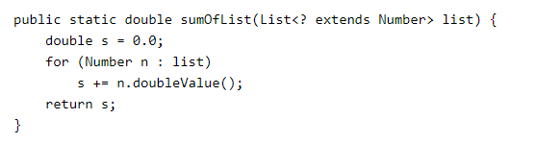
Type Parameters
Upper Bounded Wildcards
You can use an upper bounded wildcard to relax the restrictions on a variable.

Slide 21

Type Parameters
Upper Bounded Wildcards
You can use an upper bounded wildcard to relax the restrictions on a variable.

Slide 22

Type Parameters
Upper Bounded Wildcards
You can use an upper bounded wildcard to relax the restrictions on a variable.

Slide 23
Type Parameters
Lower Bounded Wildcards
A lower bounded wildcard is expressed using the wildcard character ('?'), following by the super keyword, followed by its lower bound:
<? super A>

Slide 24
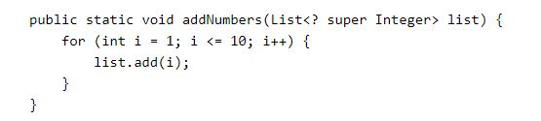
Type Parameters
Lower Bounded Wildcards

Slide 25
Type Parameters
Unbounded Wildcards
The unbounded wildcard type is specified using the wildcard character (?), for example, List<?>.
There are two scenarios where an unbounded wildcard is a useful approach:
If you are writing a method that can be implemented using functionality provided in the Object class.
When the code is using methods in the generic class that don't depend on the type parameter.

Slide 26
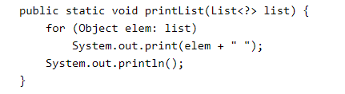
Type Parameters
Unbounded Wildcards

Slide 27
Generics and Inheritance

Slide 28

Generics and Inheritance
As you already know, it is possible to assign an object of one type to an object of another type provided that the types are compatible.
Since an Integer is a kind of Object, the assignment is allowed:

Slide 29

Generics and Inheritance
The same is also true with generics
You can perform a generic type invocation

Slide 30

Generics and Inheritance
Now consider the following method:
What type of argument does it accept?

Slide 31
Generics and Inheritance
Are you allowed to pass in Box<Integer> or Box<Double> ?

Slide 32
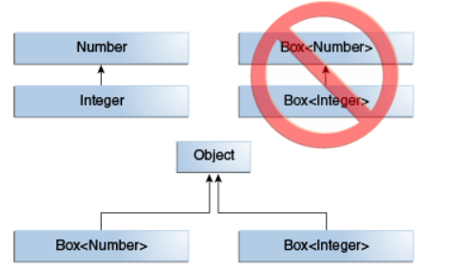
Generics and Inheritance
Box<Integer> is not a subtype of Box<Number> even though Integer is a subtype of Number.

Slide 33
Generics and Inheritance
Given two concrete types A and B (for example, Number and Integer),
MyClass<A> has no relationship to MyClass<B>,
regardless of whether or not A and B are related.
The common parent of MyClass<A> and MyClass<B> is Object.

Slide 34
Type Erasure

Slide 35
Type Erasure
To implement generics, the Java compiler applies type erasure to:
Replace all type parameters in generic types with their bounds or Object if the type parameters are unbounded
Insert type casts if necessary to preserve type safety
Generate bridge methods to preserve polymorphism in extended generic types

Slide 36
Type Erasure
The Java compiler:
erases all type parameters
replaces each with its first bound if the type parameter is bounded
replaces each with Object if the type parameter is unbounded

Slide 37
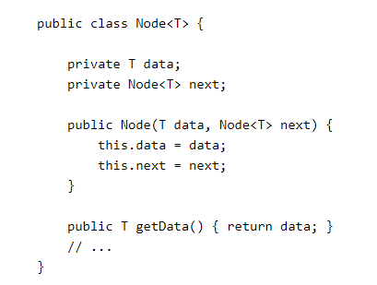
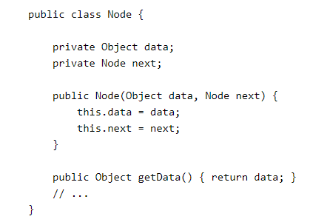
Type Erasure
Generic Types
The Java compiler:
erases all type parameters
replaces each with its first bound if the type parameter is bounded
replaces each with Object if the type parameter is unbounded

Slide 38
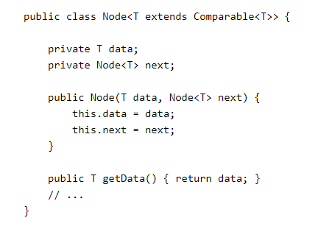
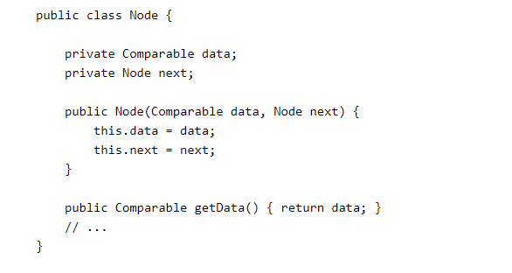
Type Erasure
Generic Types
The Java compiler:
erases all type parameters
replaces each with its first bound if the type parameter is bounded
replaces each with Object if the type parameter is unbounded

Slide 39
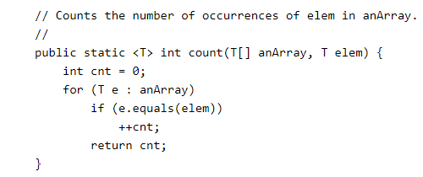
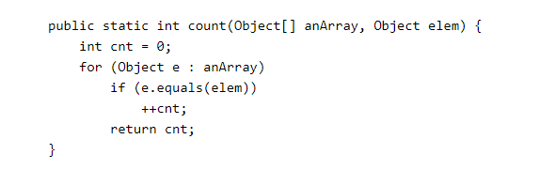
Type Erasure
Generic Methods
The Java compiler:
erases type parameters in generic method arguments
replaces each with its first bound if the type parameter is bounded
replaces each with Object if the type parameter is unbounded

Slide 40


Type Erasure
Generic Methods
The Java compiler:
erases type parameters in generic method arguments
replaces each with its first bound if the type parameter is bounded
replaces each with Object if the type parameter is unbounded

Slide 41
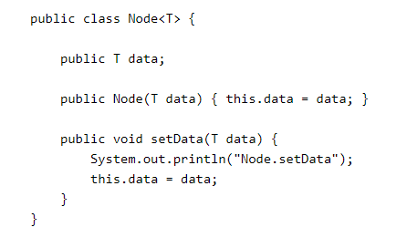
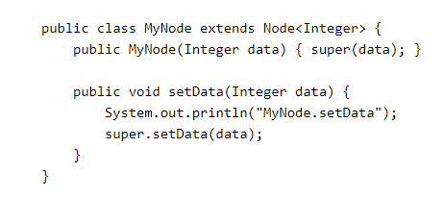
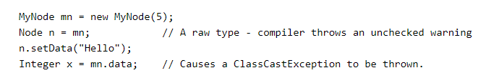
Type Erasure
Effects
Sometimes type erasure causes a situation that you may not have anticipated

Slide 42
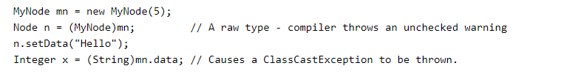
Type Erasure
Effects
Sometimes type erasure causes a situation that you may not have anticipated

Slide 43
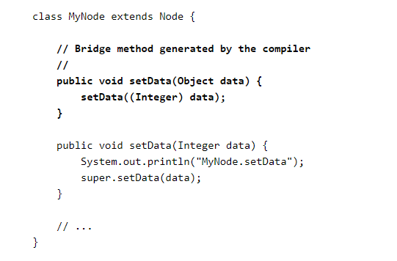
Type Erasure
Bridge Methods
The compiler may need to create a synthetic method, called a bridge method, as part of the type erasure process.
You normally don't need to worry about bridge methods, but you might be puzzled if one appears in a stack trace.

Slide 44
Restrictions

Slide 45
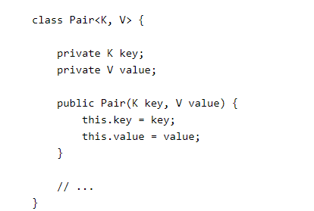
Restrictions
Cannot Instantiate Generic Types with Primitive Types

Slide 46
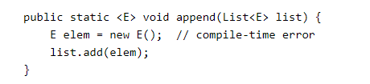
Restrictions
Cannot Create Instances of Type Parameters

Slide 47
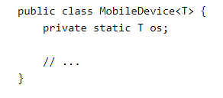

Restrictions
Cannot Declare Static Fields Whose Types are Type Parameters

Slide 48

Restrictions
Cannot Use Casts or instanceof with Parameterized Types

Slide 49
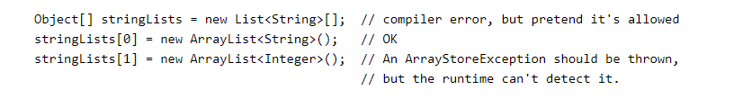
Restrictions
Cannot Create Arrays of Parameterized Types

Slide 50
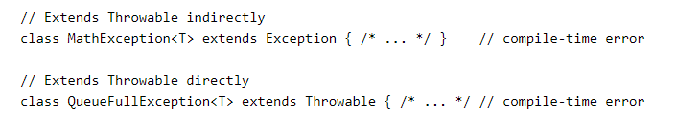
Restrictions
Cannot Create, Catch, or Throw Objects of Parameterized Types
A generic class cannot extend the Throwable class directly or indirectly. For example, the following classes will not compile:

Slide 51
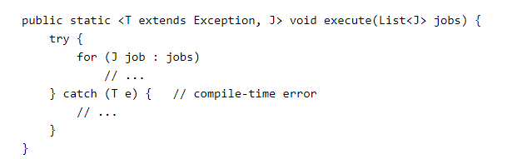
Restrictions
Cannot Create, Catch, or Throw Objects of Parameterized Types
A method cannot catch an instance of a type parameter

Slide 52
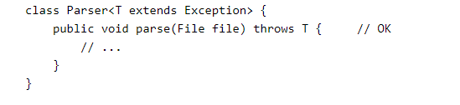
Restrictions
Cannot Create, Catch, or Throw Objects of Parameterized Types
You can, however, use a type parameter in a throws clause:

Slide 53
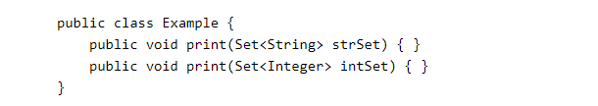
Restrictions
Cannot Overload a Method Where the Formal Parameter Types of Each Overload Erase to the Same Raw Type

Slide 54
Exercises

Slide 55
Exercises
Write a generic method to exchange the positions of two different elements in an array.
Design a class that acts as a library for the following kinds of media: book, video, and newspaper. Provide one version of the class that uses generics and one that does not. Feel free to use any additional APIs for storing and retrieving the media.
Further reading : http://www.angelikalanger.com/GenericsFAQ/JavaGenericsFAQ.html
Especially: http://www.angelikalanger.com/GenericsFAQ/FAQSections/ProgrammingIdioms.html

Slide 56
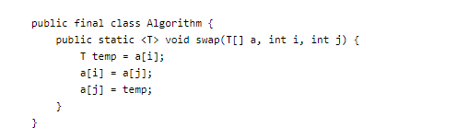
Exercises
Write a generic method to exchange the positions of two different elements in an array.

Slide 57
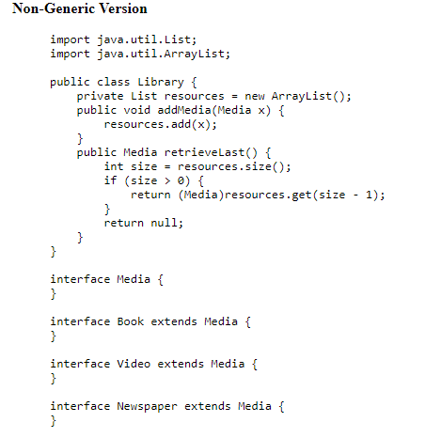
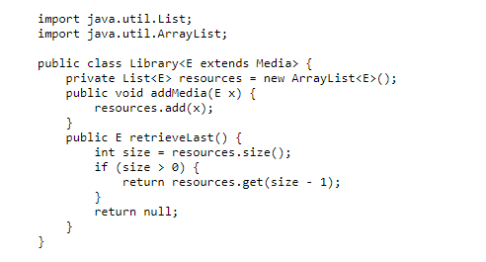
Exercises
Design a class that acts as a library for the following kinds of media: book, video, and newspaper. Provide one version of the class that uses generics and one that does not. Feel free to use any additional APIs for storing and retrieving the media.

