Slide 1
Module 6
Working with Collections

Slide 2
Table of contents
Overview
The Object class. equals() , hashCode() and toString()
Java Generics
Why do we need generics
Example
Collections
Using collections

Slide 3
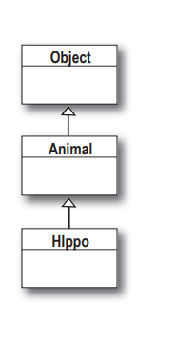
equals(), hashCode() and toString()
The Object class
Every class extends Object
A new Hippo object also IS-A Animal and IS-A Object.
Source: Kathy Sierra and Bert Bates. 2005. Head First Java, 2nd Edition. O'Reilly & Associates, Inc., Sebastopol, CA, USA.

Slide 4
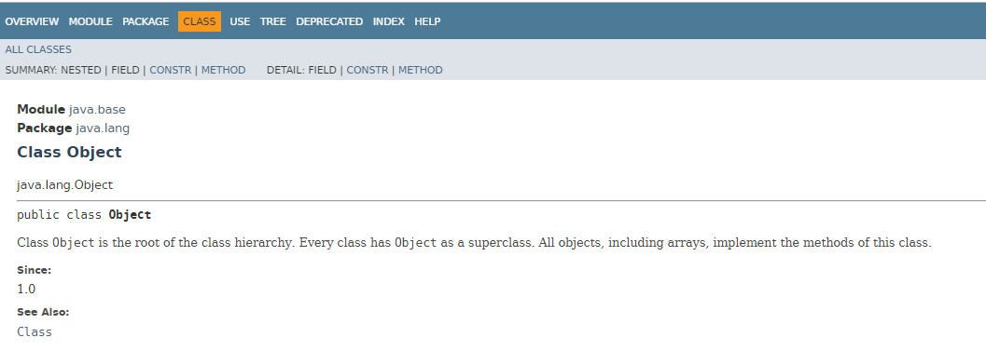
equals(), hashCode() and toString()
The Object class
https://docs.oracle.com/en/java/javase/11/docs/api/java.base/java/lang/Object.html

Slide 5
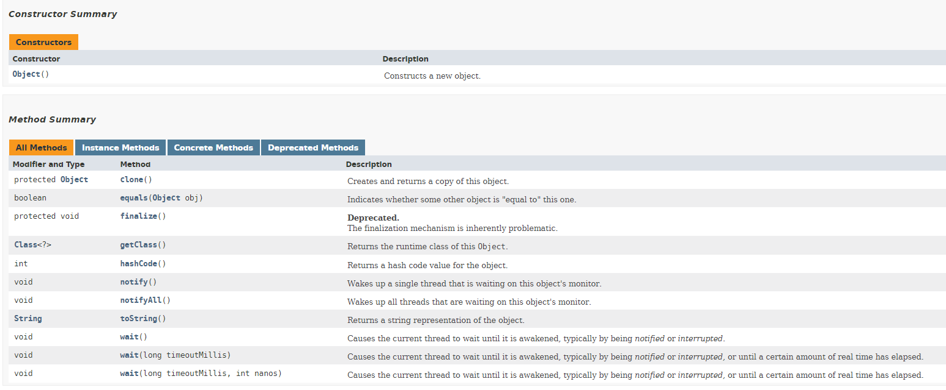
equals(), hashCode() and toString()
The Object class
https://docs.oracle.com/en/java/javase/11/docs/api/java.base/java/lang/Object.html

Slide 6
equals(), hashCode() and toString()
The toString() Method
Text representation of the object
Helps you get a meaningful text about the objects of your class
Code example – HardToRead.java / EasyToRead.java

Slide 7
equals(), hashCode() and toString()
The equals() Method
When you really need to know if two references are identical, use ==.
But when you need to know if the objects themselves (not the references) are equal, use the equals() method
The equals() method in class Object uses only the == operator for comparisons, so unless you override equals(), two objects are considered equal only if the two references refer to the same object
Example: Car.java

Slide 8
equals(), hashCode() and toString()
The equals() Method
Pulled straight from the Java docs, the equals() contract says
It is reflexive. For any reference value x, x.equals(x) should return true.
It is symmetric. For any reference values x and y, x.equals(y) should return true if and only if y.equals(x) returns true.
It is transitive. For any reference values x, y, and z, if x.equals(y) returns true and y.equals(z) returns true, then x.equals(z) must return true.
It is consistent. For any reference values x and y, multiple invocations of x.equals(y) consistently return true or consistently return false, provided no information used in equals() comparisons on the object is modified.
For any non-null reference value x, x.equals(null) should return false.

Slide 9
equals(), hashCode() and toString()
The hashCode() Method
Although you can think of it as kind of an object ID number, it isn't necessarily unique
The hashcode value of an object is used by some collection classes
Collections such as HashMap and HashSet use the hashcode value of an object to determine how the object should be stored in the collection
Example: the bucket with persons

Slide 10
equals(), hashCode() and toString()
The hashCode() Method
Now coming to you straight from the fabulous Java API documentation for class Object, the hashCode() contract:
Whenever it is invoked on the same object more than once during an execution of a Java application, the hashCode() method must consistently return the same integer, provided that no information used in equals() comparisons on the object is modified.
If two objects are equal according to the equals(Object) method, then calling the hashCode() method on each of the two objects must produce the same integer result.
It is NOT required that if two objects are unequal according to the equals(java.lang.Object) method, then calling the hashCode() method on each of the two objects must produce distinct integer results.

Slide 11
Java Generics

Slide 12
Java Generics
Why Use Generics?
Generics enable types (classes and interfaces) to be parameters when defining classes, interfaces and methods.
Type parameters provide a way for you to re-use the same code with different inputs.
Example: Box.java

Slide 13
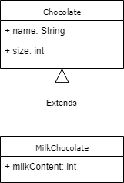


Java Generics
Why Use Generics?

Slide 14
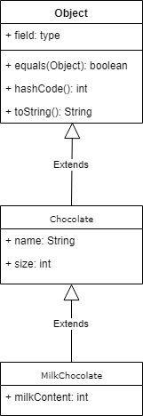
Java Generics
Why Use Generics?

Slide 15
Collections

Slide 16
Collections
What Can You Do with a Collection?
There are a few basic operations you'll normally use with collections:
Add objects to the collection.
Remove objects from the collection.
Find out if an object (or group of objects) is in the collection.
Retrieve an object from the collection without removing it.
Iterate through the collection, looking at each element (object) one after another.

Slide 17
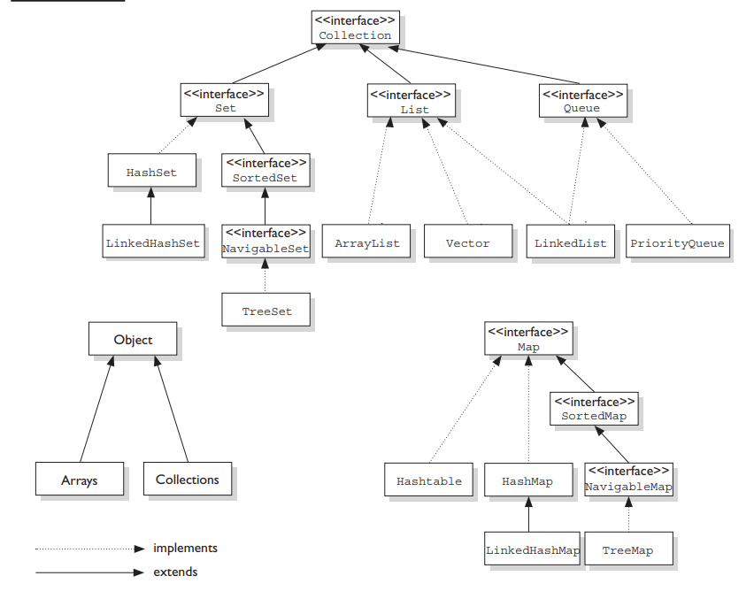
Collections
What Collections are there?
Source: Kathy Sierra and Bert Bates. 2015. OCA/OCP Java® SE 7 Programmer I & II Study Guide. McGraw Hill Education

Slide 18
Collections
Flavours
Collections come in four basic flavors:
Lists - Lists of things (classes that implement List)
Sets - Unique things (classes that implement Set)
Maps - Things with a unique ID (classes that implement Map)
Queues - Things arranged by the order in which they are to be processed

Slide 19
Collections
Flavours
Source: Kathy Sierra and Bert Bates. 2015. OCA/OCP Java® SE 7 Programmer I & II Study Guide. McGraw Hill Education

Slide 20
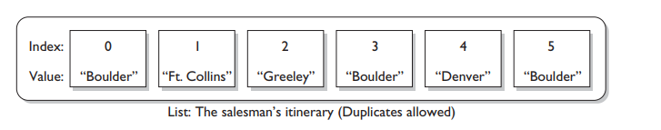
Collections
Lists
A List cares about the index
The one thing that List has that non-lists don't is a set of methods related to the index
Those key methods include things like get(int index), indexOf(Object o), add(int index, Object obj), and so on
Source: Kathy Sierra and Bert Bates. 2015. OCA/OCP Java® SE 7 Programmer I & II Study Guide. McGraw Hill Education

Slide 21
Collections
Lists
A List cares about the index
The one thing that List has that non-lists don't is a set of methods related to the index
Those key methods include things like:
get(int index)
indexOf(Object o)
add(int index, Object obj
add()
Source: Kathy Sierra and Bert Bates. 2015. OCA/OCP Java® SE 7 Programmer I & II Study Guide. McGraw Hill Education

Slide 22
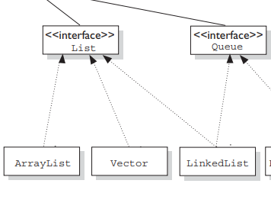
Collections
Lists
All three List implementations are ordered by index position - a position that you determine either by setting an object at a specific index or by adding it without specifying position, in which case the object is added to the end.
Source: Kathy Sierra and Bert Bates. 2015. OCA/OCP Java® SE 7 Programmer I & II Study Guide. McGraw Hill Education

Slide 23
Collections
ArrayList
Ordered collection (by index)
Not sorted
Example.

Slide 24
Collections
Vector
A Vector is basically the same as an ArrayList, but Vector methods are synchronized for thread safety
Ordered collection (by index)
Not sorted
You'll normally want to use ArrayList instead of Vector because the synchronized methods add a performance hit you might not need.
Example.

Slide 25
Collections
LinkedList
A LinkedList is ordered by index position, like ArrayList
The elements are doubly linked to one another
Example.

Slide 26
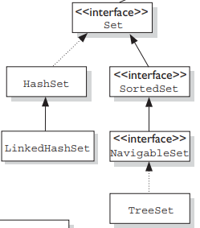
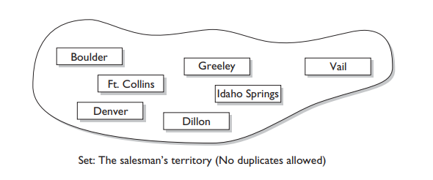
Collections
Sets
A Set cares about uniqueness—it doesn't allow duplicates.
Your good friend the equals() method determines whether two objects are identical (in which case, only one can be in the set).
Source: Kathy Sierra and Bert Bates. 2015. OCA/OCP Java® SE 7 Programmer I & II Study Guide. McGraw Hill Education

Slide 27
Collections
HashSet
A HashSet is an unsorted, unordered Set
It uses the hashcode of the object being inserted
Use this class when you want a collection with no duplicates and you don't care about order when you iterate through it
Example.

Slide 28
Collections
LinkedHashSet
Is an ordered version of HashSet
Maintains a doubly linked List across all elements
Use this class instead of HashSet when you care about the iteration order
When you iterate through a HashSet, the order is unpredictable, while a LinkedHashSet lets you iterate through the elements in the order in which they were inserted
Example.

Slide 29
Collections
TreeSet
Sorted
Guarantees that the elements will be in ascending order, according to natural order
Optionally, you can construct a TreeSet with a constructor that lets you give the collection your own rules for what the order should be.
Example.

Slide 30
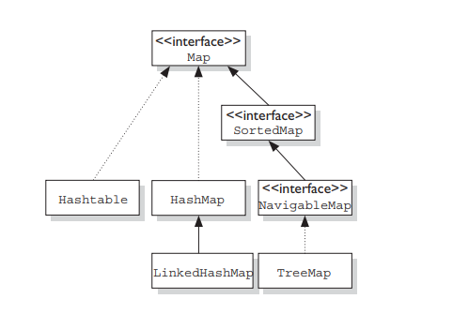
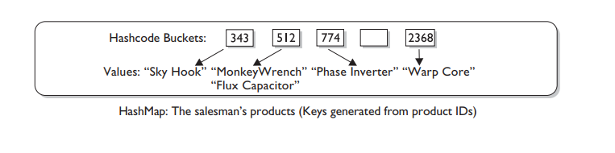
Collections
Maps
A Map cares about unique identifiers.
key/value or name/value pair
You map a unique key (the ID) to a specific value, where both the key and the value are, of course, objects.
Source: Kathy Sierra and Bert Bates. 2015. OCA/OCP Java® SE 7 Programmer I & II Study Guide. McGraw Hill Education

Slide 31
Collections
HashMap
an unsorted, unordered Map
when you need a Map and you don't care about the order when you iterate through it, then HashMap is the way to go
Example.

Slide 32
Collections
Hashtable
from prehistoric Java times
Hashtable is the synchronized counterpart to HashMap
Example.

Slide 33
Collections
LinkedHashMap
maintains insertion order
Is is somewhat slower than HashMap for adding and removing elements, but you can expect faster iteration with a LinkedHashMap.
Example.

Slide 34
Collections
TreeMap
sortedMap
sorted by the natural order of the elements
Example.

Slide 35
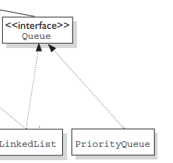
Collections
Queues
A Queue is designed to hold a list of "to-dos," or things to be processed in some way
Although other orders are possible, queues are typically thought of as FIFO (first-in, first-out)
Source: Kathy Sierra and Bert Bates. 2015. OCA/OCP Java® SE 7 Programmer I & II Study Guide. McGraw Hill Education

Slide 36
Collections
PriorityQueue
A Queue is designed to hold a list of "to-dos," or things to be processed in some way
Although other orders are possible, queues are typically thought of as FIFO (first-in, first-out)
Source: Kathy Sierra and Bert Bates. 2015. OCA/OCP Java® SE 7 Programmer I & II Study Guide. McGraw Hill Education

Slide 37
Using Collections

Slide 38
Using Collections
Array vs ArrayList
An array is basic functionality provided by Java.
Array: Simple fixed sized arrays that we create in Java, like below
int arr[] = new int[10]
ArrayList is part of collection framework in Java.
ArrayList : Dynamic sized arrays in Java that implement List interface.
ArrayList<Type> arrL = new ArrayList<Type>();
Array members are accessed using [], while ArrayList has a set of methods to access elements and modify them.
You cannot create a List with primitives

Slide 39
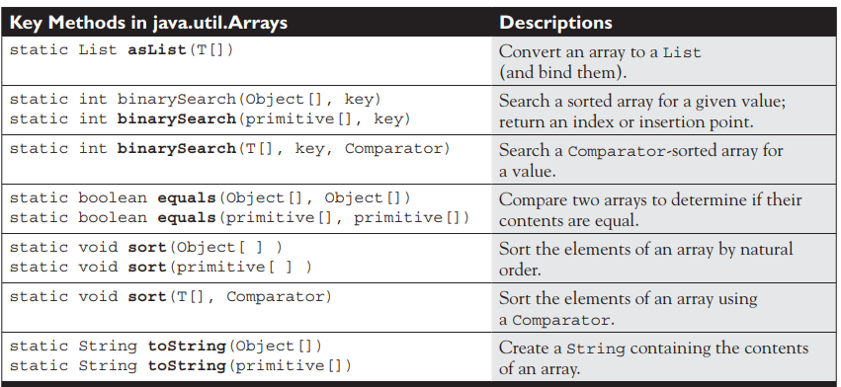
Using Collections
Arrays
Source: Kathy Sierra and Bert Bates. 2015. OCA/OCP Java® SE 7 Programmer I & II Study Guide. McGraw Hill Education

Slide 40
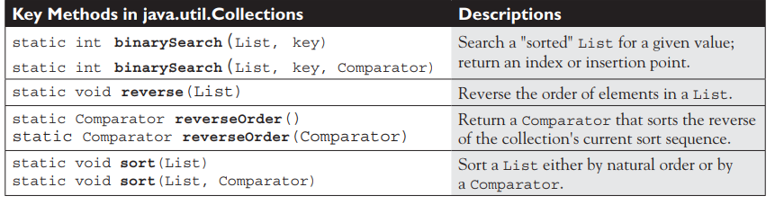
Using Collections
Collections
Source: Kathy Sierra and Bert Bates. 2015. OCA/OCP Java® SE 7 Programmer I & II Study Guide. McGraw Hill Education

Slide 41
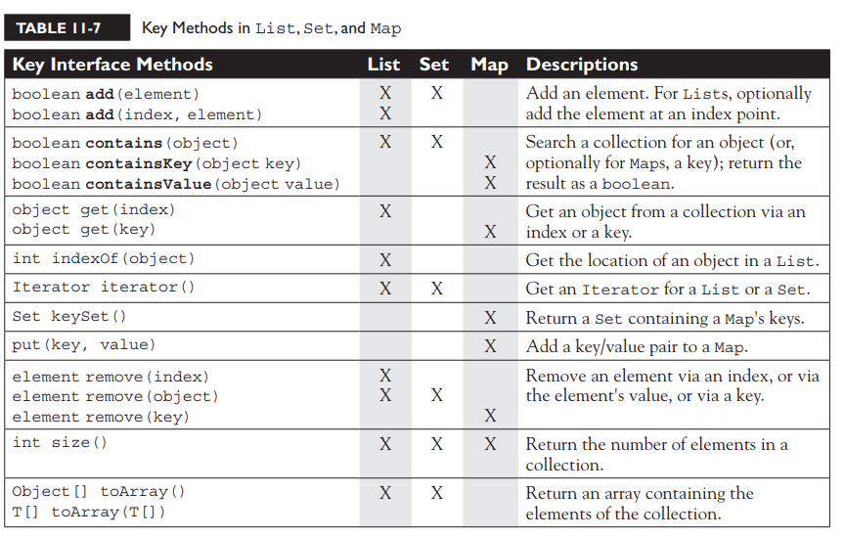
Using Collections
Key methods on collections - Overview
Source: Kathy Sierra and Bert Bates. 2015. OCA/OCP Java® SE 7 Programmer I & II Study Guide. McGraw Hill Education

Slide 42
Using Collections
Iterators and other types of loops
When to use which traversal?
If we have to modify collection, we can use Iterator.
While using nested for loops it is better to use for-each loop
Example
Source: Kathy Sierra and Bert Bates. 2015. OCA/OCP Java® SE 7 Programmer I & II Study Guide. McGraw Hill Education

