Slide 1


Slide 2


Quiz of Intelligence

Slide 3
Group Members Introduction
Jawad Ali bc160401965

Slide 4
Introduction of Project
Quiz of intelligence is designed for educational purpose
It will check user’s knowledge in different fields of life e.g. music, sports etc.
User can also challenge his friend to inspect who is more intelligent

Slide 5
Introduction of Project
On every correct answer, user will get coins and points as reward
On difficult questions, user can take hint to hide two wrong options
At the end of quiz result will be shown and winner in case of multiplayer quiz

Slide 6
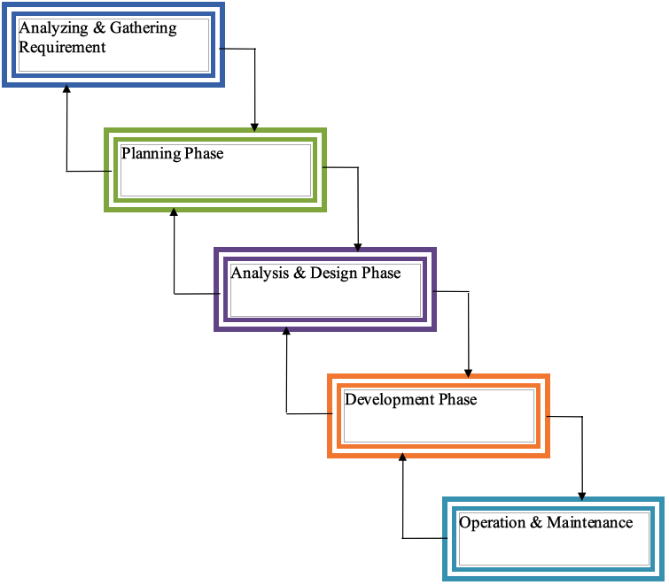
VU Process Model

Slide 7
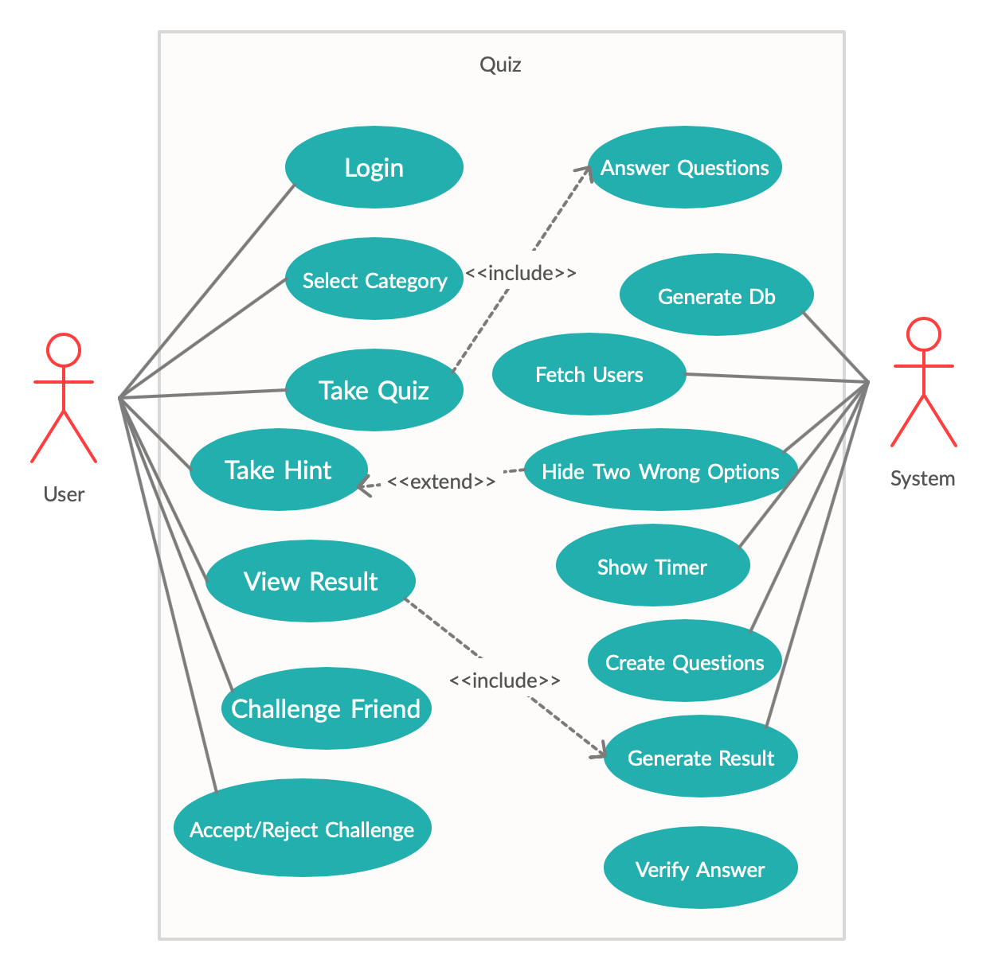
Use Case Diagram

Slide 8
Business Rules Catalog
Facebook based login
There should be questions from different topics
User can either select from one of these topics or will get questions from all topics randomly
Each questionnaire will consist of 7 questions

Slide 9
Business Rules Catalog
On every correct answer user will get 10 points and coins based on time he take to answer
In difficult questions, user can take hint by investing coins
In multiplayer mode, user can challenge his friend to play with him

Slide 10
Business Rules Catalog
The other player can either accept or reject challenge
Both players will have same questions and time to answer
In the end of quiz, results will be shown with winner in case of multiplayer game

Slide 11
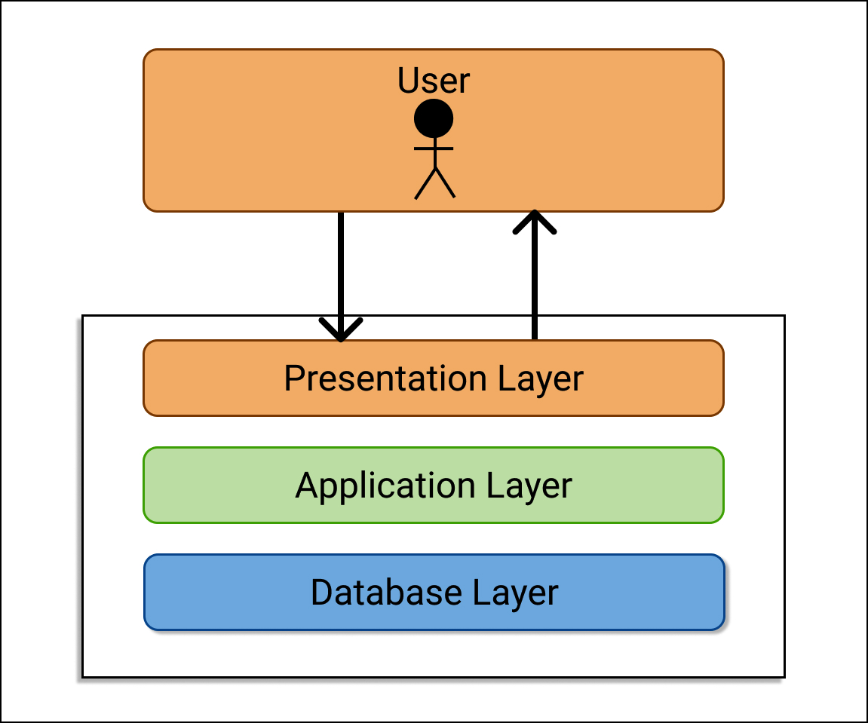
Architectural Design

Slide 12
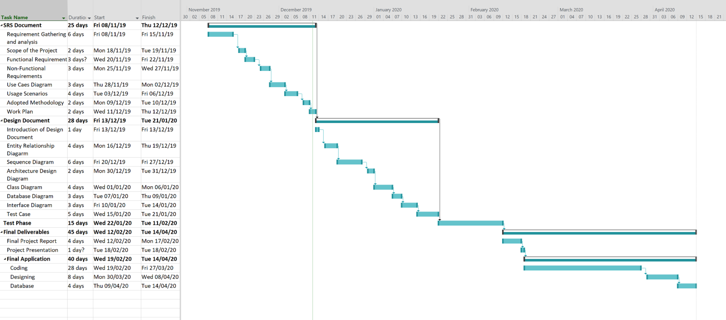
Project Schedule

Slide 13
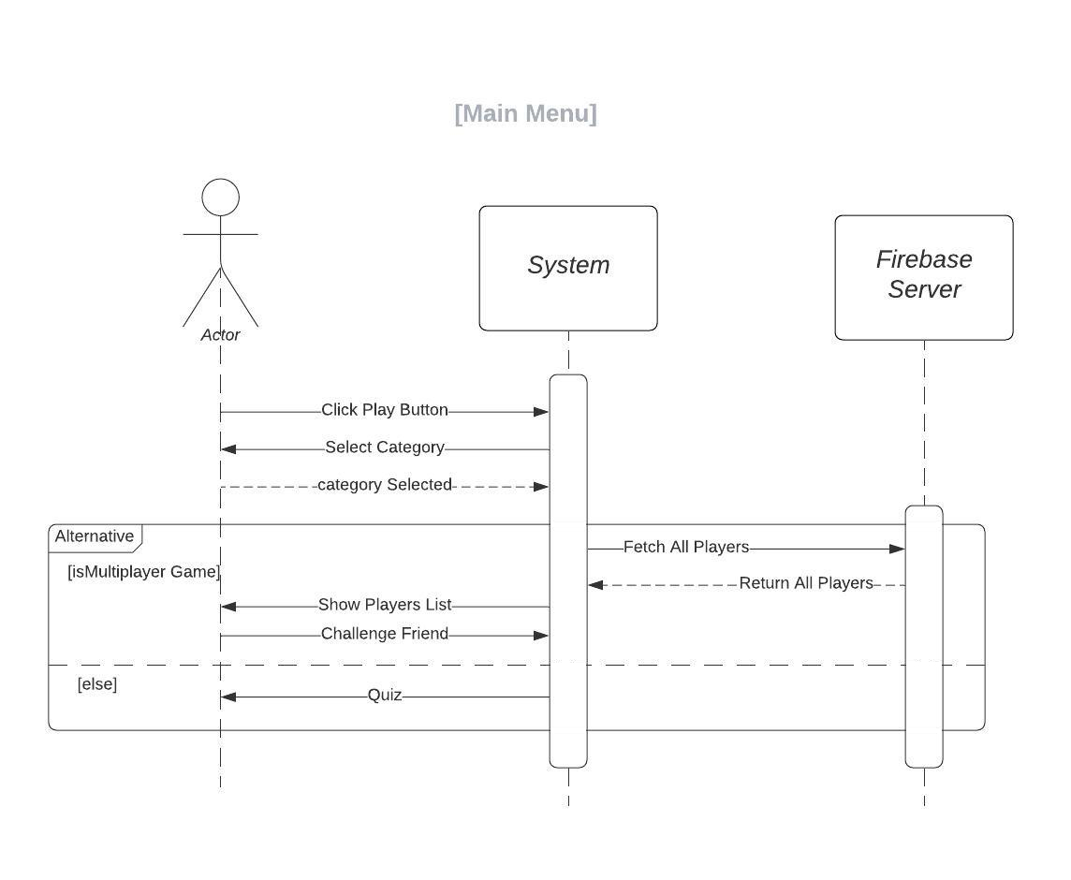
Sequence Diagram

Slide 14
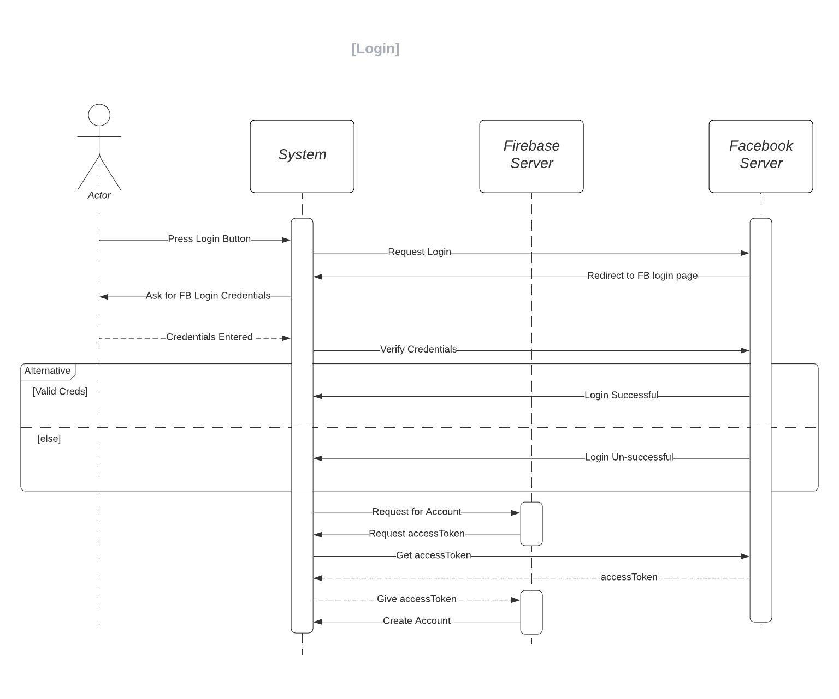
Sequence Diagram

Slide 15
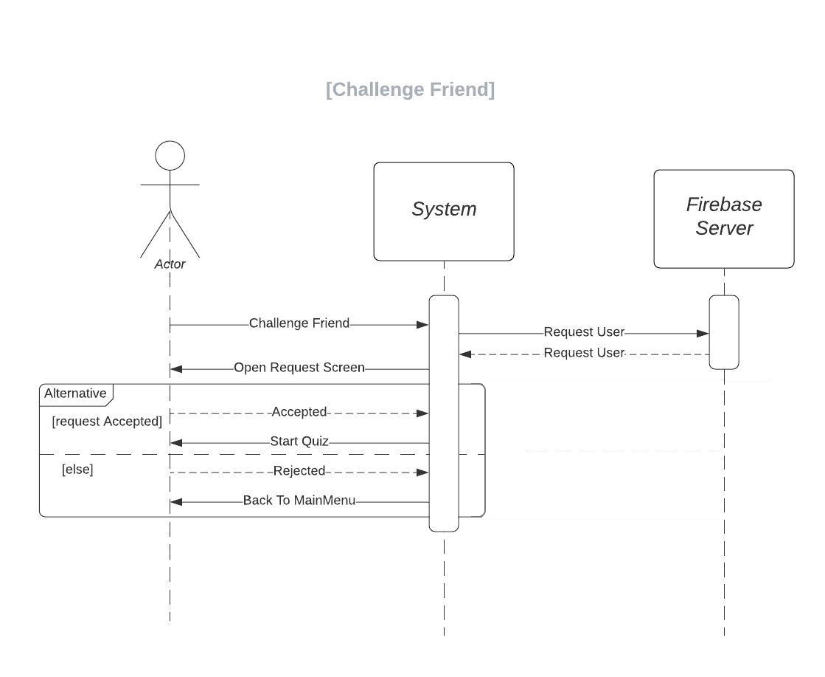
Sequence Diagram

Slide 16
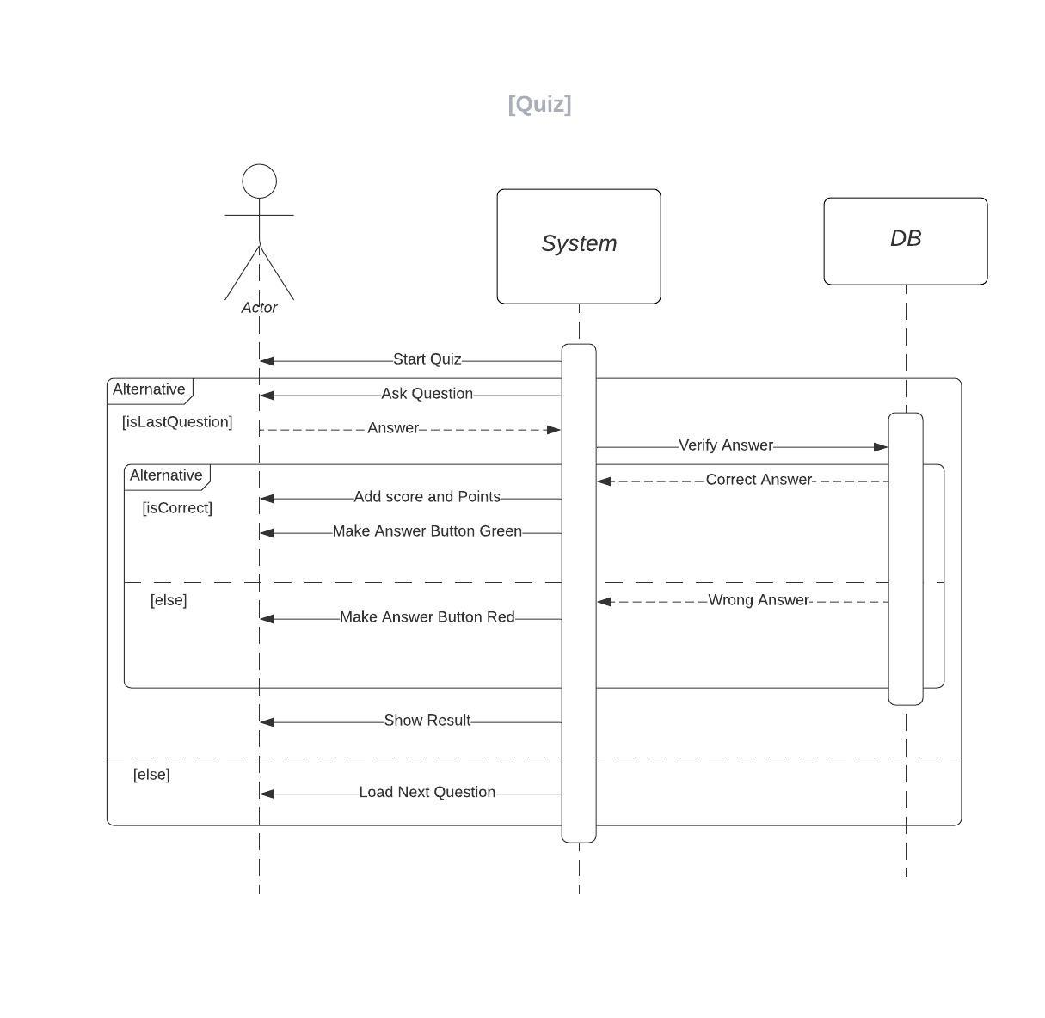
Sequence Diagram

Slide 17
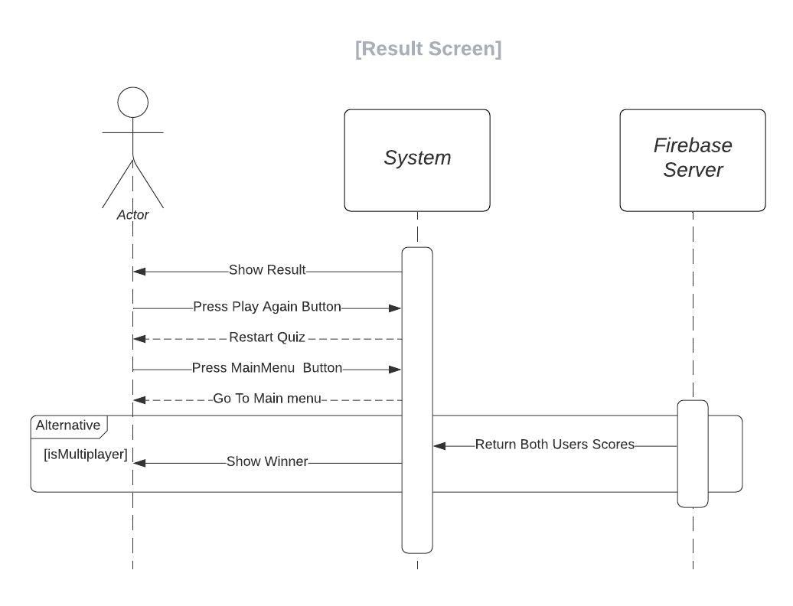
Sequence Diagram

Slide 18
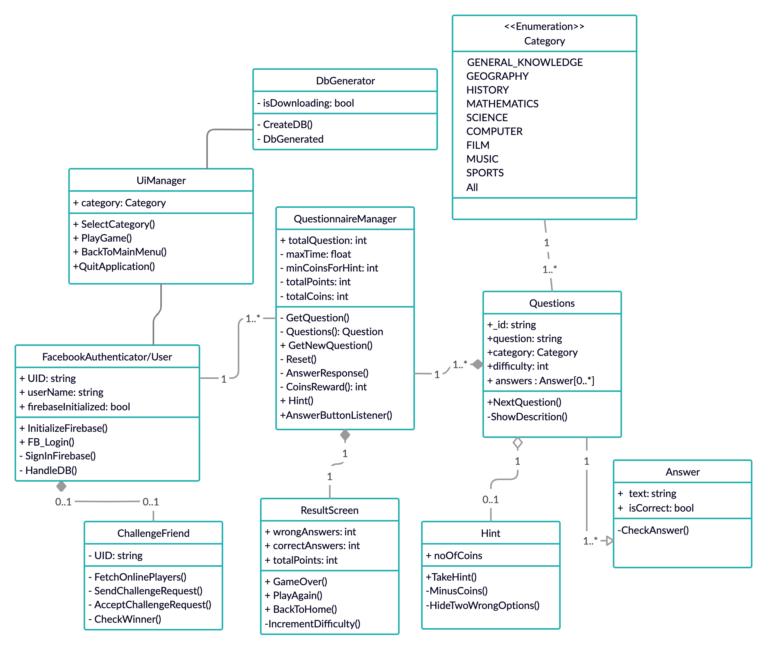
Logical Model/Class Diagram

Slide 19
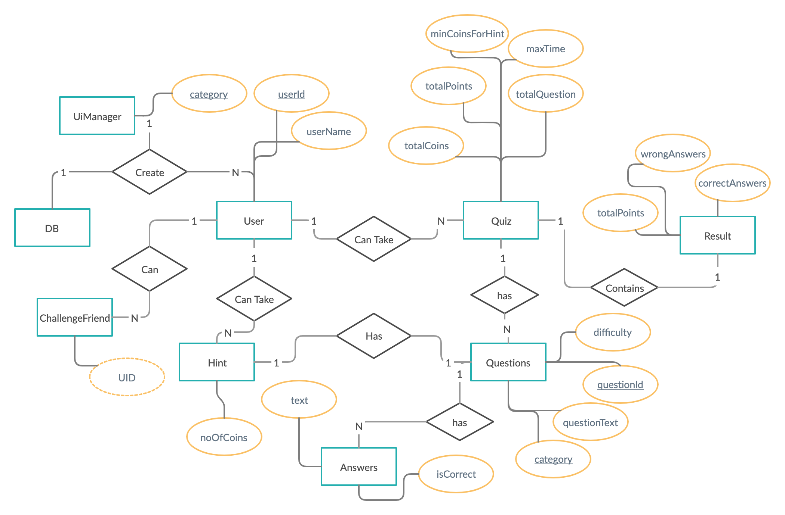
Entity-Relationship Diagram

Slide 20
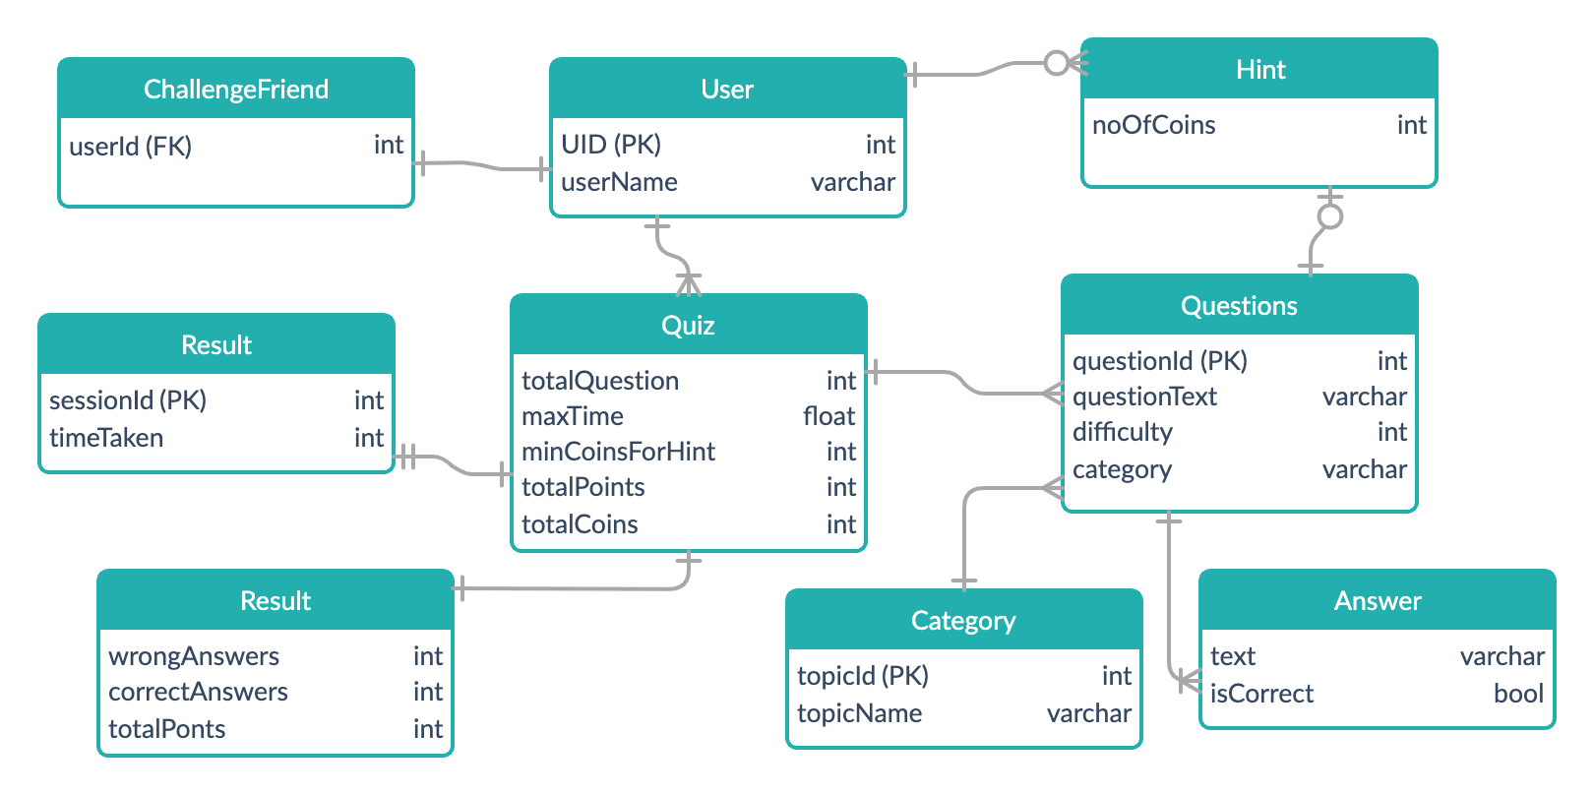
Database Diagram

Slide 21
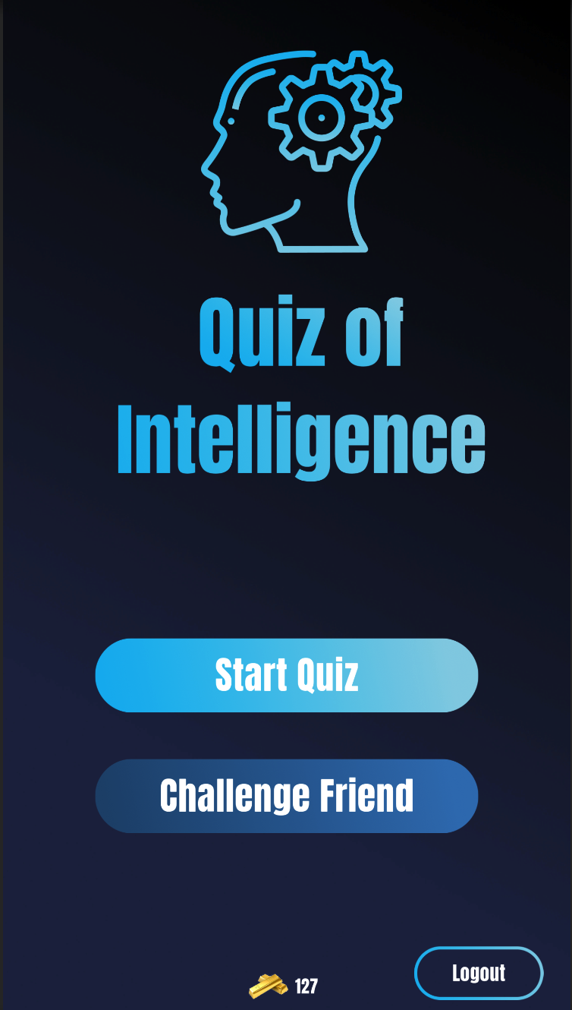
User Interface

Slide 22
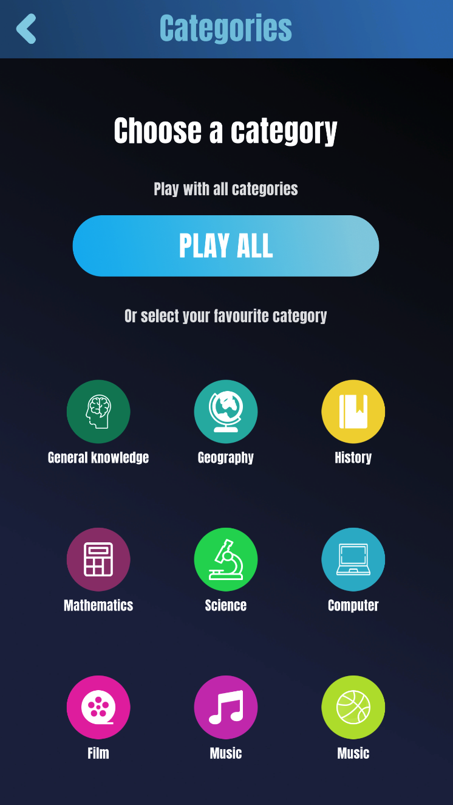
User Interface

Slide 23
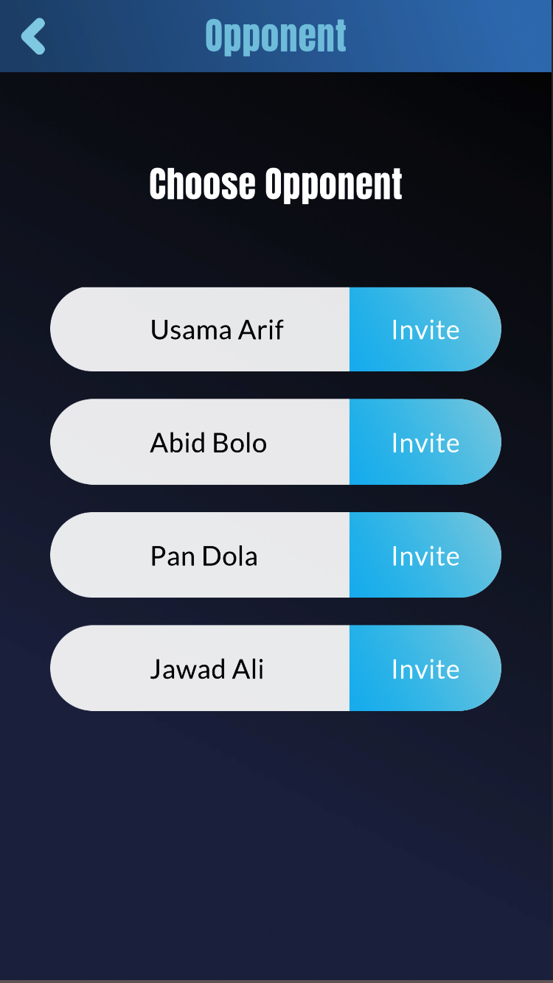
User Interface

Slide 24
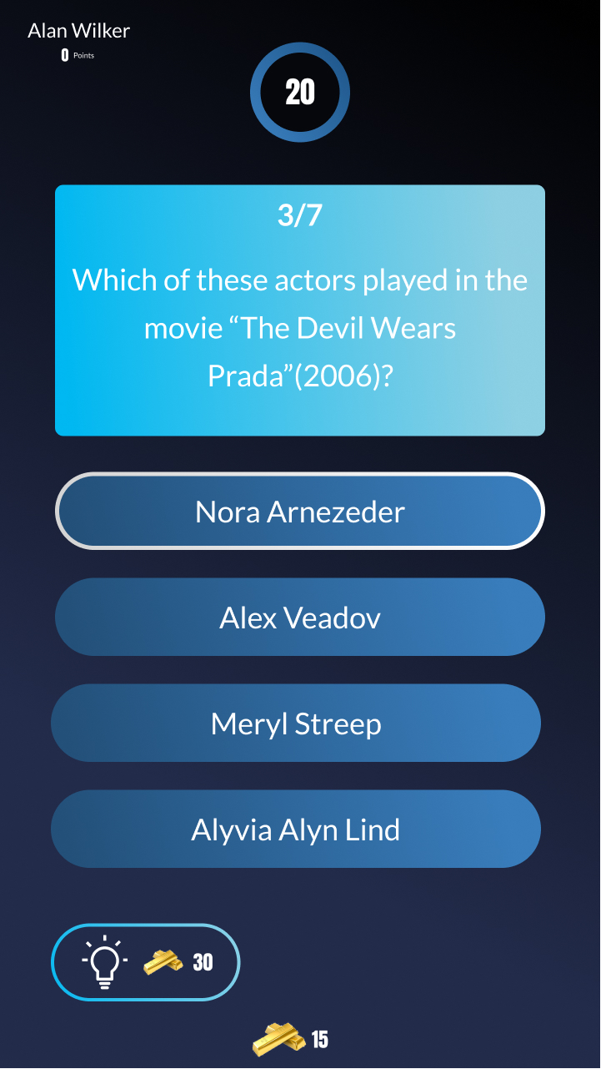
User Interface

Slide 25
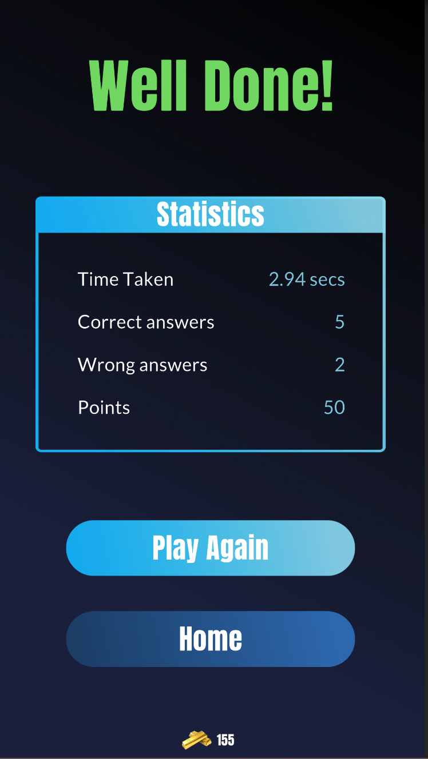
User Interface

Slide 26
Tools
Unity Game Engine
Firebase
C#
Rider IDE / VS Code
Figma

