Slide 1


AN INTELLIGENT BRAILLE SYSTEM
GUIDE NAME : Mr.R.ROSHAN JOSHUA.,M.E. AP/AI
TEAM MEMBERS:
THEJEAL SRI K (811721243057)
SUJAINITHA G (811721243055)
DHIVYA A D (811721243014)
SATHVIKA A (811721243049)
1

Slide 2
OBJECTIVE
To develop a robust Braille image recognition system that accurately extracts and translates Braille text, providing real-time audio output to enhance accessibility for visually impaired individuals.

Slide 3
PROBLEM DEFINITION
Existing System:
Current systems use LSTMs and CNNs for Braille pattern recognition and conversion. However, they struggle with handling complex Braille patterns and providing real-time audio output, often lacking the capability to operate in dynamic environments.
Proposed System:
Our system leverages OpenCV, NumPy, pandas, PySpellChecker, regex (re), and transformers to process and recognize Braille patterns, enhance text conversion accuracy, and enable real-time audio output. This combination of technologies ensures better handling of complex Braille patterns and provides an inclusive solution with instant audio access..

Slide 4
LITERATURE SURVEY
S.NO | PAPER TITLE | AUTHOR NAME | YEAR PUBLISHED | TECHNIQUE USED | DEMERITS
1. | Braille Text to Speech Conversion. | R. Patel, M. Kumar | 2018 | OCR-based Braille text recognition with TTS module. | Limited language support for multilingual Braille.
2. | Assistive Technology for Braille Reading Using Optical Braille Recognition. | J. Lee, P. Singh | 2019 | Optical Braille recognition with TTS for real-time audio feedback. | Inconsistent accuracy in recognizing worn-out Braille.

Slide 5
S.NO | PAPER TITLE | AUTHOR NAME | YEAR PUBLISHED | TECHNIQUE USED | DEMERITS
3. | Deep Learning Strategy for Braille Character Recognition. | T. Sato, Y. Nakamura | 2020 | CNN for feature extraction from Braille images, LSTM for text conversion. | High computational load affecting real-time processing.
4. | Braille Script to Voice Conversion. | A. Gupta, R. Singh | 2021 | Embedded system with text-to-speech for Braille-to-voice messaging. | Limited audio output clarity in noisy environments.

Slide 6
S.NO | PAPER TITLE | AUTHOR NAME | YEAR PUBLISHED | TECHNIQUE USED | DEMERITS
5. | Instant Phonic Braille Recognition System. | M. Li, K. Chen | 2022 | Portable device with tactile sensor for full-area scanning of Braille characters. | Reduced efficiency for complex Braille symbols.
6. | Braille Tactile-to-Auditory Conversion System Based on Self-Learning Flexible Tactile Sensor Array With Attention Mechanism. | X. Wang, Y. Zhou | 2023 | High-density sensor array with attention mechanism for Braille tactile recognition. | Limited adaptability in dynamic lighting conditions. .

Slide 7
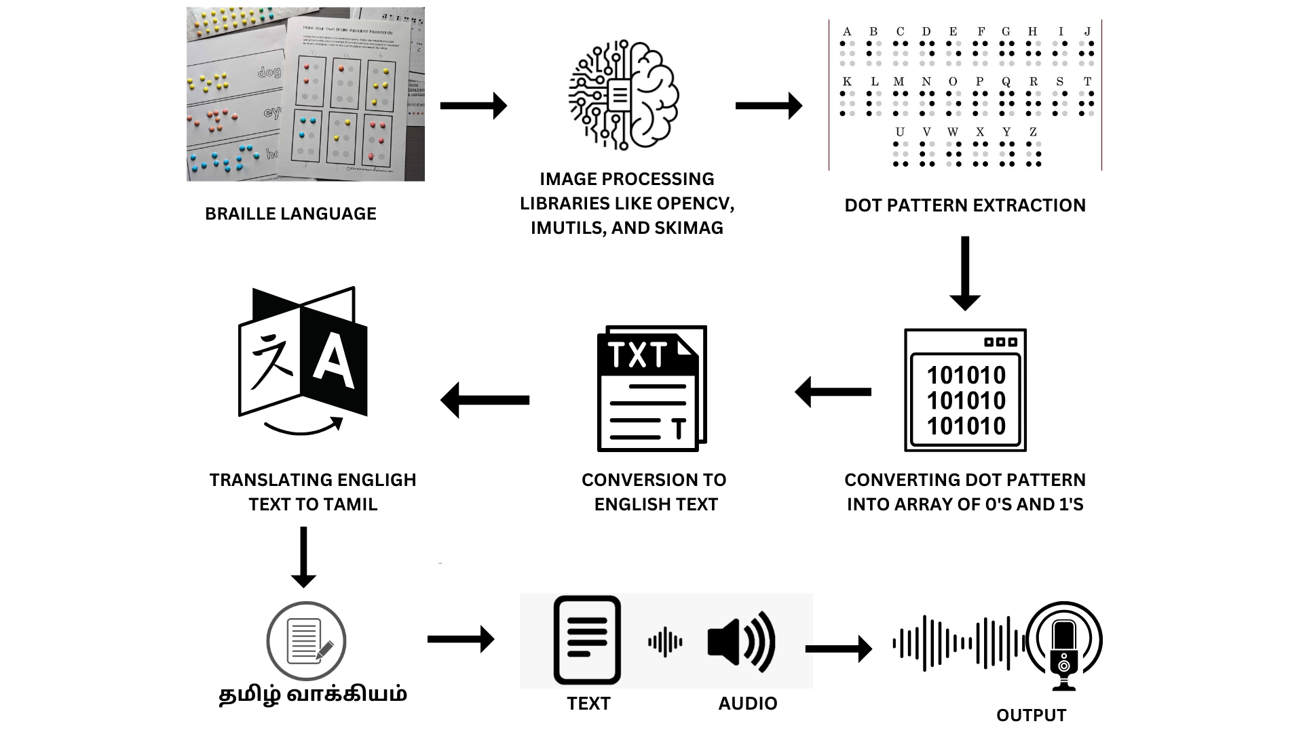
ARCHITECTURE DIAGRAM

Slide 8
SYSTEM SPECIFICATION
HARDWARE SPECIFICATION :
Computer - minimum of 4GB RAM & dual-core processor.
MOBcam - at least 720p & high frame rate of at least 30fps.
Stable internet connection.
Storage.
SOFTWARE SPECIFICATION :
Python programming language - Python 3.x installed on the computer/serve, java .
Operating system – Windows.
Python libraries such as – NumPy , pandas, matplotlib, pyspellchecker, transformers, pillow.
HTML/CSS or JavaScript - for UI design.

Slide 9
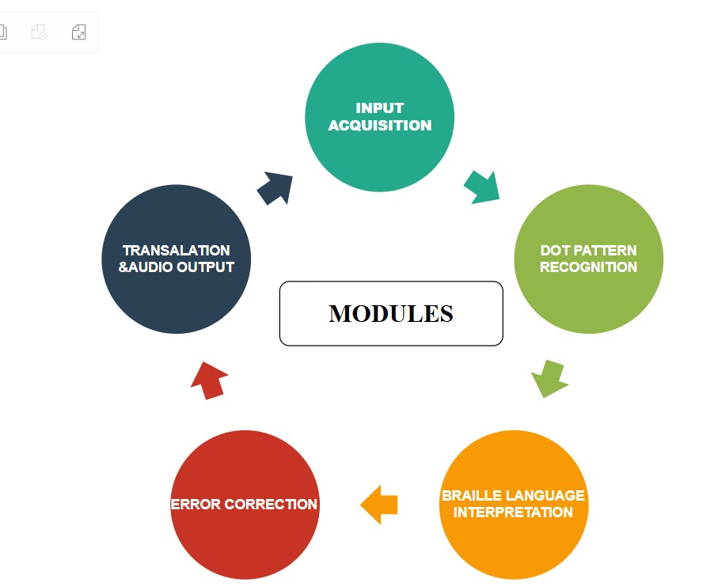
MODULES

Slide 10
INPUT ACQUISITION MODULE
This module captures high-quality images of Braille text, establishing the foundation for accurate interpretation.
Image Capture: Uses advanced camera settings to capture detailed images of Braille text.
Preprocessing: Enhances image quality through contrast and noise adjustments, preparing for analysis.
Accessibility & Efficiency: Streamlines image capture for easy user interaction and accurate data acquisition.
LIBRARIES USED : OpenCV, OS, Pillow.

Slide 11

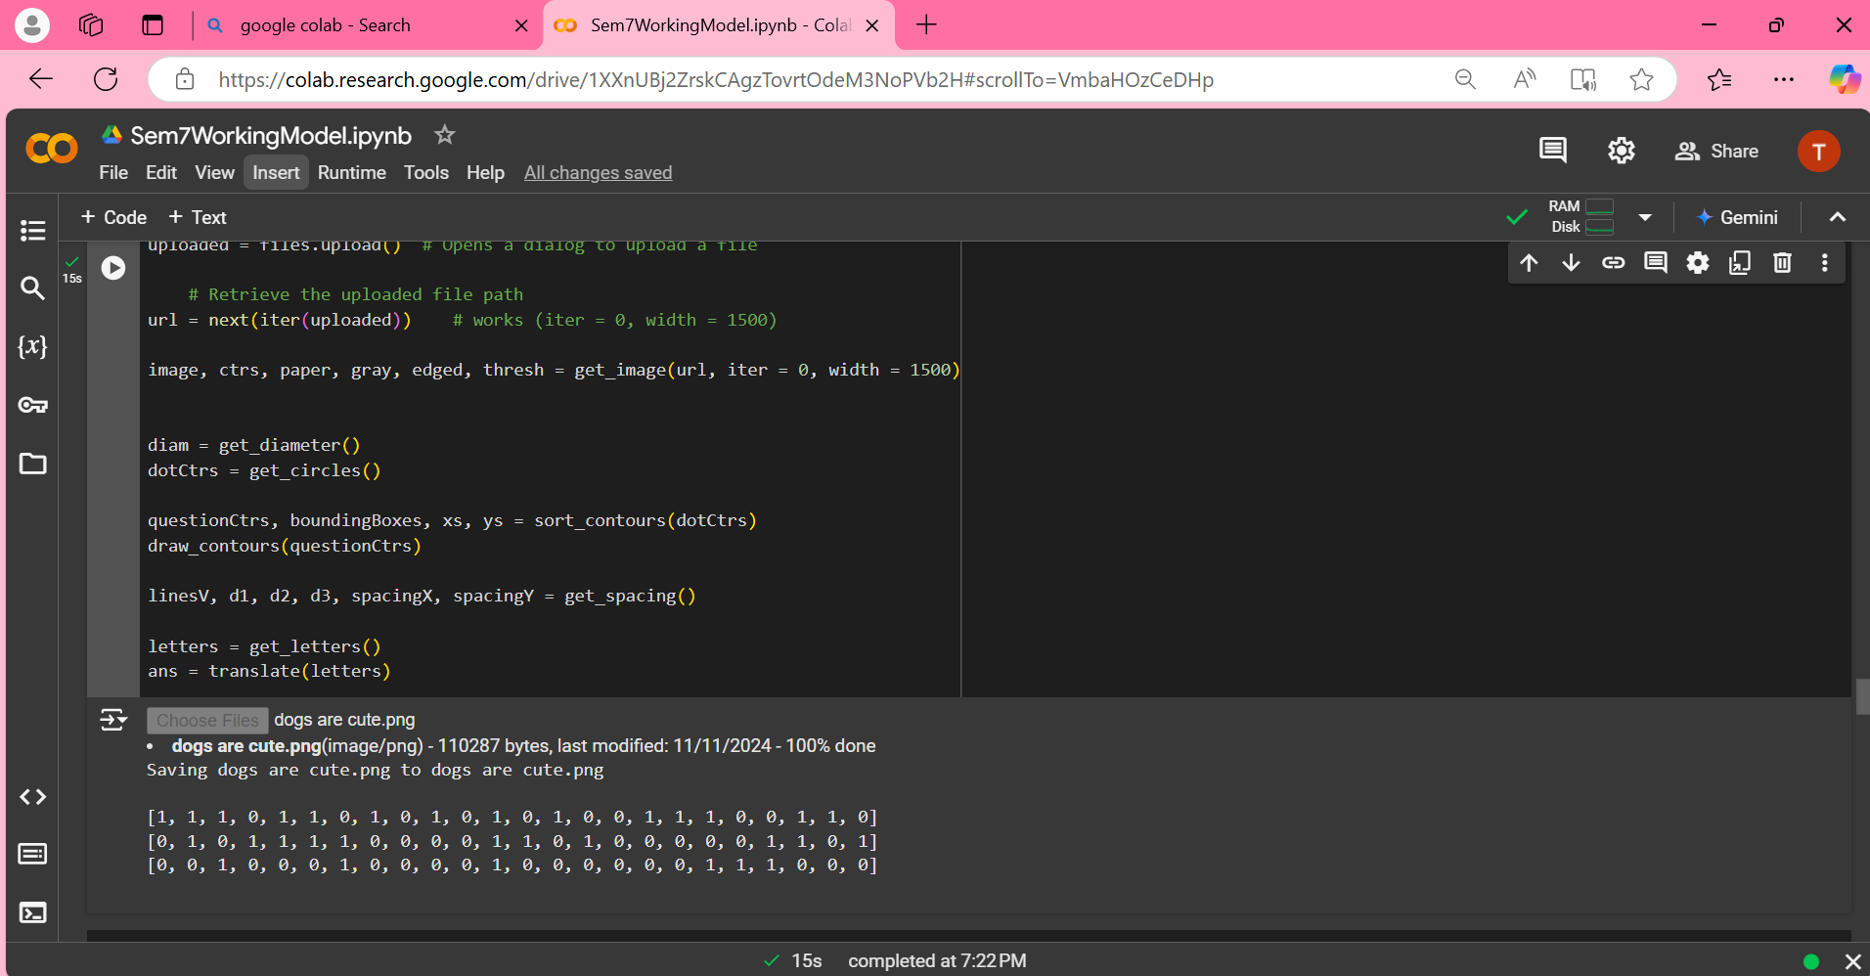

Slide 12
DOT PATTERN RECOGNITION MODULE
This module detects and extracts Braille dot patterns, transforming the captured image into a structured data format.
Dot Detection: Identifies the exact positions of Braille dots within the captured image.
Pattern Extraction: Translates identified dot positions into structured data for further processing.
Accuracy Optimization: Enhances dot recognition across various lighting and background conditions.
LIBRARIES USED : OpenCv, Matplotlib, Mutils, And Skimag.

Slide 13
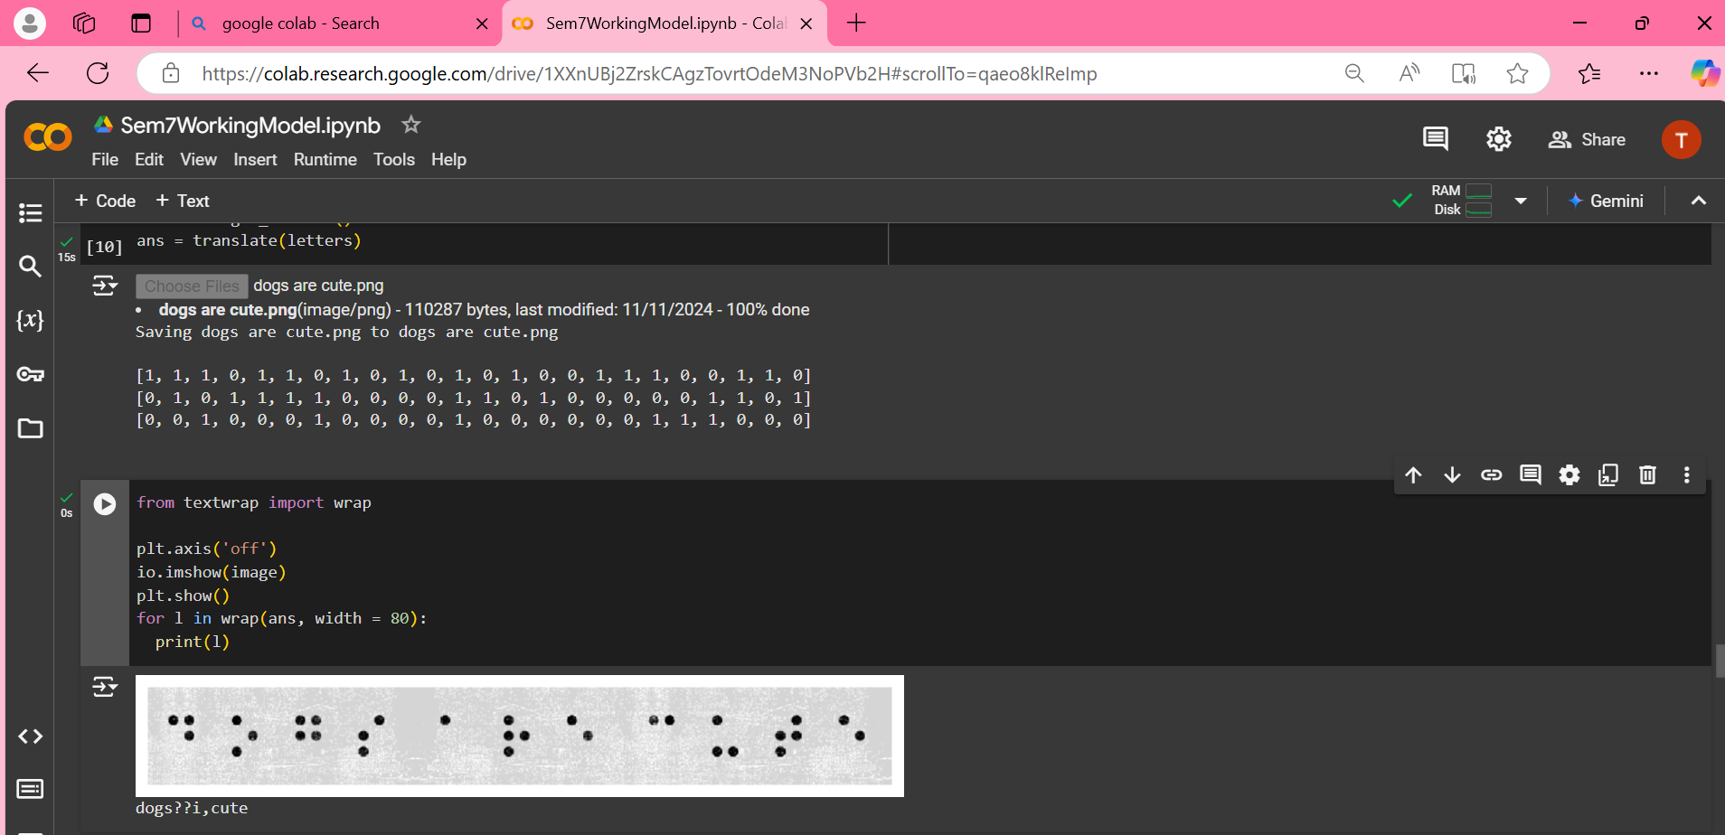

Slide 14
BRAILLE LANGUAGE INTERPRETATION MODULE
This module translates extracted Braille patterns into readable text, bridging Braille and standard language.
Pattern Mapping: Maps specific dot arrangements to corresponding characters in readable text.
Text Conversion: Converts the structured data into coherent text output.
Language Support: Adapts for different Braille languages, ensuring broader accessibility. LIBRARIES USED : NumPy, Regular Expressions.

Slide 15
ERROR CORRECTION MODULE
This module refines translated text by correcting misidentified characters for accuracy.
Character Correction: Identifies and corrects misrecognized letters.
Word Prediction: Utilizes context to correct likely errors in words.
Enhanced Accuracy: Ensures precise translation for readability.
LIBRARIES USED : pyspellchecker, language_tool_python, transformers.

Slide 16
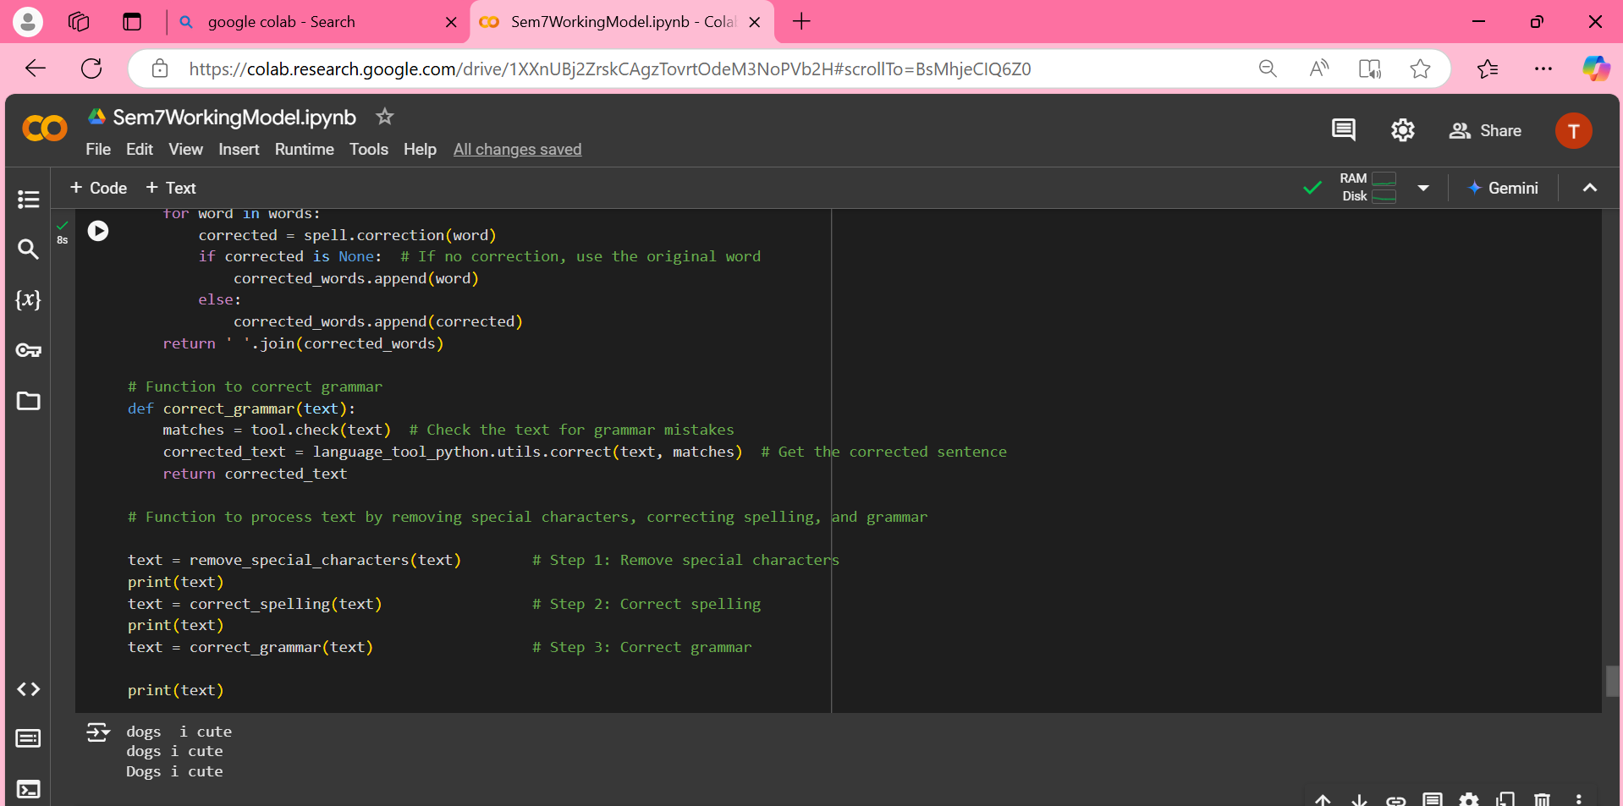

Slide 17
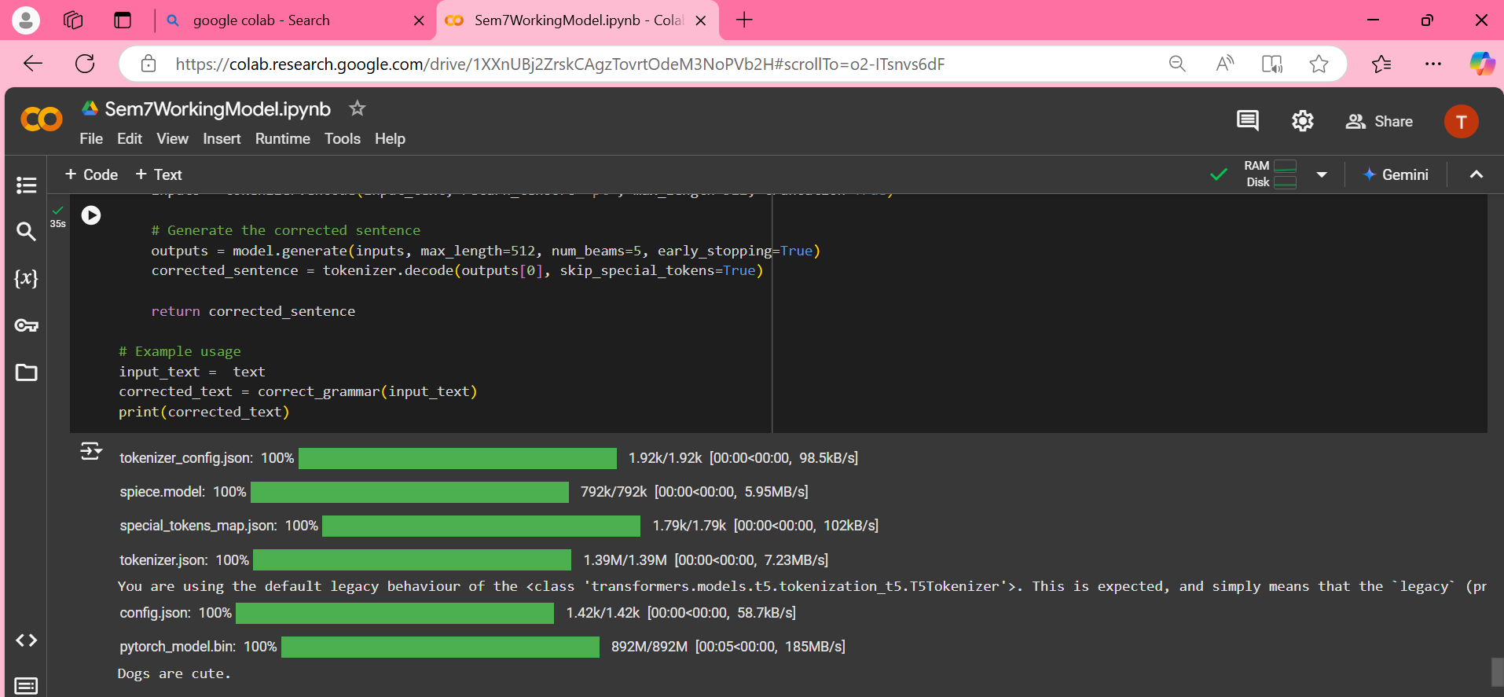

Slide 18
TRANSLATION AND AUDIO OUTPUT MODULE
This module converts final translated text into tamil audio, providing real-time accessibility.
Text-to-Speech Conversion: Transforms readable text into natural-sounding audio output.
User Accessibility: Provides an audio interface that promotes inclusivity and ease of access in language of their choice.
LIBRARIES USED : GoogleTranslator, GTTS (Google Text To Speech)

Slide 19
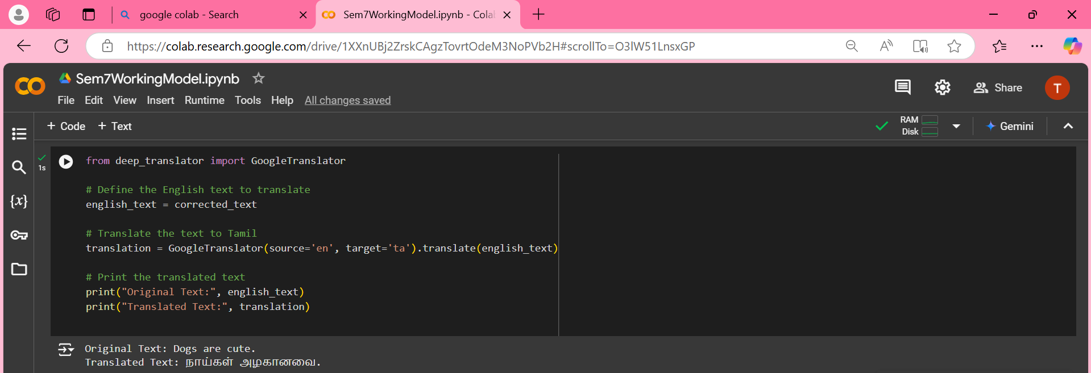
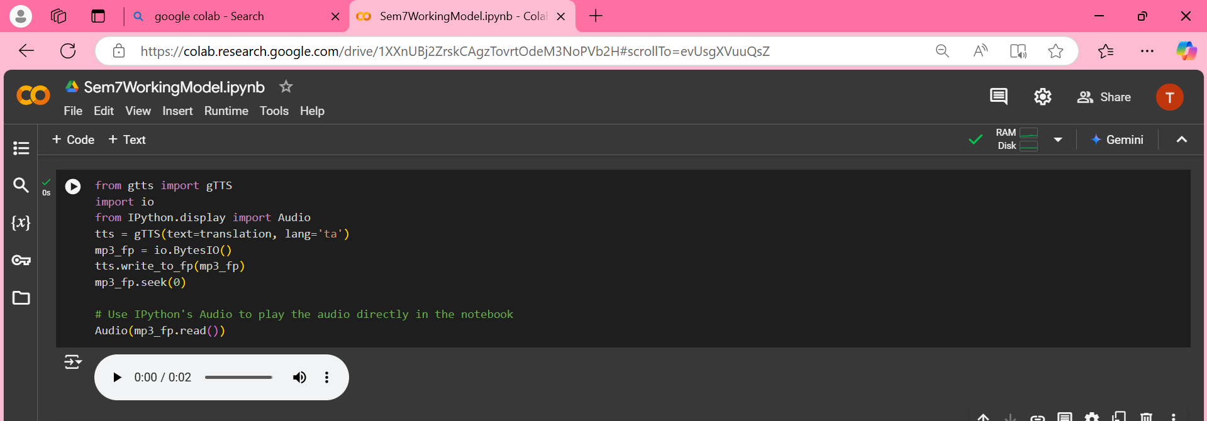

Slide 20
ADVANTAGES
Provides visually impaired users with real-time audio conversion of Braille, allowing them to access written content independently without needing assistance.
Facilitates interaction between Braille and non-Braille users by converting Braille text to audio, enhancing communication and understanding.
Quickly translates Braille into spoken words, enabling users to stay informed and responsive in dynamic environments.
Acts as a bridge to accessible information, empowering users to handle educational, professional, and daily tasks autonomously.

Slide 21
CONCLUSION
This project leverages deep learning to convert Braille to real-time audio, enhancing accessibility for visually impaired users. It promotes independence, enabling seamless access to written information and fostering inclusivity.

Slide 22
REFERENCES
J. Wang, X. Zhou, Y. Chen (2023) Braille tactile-to-audio conversion using deep CNNs and attention mechanisms. vol. 188, pp. 1024–1035.
Z. Li, P. S. Singh (2022) Instant Braille recognition with high-accuracy TTS for real-time applications. vol. 12, no. 3, pp. 345–356.
T. Sato, K. Ito (2021) Enhanced Braille-to-text using CNN-LSTM models for improved audio output. vol. 14, pp. 512–521.
A. Gupta, R. Singh (2021) Speech conversion for Braille recognition and accessibility. vol. 19, pp. 389–396.

Slide 23
THANK YOU

