Slide 1
eRegulations
makes regulations easy to find, read, and understand
Notes:
so cumbersome to get developers to get the tools and environment to contribute, that we worked to wrap everything up more and make that initiation faster

Slide 2
Previously
eRegs dev environment set up takes upwards of ~2 hours
difficult to get oldest version of a regulation because it required a hard-to-find document number
parsing of regulations’ files runs slowly

Slide 3
Now
bootstrap for getting a full eRegs dev environment set up
the oldest version of a regulation can be pulled up by its regulation number and part
system to determine which pieces of code runs slowly

Slide 4
eRegs Dev Environment
Bootstrap

Slide 5
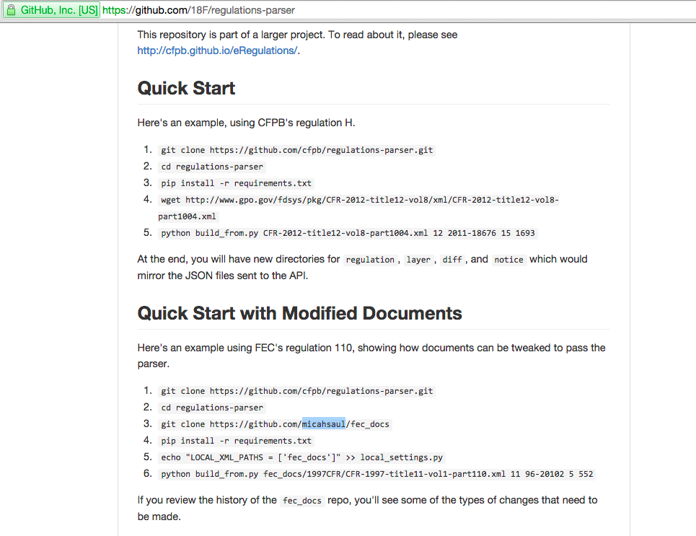

Slide 6
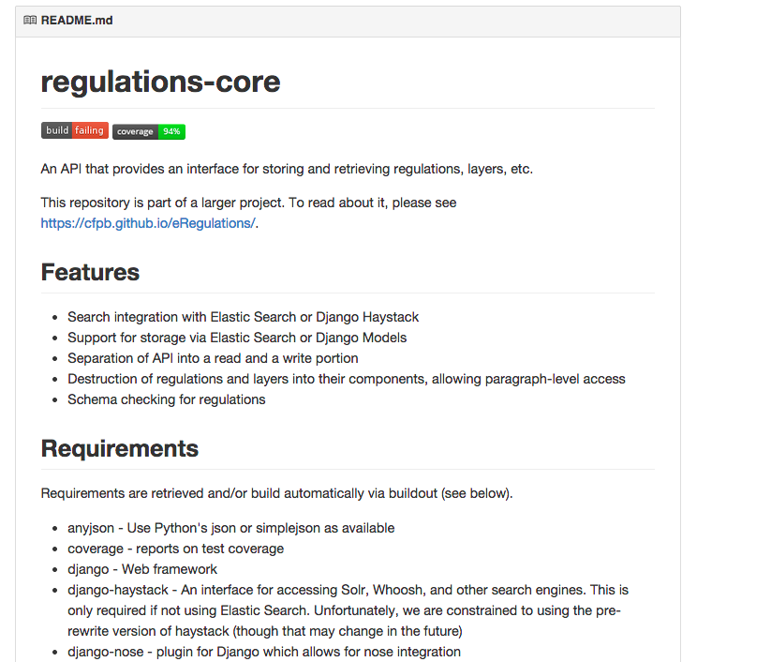

Slide 7
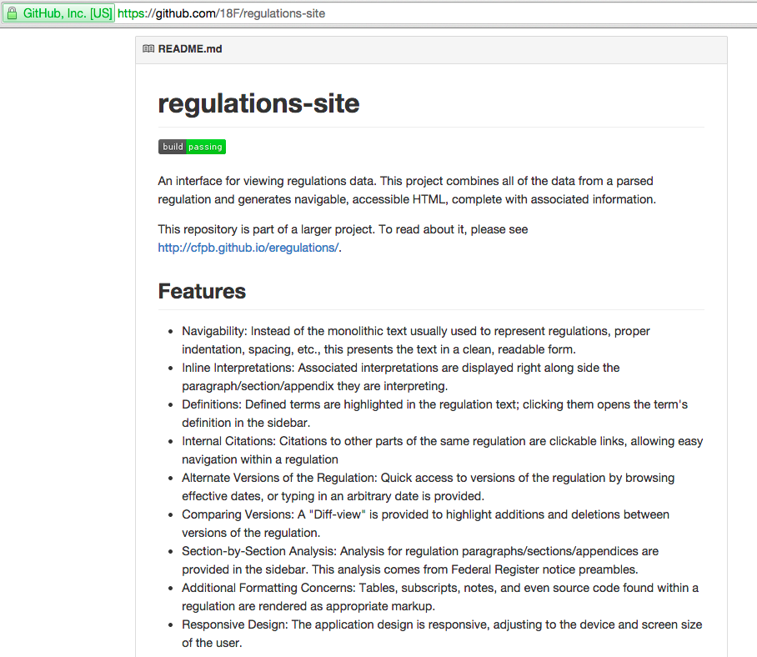

Slide 8
~2+ Hours

Slide 9
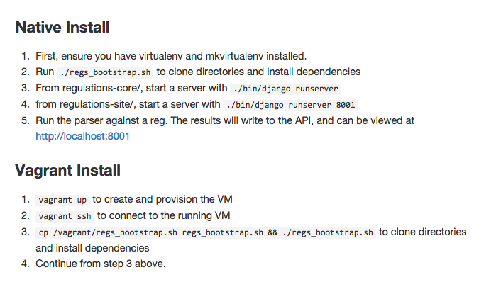

Slide 10
Improved Parser Workflow

Slide 11
Input Before
wget http://www.gpo.gov/fdsys/pkg/CFR-2006-title9-vol1/xml/CFR-2006-title9-vol1-part113.xml

Slide 12
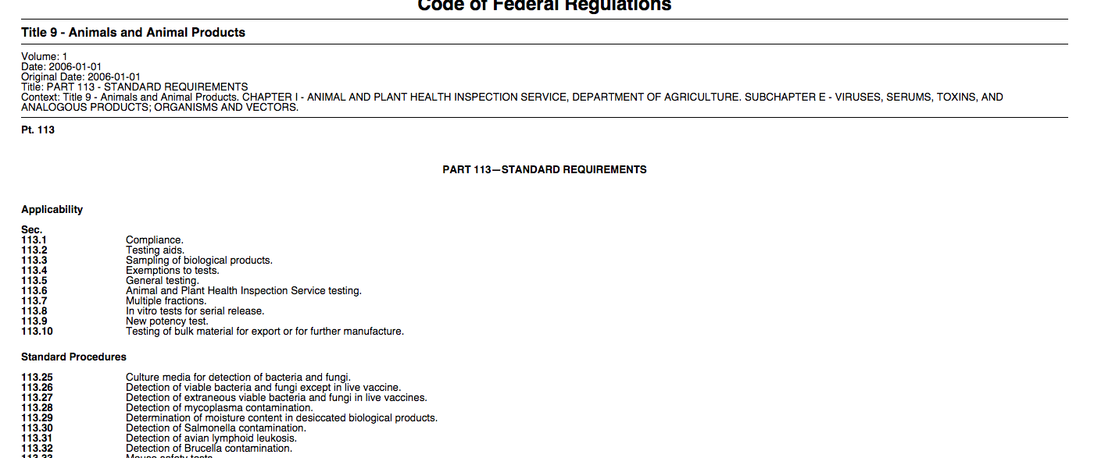

Slide 13

Search “9 CFR 113”

Slide 14
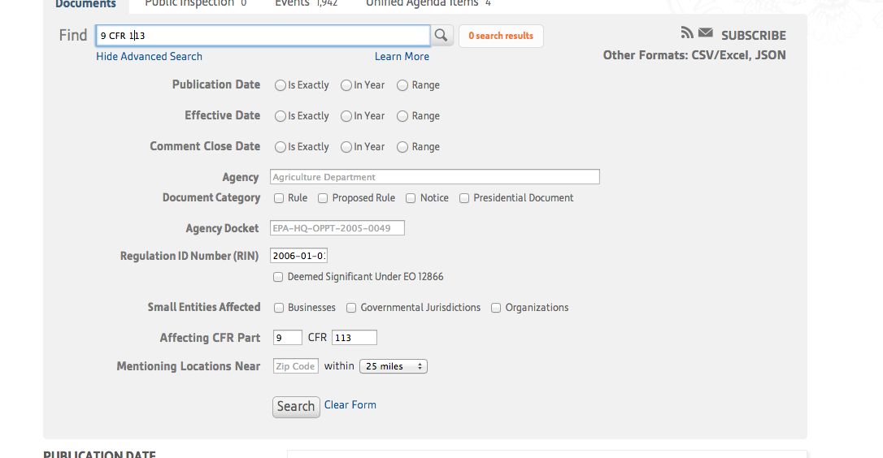

Slide 15
Find Document number on the page of the oldest document before that date
Copy that document number to the parser input
python build_from.py CFR-1997-title11-vol1-part110.xml 11 96-20102 5 552

Slide 16
NOW:
wget http://www.gpo.gov/fdsys/pkg/CFR-2006-title9-vol1/xml/CFR-2006-title9-vol1-part113.xml
python build_from.py CFR-1997-title11-vol1-part110.xml 11 5 552

Slide 17
What We Did:
Use the existing date in the XML structure to
Pull the oldest document number from the Federal Register API

Slide 18
Profiling & Parallelization

Slide 19

Profiling
We knew parsing was slow
But where to make changes?
Used cProfile to measure time spent in each function

Slide 20
Profiling, cont.
Networked calls to external servers slow
Lots of time spent reading XML and building Python objects for XML elements, e.g. “build_notice”
A notice is a change in a regulation

Slide 21
Parallelization
41 consecutive calls to “build_notice” in our (medium-sized) data set
Decided to parallelize
Building independent XML elements could happen simultaneously

Slide 22
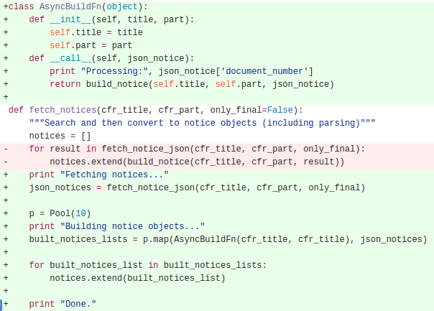
Parallelization, cont.
We did it! but results not conclusive....
Need to test on bigger data sets, with more powerful computer
Cloud computing??

Slide 23
Thank you!
Questions? :)

