Slide 1
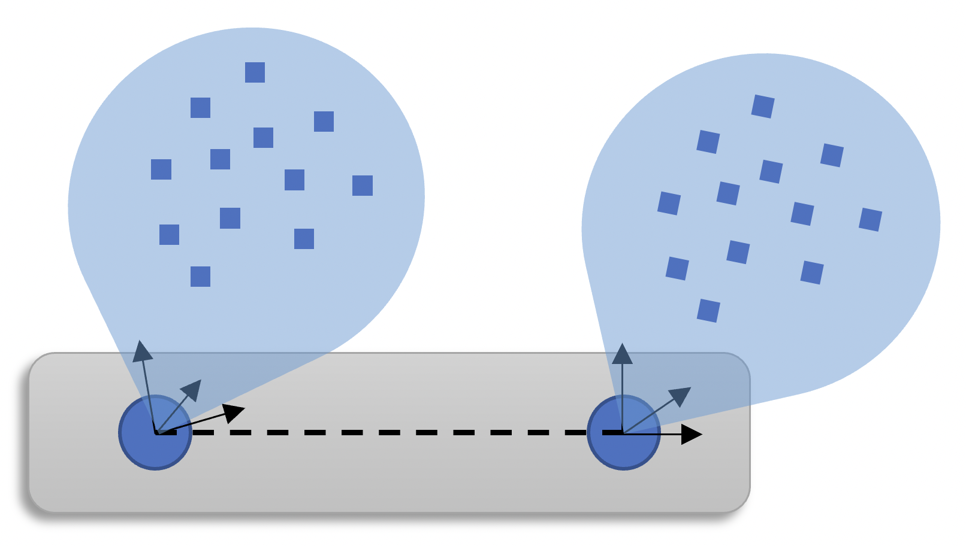








$$t_{k−2}$$
$$t_{k−1}$$
Radar Features $r_{1},θ_{1},φ_{1}, \dot{r_{1}},{RCS}_{1}$
Radar Features $r_{2},θ_{2},φ_{2}, \dot{r_{2}},{RCS}_{2}$
$$ℱ_{r_{1}}$$
$$ℱ_{r_{2}}$$
$$t_{k}$$
Radar 1
$$T,R$$
Radar 2
Rigid Body Connection

Slide 2
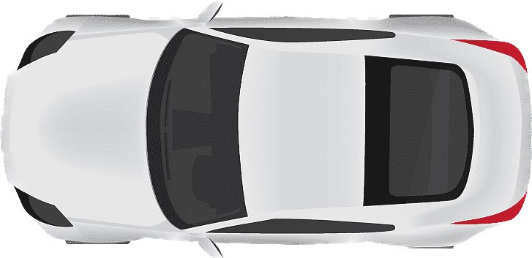


x
$$Θ$$
$$α$$
y

