Slide 1
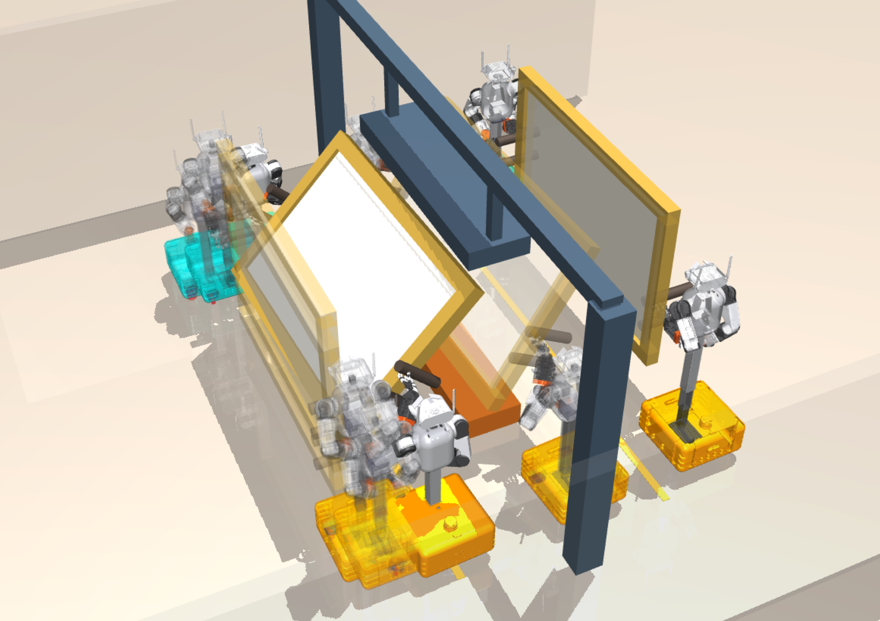
2 Grasp
4 Pitch for clearance
5 Crossing / return
5.2 s
45.0 s · 45° pitch
78.0 s · 32° pitch
1 Approach
0.0 s
6 Goal
128.6 s · 0° pitch
3 Lifted
14.1 s · 0° pitch
MABEL base
MILO base
Object center
Notes:
Source: iros_01_task.pdf. Text, lines and colored regions are editable PowerPoint objects. Simulation scenes remain images. Chart traces are freeform paths, not Excel-linked charts. Compare the included original PNG before export. Math glyphs may use font fallback.

