Slide 1
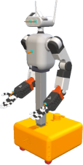







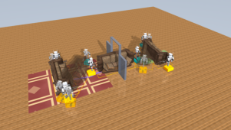
Measured object / hand poses, encoders and local contact forces
Robot & grasp geometry
Shared planning
Shared local actor · 50 Hz
Actuation + contact
Object + goal + assigned rails
Own sensor history + references
23 actions / robot
Base (3) · lift (1) · torso (1)
2 × 7-DoF arms
Joints / fingers · object / hand errors
Arms / wrists (16)
Local load / contact · sensor age
Gripper closure (2)
Dexterous hands
Lift + torso
Holonomic base
A · MABEL
B · MILO
RRT-Connect
MPC · 10 Hz
Motor limits + servos
Spatial schedule: |
ϕ
|≤90
∘
MuJoCo · 500 Hz
π
θ
π
θ
Grasp frame ̄
Finger–rail friction contacts
T
ih
Acquisition supervisor
Same MLP weights; separate histories
Measured motion / forces
Clearance + IK
8×352→128→128→23
Training experience
pose / twist reference
baseline actions
Central training only · PPO
θ
*
Full-mission baseline · separate actor and grasp model
Rollouts + rewards
Privileged critic
SE(2) RRT → MPC (10 Hz) →
21-action local actor
Pose / grasp / stability
Shared actor update
Imitation / DAgger · phase and height supervisor
Critic uses simulator state; actors use local history
Contact-gated welds · MuJoCo 200 Hz
Notes:
Source: iros_02_evaluated.pdf. Text, lines and colored regions are editable PowerPoint objects. Simulation scenes remain images. Chart traces are freeform paths, not Excel-linked charts. Compare the included original PNG before export. Math glyphs may use font fallback.

