Slide 1
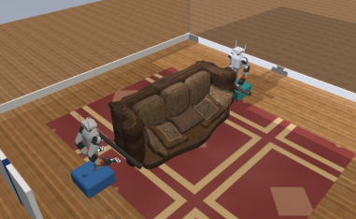
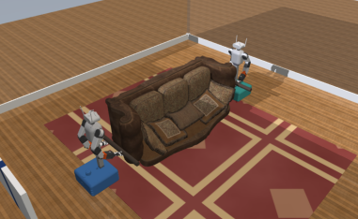
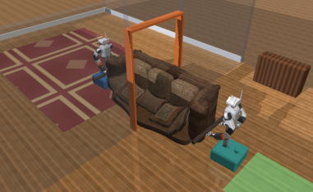
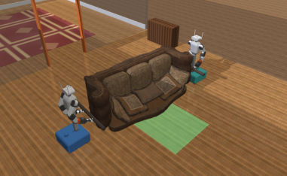
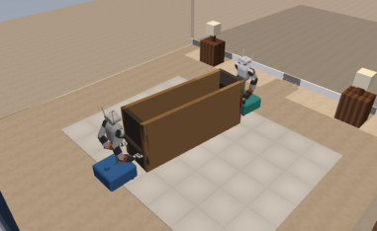
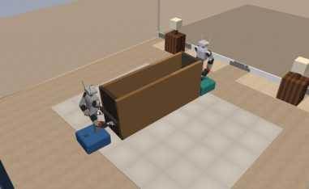
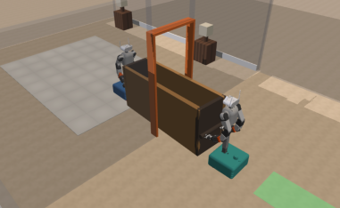
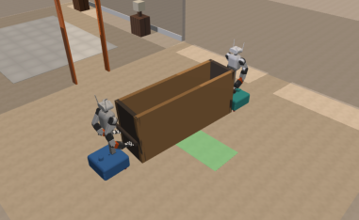
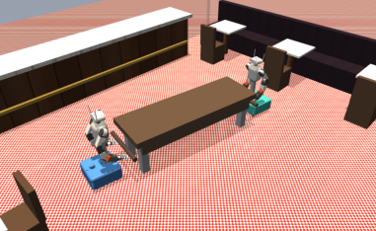
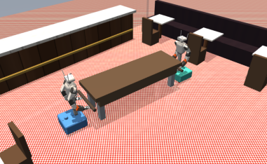
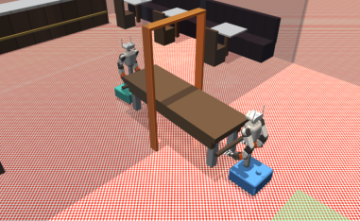
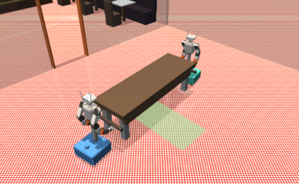
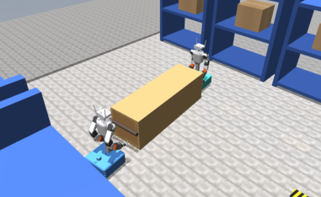
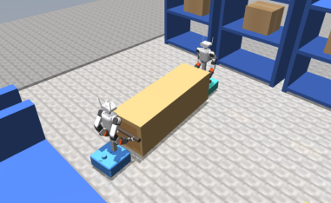
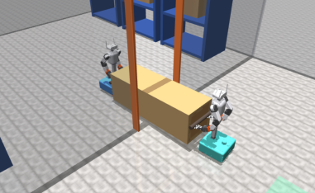
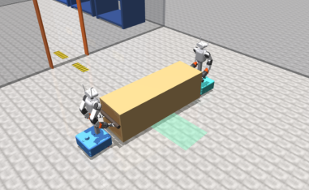
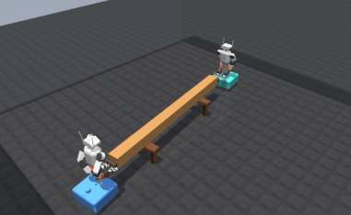
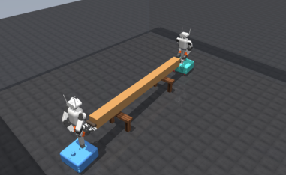
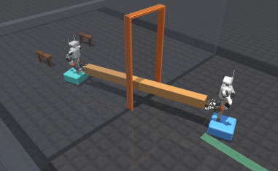
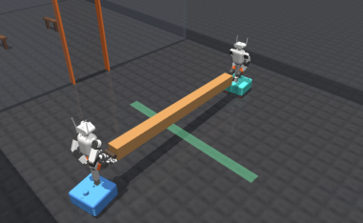
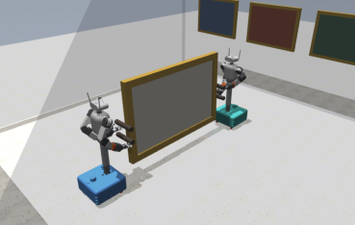
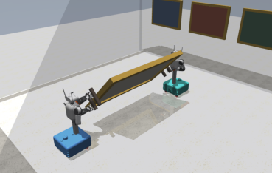
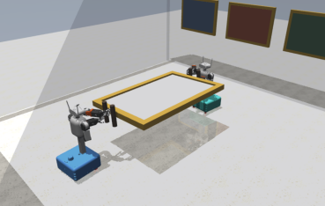
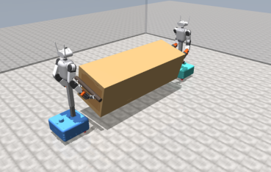
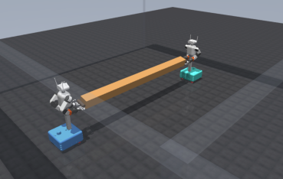
Acquire · 3.7 s
Lift · 8.6 s
Doorway · 55.5 s
Goal · 98.3 s
2
Paths (m)
0
Living room
−2
sofa
Acquire · 5.0 s
Lift · 12.6 s
Doorway · 52.6 s
Goal · 91.1 s
2
0
Bedroom
−2
wardrobe
Acquire · 4.5 s
Lift · 8.9 s
Doorway · 54.2 s
Goal · 96.1 s
2
0
Dining
−2
table
Acquire · 3.6 s
Lift · 9.9 s
Doorway · 55.2 s
Goal · 96.1 s
2
0
Warehouse
−2
crate
Acquire · 8.0 s
Lift · 17.8 s
Doorway · 78.6 s
Goal · 123.6 s
2
0
Workshop
−2
beam
−4
0
4
Panel · lift
Panel · rotate
Panel · hold
Crate · rotate
Beam · rotate
0.1° measured
45.0° measured
88.3° measured
14.9° measured
14.2° measured
Payload
Robot A
Robot B
Plan
Notes:
Source: iros_13_execution.pdf. Text, lines and colored regions are editable PowerPoint objects. Simulation scenes remain images. Chart traces are freeform paths, not Excel-linked charts. Compare the included original PNG before export. Math glyphs may use font fallback.

