Slide 1
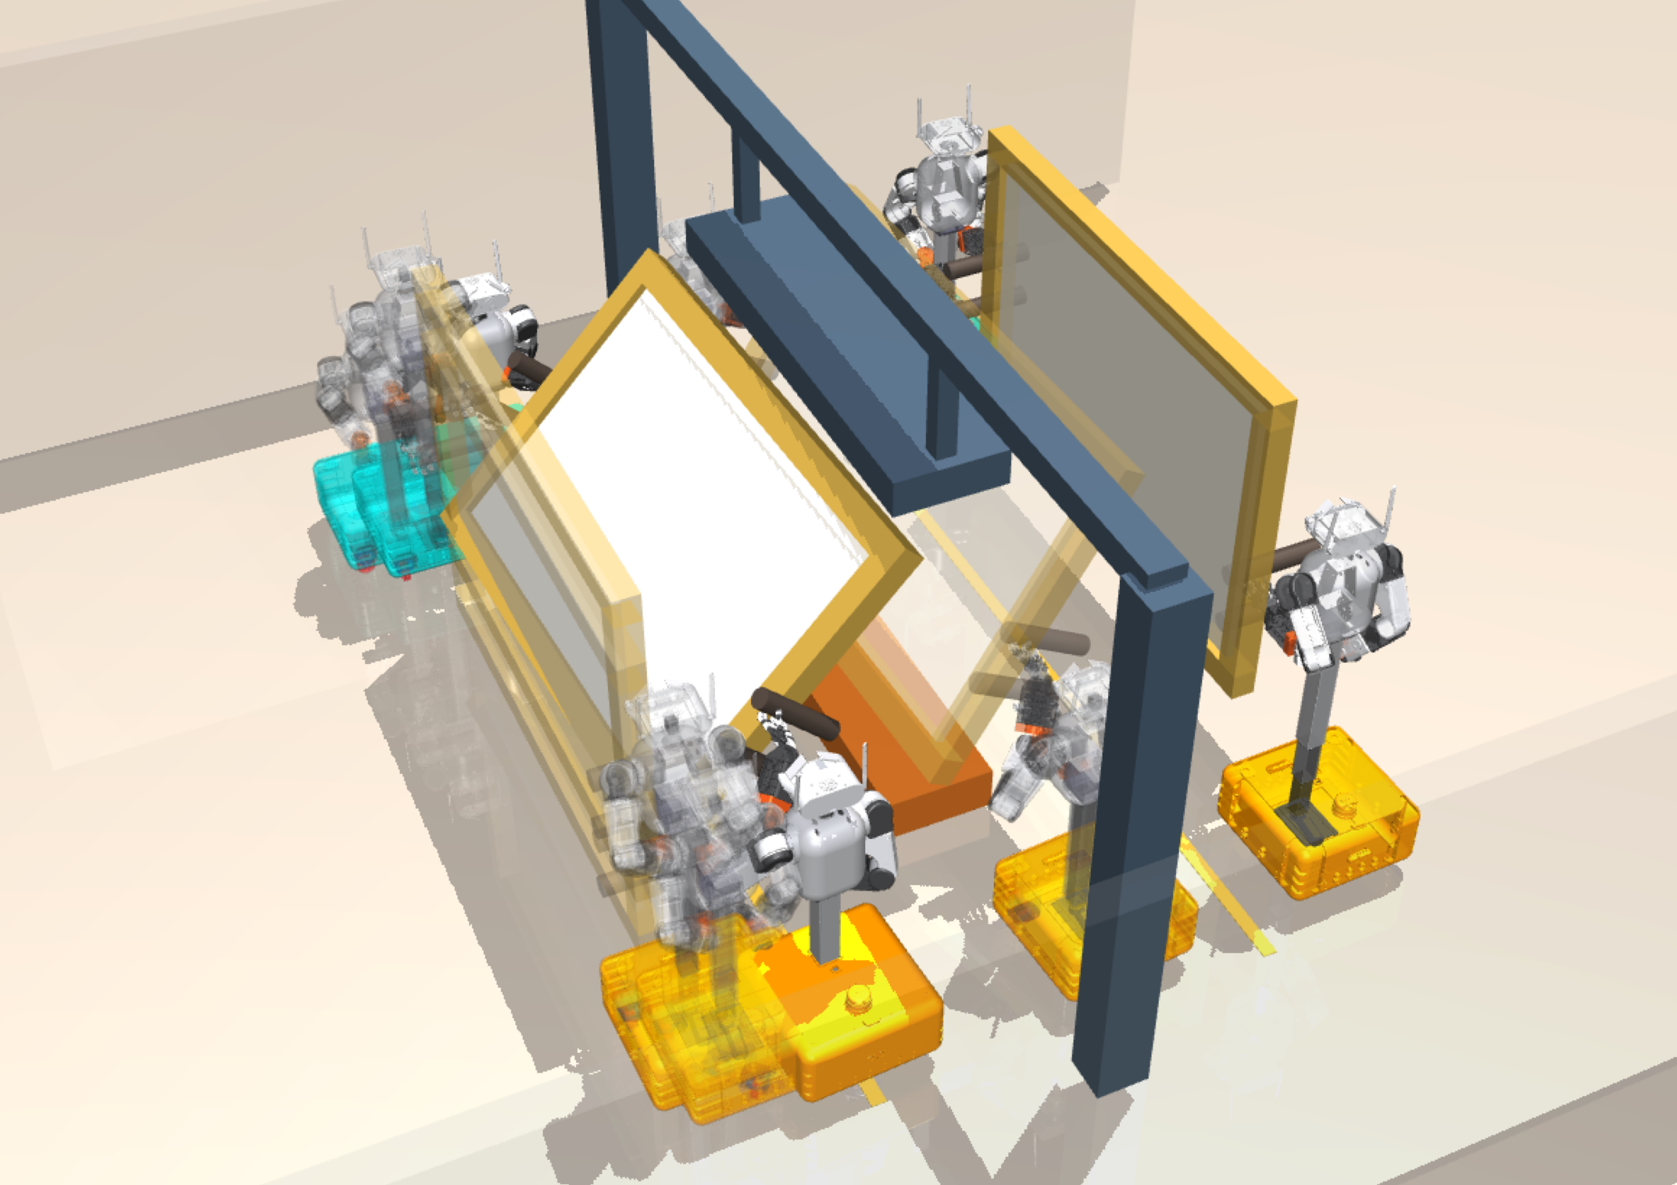
2 Grasp
4 Pitch for clearance
5 Crossing / return
5.2 s
45.0 s · 45° pitch
78.0 s · 32° pitch
1 Approach
0.0 s
6 Goal
128.6 s · 0° pitch
3 Lifted
14.1 s · 0° pitch
MABEL base
MILO base
Object center
Notes:
Source: iros_01_task.pdf. Text, lines and colored regions are editable PowerPoint objects. Simulation scenes remain images. Chart traces are freeform paths, not Excel-linked charts. Compare the included original PNG before export. Math glyphs may use font fallback.

Slide 2
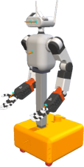







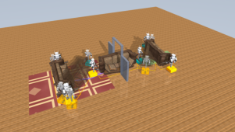
Measured object / hand poses, encoders and local contact forces
Robot & grasp geometry
Shared planning
Shared local actor · 50 Hz
Actuation + contact
Object + goal + assigned rails
Own sensor history + references
23 actions / robot
2 × 7-DoF arms
Joints / fingers · object / hand errors
Base (3) · lift (1) · torso (1)
Local load / contact · sensor age
Arms / wrists (16)
Dexterous hands
Gripper closure (2)
Lift + torso
Holonomic base
A · MABEL
B · MILO
RRT-Connect
MPC · 10 Hz
Motor limits + servos
Spatial schedule: |
ϕ
|≤90
∘
MuJoCo · 500 Hz
π
θ
π
θ
Grasp frame ̄
Finger–rail friction contacts
T
ih
Acquisition supervisor
Same MLP weights; separate histories
Measured motion / forces
Clearance + IK
8×352→128→128→23
Training experience
pose / twist reference
baseline actions
Central training only · PPO
θ
*
Full-mission baseline · separate actor and grasp model
Rollouts + rewards
Privileged critic
SE(2) RRT → MPC (10 Hz) →
Pose / grasp / stability
Shared actor update
21-action local actor
Imitation / DAgger · phase and height supervisor
Critic uses simulator state; actors use local history
Contact-gated welds · MuJoCo 200 Hz
Notes:
Source: iros_02_evaluated.pdf. Text, lines and colored regions are editable PowerPoint objects. Simulation scenes remain images. Chart traces are freeform paths, not Excel-linked charts. Compare the included original PNG before export. Math glyphs may use font fallback.

Slide 3
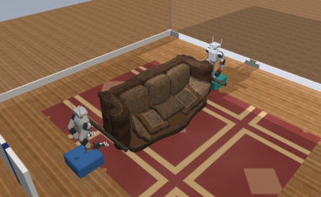
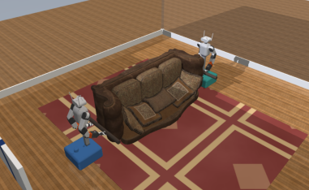
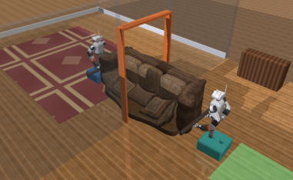
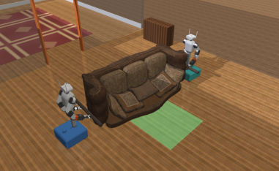
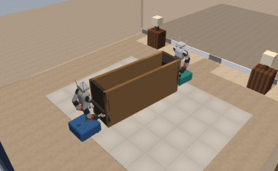
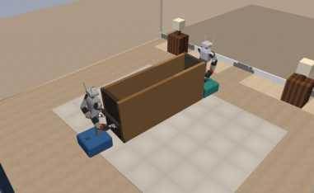
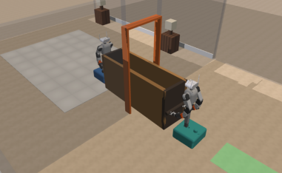
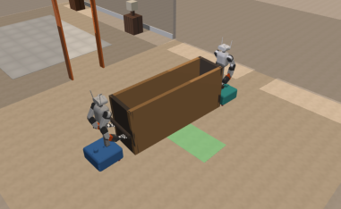
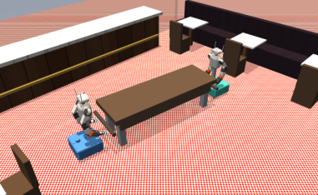
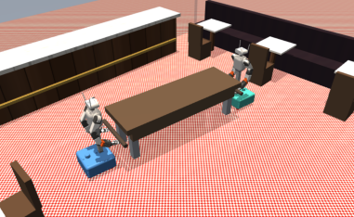
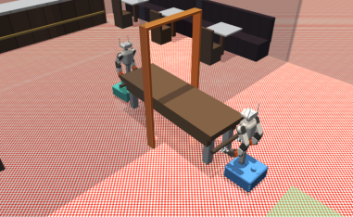
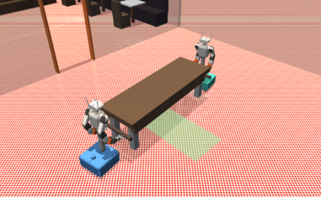
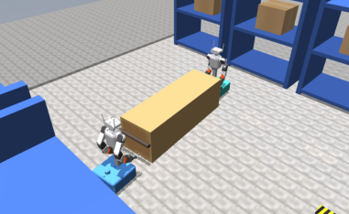
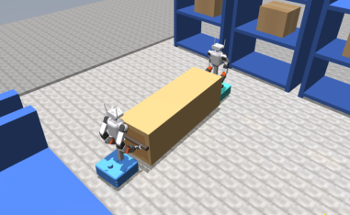
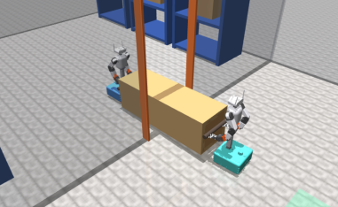
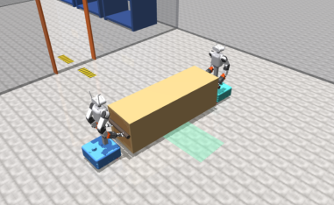
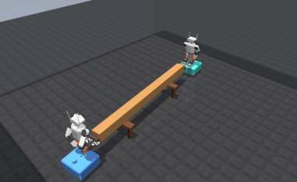
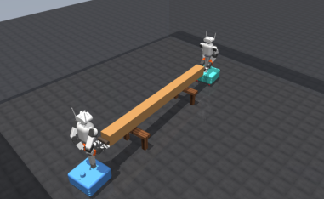
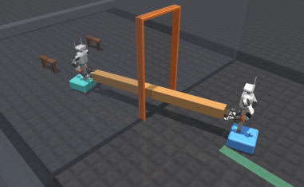
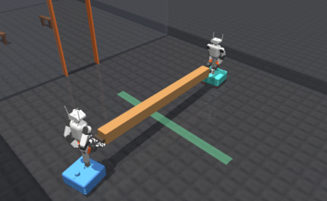
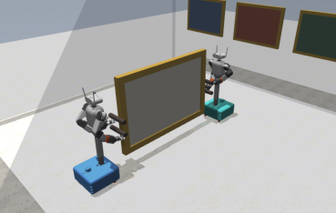
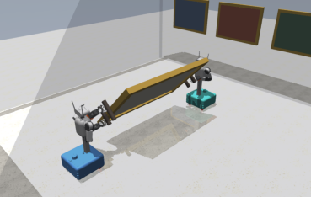
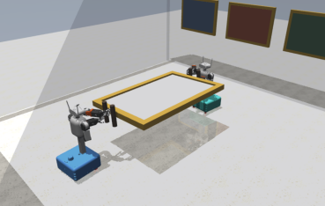
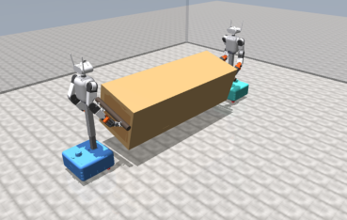
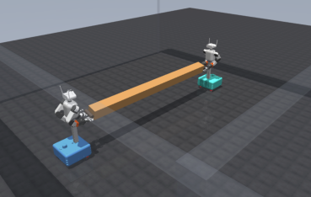
Acquire · 3.7 s
Lift · 8.6 s
Doorway · 55.5 s
Goal · 98.3 s
2
Paths (m)
0
Living room
−2
sofa
Acquire · 5.0 s
Lift · 12.6 s
Doorway · 52.6 s
Goal · 91.1 s
2
0
Bedroom
−2
wardrobe
Acquire · 4.5 s
Lift · 8.9 s
Doorway · 54.2 s
Goal · 96.1 s
2
0
Dining
−2
table
Acquire · 3.6 s
Lift · 9.9 s
Doorway · 55.2 s
Goal · 96.1 s
2
0
Warehouse
−2
crate
Acquire · 8.0 s
Lift · 17.8 s
Doorway · 78.6 s
Goal · 123.6 s
2
0
Workshop
−2
beam
−4
0
4
Panel · lift
Panel · rotate
Panel · hold
Crate · rotate
Beam · rotate
0.1° measured
45.0° measured
88.3° measured
14.9° measured
14.2° measured
Payload
Robot A
Robot B
Plan
Notes:
Source: iros_13_execution.pdf. Text, lines and colored regions are editable PowerPoint objects. Simulation scenes remain images. Chart traces are freeform paths, not Excel-linked charts. Compare the included original PNG before export. Math glyphs may use font fallback.

Slide 4
(a) Available grasp placements
(b) Matched 20,000-iteration search
Bedroom
0.53
30
○ verified × unsuccessful
5/16 verified
16/16 verified
Apartment
0.64
0.85
25
Living room
Dining
1.87
20
Beam
2.02
Collision-check calls (thousands)
15
Office
2.68
Crate
3.26
10
Dock
4.17
5
Panel
4.32
0
0
1
2
3
4
5
Uniform
Aperture-biased
Layouts passing geometric screen (%)
Notes:
Source: journal_grasp_search.pdf. Text, lines and colored regions are editable PowerPoint objects. Simulation scenes remain images. Chart traces are freeform paths, not Excel-linked charts. Compare the included original PNG before export. Math glyphs may use font fallback.

Slide 5
Object only
Assembly
(a) Projected footprint
(b) Admissible yaw
2
5.5° assembly window
0°: assembly fits
Width (m)
1
10°: only object fits
0
−20
0
20
Yaw (deg)
Notes:
Source: iros_03_geometry.pdf. Text, lines and colored regions are editable PowerPoint objects. Simulation scenes remain images. Chart traces are freeform paths, not Excel-linked charts. Compare the included original PNG before export. Math glyphs may use font fallback.

Slide 6
(a) Failure localization
(b) 31 doorway passes
(c) Formation variation
40
150
1.0
40
37
36
35
35
125
0.8
100
Missions (40 starts)
Measured minimum (mm)
0.6
75
Fraction of 35 passes
20
0.4
50
20 mm
25
0.2
margin
0
0
0.0
Start
Attach
Lift
Route
Goal
0
50
100
150
0
10
20
30
40
Planned minimum (mm)
Maximum carrier drift (mm)
Notes:
Source: journal_mission_evidence.pdf. Text, lines and colored regions are editable PowerPoint objects. Simulation scenes remain images. Chart traces are freeform paths, not Excel-linked charts. Compare the included original PNG before export. Math glyphs may use font fallback.

Slide 7
Planner
Object
50
Roll (°)
0
0
10
20
30
40
50
F
F
F
x
y
z
Robot A · left
Robot A · right
100
100
Force (N)
0
0
−100
−100
Robot B · left
Robot B · right
250
0
Force (N)
0
−250
0
20
40
0
20
40
A · left
A · right
B · left
B · right
100
‖ (N m)
50
τ
‖
0
0
10
20
30
40
50
Time after reference activation (s)
Notes:
Source: iros_14_force_response.pdf. Text, lines and colored regions are editable PowerPoint objects. Simulation scenes remain images. Chart traces are freeform paths, not Excel-linked charts. Compare the included original PNG before export. Math glyphs may use font fallback.

Slide 8

(a) Worst-case support steps
(b) Learning and frozen evaluation
(c) Retained target accuracy
100
1.0
-60
0
302
80
200/200
0.8
60
Stochastic training
0.6
Palm height offset (mm)
296
300
Success (%)
(last 20 episodes)
Fraction of 200 trials
-65
Nominal frozen test
40
0.4
-70
303
297
20
0.2
Object
0
Worst hand
0.0
70
80
0
20
40
60
80
0
10
20
30
40
Forward offset (mm)
Environment steps (thousands)
Terminal position error (mm)
Notes:
Source: journal_native_learning.pdf. Text, lines and colored regions are editable PowerPoint objects. Simulation scenes remain images. Chart traces are freeform paths, not Excel-linked charts. Compare the included original PNG before export. Math glyphs may use font fallback.

