Slide 1
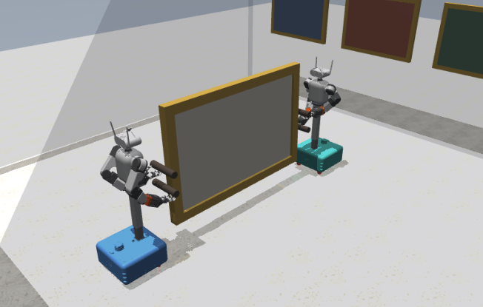
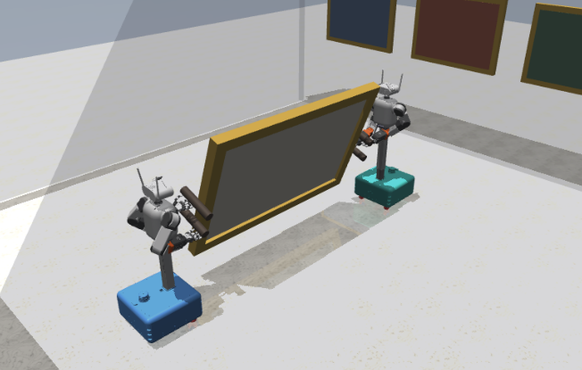
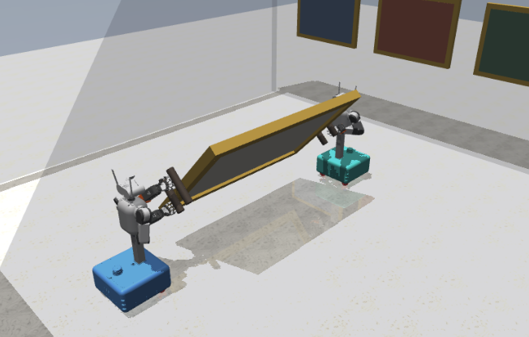


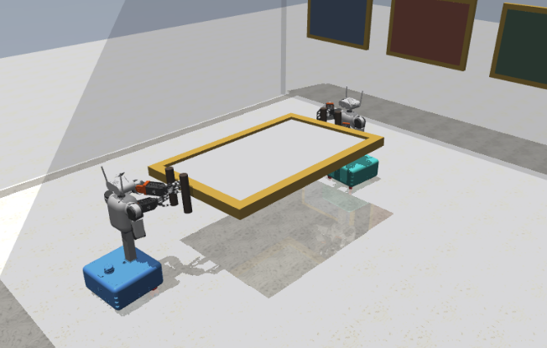
1 Raised
2 Rotate
3 Hold
45° goal · teacher
0.2° measured
22.5° measured
44.3° measured
1 Raised
2 Rotate
3 Hold
90° goal · teacher
0.1° measured
45.0° measured
88.3° measured
Notes:
Source: iros_09_reorientation.pdf. Text, lines and colored regions are editable PowerPoint objects. Simulation scenes remain images. Chart traces are freeform paths, not Excel-linked charts. Compare the included original PNG before export. Math glyphs may use font fallback.

