Slide 1
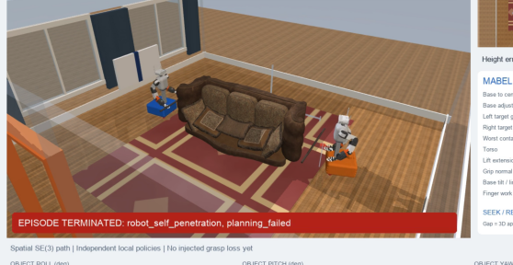
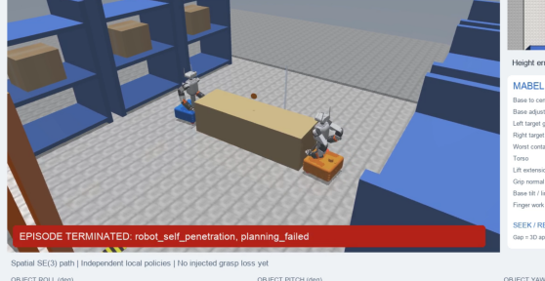
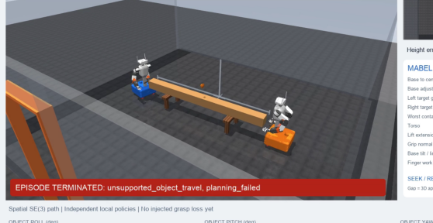
Couch · failed
Crate · failed
Beam · failed
A · L
A · R
B · L
B · R
400
140
200
300
120
Palm error (mm)
100
150
200
80
100
100
60
50
0
1
2
3
4
5
0
1
2
3
4
5
6
0
1
2
3
1
1
1
Qualified contact
0
0
0
0
1
2
3
4
5
0
1
2
3
4
5
6
0
1
2
3
Time (s)
Time (s)
Time (s)
Notes:
Source: iros_15_grasp_failures.pdf. Text, lines and colored regions are editable PowerPoint objects. Simulation scenes remain images. Chart traces are freeform paths, not Excel-linked charts. Compare the included original PNG before export. Math glyphs may use font fallback.

