Slide 1
Indoor Positioning using Ultra-Wideband Ranging Systems Progress Report #1 ENGO 500: Trilateration Nation
Team Members: Paul Gratton, Jamie Horrelt, Katherine Pexman, Jeffrey Plett
Supervisor: Dr. Kyle O’Keefe
January 15, 2019

Slide 2
Presentation Overview
Project Overview
Milestone Summary
Work Accomplished
Proof of Concept
Control Survey
Android Application
Changes to Work Plan
Lessons Learned
Notes:
PUAL

Slide 3
Project Overview
Ultra-wideband ranging radios
Real-time location system
Android application
Decawave mdek1001 [1]
Notes:
JEFF

Slide 4
Milestone Summary
 | Components | Planned Delivery Date | Actual Delivery Date
1 | Project Proposal Presentation | 2018-10-31 | 2018-10-31
2 | Phase 1 Proof of Concept | 2018-11-30 | 2018-11-30
3 | Control Survey of Testing Environment* | 2018-12-07 | 2018-12-10
4 | Phase 2 Proof of Concept* | 2019-01-15 | In Progress
5 | Basic App Documentation | 2018-11-30* | In Progress
6 | Data Stream Documentation | 2019-01-31* | -
7 | Data Stream Integration into Android App | 2019-03-01 | -
Notes:
Jamie
*These items/dates that are starred have been changed from project proposal and will be discussed further in changes to workplan

Slide 5
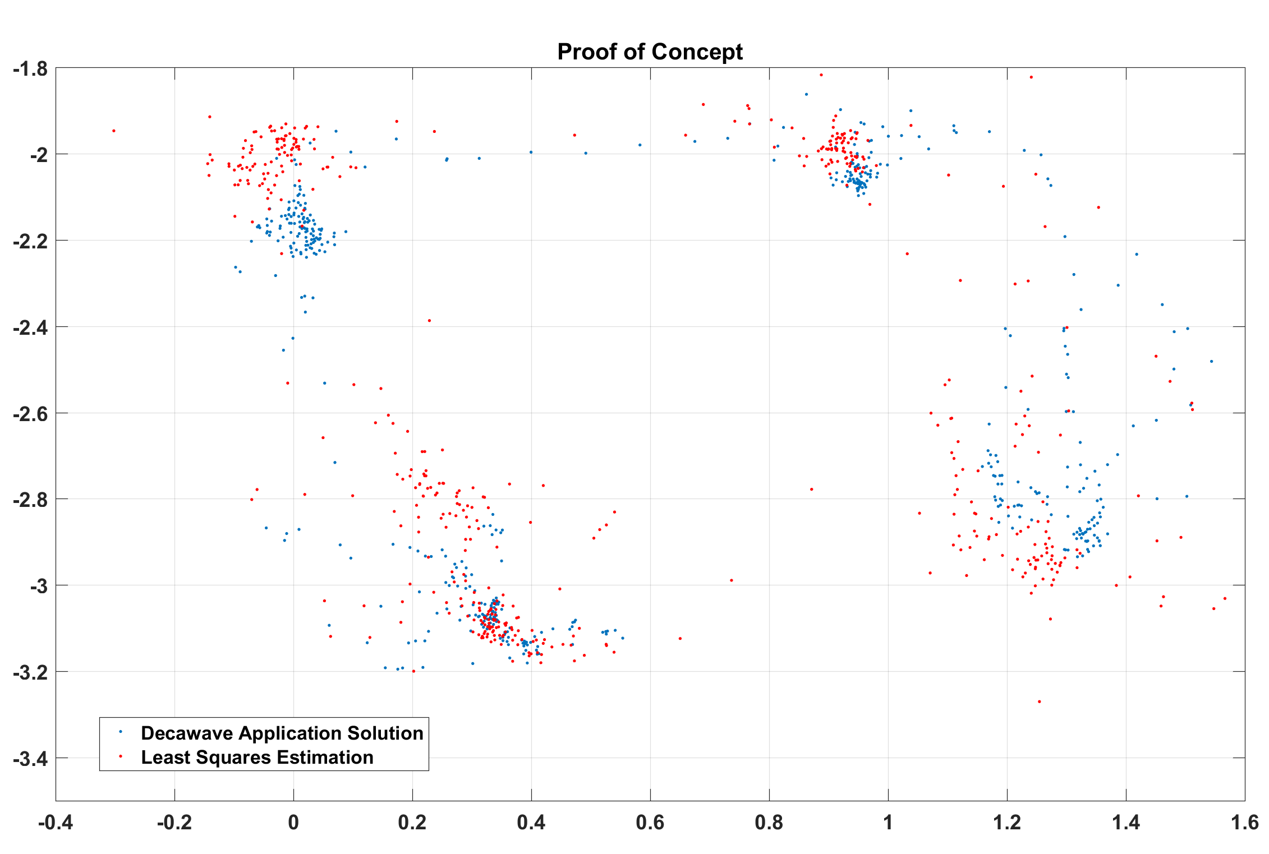
Work Accomplished: Proof of Concept
Position Estimation
Post Processed least squares estimation
Results
Issues
Notes:
Jamie

Slide 6
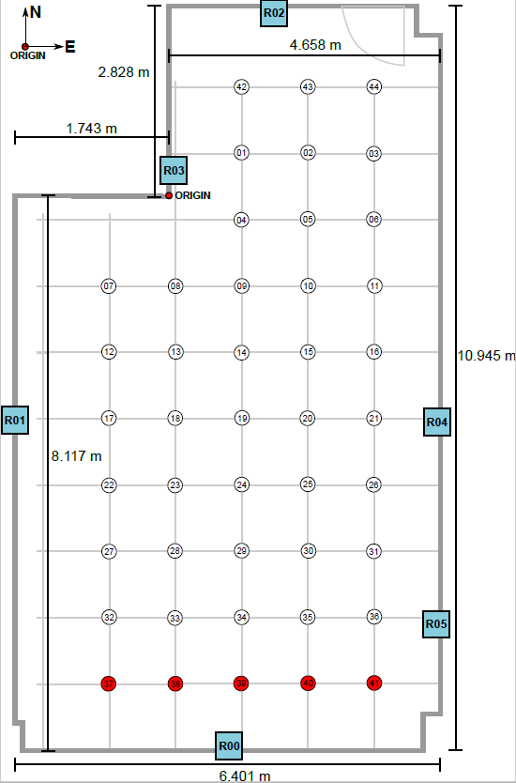
Work Accomplished: Control Survey
Notes:
Paul
Work Accomplished: Control Survey, Next steps for code improvement

Slide 7

Work Accomplished: Android Application
Android framework studied
decaWave application source code studied
Notes:
Work Accomplished: Android Studio Progress

Slide 8
Changes to Work Plan
Control survey of testing environment milestone has been added
Phase 2 Proof of Concept has been added
Delivery date of basic app documentation has been changed
Delivery date of data stream documentation has been changed
Notes:
KATE

Slide 9



Lessons Learned
Communication
Time Management
Technical development and adaptation
Notes:
Kate

Slide 10
References
[1]“MDEK1001 – decaWave”, decaWave.com, 2018. [Online].

