Slide 1
Indoor Positioning using Ultra-Wideband Ranging Systems Progress Report #1 ENGO 500: Trilateration Nation
Team Members: Paul Gratton, Jamie Horrelt, Katherine Pexman, Jeffrey Plett
Supervisor: Dr. Kyle O’Keefe
January 15, 2019

Slide 2
Presentation Overview
Project Overview
Milestone Summary
Work Accomplished
Proof of Concept
Control Survey
Android Application
Changes to Work Plan
Lessons Learned
Notes:
PUAL

Slide 3
Project Overview
Ultra-wideband ranging radios
Real-time location system
Android application
Decawave mdek1001 [1]
Notes:
JEFF

Slide 4
Milestone Summary
 | Components – Deliverables | Planned Delivery Date | Actual Delivery Date
1 | Project Proposal Presentation | 2018-10-31 | 2018-10-31
2 | Phase 1 Proof of Concept | 2018-11-30 | 2018-11-30
3 | Control Survey of Testing Environment* | 2018-12-07 | 2018-12-10
4 | Phase 2 Proof of Concept* | 2019-01-15 | In Progress
5 | Basic App Documentation | 2018-11-30* | In Progress
6 | Data Stream Documentation | 2019-01-31* | -
7 | Data Stream Integration into Android App | 2019-03-01 | -
Notes:
Here is our milestone summary. The items and dates that are starred have been added or modified from our project proposal. The highlight of this progress report is item 2 on our milestone list, the phase 1 proof of concept. With this step completed, we now have an initial working product to be modified and improved throughout the remainder of the project. We will now discuss the main components of our milestones through our work accomplished and changes made up to this point in our project.

Slide 5
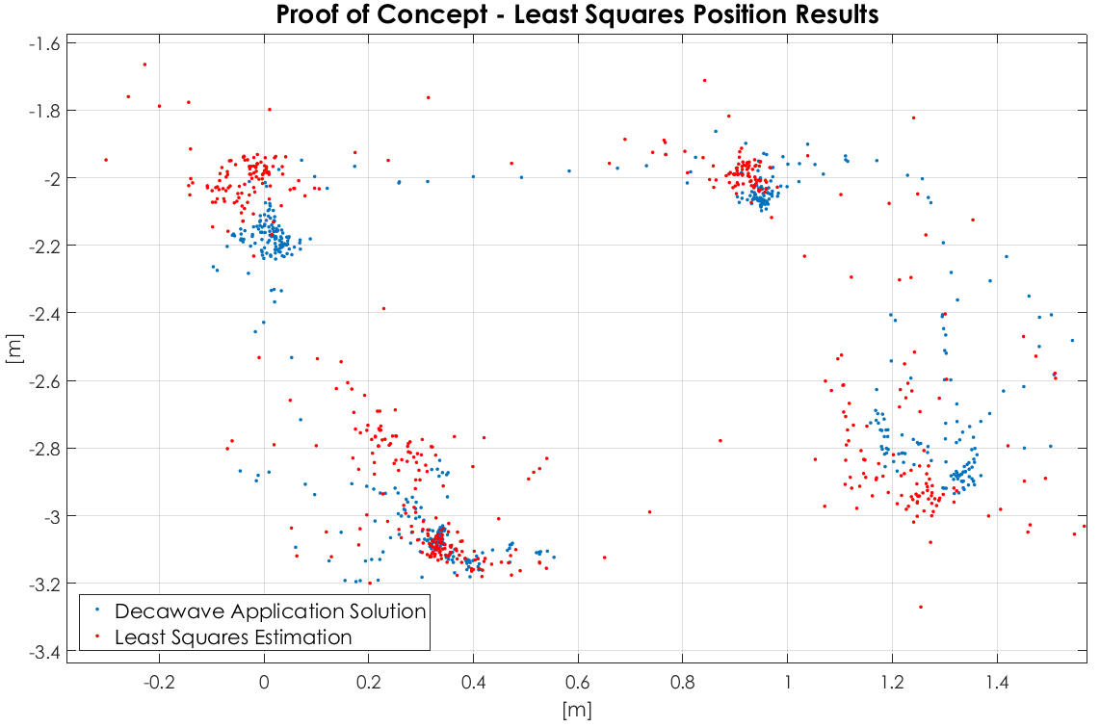
Work Accomplished: Proof of Concept
Position Estimation
Post Processed least squares estimation
Results
Issues
Notes:
The initial Proof of Concept was completed in two steps, first code was written in MATLAB to read the raw data files collected with the decawave application to obtain the ranges from each node, at each epoch, as well as the position determined by the decawave application.
The ranges were then used in a 2D trilateration least squares estimation of the position. Explained in the Phase 1 PoC Documentation found in the appendix.
The Results can be seen in the figure
Issues we ran in to arose from our first data collection, where we did not record the coordinates of the control nodes used in the decaWave application. Therefore coordinates were estimated using the floor plan on the following slide. Another issue that we are hoping will improve our results is by implementing a 3D network, as the ranges do include changes in heights.

Slide 6
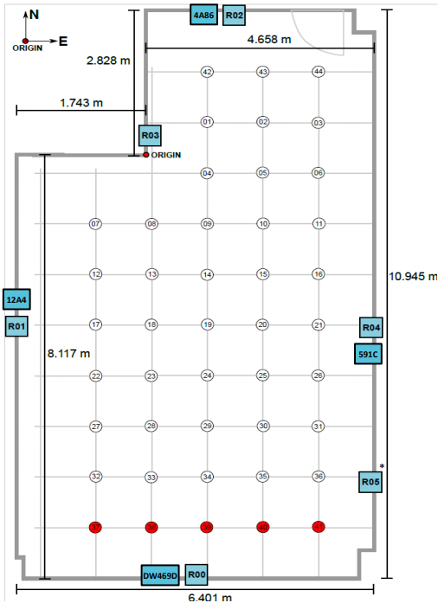
Work Accomplished: Control Survey
Notes:
Paul
Work Accomplished: Control Survey, Next steps for code improvement

Slide 7

Work Accomplished: Android Application
Android framework studied
decaWave application source code studied
Notes:
Work Accomplished: Android Studio Progress

Slide 8
Changes to Work Plan
Control survey of testing environment milestone has been added
Phase 2 Proof of Concept has been added
Delivery date of basic app documentation has been changed
Delivery date of data stream documentation has been changed
Notes:
KATE

Slide 9



Lessons Learned
Communication
Time Management
Technical development and adaptation
Notes:
Kate

Slide 10
References
[1]“MDEK1001 – decaWave”, decaWave.com, 2018. [Online].
[2]“ENGO500_Group1”, https://github.com/thejfry/ENGO500_Group1, 2018. [Online].

Slide 11
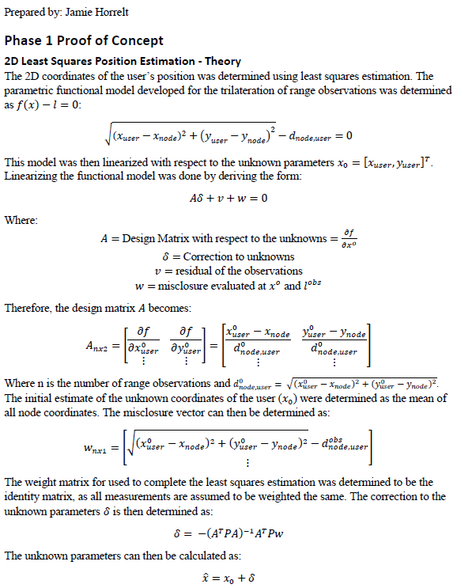
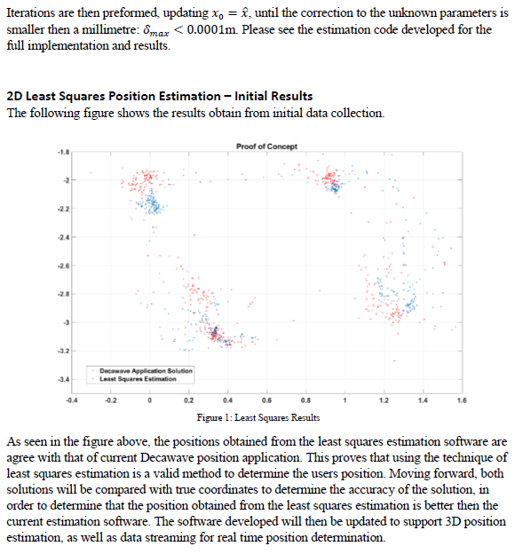
Appendix A – Phase 1 PoC Deliverable
Please see MATLAB code (available on GitHub [2]) for full implementation of the least squares estimation.

