Slide 1
Pseudo Random Number Generator Based on Chaotic Double Pendulum
EECE 682 – Advanced Digital IC Design
Instructor: Muhammad Khan, PhD
Students: James Jenkins, Jeff Allo, Anthony Berry, Olusegun Alofabi, Griffin Laney

Slide 2

Introduction
Random Number Generators (RNGs) are an integral part of encryption [1]:
Key generation
Initialization Vectors (IVs)
Nonces
Salting
Outside of encryption:
Shuffling data
Monte Carlo simulations
Gaming/Lottery
Statistical sampling

Slide 3
Introduction
RNGs are placed into two categories: True RNG (TRNG) and Pseudo RNG (PRNG) [2]
TRNG | PRNG
Quantum effects (QRNG) Optics (wave interference) Photon polarization Spontaneous emission (photons) Thermal/electrical noise Radioactive decay OS entropy (time, processes, memory) Computationally expensive Complex | Deterministic Not truly random Algorithm-based Seeded Computationally efficient Simple
PRNGs are widely used because of their computational efficiency and wide-variety of seed sources. PRNGs are not truly random, but the mechanism for acquiring the seed can make a pseudo random number nearly impossible to replicate.

Slide 4
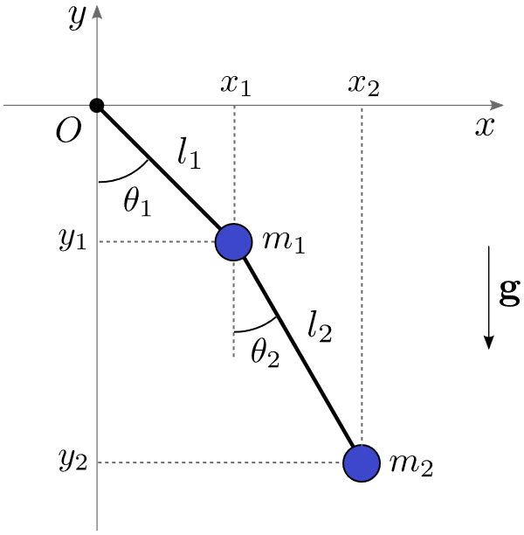

Motivation
Double pendulums are characterized as a chaotic system. As stated by Shinbrot et al. [4]:
Sensitive dependence on initial conditions is the hallmark of chaos. This means that tiny separations, $Δx(t_{0})$, between nearby initial conditions are amplified exponentially in time:
$$Δx\left(t\right)\sim Δx\left(t_{0}\right)e^{λt}$$
Slight variations in lever arm length, mass, gravity, and initial angles produce vastly different results.
The inherent chaos of the double pendulum can be harnessed and used as a seed for a pseudo random number generator [3].
Fig 1: Cartesian representation of double pendulum [5].

Slide 5
Problem Analysis
There are seven adjustable parameters:
L1: length of lever arm 1
L2: length of lever arm 2
M1: mass at the end of arm 1
M2: mass at the end of arm 2
G: gravity in m/s^2
Θ1: angle of m1 relative to origin
Θ2: angle of m2 relative to m1
Theoretically, all seven could be obtained from analog sources to increase entropy.
In [3], the authors use only four analog sources, and it is unclear which parameters are altered with the sources.
Fig 2: Cartesian representation of double pendulum [5].

Slide 6
Hardware Architecture
Here is my idea of the system: there are two buttons. One button does the following: when pressed, all four analog sources are read, the parameters are set, and the simulation restarts with those parameters. The other button is simply meant to ``get” the seed at any moment in time.
The simulation will run in 10 second loops. This is an arbitrary number but is chosen because a double pendulum can descend into extreme chaos in that time. If neither button is pressed, a new seed will be output every 10 seconds.
In order to ``run” the simulation, I believe we will have to implement some numerical integration technique such as the Euler-Lagrange or RK4.

Slide 7
Hardware Architecture
Decide which sensors because that determines comm protocol, specs, clock speed, etc.
Sensor 1
UART/I2C/SPI
Sensor 2
UART/I2C/SPI
IC (pRNG)
PC
USB (FTDI?)
Sensor 3
UART/I2C/SPI
UART/I2C/SPI
Sensor 4

Slide 8
References
[1] F. Tinsley, “Random Number Generators and their Applications,” Medium, Apr. 06, 2023. https://medium.com/@randomisergen/random-number-generators-and-their-applications-acafd36aea2e.
[2] Twingate Team, “What is a Random Number Generator? Types & Importance | Twingate,” Twingate.com, 2024. https://www.twingate.com/blog/glossary/random-number-generator.
[3] T. H. Teo et al., "Hardware Implementation of Double Pendulum Pseudo Random Number Generator," 2024 IEEE 17th International Symposium on Embedded Multicore/Many-core Systems-on-Chip (MCSoC), Kuala Lumpur, Malaysia, 2024, pp. 394-399, doi: 10.1109/MCSoC64144.2024.00071.
[4] T. Shinbrot, C. Grebogi, J. Wisdom, and J. A. Yorke, “Chaos in a double pendulum,” American Journal of Physics, vol. 60, no. 6, pp. 491–499, 1992.
[5] D. Assencio, “Double pendulum: Lagrangian formulation,” dassencio.org. https://dassencio.org/33.

