Slide 1
Runge-Kutta Fourth Order Numerical Integrator
EECE 682 – Advanced Digital IC Design
Instructor: Muhammad Khan, PhD
Students: James Jenkins, Jeff Allo, Anthony Berry, Olusegun Alofabi, Griffin Laney

Slide 2
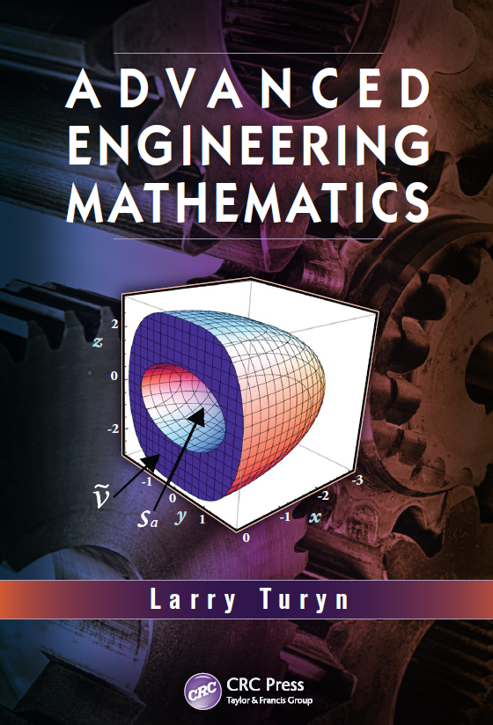
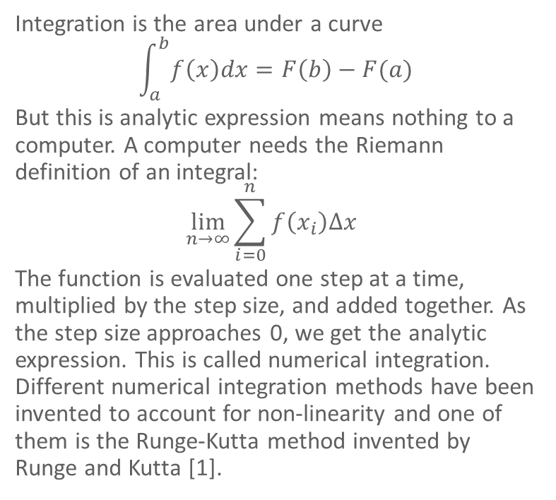
Introduction
Integration is the area under a curve
$$\int_{a}^{b}{f\left(x\right)dx=F\left(b\right)−F(a)}$$
But this is analytic expression means nothing to a computer. A computer needs the Riemann definition of an integral:
$$\lim_{n→∞}{\sum_{i=0}^{n}{f\left(x_{i}\right)Δx} }$$
The function is evaluated one step at a time, multiplied by the step size, and added together. As the step size approaches 0, we get the analytic expression. This is called numerical integration. Different numerical integration methods have been invented to account for non-linearity and one of them is the Runge-Kutta method invented by Runge and Kutta [1].

Slide 3
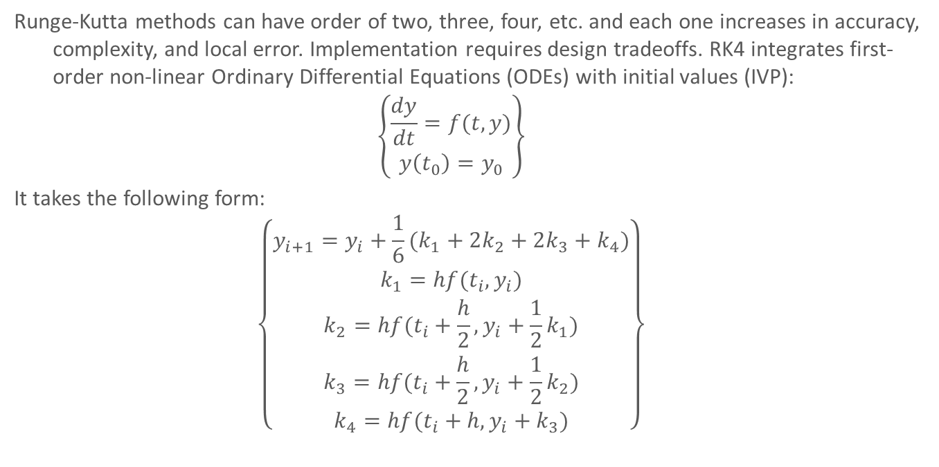
Introduction – RK4
Runge-Kutta methods can have order of two, three, four, etc. and each one increases in accuracy, complexity, and local error. Implementation requires design tradeoffs. RK4 integrates first-order non-linear Ordinary Differential Equations (ODEs) with initial values (IVP):
$$\left\{\begin{matrix}\frac{dy}{dt}=f(t,y) \\ y\left(t_{0}\right)=y_{0}\end{matrix}\right\}$$
It takes the following form:
$$\left\{\begin{matrix}y_{i+1}=y_{i}+\frac{1}{6}(k_{1}+2k_{2}+2k_{3}+k_{4}) \\ \begin{matrix}k_{1}=hf(t_{i},y_{i}) \\ \begin{matrix}k_{2}=hf(t_{i}+\frac{h}{2},y_{i}+\frac{1}{2}k_{1}) \\ k_{3}=hf(t_{i}+\frac{h}{2},y_{i}+\frac{1}{2}k_{2})\end{matrix}\end{matrix} \\ k_{4}=hf(t_{i}+h,y_{i}+k_{3})\end{matrix}\right\}$$

Slide 4
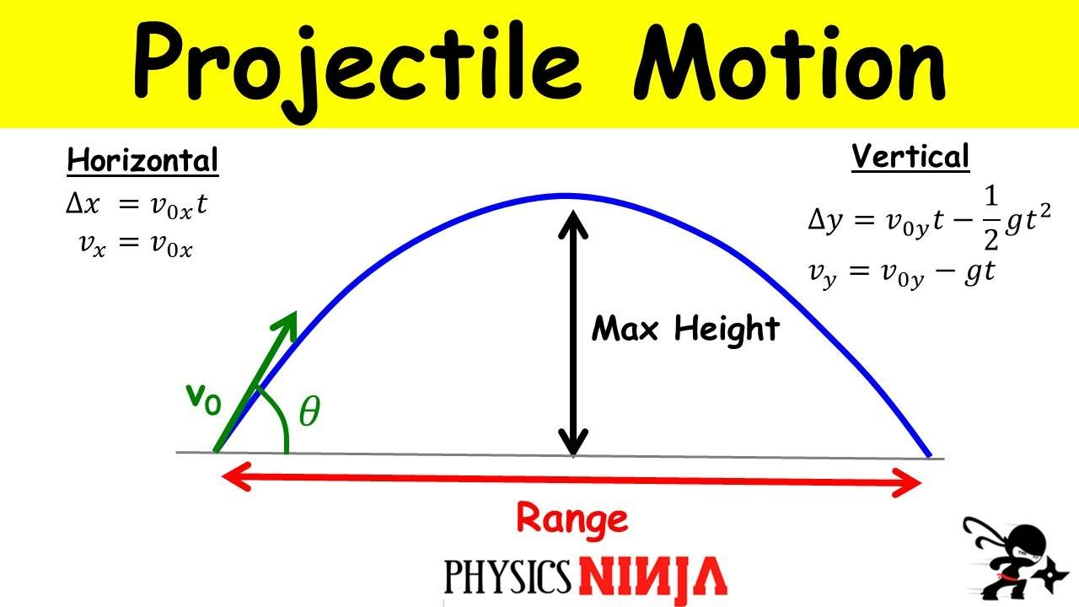

Motivation
Use a mathematical method learned in class
Apply it to a problem with a known solution
Verify mathematical method usage and chip functionality
Projectile motion in a plane is a simple problem from first-year physics which involves linear differential equations. When external forces except for gravity are neglected, the equations determining maximum height and range are only in terms of y:
$$Range=\frac{2V_{oy}}{g}$$
$$y_{f}=y_{i}+V_{0y}t−\frac{1}{2}gt^{2}$$
Take the derivative of yf to make a first-order ODE to use Runge-Kutta:
$$f\left(t,y\right)=\frac{dy_{f}}{dt}=V_{0y}−gt$$
Fig. 1: Projectile Motion [2]

Slide 5
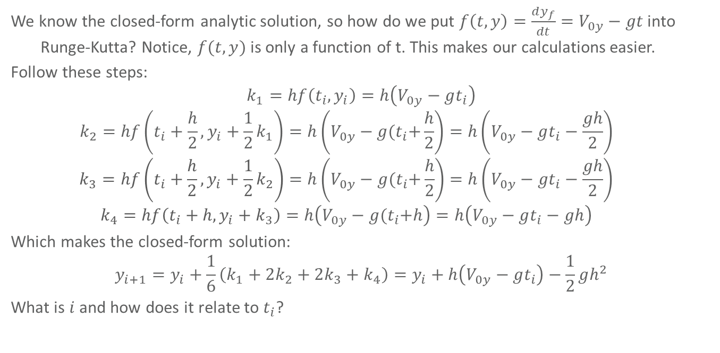
Problem Analysis
We know the closed-form analytic solution, so how do we put $f\left(t,y\right)=\frac{dy_{f}}{dt}=V_{0y}−gt$ into Runge-Kutta? Notice, $f(t,y)$ is only a function of t. This makes our calculations easier.
Follow these steps:
$$k_{1}=hf\left(t_{i},y_{i}\right)=h\left(V_{0y}−gt_{i}\right)$$
$$k_{2}=hf\left(t_{i}+\frac{h}{2},y_{i}+\frac{1}{2}k_{1}\right)=h\left(V_{0y}−g{(t}_{i}+\frac{h}{2}\right)=h\left(V_{0y}−gt_{i}−\frac{gh}{2}\right)$$
$$k_{3}=hf\left(t_{i}+\frac{h}{2},y_{i}+\frac{1}{2}k_{2}\right)=h\left(V_{0y}−g{(t}_{i}+\frac{h}{2}\right)=h\left(V_{0y}−gt_{i}−\frac{gh}{2}\right)$$
$$k_{4}=hf\left(t_{i}+h,y_{i}+k_{3}\right)=h\left(V_{0y}−g{(t}_{i}+h\right)=h\left(V_{0y}−gt_{i}−gh\right)$$
Which makes the closed-form solution:
$$y_{i+1}=y_{i}+\frac{1}{6}\left(k_{1}+2k_{2}+2k_{3}+k_{4}\right)=y_{i}+h\left(V_{0y}−gt_{i}\right)−\frac{1}{2}gh^{2}$$
What is $i$ and how does it relate to $t_{i}$?

Slide 6
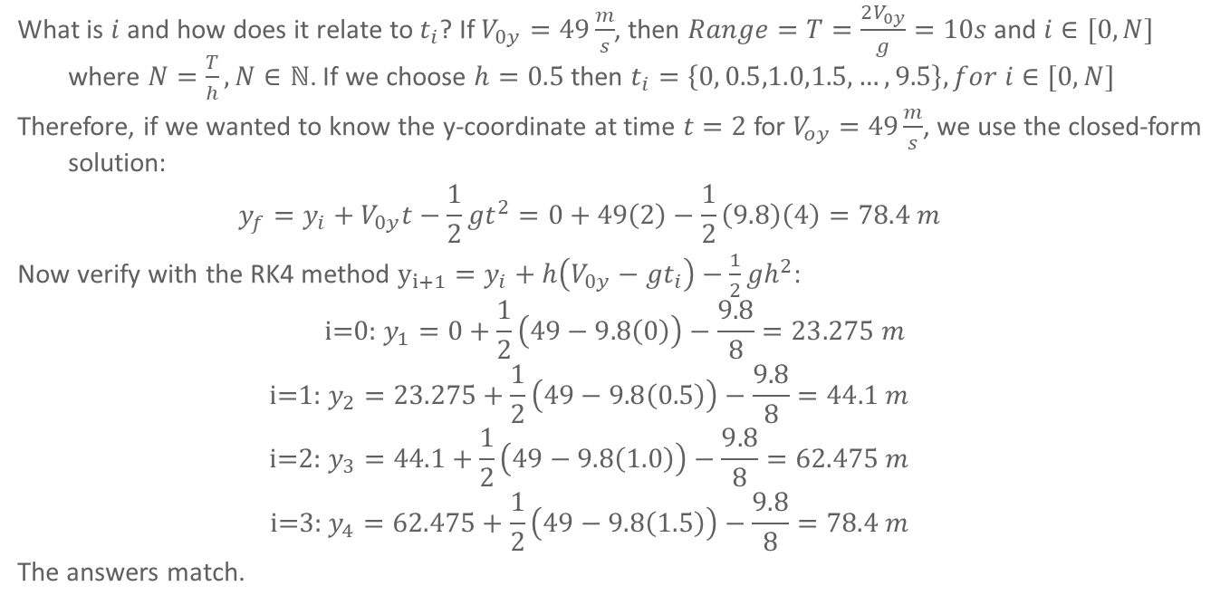
Problem Analysis
What is $i$ and how does it relate to $t_{i}$? If $V_{0y}=49\frac{m}{s}$, then $Range=T=\frac{2V_{0y}}{g}=10s$ and $i∈[0,N]$ where $N=\frac{T}{h}, N∈ℕ$. If we choose $h=0.5$ then $t_{i}=\left\{0, 0.5,1.0,1.5,…,9.5\right\}, for i∈[0,N]$
Therefore, if we wanted to know the y-coordinate at time $t=2$ for $V_{oy}=49\frac{m}{s}$, we use the closed-form solution:
$$y_{f}=y_{i}+V_{0y}t−\frac{1}{2}gt^{2}=0+49\left(2\right)−\frac{1}{2}\left(9.8\right)\left(4\right)=78.4 m$$
Now verify with the RK4 method $y_{i+1}=y_{i}+h\left(V_{0y}−gt_{i}\right)−\frac{1}{2}gh^{2}$:
$$\text{i}\text{=0: }y_{1}=0+\frac{1}{2}\left(49−9.8\left(0\right)\right)−\frac{9.8}{8}=23.275 m$$
$$\text{i}\text{=1: }y_{2}=23.275+\frac{1}{2}\left(49−9.8\left(0.5\right)\right)−\frac{9.8}{8}=44.1 m$$
$$\text{i}\text{=2: }y_{3}=44.1+\frac{1}{2}\left(49−9.8\left(1.0\right)\right)−\frac{9.8}{8}=62.475 m$$
$$\text{i}\text{=3: }y_{4}=62.475+\frac{1}{2}\left(49−9.8\left(1.5\right)\right)−\frac{9.8}{8}=78.4 m$$
The answers match.

Slide 7
Hardware Architecture: FCB [3], Range, and K1-K4
K1
FCB
ti
FCB
MUL
K1
h
V_0y
SUB
f(ti,yi)
ti
MUL
K2
g
ti+h/2
FCB
MUL
K2
h
Range
K3
V_0y
MUL
DIV
T
FCB
MUL
2
g
ti+h/2
h
K3
K4
ti+h
FCB
MUL
K4
h

Slide 8
Hardware Architecture – K-block, yi+1, and memory
K-block
K1
ADD
MUL
yi+1
K2
2
DIV
ADD
yi+1
MUL
g
yi
K3
K4
Mem

Slide 9
References
[1] Turyn, L. (2013). Advanced Engineering Mathematics (1st ed.). CRC Press. Pg 699-705. https://doi.org/10.1201/b15750
[2] Physics Ninja, “Projectile Motion: Finding the Maximum Height and the Range,” 2017. https://youtu.be/Mp8bz5P1m4I?si=Gj5HcVudR_Tm61vA.
[3] S. Bhattacharya, “Implementation of Runge-Kutta Hardware Accelerator,” GitHub, https://github.com/BhattSoham/Implementation-of-Runge-Kutta-Hardware-Accelerator/tree/main/RK4.

