Slide 1


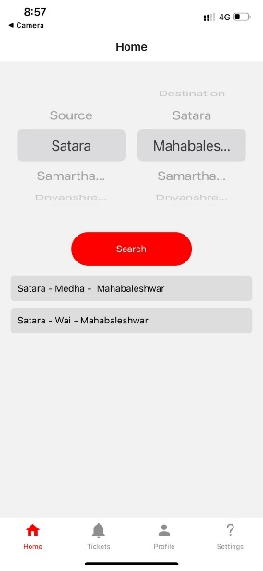
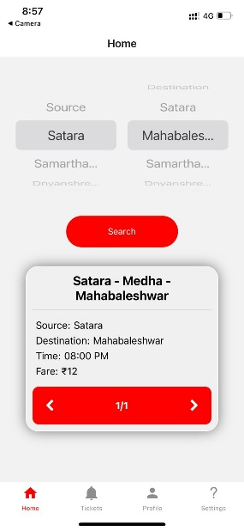
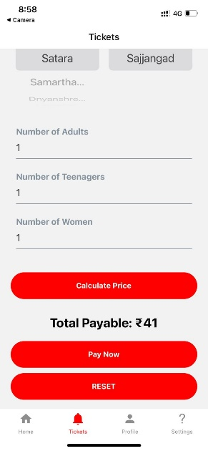
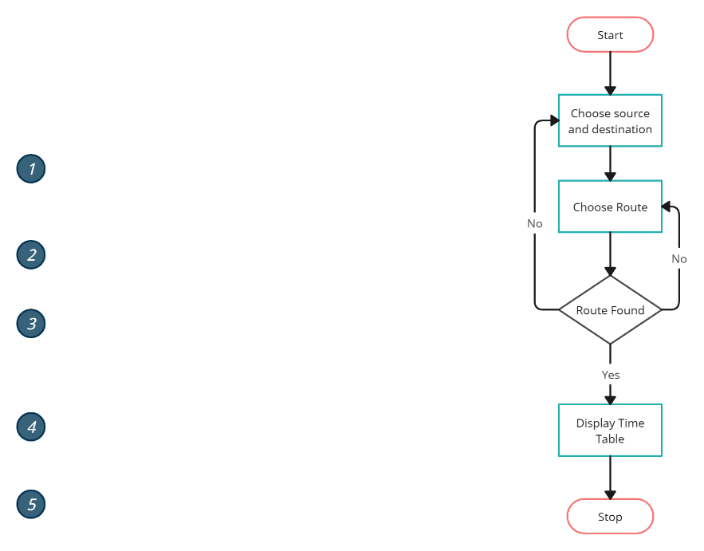
Public Transport System to display offline timetables in remote area
Domain: Android / IOS Application Category: Inhouse
Department: Computer Science
and Engineering
Class: B. Tech CSE Academic Year: 2022-23
Guide: Dr. V. K. Bhosale
Results:
Roll No. | Enrolment No. | Name of Student
4307 | 1967971242007 | Junghare Prasad Shridhar
4310 | 1967971242010 | Kadam Yash Vitthal
4311 | 1967971242011 | Katte Shreya Sanjay
4339 | 1967971242039 | Shinde Saras Shivaji
Block Diagram-
Applications:
Display timings for local bus
Book tickets for local bus
Specifications:
Android Studio
Firebase
React Native
8 GB RAM, with i3 11th generation processor
Platform: Android , IOS, Web Application
Tools: Android Studio, Firebase, React Native
Total Cost: 6000/- (INR)
Think Different… Think Dnyanshree… Think Success…

