Slide 1

Project Topic:- Public Transport application for providing offline timetables of buses and train in remote areas
Project members :
4307 (Junghare Prasad Shridhar)
4310 (Kadam Yash Vithal)
4311 (Katte Shreya Sanjay)
4339 (Shinde Saras Shivaji)
Project Guide:
Dr. V.K. Bhosale

Slide 2
Contents
Domain
About Project
Proposed System
Objective
Literature Survey
UML Diagram
Screens
Conclusion

Slide 3

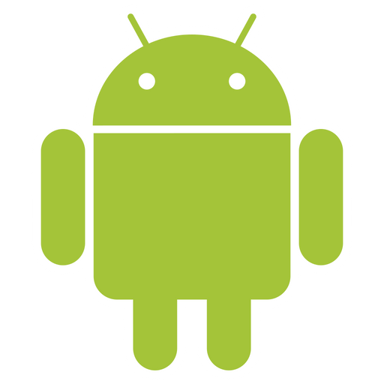

Domain -
Android + Database
React

Slide 4
About Project
Today the transport system has been kind of a mess, especially in remote areas, bus
arriving timing, depart timing has been a major issue. Also, if you are in a new area which
is completely new, and you don’t have clue of the transport system, then you don’t have
many choices in the market for doing the same. This application will solve the same
problem, help travelers to find the nearest bus, train station also checks time of bus, train,
live track it and check the ticket fare and also available to book tickets.

Slide 5
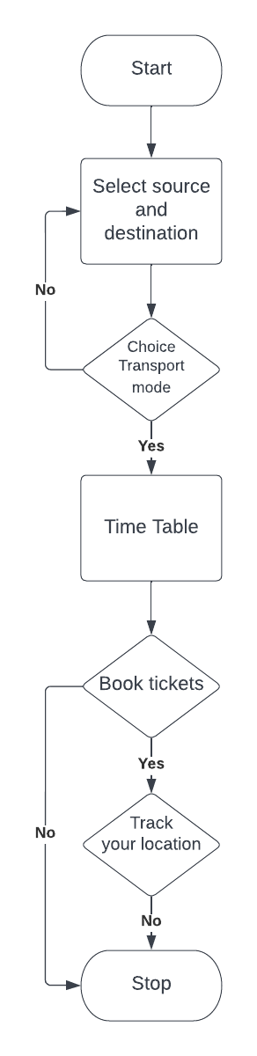
Proposed System

Slide 6
Objective
To build an android application that is located near bus and train station.
To build an android application that is available to track your bus, train.
To build an android application that can predict arrival and depart timings.
To build an android application that is available to book bus and train stations

Slide 7
Literature Survey
Sr.No. | Year | Title | Methodology Used
1 | 2018 | Sanam Kazi , Murtuza BagasrawalaFarheen Shaikh, Anamta Sayyed: Smart E-Ticketing System for Public Transport Bus. | Buses are an integral means of public transport in India. In metropolitan cities like Mumbai and Delhi, 10-15 million people travel through public transport buses daily. Today, in the era of Digital India (a campaign launched by the Government of India) and Cashless Economy, public transport needs to adapt the technology advancement
2 | 2016 | Fatin Balkis Binti Alzahri, Maziani Sabudin: Vehicle Tracking Device. | Published vehicle Tracking Device. This paper discuss the process of developing a Vehicle Tracking Device (VTD).

Slide 8
Literature Survey
Sr. No. | Year | Title | Methodology Used
3 | 2019 | Shubham Jain, Adarsh Trivedi, Shweta Sharma: Application Based Bus Tracking System. | This research is based on Bus Tracking System, The main objective of this work is to make a GPS tracking application which would be able to track school buses more accurately and efficiently than present bus-tracking systems. We got the motivation for our research paper by observing how much precious time of the students studying in our college is wasted by just waiting for the bus on their particular route, and also there is a lack of information for the buses which are traveling on their particular route for the students who have already missed their particular bus.

Slide 9
Literature Survey
Sr.No. | Year | Title | Description
4 | 2011 | Mohammad A. Al-Khedher: Integrated GPS-GSM system is proposed to track vehicles using Google Earth application. | An integrated GPS-GSM system is proposed to track vehicles using Google Earth application. The remote module has a GPS mounted on the moving vehicle to identify its current position, and to be transferred by GSM with other parameters acquired by the automobile’s data port as an SMS to a recipient station.
5 | 2008 | Noppadol Chadil, Apirak Russameesawang: real-Time Tracking Management System Using GPS, GPRS and Google Earth. | Due to the high cost of fossil-based energy, several methods are proposed to reduce the usage of the energy in logistics and fleet management to be even more. GPS tracking system is a common approach to get vehicle location information in real-time for fleet planning.

Slide 10
Literature Survey
Sr.No. | Year | Title | Description
6 | 2020 | Ayman R. Mohammed: UML Modeling of Online Public Bus Reservation System in Egypt. | Designing a proper public transportation system is a main concern for many countries with large population size like Egypt. Therefore, the online based transportation business for individuals is highly growing in Egypt and the concept of online reservation in the transportation field has arisen. In this paper, a model in the analysis phase for an online public bus reservation system (OPBRS) is proposed

Slide 11
UML Diagrams -
Structural Diagrams -
1. Class Diagram
2. Object Diagram
3.Component Diagram
4. Deployment Diagram
5. Package Diagram
Behavioral Diagram -
1. State Machine Diagram
2. Activity Diagram
3. Use case Diagram
4. Sequence Diagram

Slide 12
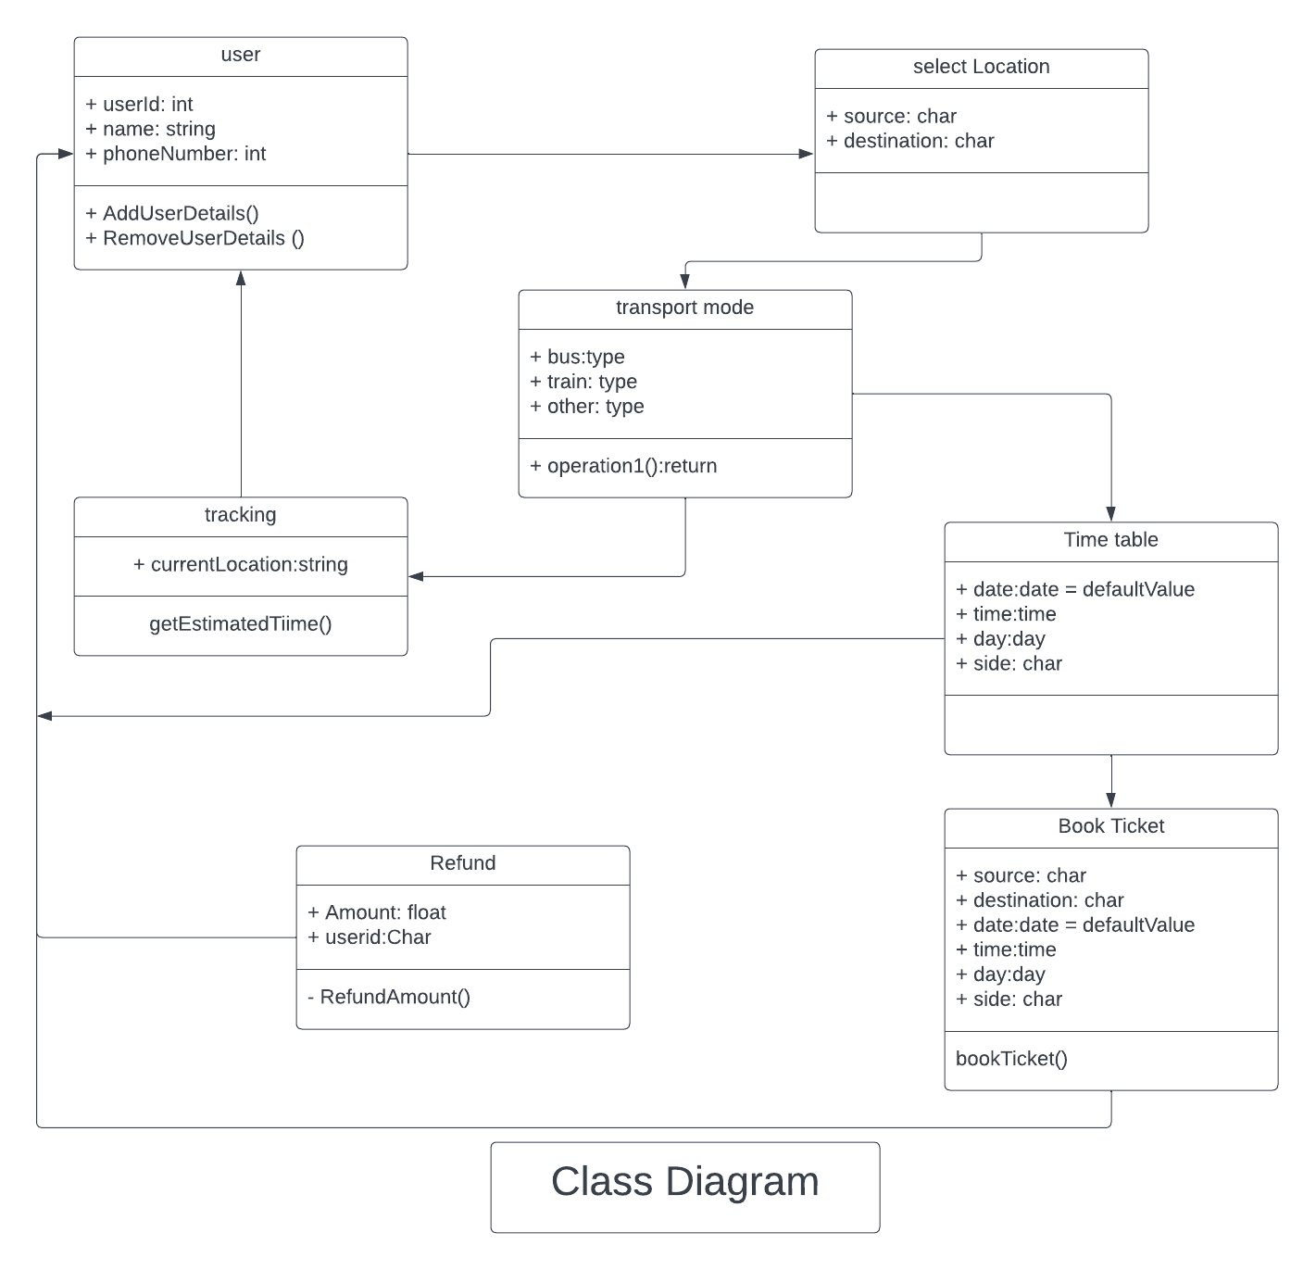

Slide 13
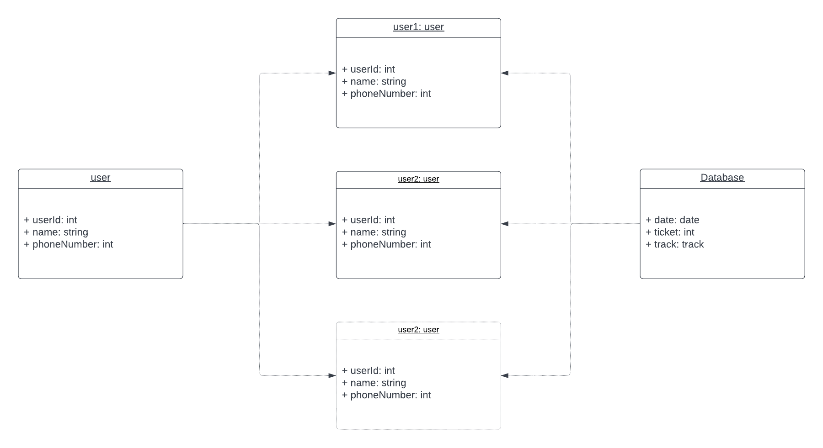
Object Diagram

Slide 14
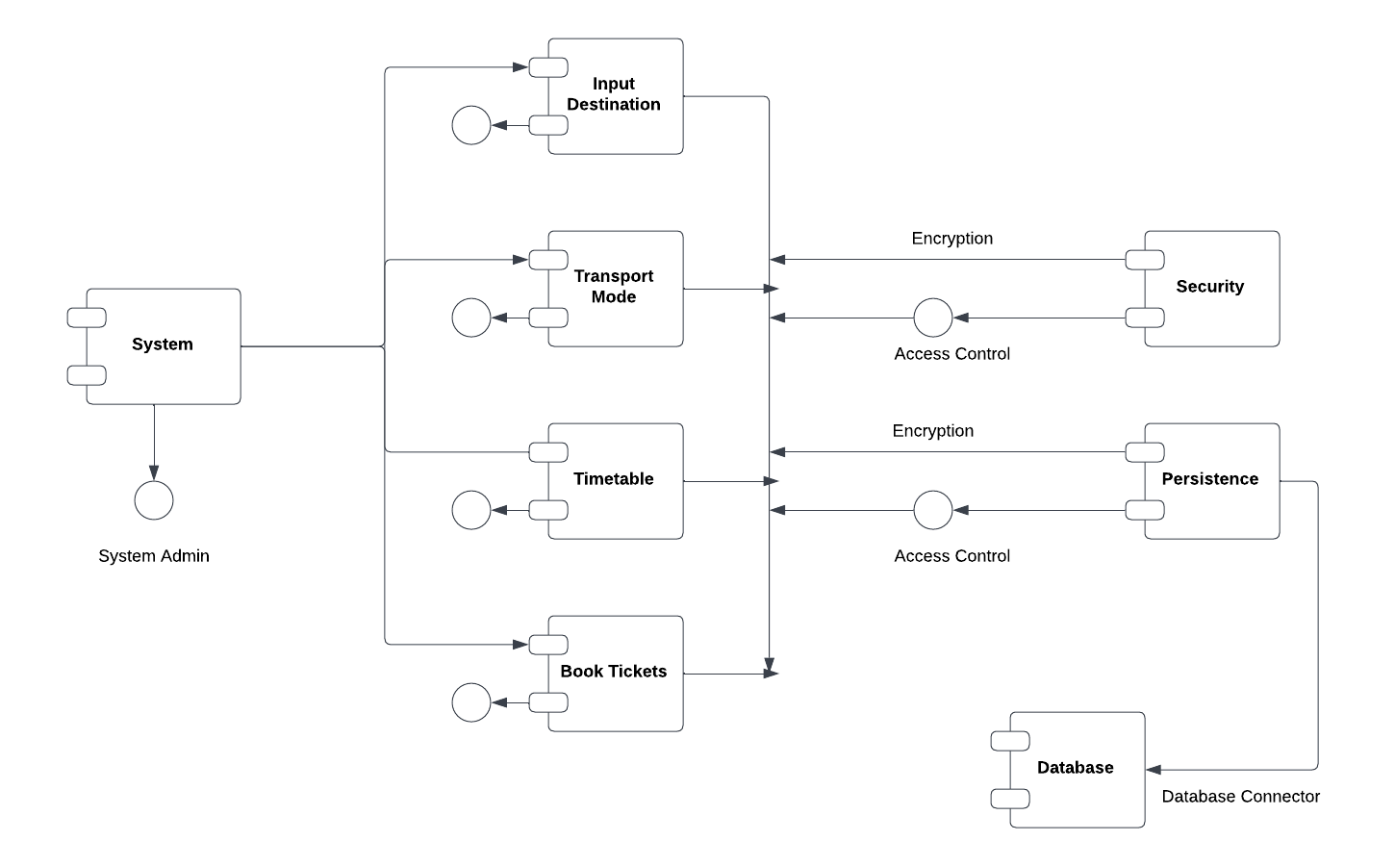
Component Diagram

Slide 15
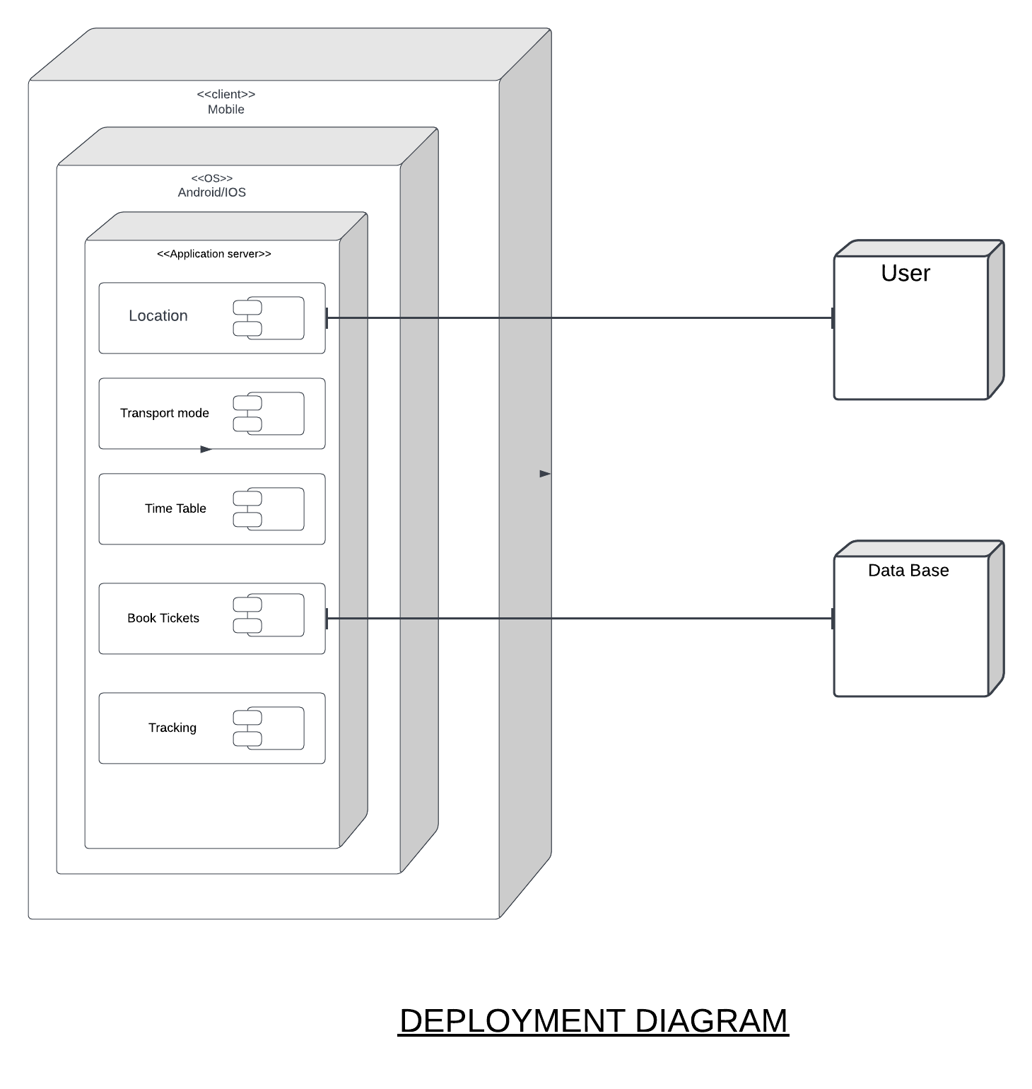

Slide 16
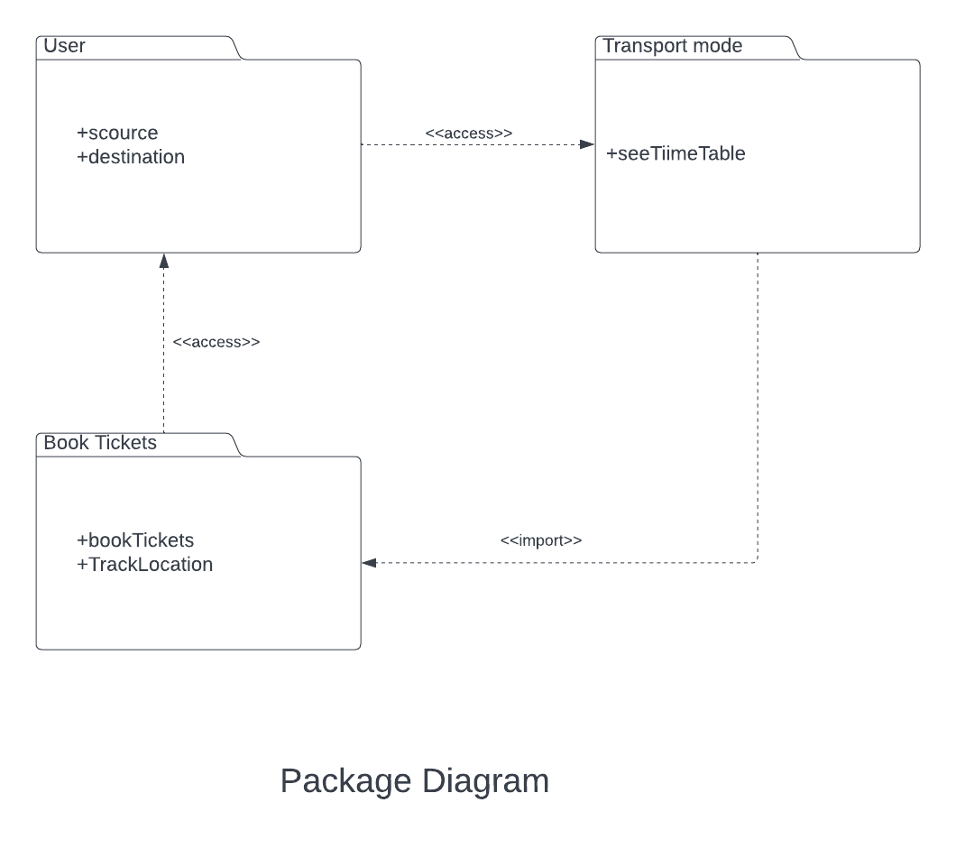

Slide 17
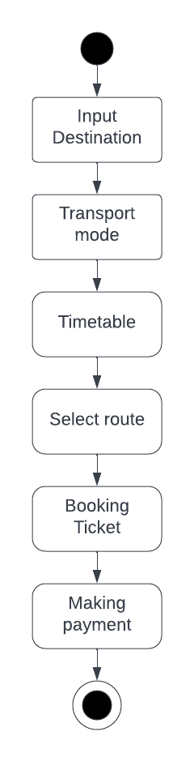
State Chart

Slide 18
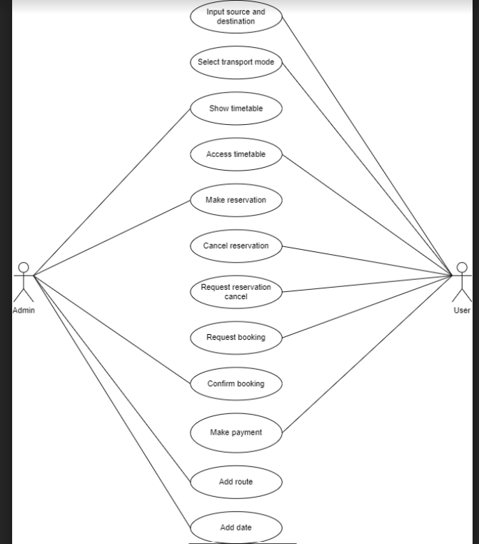
user
system
Use case diagram

Slide 19
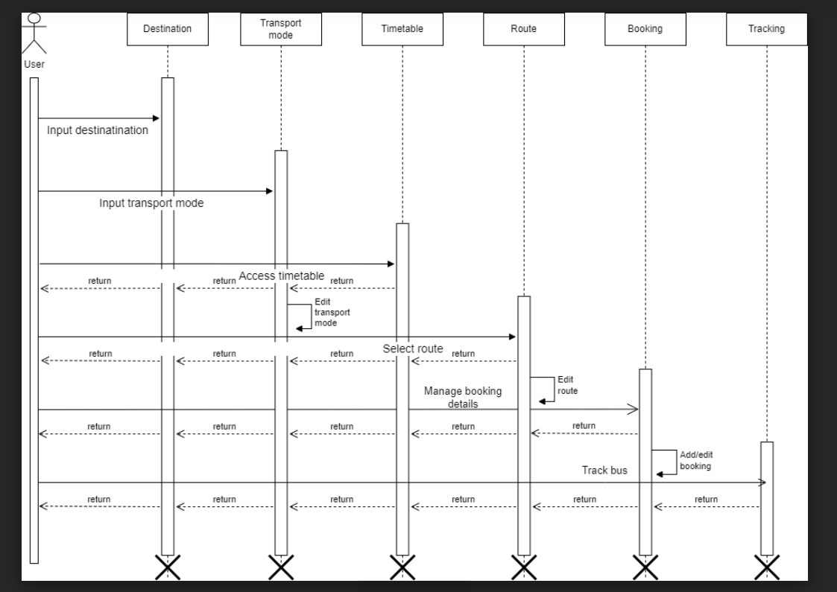
Sequence Diagram

Slide 20
DFD Diagrams -
0-LEVEL DFD
1-LEVEL DFD
2-LEVEL DFD

Slide 21
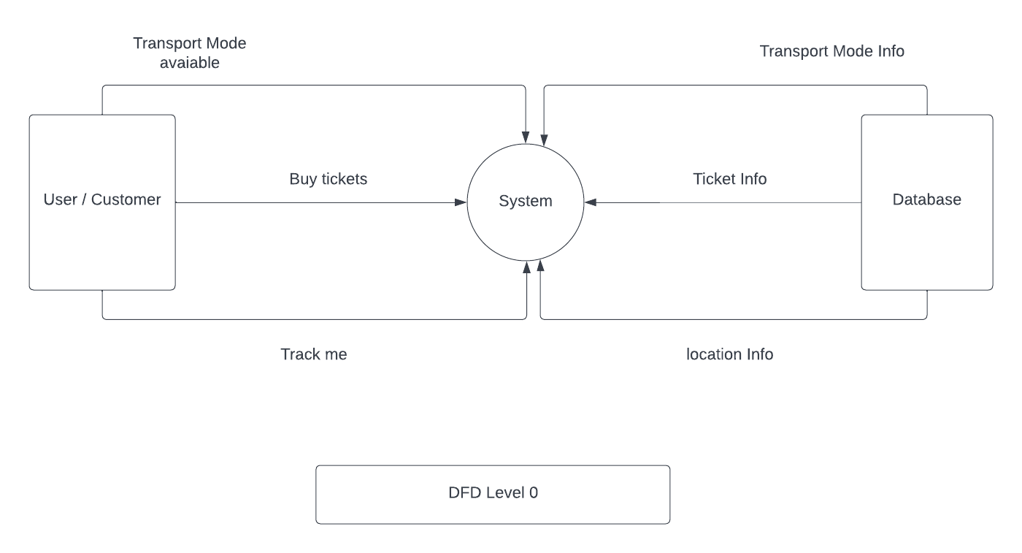

Slide 22
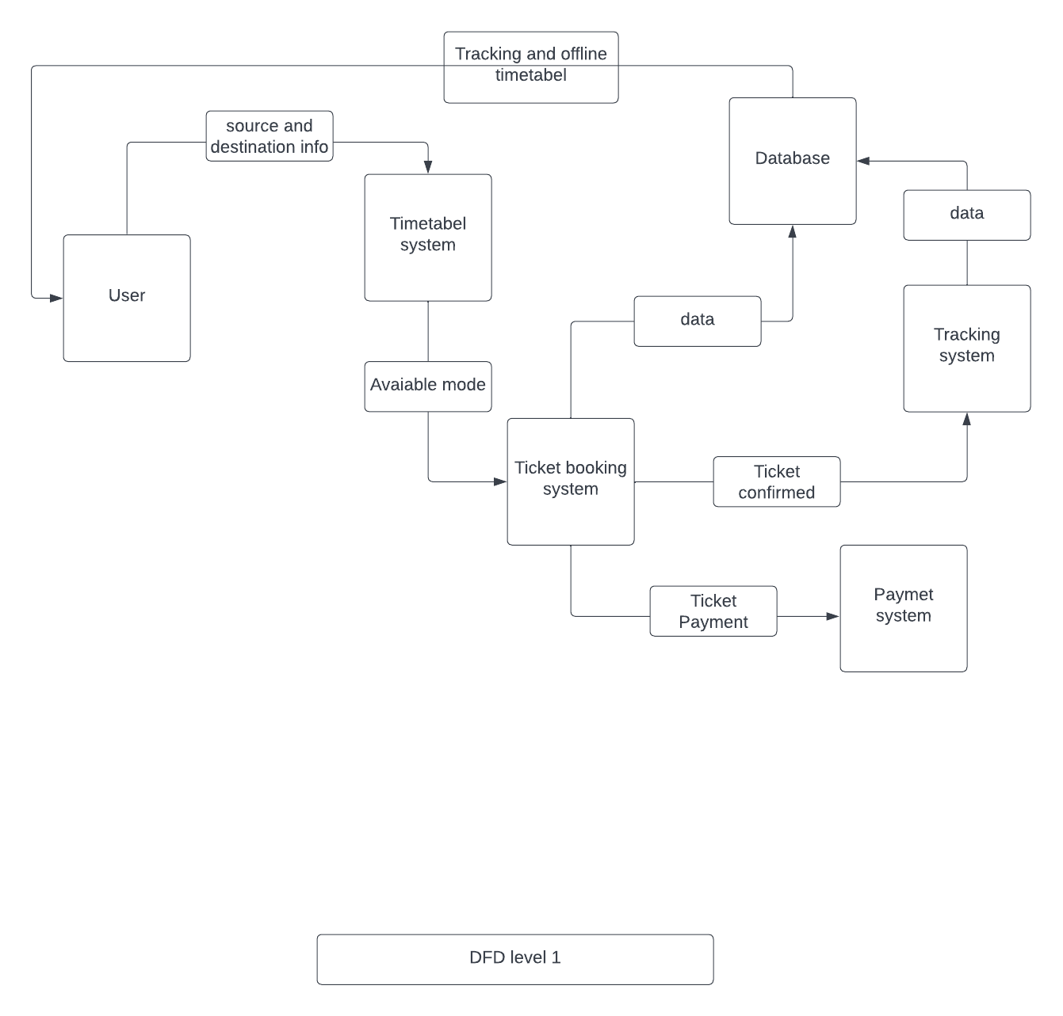

Slide 23
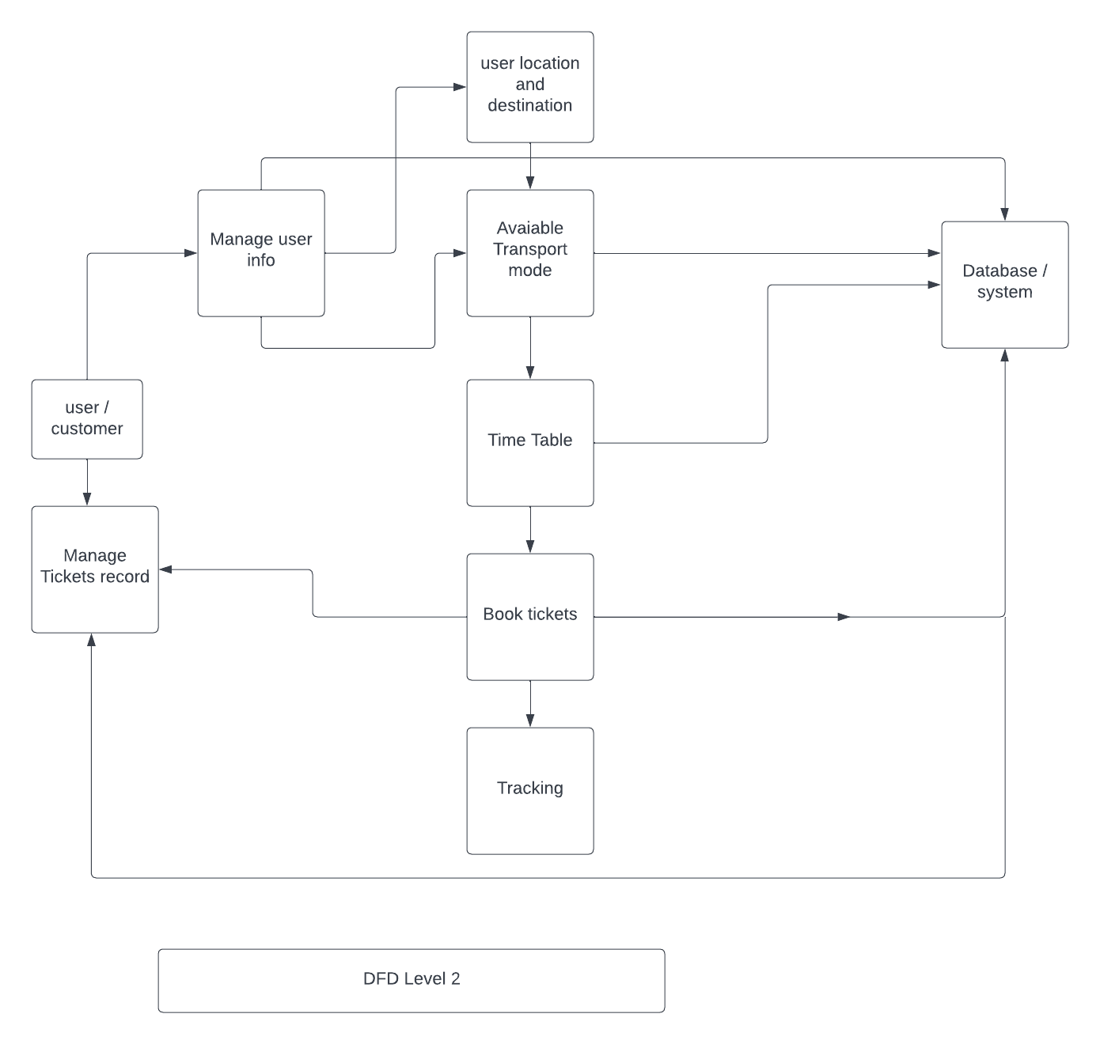

Slide 24
Application

Slide 25
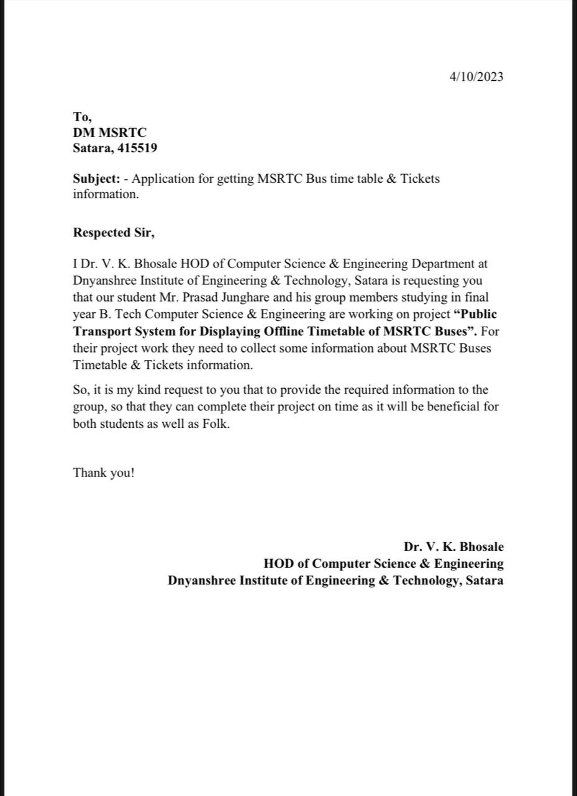

Slide 26
Screens
Sign up page
Login Screen
Home Screen
Search Result
Ticket Booking Screen

Slide 27
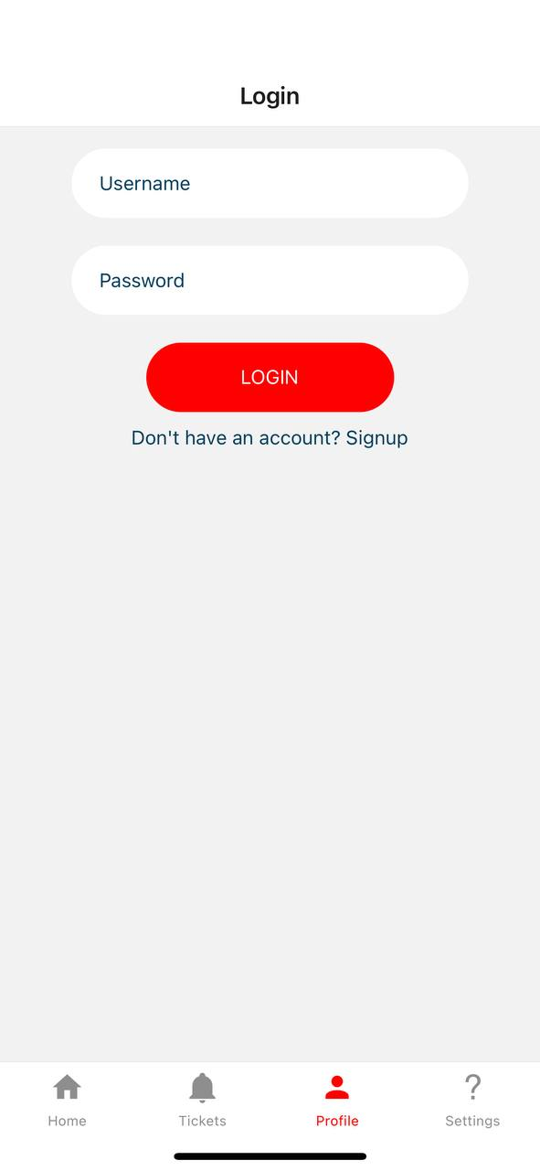

Slide 28
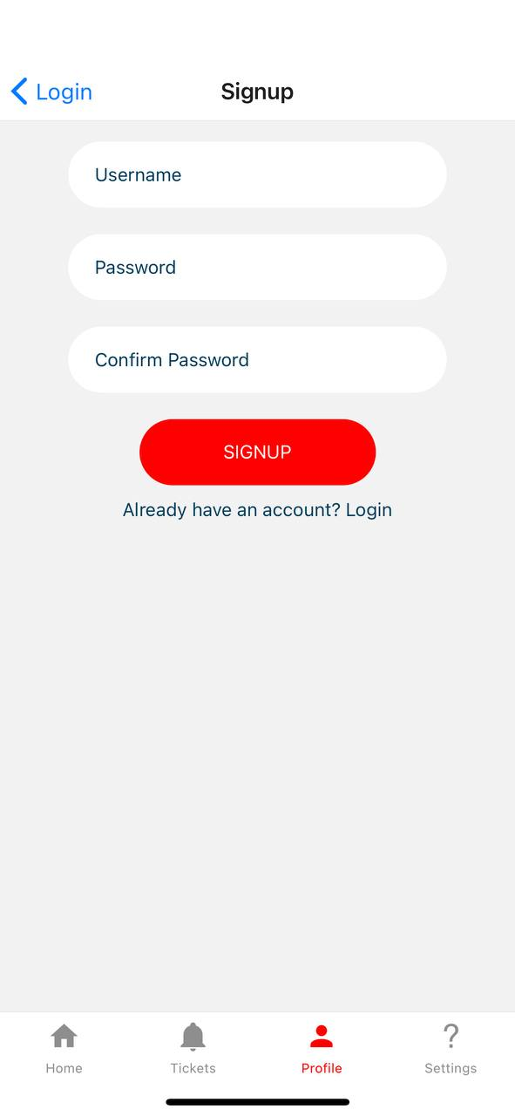

Slide 29
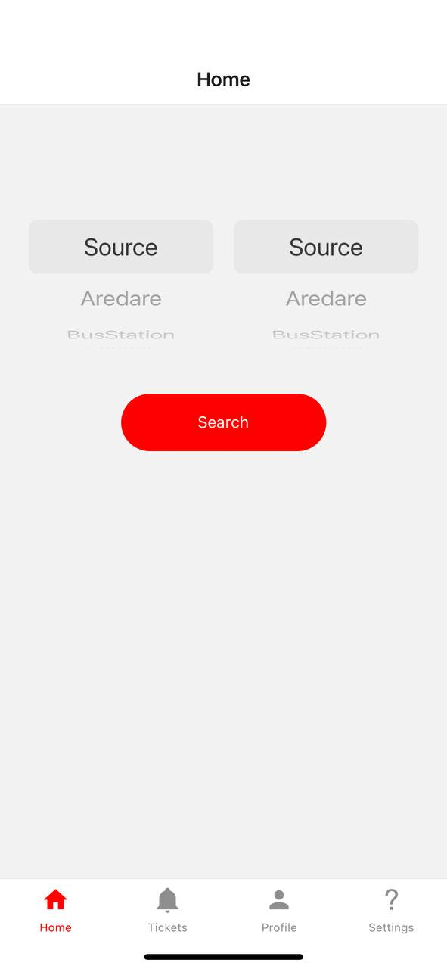

Slide 30
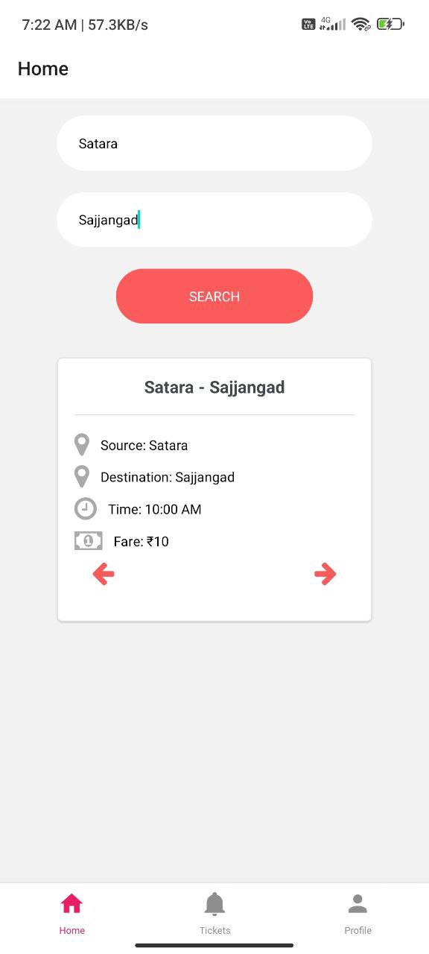

Slide 31
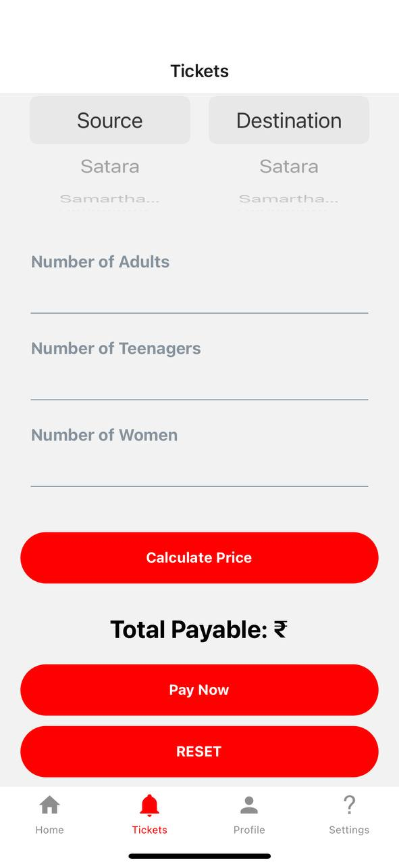

Slide 32
Conclusion
Our system provides a platform to users where they locate nearby bus and train station, it also provides offline timetable and provide transport tracking system, overall this system will help people from remote areas and save the time.

Slide 33
Reference
[1] Sanam Kazi , Murtuza BagasrawalaFarheen Shaikh, Anamta Sayyed Smart E-Ticketing System for Public Transport Bus - ©2018 IEEE
[2] Fatin Balkis Binti Alzahri, Maziani Sabudin, Vehicle Tracking Device – ©2016 IEEE.
[3] Shubham Jain, Adarsh Trivedi, Shweta Sharma, Bus Tracking System – ©2019 IEEE.
[4] Mohammad A. Al-Khedher, “Hybrid GPS-GSM Localization of Automobile Tracking system”, International Journal of Computer Science & Information Technology (IJCSIT) Vol 3, No 6, Dec 2011.
[5] Chadil, Noppadol, Apirak Russameesawang, and Keeratiwintakorn. Real-Time Tracking Management System Using GPS, GPRS and Google Earth, In IEEE 5th International Conference on Electrical Engineering/Electronics, Computer, Telecommunications and Information Technology, vol. 1,2008, pp. 393-3.

Slide 34
Reference
[6] Ayman R. Mohammed: UML Modeling of Online Public Bus Reservation System in Egypt - ©2020 IEEE
[7] Android Studio [en.wikipedia.org]
[8] Java [en.wikipedia.org]
[9] Firebase [en.wikipedia.org]
[10] React native [en.wikipedia.org]

Slide 35


