Slide 1


SAPTHAGIRI COLLEGE OF ENGINEERING
(Affiliated to Visvesvaraya Technological University, Belagavi& Approved by AICTE, New Delhi.)
ISO 9001-2015 & 14001-2015 Certified, Accredited by NAAC with ‘A’ Grade, Accredited by NBA
14/5, Chikkasandra, Hesarghatta Main Road
Bengaluru – 560057.
Technical Seminar
Presentation
On
“Non –Pneumatic Tyre”
Presented By:
VIKAS GOWDA U T
1SG19ME068
Under the guidance of :-
Prof.
Assistant Professor
Dept of ME

Slide 2
CONTENTS
Introduction
Pneumatic Tyres
Non-Pneumatic Tyres
- How it works
4. Different design approaches
5. Advantages
Applications
Conclusion
References

Slide 3
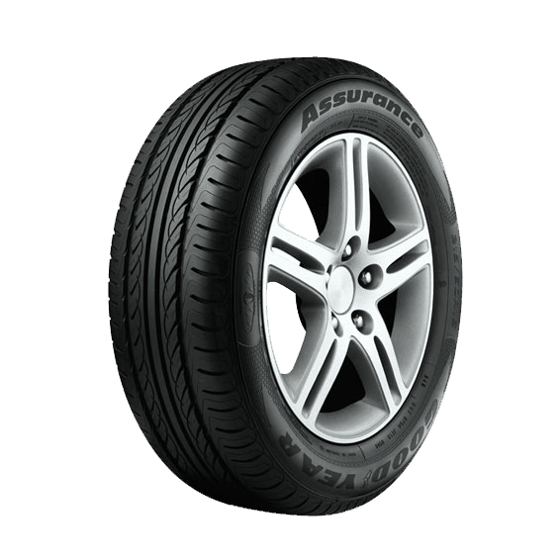
INTRODUCTION
A tyre is a key component of a vehicle driving system and is the only component that interacts with vehicle and road.
Its fundamental functions are to carry loads, generate ground forces, and buffer ground excitation.
It also affects vehicle handling stability, driving comfort, riding comfort, and other aspects of vehicle performance

Slide 4
PNEUMATIC TYRES
A Pneumatic or air-filled tire is made of an air tight inner core filled with pressurized air.
The pressure of the air inside the tire is greater than atmospheric air pressure.
DRAWBACKS
Puncture or Blowout.
A blowout at high speeds can lead to a dangerous vehicle accident.
Variations in air pressure changes tire performance.
Can blow out by explosion.

Slide 5
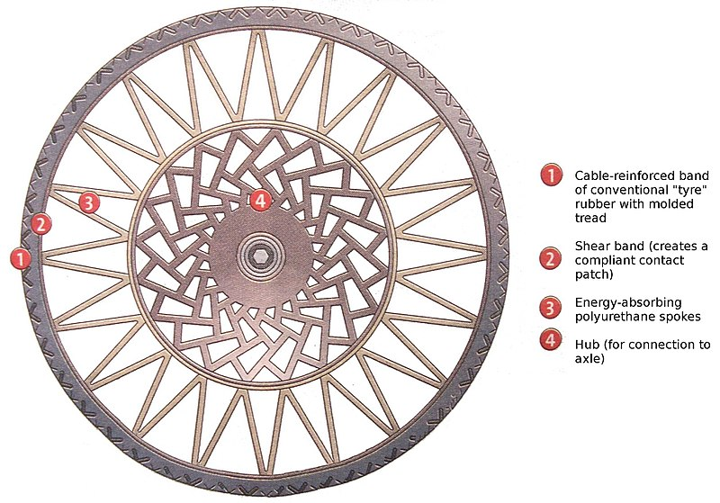
NON PNEUMATIC TYRES
Airless tyres or Non-pneumatic tyres (NPT), are the tyres that are not supported by air pressure. These tyres are also called as Tweel which is a merger of the words tyre and wheel.
The Tweel concept was first announced by Michelin back in 2005.
The Tweel airless tire design

Slide 6
The Tweel airless tire design Structure
There is a solid inner hub mounted onto the vehicles axle.
Hub is surrounded by polyurethane spokes. This forms a pattern of wedges, which help to absorb the impacts of the road. These spokes look similar to the ones found on bicycles and plays the shock-absorbing role.
A sheer band is then stretched across the spokes, which forms the outer edge of the tyre.
The tread comes into contact with the ground and provides grip (tangential reaction force of the ground to the tyre) and rolling resistance.

Slide 7
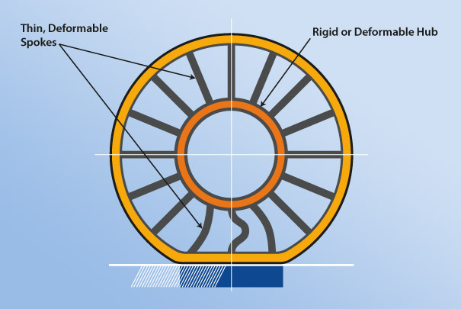
HOW IT WORKS
When the Tweel is running on the road, the spokes absorb road defects the same way air pressure does in the case of pneumatic tyres. The flexible tread and shear bands deform temporarily as the spokes bend, then quickly go back to the initial shape. Different spoke tensions can be used, as required by the handling characteristics and lateral stiffness can also vary. However, once produced the Tweel’s spoke tensions and lateral stiffness cannot be adjusted.

Slide 8
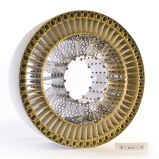
DIFFERENT DESIGN APPROACHES
1. NASA and the Apollo Lunar Rover
The first major attempt at creating an airless tyre was in 1970 for NASA’s Apollo Lunar Roving Vehicle.
The tyres were made of steel strands woven together to form the shape, and then were coated with zinc.
This design worked well on the moon, where comfort of the drivers was not an issue , but it would not have been practical on earth. The design would also be very expensive for a regular automobile, which is not attractive to the average consumer.
NASA and the Apollo Lunar Rover

Slide 9
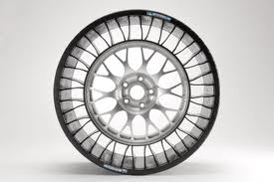
Michelin
The next main attempt at creating an airless tyre was called the Tweel (combination of tyre and wheel) by the tyre company, Michelin. Their design consisted of a thin rubber tread with V-shaped spokes made of polyurethane.
There were extremely high hopes for this model when it came out.
This development has very positive implications because it means that the tyre would last about two times longer than a standard pneumatic tyre before it would have to be retreaded
Michelin

Slide 10
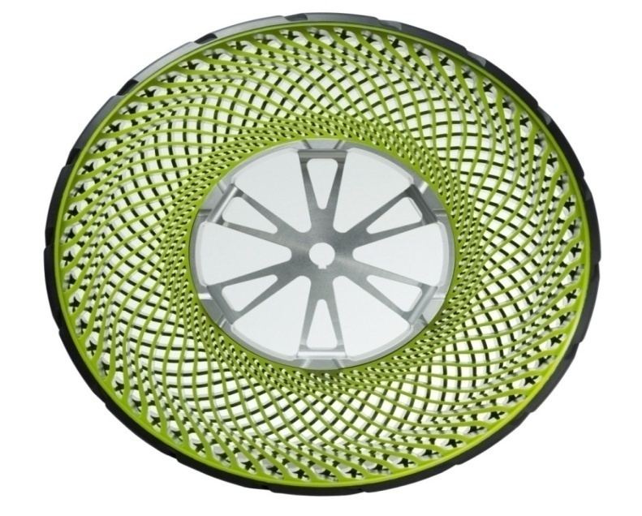
3 Bridgestone
Another model for the non-pneumatic tyre came from the well-known tyre company, Bridgestone.
The core is made of rigid aluminum and has thermoplastic spokes radiating outward at an angle in opposite directions on each side. This creates more stability and less lateral movement in the tyre.
Bridgestone also fixed the vibration and noise problem.
The materials used in the tyres are recyclable, contributing to the efficient use of resources.
Bridgestone

Slide 11
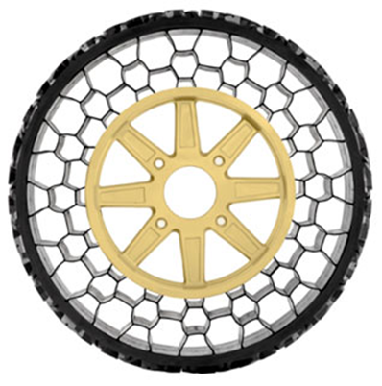
4. Resilient Technologies, LLC
The production of airless tyres would be extremely beneficial to the military. The group Resilient Technologies, LLC is working with the military to develop such a tyre for Humvees. To meet the requirements of heavy loads and rough terrain, these tyres are quite industrial-looking.
They consist of a thick outer tread with a honeycomb-like structure inside. This allows for the load to be evenly distributed around the tyre.
This design causes the tyre to be very loud, making in unsuitable for regular automobiles.
For military purposes however, it is useful. It can withstand a large amount of abuse, including blasts when under attack.
Resilient Technologies, LLC

Slide 12
Advantages of airless tyres
1. Eliminates air leaks or tyre blow outs.
2. With no air pressure you are left with consistent economy and handling.
3. Its flexibility provides an increase in surface area of contact.
4. No maintenance needed.
5. To lengthen tread life.
6. Facilitate recycling.
7. Makes Vehicle more Efficienthave high lateral strength for better handling without a loss in comfort.
8. Vehicle remains under control even in emergency brake.
9. Remains mobile even with some of the spokes damaged or missing.
10. Durability & Long Life.
11. Can take gunfire or explosion.
11. Less environmental impact.

Slide 13
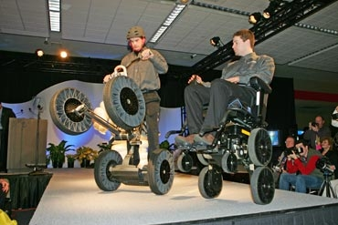
APPLICATIONS OF AIRLESS TYRES
1. They are used on some small vehicles such as riding lawn mowers and motorized golf carts.
2. Military Usage Tweel deflects mine blasts away from the vehicle better than standard tyres and that the Tweel remains mobile even with some of the spokes damaged or missing.

Slide 14
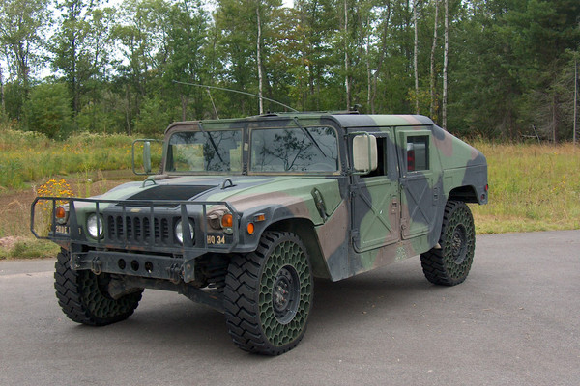
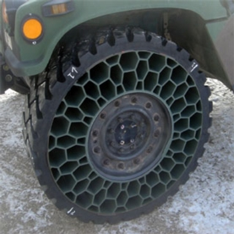
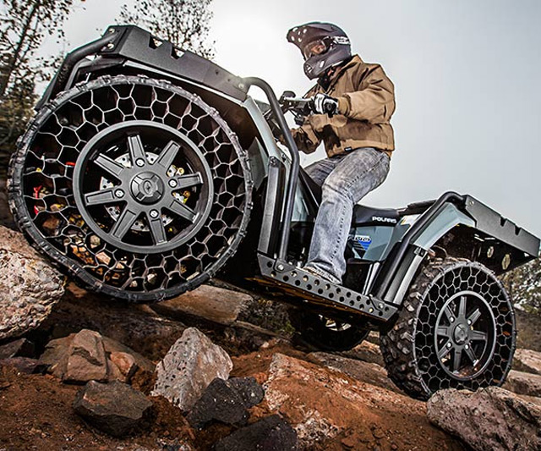
The airless tyres are also used in All-terrain vehicle(ATV) made by polaris. These tyres can
suffer a shot from a .50-caliber rifle and still travel 350 miles, and also drive 1,000 miles after
running over a railroad spike. It will start at $14,999.

Slide 15
CONCLUSION
Tyres may seem to be a trivial part of an automobile that cannot be improved, but research into airless tyres shows otherwise. This new technology will increase the safety of cars as well as have a positive impact environmentally. Since these tyres are also able to be retreaded, there is the possibility of a smaller cost per tyre- which is always embraced by the consumer

Slide 16
REFERENCES
1. A.Kwon. (2012) Design Spotlight: The Airless Tyre. Gear Patrol (Online article) http://gearpatrol.com/2012/05/24/design-spotlight-the-airless-tyre/ p. 1
2. E.Grabianowski. (2011). How the Tweel Airless Tyre Works How Stuff Works (Online article) http://auto.howstuffworks.com/tweel-airless-tyre.htm p. 2
3. D.Sherman. (2012). Tech Dept.: The Latest on the Airless Tyre-and-Wheel Combo Car and Driver (Online article) http://www.caranddriver.com/features/tech-dept-the-latest-on-the-airless-tyre-and-wheel-combo-tech-dept p. 1
4. B.Mattmiller. (2008). Airless Tyre Project May Prove a Lifesaver in Military Combat. University of Wisconsin News Archive (Online article).http://www.engr.wisc.edu/news/archive/2008/Jul08.html p. 1
5. Airless TyreProject SciTech Industries (2012). (Video)http://vimeo.com/41741265
6. Goodyear’s Prototype Non-pneumatic Lunar Tyre Unexplained-Mysteries.com (Online article) http://www.unexplained-mysteries.com/forum/index.php?showtopic=69787&st=150

Slide 17
Thank You

