Slide 1
MASTER'S THESIS · WORK IN PROGRESS
Neural Operator Architectures for the 21 cm Reionization Field
Fourier and beyond — a surrogate for the density → neutral-fraction map
Haris · Computational Astrophysics
21cmFAST lightcones · FNO / U-FNO / SIREN / Walsh–Hadamard · Aug 2026
Notes:
Introduce yourself. One sentence on the goal: we are building a fast, accurate surrogate that maps the matter density field to the neutral-hydrogen fraction during reionization, to be used inside simulation-based inference. The talk is about the journey through neural-operator architectures and what we learned about sharp ionization fronts.

Slide 2
1 · THEORY
The 21 cm signal and the neutral fraction
▪ The 21 cm line is a hyperfine spin-flip of neutral hydrogen (ν₀ = 1420.4 MHz), redshifted to ≈50–250 MHz at z = 6–30 — the HERA / SKA-Low band.
▪ Observed as a differential brightness temperature against the CMB. In the saturated spin-temperature limit:
δTₖ(x, z) ≈ 27 mK · [Ωb, Ωm, z factors] · x_HI(x, z) · [ 1 + δ_m(x, z) − ∂∥ v∥ / (aH) ]
▪ Gravity (density δ_m and the RSD velocity term) is shared across simulators — the physics we care about lives entirely in x_HI.
▪ Signal is ~10–100 mK, while foregrounds are 10⁴–10⁵× brighter → foregrounds occupy a “wedge” in (k⊥, k∥); the clean “EoR window” survives.
2
Notes:
~40s. The observable is the 21cm brightness temperature. In the saturated spin-temperature limit it factorizes: density and velocity terms are set by gravity, which all simulators share; the code-specific physics sits entirely in the neutral fraction x_HI. So if we can emulate x_HI faithfully, we have the science.

Slide 3
1 · THEORY
x_HI is a near-binary field with sharp fronts
▪ Reionization is inside-out: ionized bubbles grow around clustered sources, percolate around ≈50% ionization (z ≈ 7–10), and complete by z ≲ 6.
▪ At the voxel level the field is nearly binary — mostly fully ionized (x_HI = 0) or fully neutral (x_HI = 1).
▪ The action is at the ionization fronts: step edges ≈ 1 px / ≈3.6 Mpc wide in truth, where x_HI jumps discontinuously.
▪ Why this is hard for spectral models: a step edge has power at every frequency — any truncation of a smooth basis rings (Gibbs) and blurs the wall.
▪ This one fact — sharp walls in a smooth global basis — drives the entire architecture search that follows.
3
Notes:
~35s. The neutral-fraction field is nearly binary, and the physics of interest is the sharp ionization fronts. A step edge needs all frequencies; a smooth truncated basis rings and blurs. Everything after this slide is a systematic attack on that single problem.

Slide 4
1 · THEORY
Ground-truth data and the learning task
▪ Task: learn the operator G : δ_m(x, z) ⟶ x_HI(x, z), conditioned on 11 astrophysical + cosmological parameters.
▪ Source: 21cmFAST semi-numerical lightcones.
▪ Cube geometry: 140×140×256, z = 5→25, ≈200 Mpc transverse · ≈3340 Mpc line of sight.
▪ Data: 6600 cones (80/10/10 split, seed 42).
▪ Metrics: L² and H¹ error, power spectra, bubble-size distribution — not just RMSE.
▪ Use: fast forward model for simulation-based inference (P2).
4
Notes:
~40s. The concrete task: given the matter density field and eleven parameters, predict the full 3-D neutral-fraction lightcone. Training data is 6600 21cmFAST lightcones. Right: a slice through one cone showing density, true x_HI, and a model prediction across redshift. The vertical axis is the line of sight; reionization runs from neutral at high z down to ionized at low z.

Slide 5
2 · MODEL JOURNEY
Step 1 — neural operators and the FNO
▪ A neural operator learns a map between function spaces (not vectors) → resolution-invariant; retrain-free across grid sizes.
▪ FNO layer: v′ = σ( W·v + F⁻¹[ R(k) · F[v] ] ) — a learned spectral filter in Fourier space.
▪ Global receptive field at O(N log N) via FFT; the Green's-function view of physics makes it natural for PDE-like maps.
▪ The catch: keep only N_modes lowest modes + smooth sinusoidal basis → step-like bubble walls ring and blur.
▪ First result, pure FNO: after adding parameter conditioning, val L² = 0.056, val H¹ = 11.4 — correct timing & location, but walls too smooth.
– More modes → no change. BCE → no change. Capacity was not the bottleneck; the basis was.
5
Notes:
~40s. We start from the FNO: a resolution-invariant operator that does a learned spectral convolution. It gets the global reionization history right but blurs the walls. Two negative results matter: adding more modes and adding a BCE regularizer both failed, which told us capacity was not the problem - the smooth Fourier basis itself was.

Slide 6
2 · MODEL JOURNEY
Step 2 — swapping the basis: Wavelet & Walsh–Hadamard
▪ Key insight: the transform in the operator block is just a slot — transform → learned per-coefficient weight → inverse transform works for any fast orthogonal transform.
▪ Wavelet (Haar): local, step-shaped atoms → a bubble wall is sparse (no Gibbs).
▪ Walsh–Hadamard: global, square-wave basis — step edges are sparse and long-range coupling survives; O(N log N), no complex arithmetic, no trig.
▪ Intuition: Fourier = global + smooth (blurs edges); Wavelet = local + step (sharp but short reach); Walsh = global + step (sharp and long-range).
▪ Also makes basis choice a hyperparameter — which is what enables the controlled comparisons later.
6
Notes:
~35s. Rather than fight Fourier, we generalize the operator block so the basis is swappable. Two alternatives: Haar wavelets - local step functions - and the Walsh-Hadamard transform - global square waves. Walsh-Hadamard is the theoretically interesting one: step edges are sparse in it, and unlike wavelets it keeps global support.

Slide 7
2 · MODEL JOURNEY
Step 3 — the U-Net path (U-FNO)
▪ U-FNO interleaves FNO blocks with U-Fourier blocks: each adds a parallel mini 3-D U-Net (strided conv) beside the spectral path.
▪ Why it works: pure local convolution is Gibbs-free for step functions — a genuinely different basis, not more of the same.
▪ Result: val L² 0.056 → 0.0418; val H¹ 11.36 → 8.27 — the first time H¹ breaks 11, i.e. the walls got sharper.
▪ Same inputs, same loss, same modes as the FNO — the win is purely the local conv path.
– Engineering footnote: BatchNorm under batch-1 DDP silently drifts running stats → fixed with SyncBatchNorm (a 4.6× val-L² trap).
7
Notes:
~40s. The decisive breakthrough: the U-FNO adds a local U-Net path alongside the spectral path. Local convolution represents step functions without ringing. It broke the floor that looked information-bound, dropping L2 by 25% and H1 by 27%. The lesson: the bottleneck was the basis, not the inputs or the loss.

Slide 8
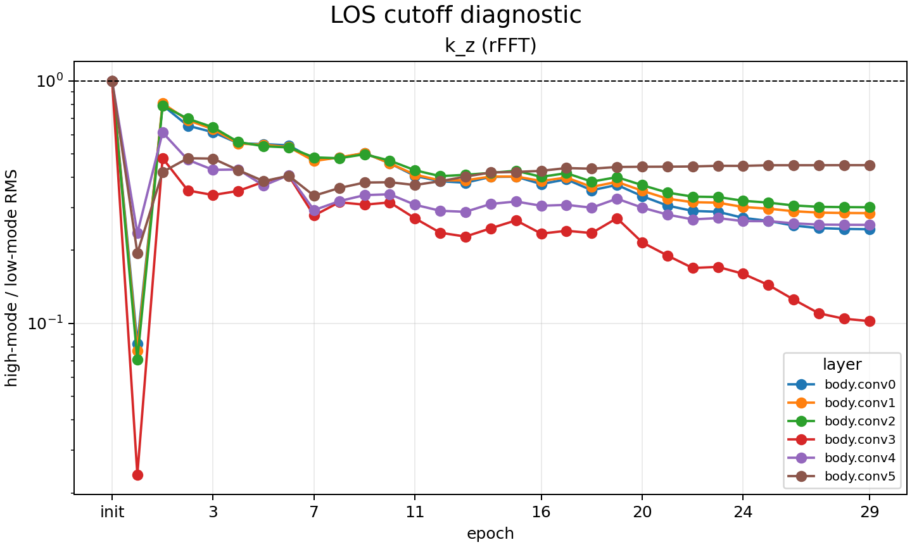
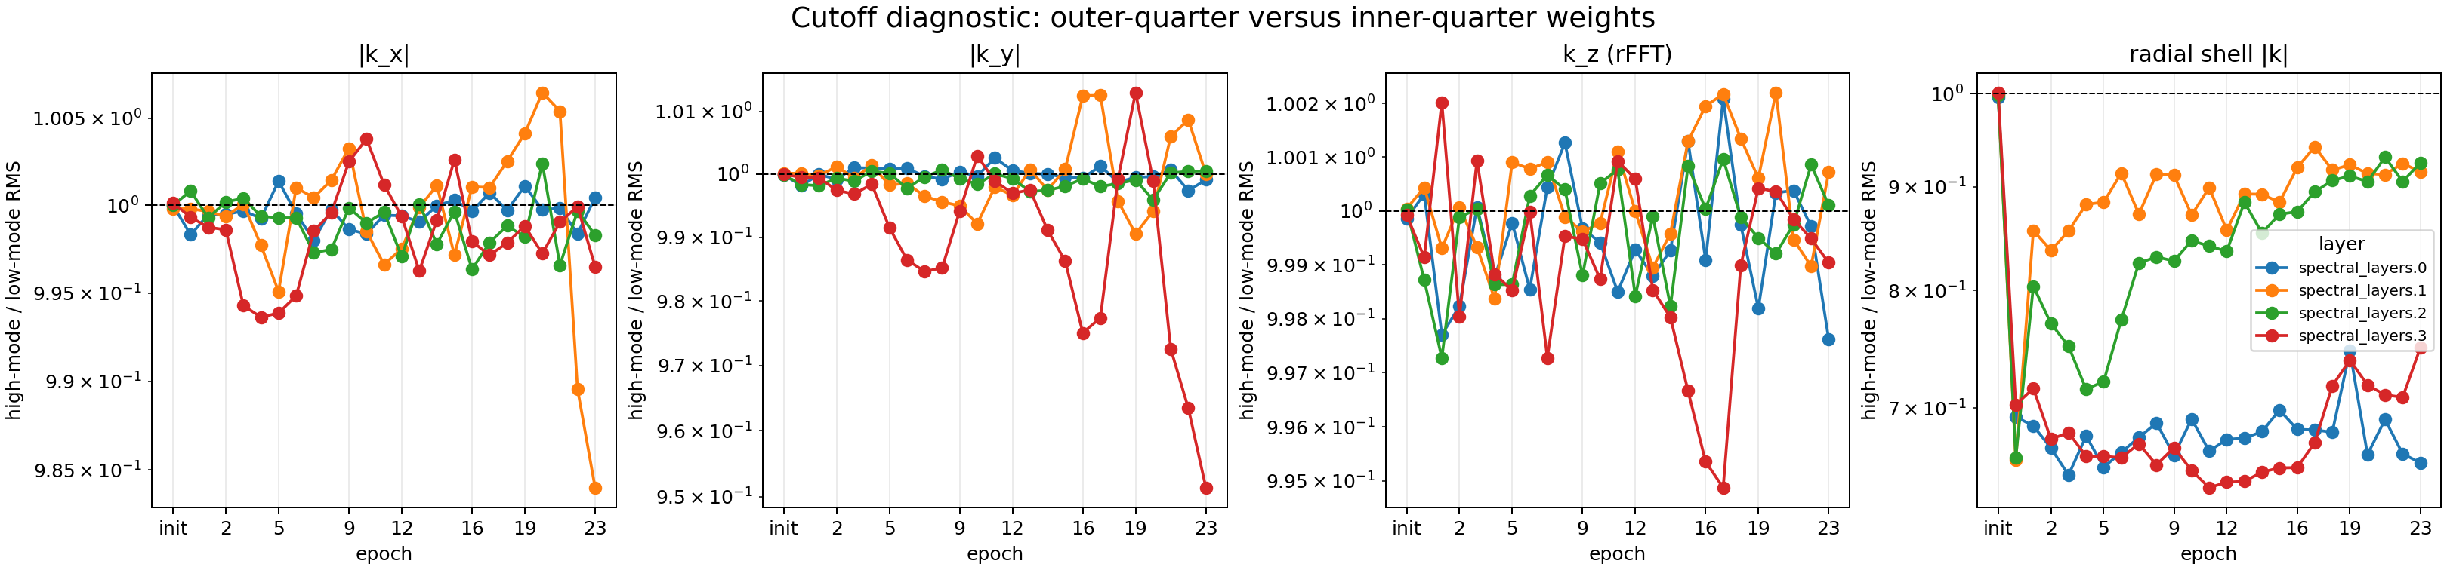
2 · MODEL JOURNEY
Step 4 — the SIREN hypernetwork (SirenFNO)
▪ Diagnosis: learnable per-mode weights collapse to low frequencies — the lowest 8 of 32 LOS modes hold 52% of the weight (learned within one epoch).
▪ SirenFNO: a SIREN MLP generates the kernel R(k) for every mode — no truncation, constant parameter count.
U-FNO: high/low-mode ratio falls 1.0 → 0.1–0.45 (low-frequency collapse)
SirenFNO: ratio pinned at ≈1.0 (flat spectrum)
▪ Result: flat learned spectrum; beats plain FNO (test L² 0.057 → 0.050, H¹ 11.6 → 9.8) — but not yet the U-FNO, because it lacks the local path.
8
Notes:
~40s. We instrumented the spectral layers to measure where the weight lives. The U-FNO visibly collapses onto low modes. The SIREN hypernetwork - which generates the kernel for every mode - removes that bias entirely, keeping the spectrum flat, and beats the plain FNO. But it does not beat the U-FNO, plausibly because it has no local U-Net path.

Slide 9
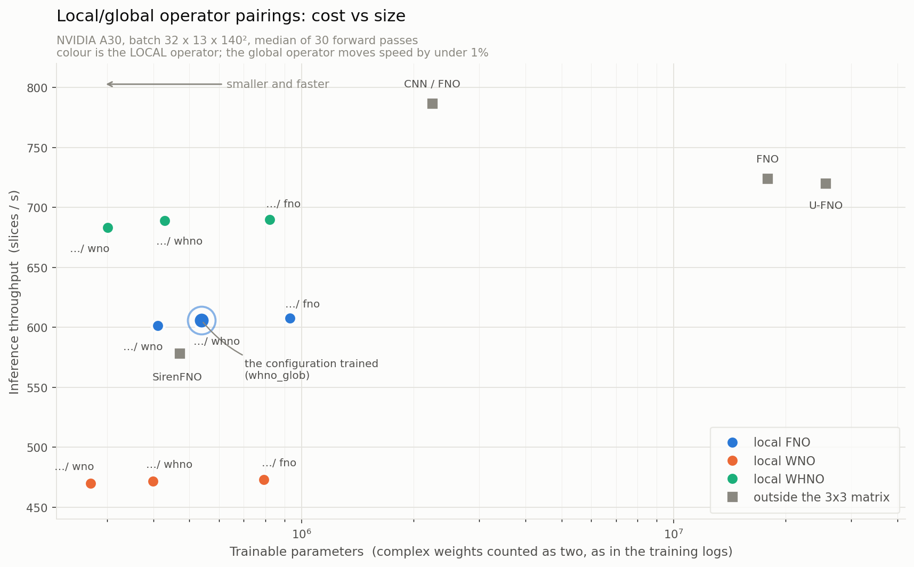
2 · MODEL JOURNEY
Step 5 — putting it together: two slots, one skeleton
▪ A single windowed U-Net skeleton with two independent operator slots:
– local slot — windowed encoder/decoder branches (sharp, small-patch);
– global slot — whole-field bottleneck (long-range, 200 Mpc).
▪ Any operator can fill either slot → FNO, LocalFNO, LocalWNO, WHNO, LocalSirenFNO …
▪ This is what turns “which basis is best” into a testable question.
▪ Payoff on cost: local models are 20–60× smaller than the U-FNO and use ~40% less peak memory — the number that matters inside an SBI loop.
Parameters vs throughput (A30 benchmark)
9
Notes:
~35s. We unify everything in one skeleton with two operator slots: windowed local branches and a global whole-field bottleneck. Any transform can fill either slot. This gives controlled comparisons, and the local models end up 20 to 60 times smaller than the U-FNO at better accuracy - critical for a model that will be called inside an inference loop.

Slide 10
3 · RESULTS
Plain-L² ranking — 2-D x_HI slices
▪ All models, same task / split / resolution, 30 epochs, pure L². Sorted by RMSE.
architecture | val RMSE | test RMSE | val/train | params
local fno / global whno ★ | 0.1453 | 0.1502 | 1.01× | 0.54 M
local fno / global fno (LocalFNO) | 0.1487 | 0.1540 | 1.08× | 0.93 M
local wno / global fno (LocalWNO) | 0.1502 | 0.1549 | 1.08× | 1.78 M
local whno / global whno | 0.1501 | 0.1550 | 1.01× | 0.43 M
U-FNO | 0.1595 | 0.1648 | 1.19× | 25.6 M
▪ Walsh–Hadamard in the global slot is the new leader; the local/global slot matters more than the basis (≈5% vs <1% for ordering).
▪ U-FNO generalizes worst (1.19×) — consistent across all three tasks.
10
Notes:
~40s. The clean 2-D ranking. Walsh-Hadamard in the global slot is the new leader, beating plain LocalFNO, and every local model beats the U-FNO while being 20 to 60 times smaller. Two structural results: which slot gets the non-Fourier operator matters more than which basis it is; and the U-FNO generalizes worst.

Slide 11
3 · RESULTS
z_re task — SIREN weights close the gap to U-FNO
▪ Second task: density lightcone → z_re(x,y) map (reionization-redshift per sightline). Held-out 660 cones; RMSE in redshift units.
▪ SIREN weights rescue the Local-FNO: RMSE 0.305 → 0.123 — the largest architectural effect measured, at 54× fewer params than U-FNO.
model | loss | RMSE(z) | R² (struct) | params
FNO (w=64) | L² only | 0.1168 | 0.766 | 17.9 M
LocalSirenFNO (w=32) | L² only | 0.1233 | 0.740 | 0.47 M
SirenFNO (w=64) | L² only | 0.1344 | 0.691 | 2.3 M
U-FNO (w=32) | L² only | 0.1505 | 0.612 | 25.6 M
FNO (w=64) | L²+H¹ | 0.1822 | 0.432 | 17.9 M
LocalFNO (w=16) | L² only | 0.3047 | −0.589 | 0.74 M
11
Notes:
~40s. On the z_re task the headline is that SIREN-generated weights turn the LocalFNO from the worst model into the second-best, beating the U-FNO by 18% with 54 times fewer parameters. Also: pure L2 beats L2+H1 by roughly 35% for every architecture - the H1 term was actively harmful.

Slide 12
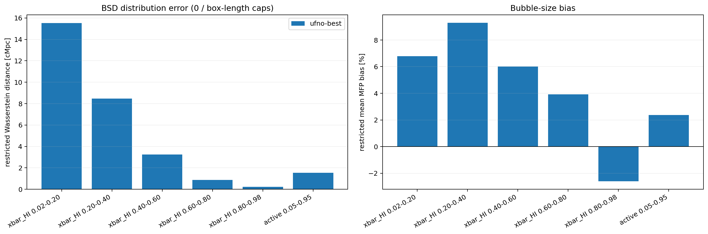
3 · RESULTS
Edge sharpness & bubble sizes
▪ Diagnosis — hedging: L² (and H¹ one derivative up) are minimised by a blurred front when the wall position is uncertain → every RMSE-optimal model sits at ≈2.9 px width (truth 1.46).
▪ Fix — expwall: exponential-in-distance absolute error → picks a side (conditional median) instead of averaging.
– Front width 1.16 px vs truth 1.46, at ≈22% RMSE.
▪ Bubbles: the best U-FNO makes bubbles +6–9% too large early (soft walls read as bigger bubbles); JS divergence ≤ 0.017, so shape is right, scale drifts.
Bubble-size distribution, truth vs U-FNO, by ¯x_HI stage
12
Notes:
~45s. The reason all the basis-side attacks never fixed the walls: a pointwise squared loss actively prefers a blurred front. The constructive fix is an exponential absolute error - it reaches truth-like front width for the first time. On morphology: the best U-FNO makes bubbles too large early on, the signature of soft walls.

Slide 13
3 · RESULTS
The tradeoff: accuracy vs sharpness is a frontier
▪ There is no free lunch — an explicit accuracy-vs-sharpness frontier:
– RMSE 0.145 at front width 2.89 px, or RMSE 0.177 at width 1.16 px (truth 1.46).
▪ Sharpening restores small-scale power: high-k power ratio 0.51 → 0.82 (1.0 = correct), but high-k cross-correlation falls 0.70 → 0.58.
▪ A granulometry (BSD) auxiliary loss halves the bubble-size bias (+6.0% → +2.9%) at a cost of 6.5% val-L² — the first aux term that moves what it targets.
▪ Which end matters depends on the deliverable: for SBI on summary statistics, truth-like P(k) and bubble sizes plausibly beat per-pixel RMSE — a choice to make deliberately.
13
Notes:
~45s. Putting it together: sharpness and L2 accuracy are in tension. We can have per-pixel accuracy or truth-like fronts, not both simultaneously - at least not yet. The thesis now has to pick a point on this frontier explicitly, and for inference on summary statistics the sharp end is likely the right one.

Slide 14
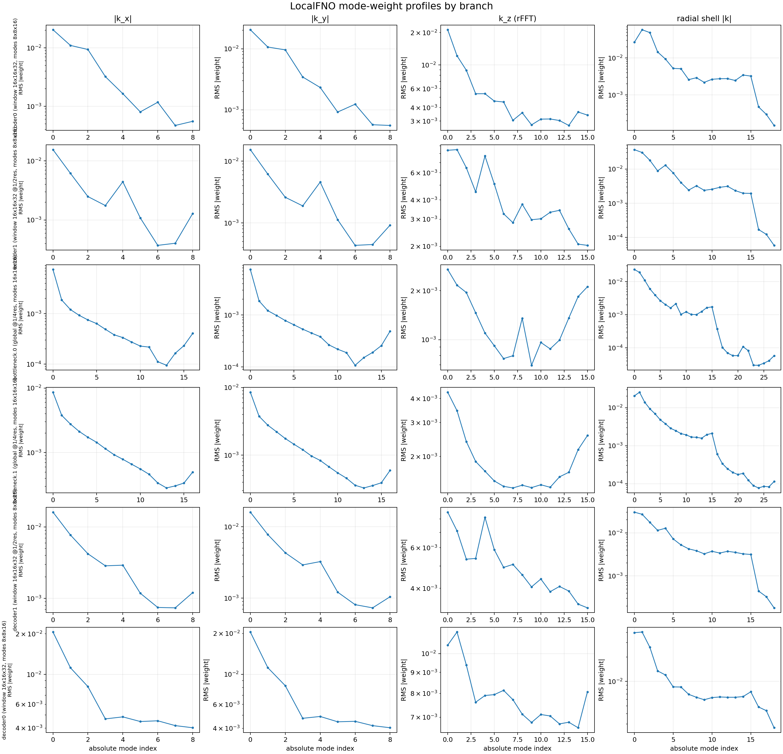
4 · OUTLOOK
What's next
▪ Run expwall in 3-D — the front-width defect is ~3.5× worse there; the loss is already merged.
▪ Fix the LOS grid: the cube cache discards 87% of front sharpness before training (uniform-z → 12.7% recovered). A warped grid recovers 33% at the same budget.
▪ Spend LOS bandwidth: mode-weight diagnostic says the line-of-sight axis is the binding 3-D constraint (0.60–0.78 vs 0.03–0.20 transverse).
▪ SIREN × U-Net hybrid — full-frequency global kernel + the Gibbs-free local path.
▪ FNO + WHNO ensemble and the shift-consistency test for the Walsh dyadic-convolution caveat.
Per-branch mode weights: LOS pressed against truncation edge
14
Notes:
~40s. Four concrete next steps. expwall in 3-D is the top priority. The LOS grid is a data-side fix that should arguably have come first. And the diagnostic shows the line-of-sight axis is where bandwidth is actually tight in 3-D.

Slide 15
4 · OUTLOOK
Back to the thesis
▪ The goal is inference, not pixels. This surrogate is the forward model for simulation-based inference.
▪ P1: extract renormalized EFT coefficients {b₁ˣ, b₂ˣ, bᵇ²ˣ, Pεε} across simulators — the simulator-independent representation.
▪ P2: target EFT coefficients rather than native parameters to beat cross-simulator generalization (vs the multi-simulator-training baseline).
▪ Consequence of this work: the emulator's residual power should be compared to the EFT stochastic term Pεε; and we now know to pick the sharp end of the frontier for morphology-sensitive inference.
Thank you.
15
Notes:
~30s. Wrap up: the point of the surrogate is inference. P1 characterizes the EFT coefficients across simulators; P2 uses them as inference targets to beat simulator dependence. The emulator feeds that pipeline, and the frontier we just measured tells us which accuracy regime to buy.

