Slide 1
MASTER'S THESIS • WORK IN PROGRESS
Learning the 21 cm
reionization field
From Fourier operators to local/global SirenFNO surrogates
Haris • August 2026
Notes:
Timing: 0:15
Set up the question: can a compact neural operator regenerate the near-binary 21cmFAST neutral-fraction lightcone accurately enough for inference, including its morphology?
[Sources]
- /Users/kaharis/Documents/Vaults/CompAstro/wiki/thesis/Talks/euCAIF Talk FNOs.md
[/Sources]

Slide 2
21 cm maps the ionization field
SATURATED-SPIN-TEMPERATURE LIMIT
δTᵦ ∝ x_HI (1 + δₘ) × RSD
When Tₛ ≫ T_CMB, the spin-temperature factor is ≈ 1.
x_HI = 1: neutral gas, bright 21 cm signal
x_HI = 0: ionized bubble, signal suppressed
The mean x̄_HI(z) gives the global history; the spatial boundaries give the morphology.
PHYSICS
02
Notes:
Timing: 0:50
Keep the theory short. The observable depends on neutral fraction, matter density, spin temperature, and velocities. In the heated EoR limit, x_HI is the dominant on/off morphology. Point to the image: the target is nearly binary and its sharp walls are physically meaningful.
[Sources]
- /Users/kaharis/Documents/Vaults/CompAstro/wiki/concepts/Brightness Temperature.md
- /Users/kaharis/Documents/Vaults/CompAstro/wiki/concepts/Neutral Fraction.md
- /Users/kaharis/Documents/Vaults/CompAstro/wiki/thesis/findings/figures/ufno-detailed_20260606-234954_job3966888/comparison_3d_test_cone3553.png
[/Sources]

Slide 3
The task is a conditional field-to-field operator
INPUTS
NEURAL OPERATOR
GROUND TRUTH
δₘ(x, y, z)
+ 11 parameters
+ 1/(1+z)
Gθ
x_HI(x, y, z)
∈ [0, 1]
One set of weights learns a map between fields—not a lookup on one fixed image grid.
Sharp ionization fronts across cosmic time
6,600 cones • 140 × 140 × 256 • z = 5 → 25 • 80 / 10 / 10 split
DATA + TASK
03
Notes:
Timing: 0:45
Explain the learning problem before the architectures. Each sample is a full lightcone. Conditioning on all eleven astrophysical/cosmological parameters was essential; it changed the problem from an ambiguous density-only map into a learnable conditional operator.
[Sources]
- /Users/kaharis/Documents/Vaults/CompAstro/wiki/thesis/findings/FNO Lightcone Experimental Findings.md
[/Sources]

Slide 4
Operator slot mattered more than basis choice
01 GLOBAL OPERATOR
02 MATCH THE BASIS
03 MEASURED LESSON
FNO
FFT → learned low-mode weights → inverse FFT.
Fast global context, but a smooth truncated basis is awkward for discontinuities.
Wavelet NO
Local, multiscale Haar features.
WHNO
Global Walsh–Hadamard step waves for piecewise-constant structure.
Global-slot WHNO reached 2-D RMSE 0.1453.
Changing where the transform acts mattered more than changing the local branch itself.
MODEL JOURNEY
04
Notes:
Timing: 1:00
Describe neural operators as learnable integral/convolutional maps. The first move was FNO. Wavelets and Walsh–Hadamard then changed the representation. The surprising empirical lesson was architectural: the global bottleneck benefited most from the non-Fourier transform.
[Sources]
- /Users/kaharis/Documents/Vaults/CompAstro/wiki/concepts/Fourier Neural Operator.md
- /Users/kaharis/Documents/Vaults/CompAstro/wiki/papers/Pérez Cuadrado et al 2025 (WHNO).md
- /Users/kaharis/Documents/Vaults/CompAstro/wiki/thesis/findings/Structured-Transform Operator Findings.md
[/Sources]

Slide 5
The final design gives each ingredient a distinct job
U-NET BACKBONE
SIREN
k → Rφ(k)
Multiscale local paths and skip connections preserve compact structure.
U-Net skip
local
operator
decode
LOCAL / GLOBAL SPLIT
Windowed operators handle detail; one whole-field bottleneck handles timing and long-range morphology.
13 ch
x
global
bottleneck
SIREN HYPERNETWORK
k → Rφ(k): generate the spectral kernel over the full grid instead of storing a truncated mode table.
MODEL JOURNEY
05
Notes:
Timing: 1:05
This is the synthesis. U-FNO supplied the local convolutional path; the Local-FNO introduced explicit windowed/local and whole-field/global slots; SirenFNO replaced per-mode tables with an implicit full-frequency kernel. Keeping the slots swappable made the experiments controlled rather than anecdotal.
[Sources]
- /Users/kaharis/Documents/Vaults/CompAstro/wiki/papers/Shi et al 2025 (SirenFNO).md
- /Users/kaharis/Documents/Vaults/CompAstro/wiki/thesis/findings/FNO Lightcone Experimental Findings.md
- /Users/kaharis/Documents/Vaults/CompAstro/wiki/thesis/planning/Windowed Local-FNO U-Net Plan.md
- /Users/kaharis/Documents/Vaults/CompAstro/wiki/thesis/findings/z_re Map Training Results.md
[/Sources]

Slide 6
Local SirenFNO nearly reaches the plain U-FNO floor
0.0467
plain U-FNO
GroupNorm baseline
0.0488
Local SirenFNO
only 4.5% higher
0.0548
global SirenFNO
17% higher
Held-out 3-D RMSE at each run’s best epoch ≤ 19 → lower is better
Best epoch ≤ 19 on the common 3-D grid; held-out cones.
RESULTS • GLOBAL L²
06
Notes:
Timing: 1:05
This is the plain held-out RMSE ranking at the common twenty-epoch score cap. U-FNO still leads. The important result is how close the implicit-kernel models come: Local SirenFNO is within 4.5 percent of the plain U-FNO score, while the global-only SirenFNO also closes much of the pure-operator gap.
[Sources]
- /Users/kaharis/Documents/Vaults/CompAstro/wiki/thesis/findings/Loss Objective and Operator Basis Sweep.md
[/Sources]

Slide 7
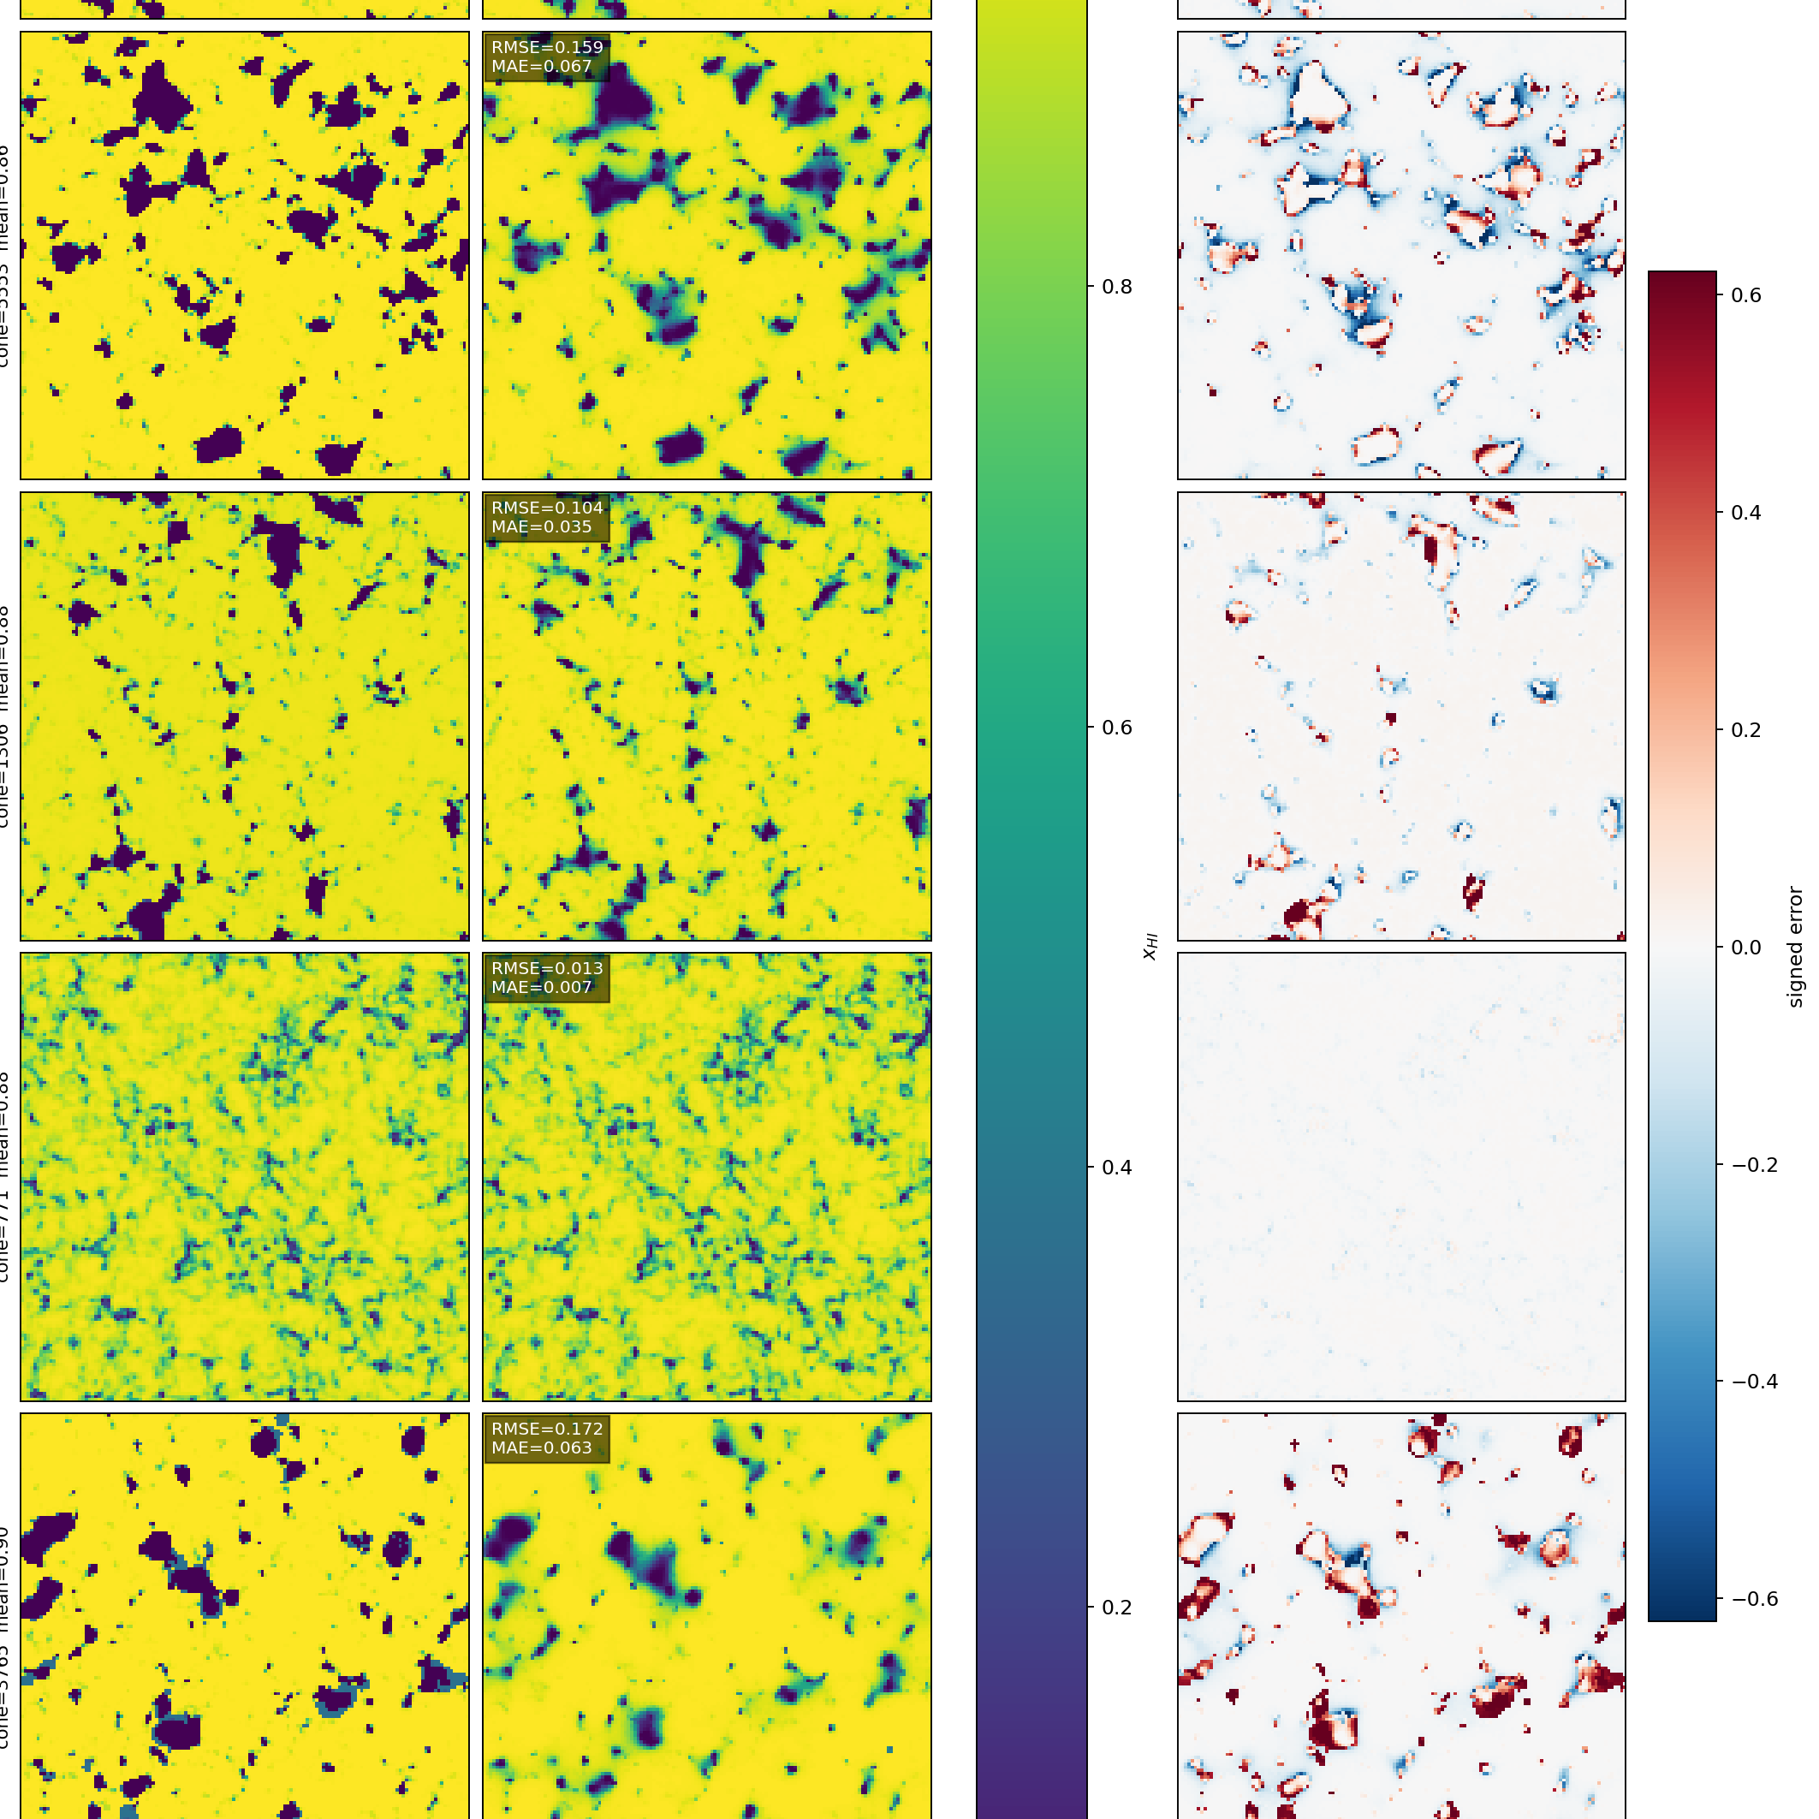
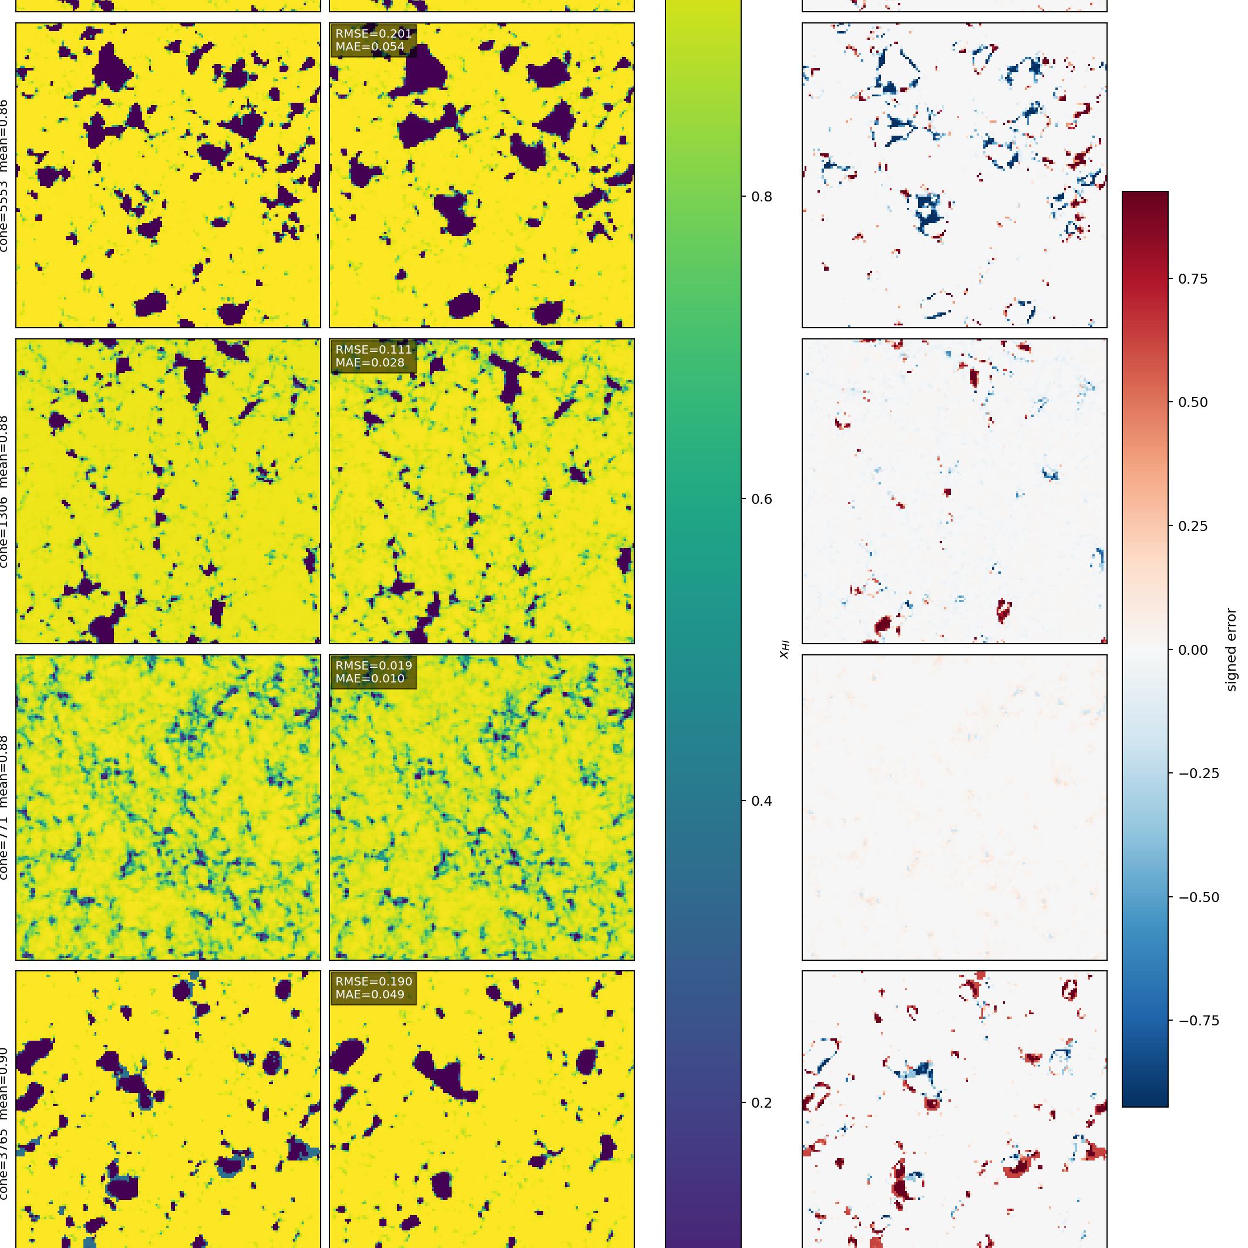
Sharper walls cost global L² accuracy
L² BASELINE
EXPWALL s = 16
METRIC
L²
EXPWALL
Held-out RMSE
0.1448
0.1767
Front width
2.89 px
1.16 px
High-k power ratio
0.51
0.82
Truth front width: 1.46 px
2-D x_HI slices • 384 shared held-out examples
No free lunch yet: truth-like edges cost ≈22% in global RMSE.
RESULTS • EDGES
07
Notes:
Timing: 1:15
This is the central tradeoff. L2 prefers a conditional mean when the wall position is uncertain, so it hedges with a ramp. Exponential wall-weighted absolute error instead selects a side. It recovers truth-like width and much more high-k power, but the field RMSE rises by about twenty-two percent.
[Sources]
- /Users/kaharis/Documents/Vaults/CompAstro/wiki/thesis/findings/Edge and Wall-Placement Losses.md
- /Users/kaharis/Documents/Vaults/CompAstro/wiki/thesis/findings/figures/xhi2d-wall-losses_20260728/whno_glob_baseline_representative_z_slices.png
- /Users/kaharis/Documents/Vaults/CompAstro/wiki/thesis/findings/figures/xhi2d-wall-losses_20260728/expwall16_representative_z_slices.png
[/Sources]

Slide 8
Bubble scales drift even when topology looks right
+9.3%
largest mean
scale bias
≤ 0.017
JS divergence:
distribution shape is close
The topology can look right while its characteristic scale drifts.
RESULTS • MORPHOLOGY
08
Notes:
Timing: 0:55
RMSE does not ask whether the bubble population is physically right. The U-FNO recovers the distribution shape well, with small JS divergence, but the characteristic size is biased by several percent and peaks near nine percent in one stage bin. That is a physically meaningful error for power spectra and EFT-scale interpretation.
[Sources]
- /Users/kaharis/Documents/Vaults/CompAstro/wiki/concepts/Bubble Size Distribution.md
- /Users/kaharis/Documents/Vaults/CompAstro/wiki/thesis/findings/figures/bubble-size_20260722/bubble_size_metrics.csv
[/Sources]

Slide 9
Next: optimize for inference—not voxel RMSE
01 3-D SHARPNESS
02 DATA FIDELITY
03 INFERENCE CRITERION
Run expwall in 3-D.
Re-check front width, high-k power, and BSD together—not as isolated metrics.
Rebuild the warped LOS cache and compare on a common physical grid with proper volume weighting.
Choose the operating point using SBI summaries and cross-simulator robustness—not voxel RMSE alone.
Goal: a fast surrogate that is honest about morphology.
OUTLOOK
09
Notes:
Timing: 0:45
Close by resolving the opening. The architecture is now competitive and compact; the unresolved decision is what fidelity the inference pipeline actually needs. The next experiments connect the sharpness lever, the LOS sampling limit, and the physical summary statistics in one evaluation.
[Sources]
- /Users/kaharis/Documents/Vaults/CompAstro/wiki/hot.md
- /Users/kaharis/Documents/Vaults/CompAstro/wiki/thesis/findings/Edge and Wall-Placement Losses.md
- /Users/kaharis/Documents/Vaults/CompAstro/wiki/thesis/findings/Warped LOS Grid Evaluation.md
[/Sources]

