Slide 1
Hospital Quality and Insurance Base Rates
Python healthcare analytics project

Slide 2
Project Aim
Determine whether Blue Distinction status and CMS Overall Hospital Star Ratings are associated with higher hospital base rates for inpatient spine surgery DRGs.

Slide 3
Data Matching Summary
Hospitals in base-rate dataset: 346
CMS source hospitals: 5424
CMS matches by CCN: 136
CMS fallback name matches: 90
CMS ratings available: 156
Blue Distinction accepted: 30
Blue Distinction manual review: 35

Slide 4
Key Statistical Results
Hospital-level Welch t-test: estimate=2.8e+03, p=0.0511
Mann-Whitney U test: estimate=2.86e+03, p=0.029
DRG-adjusted log-linear regression: estimate=21.2, p=0.0354
CMS Spearman correlation: estimate=0.24, p=0.00392
CMS log-linear regression: estimate=15.9, p=0.000107

Slide 5
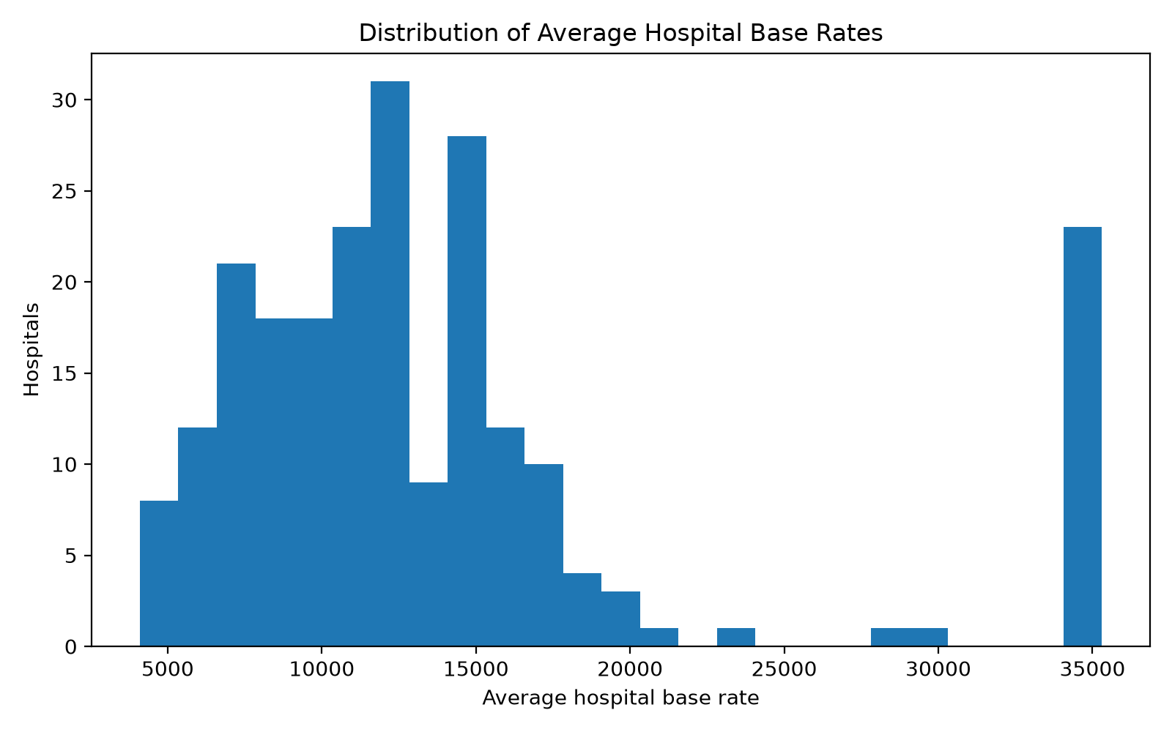
Average Base Rate Histogram

Slide 6
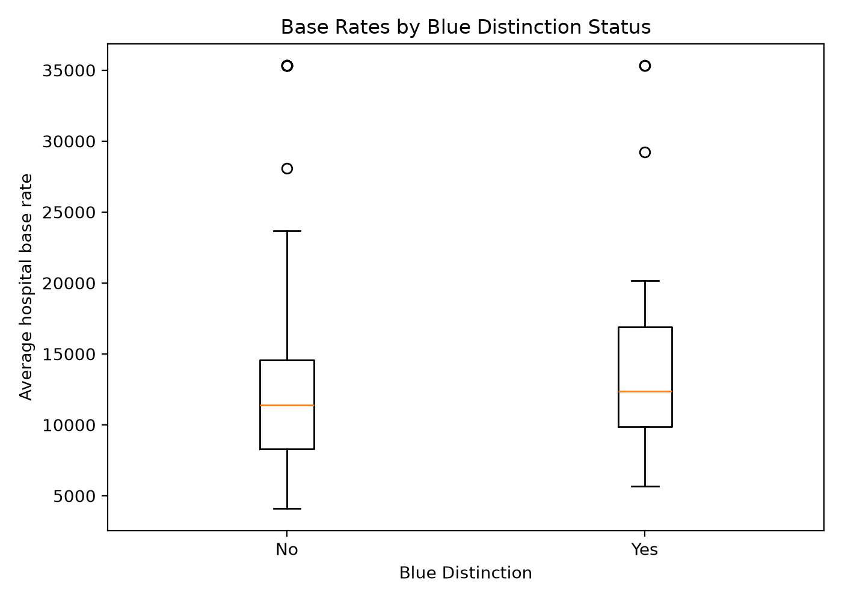
Blue Distinction Boxplot

Slide 7
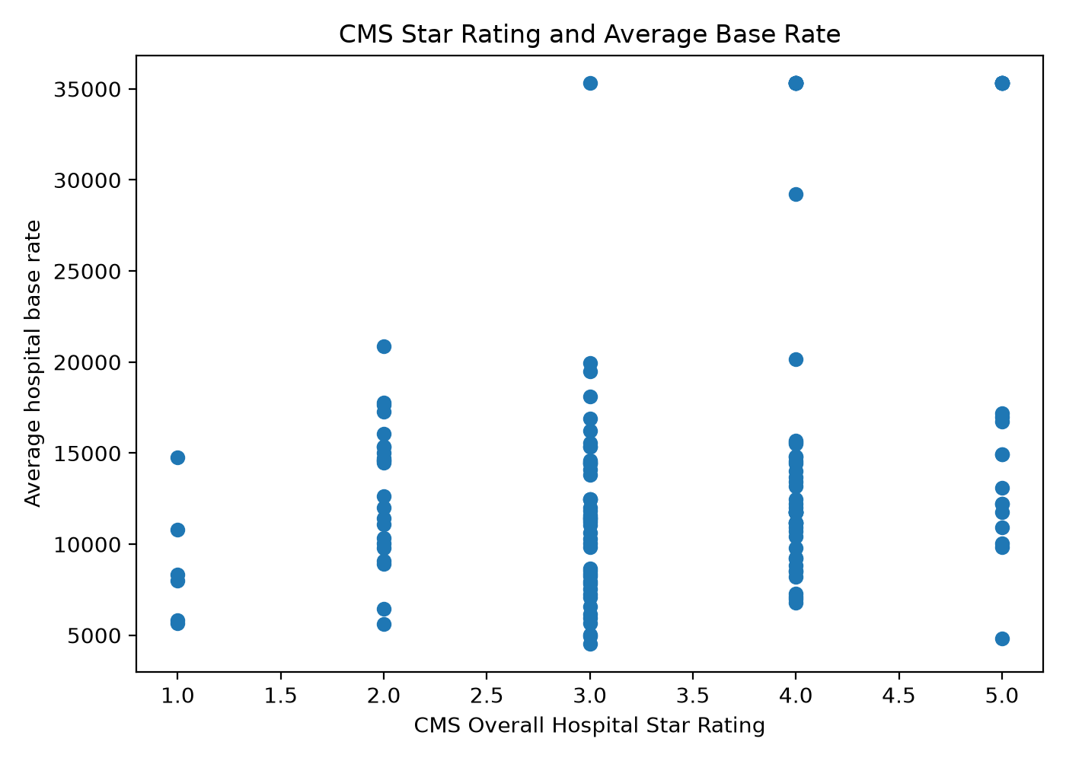
Cms Rating Scatterplot

