Slide 1
Geoinformation system of vehicle routing and parameters of
voice interaction of subjects of logistics
Ivan Naydonov
Department of Technology Management
Taras Shevchenko National University of Kyiv

Slide 2
Scientific relevance
Transport logistics, which should take into account the topology of the terrain, road network and other delivery options is one of the current trends of GIS
Effective GIS routing can reduce emissions from vehicles in the atmosphere, and the risk of environmental impact

Slide 3
Transport logistics
Transport logistics – the system of delivery, or the movement of any material objects or substances from one point to another using the best route
Last mile – the last stage of delivery from the distribution center to customers. The least effective of the entire supply chain, cost up to 28% of the cost of delivery

Slide 4
What logistics do now?
Decide which vehicle will carry the load, but do not create a specific route, leaving this decision to the drivers
Develop planned routes manually without involving automated systems
Oriented towards mass-dimensional parameters, and takes time requirements into account only partially which cannot guarantee the principal feasibility of routes

Slide 5
Why do they do that?
Mass and dimensions parameters can be calculated in total regardless of the order but timing may be checked only for a specific route
Calculation of such route goes beyond human capabilities without the use of technology
Calculating routes for individual vehicles do not make sense – it is needed to solve the problem in general

Slide 6
Advantages of implementing of automatically calculation of the routes
Guaranteе of the principal feasibility of routes, excluding extraordinary situations
Increasing the level of service because of having a planned arrival time
  We can inform customers with more specific arrival time
  Customers will wait us exactly in that time without latency

Slide 7
Advantages of implementing of automatically calculation of the routes
Enhance monitoring and responses to unplanned situations
  Clear understand intentions of driver and check them using GPS monitoring
  Predict whether vehicle has time to serve all points of delivery in time and see possible violation of customer`s time windows beforehand
Economy by improving the efficiency of the automatically planned route
  At least unlink quality of route from human factors

Slide 8
Problems in implementation of such systems
Exact solution of VRP is not possible and time is limited, so we need to use fast heuristics
Personnel resistance for innovations
  Drivers are used to obtain routing formed only on territorial and mass-dimensional criteria, but time limits are treated fairly formal
  Changes in the usual plans are perceived negatively, extremely up to sabotage
  Global cost optimisation isn't very useful for prettiness of individual routes

Slide 9
System input parameters
Mass-dimensions parameters – known in advance
Allowed time windows – determined by the final customer
Time and distance of movement between two
points – a lot of already developed tools
Amount of time for service at point
  One of the most defining input parameters
  Can strongly influence the result of planning and possibility of its implementation in reality
  No reliable source of this kind of information

Slide 10
Ways to obtain service-time
Bad practice – use constant time for all points
Better – use categorization of points and apply constant time to categories
The best – use statistical analysis of the history of service time in points

Slide 11
Stopping time from analyzing GPS track
GPS data have some level of error, which may become worse depending on the quality of hardware, or depending on the serviced territory
Linking the stops and points of delivery clearly possible if only one stopping and one point of delivery are in a given radius

Slide 12
Supplement GPS with additional information
Attempts to require the driver to select the appropriate command in the mobile app on phone/tablet, results in driver’s strategy to marks all points as done before or after the fulfillment of all deliveries at the stop
Voice interface would not distract driver from his main task and will take command on the start and completion of the delivery

Slide 13
Advantages of voice interface
Gives us exact time of service of each delivery
We can automatically guide drivers with voice commands, preventing common mistakes
We can collect information about real-time problems and send it to the dispatcher in a formalised way
  Frees the hands of the driver
  Accelerates transfer and response on the information

Slide 14
Conclusions
The role of GIS in solving logistical problems include the topology of the terrain was considered
The importance of automating voice interaction component between dispatcher and driver was grounded
Key parameters of voice interactions that increase the efficiency of routing was highlighted
Prospects of further investigation were outlined

Slide 15
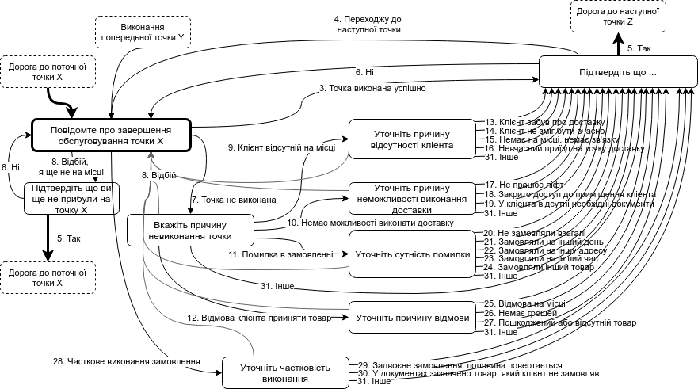
Voice interaction model: point

Slide 16
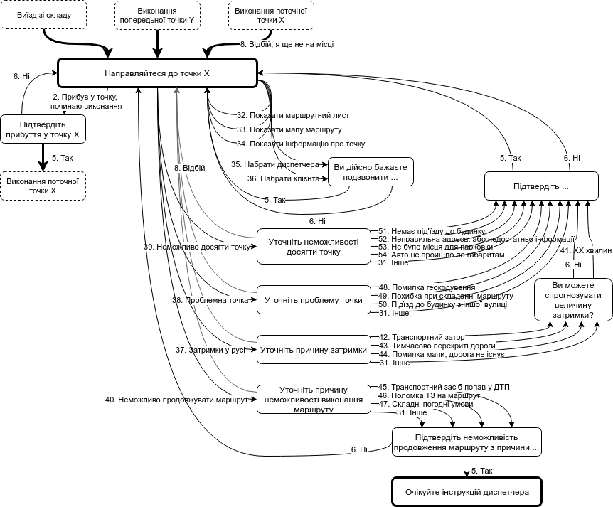
Voice interaction model: road

Slide 17
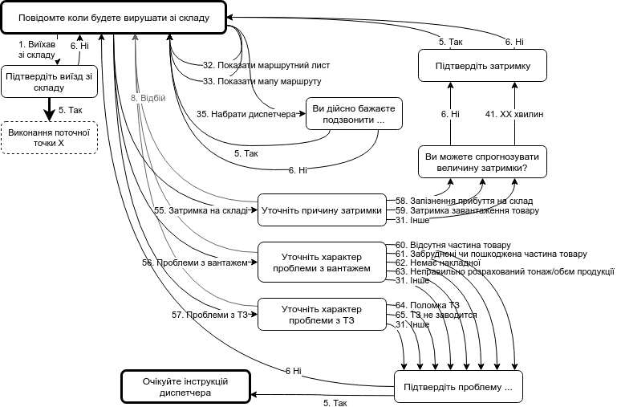
Voice interaction model: depot

Slide 18
Thank you for attention
Contact email: samogot@gmail.com

