Slide 1
Reference Slides

Slide 2
Smoot expander
Horizontal Settling Chamber
Smooth nozzle
Input line
Series Filter
Need some length to ensure laminar
Small resistance filter in case of agitation
Length, size given by settling rate, particulate volume with safety factor
May include lamella clarifiers, turbulent grating if length does not suffice
Curvature for centripetal assist and increased length
Area and length constrained by desire exit velocity and Re
Needs to be oblique cone, rather than right cone.

Slide 3
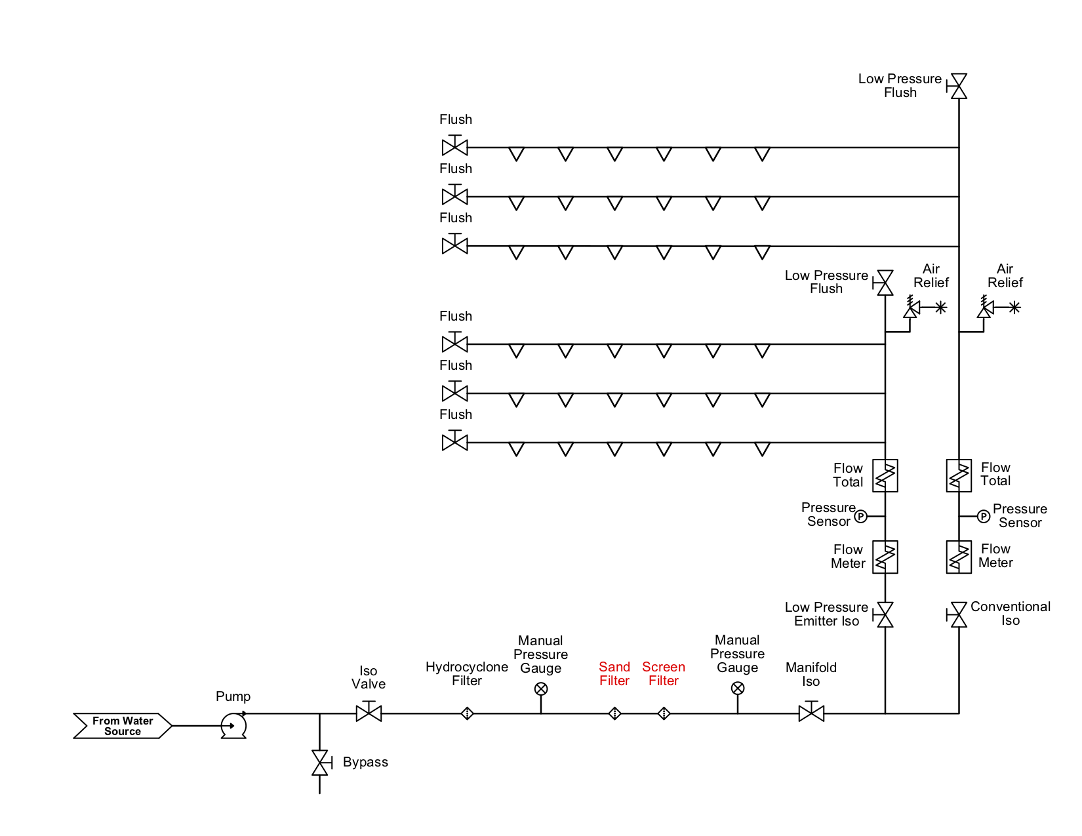
System Schematic
Our system is replacing 1 or 2 of the 3 filters in a typical system. Our system greatly reduces the pressure drop.
Horizontal Settling Tank

Slide 4
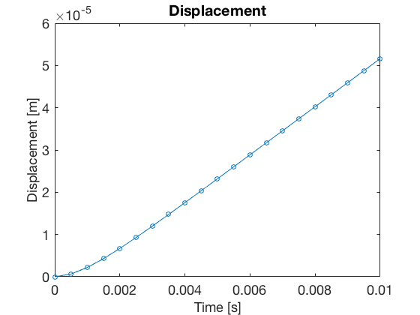
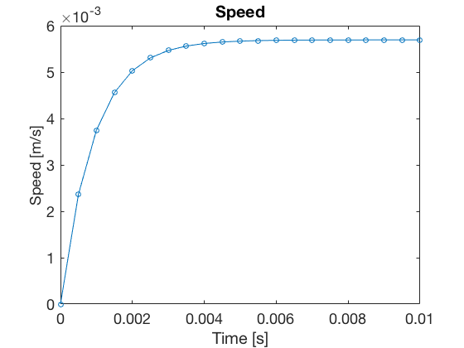
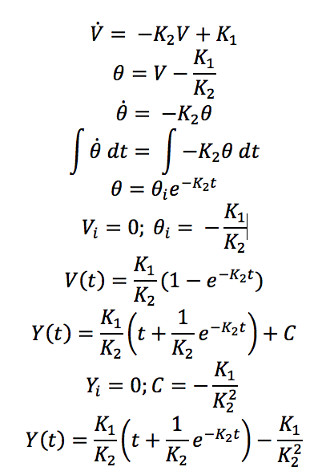
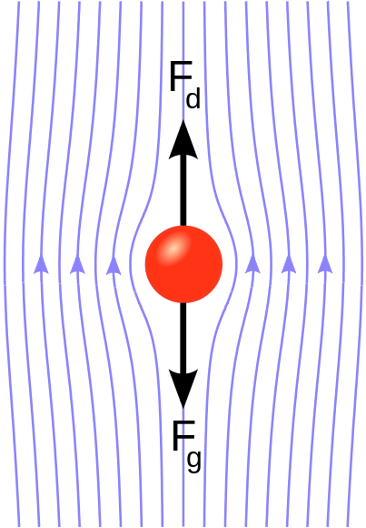
Settling Velocity / Settling Time Plots / Math
Since concentration is low 100-250 ppm, settling is unhindered. In stokes flow regime.
75μm particle of silica reaches terminal settling velocity in less than a second

Slide 5
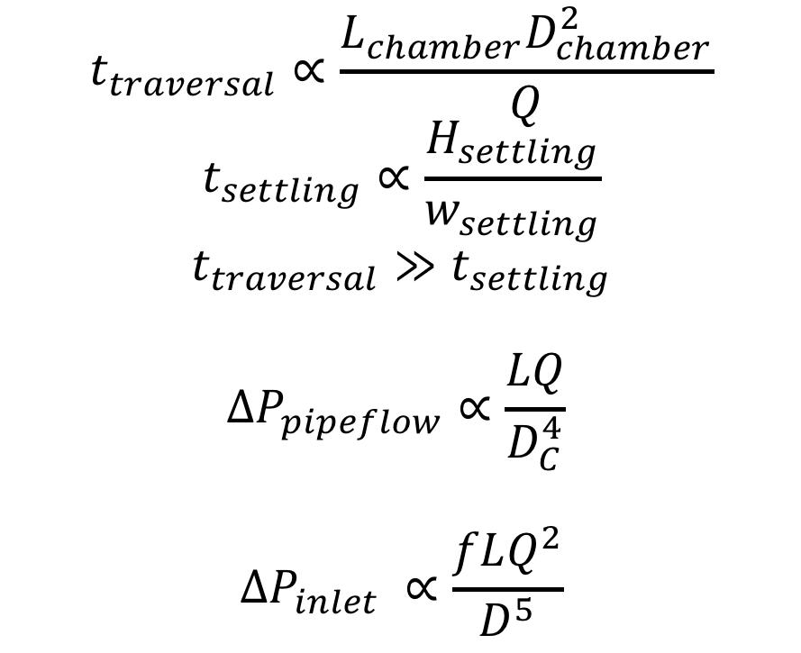
Order of Magnitude Arguments for Parameters
Seek to:
Minimize settling time
Maximize traversal time
Minimize pressure losses
Add diagonal plates (lamella clarifiers) to reduce settling height (H_settling)
Increase the chamber cross-sectional area (D_chamber) to increase traversal time.
Smoothly expand in to reduce inlet and outlet pressure losses (f)
Can setup up optimization including cost (L,D,t), safety factor (t_traversal/t_settling)
$$t_{traversal}∝\frac{L_{chamber}D_{chamber}^{2}}{Q}$$
$$t_{settling}∝\frac{H_{settling}}{w_{settling}}$$
$$t_{traversal}≫t_{settling}$$
$$ΔP_{pipeflow}∝\frac{LQ}{D_{C}^{4}}$$
$$ΔP_{inlet} ∝\frac{fLQ^{2}}{D^{5}}$$

Slide 6
Diagrams
Total cropped land
Irrigated land (48%)
Drip Irrigated land (3.5%)
Total cropped land
Total cropped land
Irrigated land (48%)
Irrigated land (43%)
Drip Irrigated land (3.5%)
Drip Irrigated land (3.5%)
(2018 - link)
(2013)
Outlet Expander
Inlet Expander
Collector (PVC)
Main Chamber (PVC)

Slide 7

$t_{traversal}=\frac{L_{chamber}}{V_{flow}}$ , $V_{flow}=\frac{Q}{\frac{1}{4}πD_{c}^{2}}$
$$t_{traversal}=\frac{L_{chamber}{πD}_{c}^{2}}{4Q}$$
$$t_{settling}=\frac{H_{c}}{w}$$
$$t_{traversal}>t_{settling}$$
$$L>\frac{4QH_{c}}{w{πD}_{c}^{2}}$$

