Slide 1
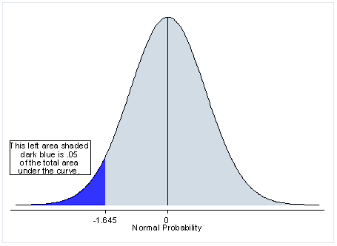
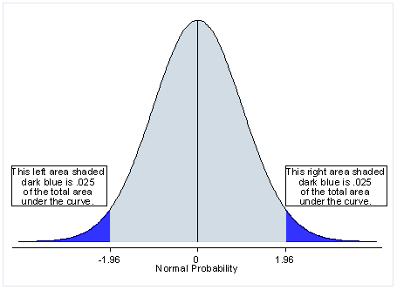
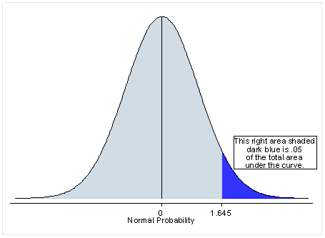
High-level graphical depiction of
One- vs. Two-tailed tests
Two-tailed
One-tailed

Slide 2
What this means for us superficially
One-tailed left test p-value < 0.05 → less likely to find matches in rest of genome than expected
One-tailed right test p-value < 0.05 → more likely to find matches in rest of genome than expected
Two-tailed test p-value < 0.05 → somehow different from expected

Slide 3
What this means for us in terms of significance
Unfortunately, as I pointed out before, I don’t think this tells us much
Basically, if we ever see a single hit in a terminator, we immediately get a one-tailed left p-value ~0.05, because there aren’t that many positions which can overlap terminators.
All this tells us is that getting a hit in a terminator is less likely than getting one in the rest of the transcript, which we already knew.
At least I think that’s what I’m getting from this…

