Slide 1
Online Transfer Services
By : Kunal Saini

Slide 2
Online Transfer Services System is a web-based application that deals with bank transactions which include various transfer modes. All details of Transfers are saved in the database. Online Transfer Services System project is developed using Nodejs and MongoDB,Pg including other libraries.

Slide 3
Problem Statement: When you visit the bank website for fund transfer purpose so there is a section i.e. online transfer services where we have NEFT, IMPS and UPI for fund transfer, where by using various mode of transfer of funds we transfer our funds so, in this project the customer can transfer funds in similar fashion using various modes of transfer i.e. NEFT, IMPS and UPI.

Slide 4
Our objective is to provide best user experience so that user can make transaction easily with security.

Slide 5
Project Overview :
Micro-Services
API Gateway
USERS Module
Admin
User Login
UPI Payment
NEFT Payment
ADMIN
IMPS Payment
Using JWT for user Authentication to access API

Slide 6
Admin Module API
CRUD
UPI
User need to be verify first and then can access the API’S
NEFT
IMPS
CRUD
USER
Using jwt for user Authentication

Slide 7
Micro-Services
Database
Architecture
Secure word and Keys are stored in encrypted format
Users
MongoDB
Users/Admin
API Request
Admin
Postgresql
API - Gateway
API Request
MongoDB
UPI
MongoDB
NEFT
API Request
IMPS
API Request
MongoDB

Slide 8
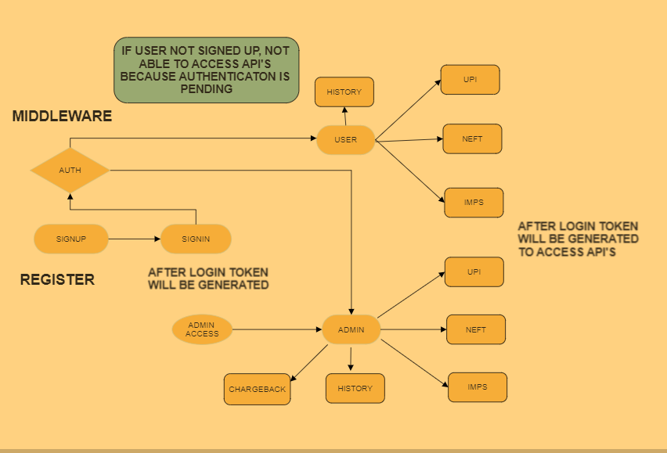

Slide 9


Password encryption (aes-256)
The GCM mode uses an initialization vector (IV) in its processing. This mode is used for authenticated encryption with associated data. GCM provides confidentiality and authenticity for the encrypted data and authenticity for the additional authenticated data (AAD). The AAD is not encrypted.
How does it works?
According to the AES, the AES algorithm uses a 128-bit symmetric, or single-key, block cipher that encrypts and decrypts information. The AES encryption process creates ciphertext, which is an unreadable, effectively indecipherable conversion of plaintext data, the version of information that humans can read and understand. The output of the encryption process, the AES ciphertext, cannot be read until a secret AES key is used to decrypt it.

Slide 10
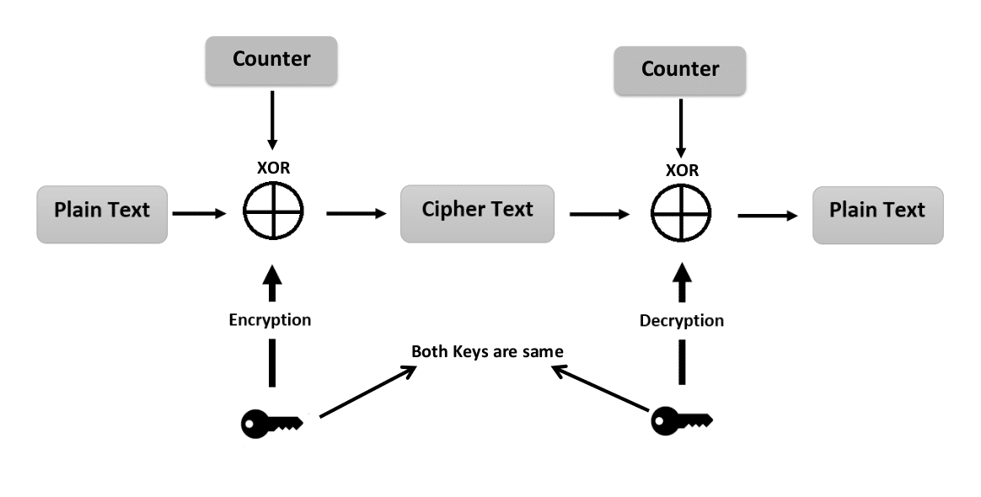

Slide 11
JMETER
The Apache JMeter is an open-source, purely Java-based software. The software is used to perform performance testing, functional testing, and load testing of web applications. It is used to test load testing functional behavior and measuring performance.

Slide 12


What Is Static Code Analysis?
Static analysis is a method of debugging that is done by automatically examining the source code without having to execute the program. This provides developers with an understanding of their code base and helps ensure that it is compliant, safe, and secure.
Static code analysis refers to the operation performed by a static analysis tool, which is the analysis of a set of code against a set (or multiple sets) of coding rules.

Slide 13

SonarQube:
SonarQube (formerly Sonar) is an open-source platform developed by SonarSource for continuous inspection of code quality to perform automatic reviews with static analysis of code to detect bugs and code smells on 29 programming languages. SonarQube offers reports on duplicated code, coding standards, unit tests, code coverage, code complexity, comments, bugs, and security recommendations. SonarQube can record metrics history and provides evolution graphs.

Slide 14
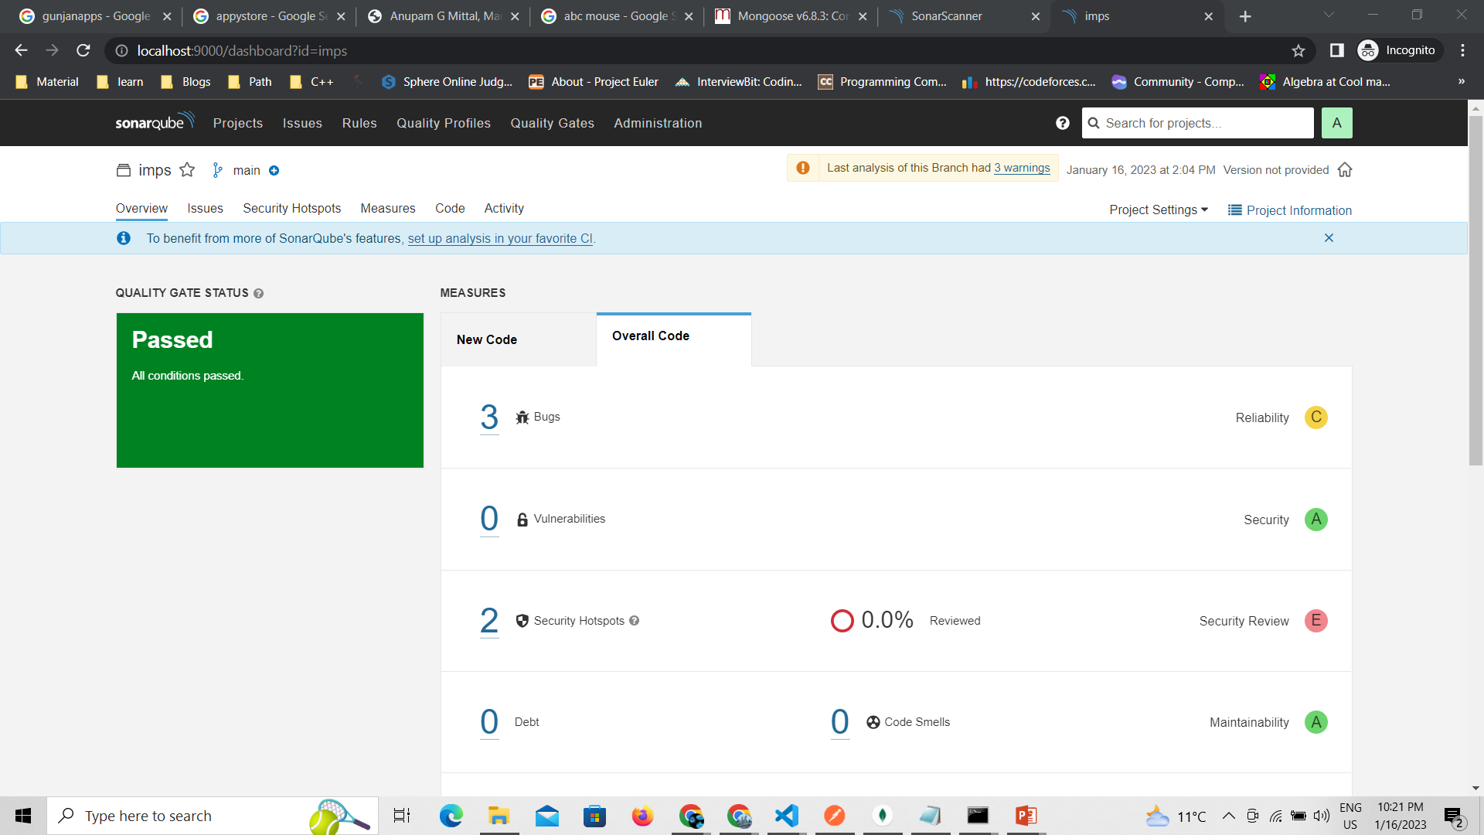

Slide 15
Conclusion The web app helps the user to do transaction fast and securely.

Slide 16


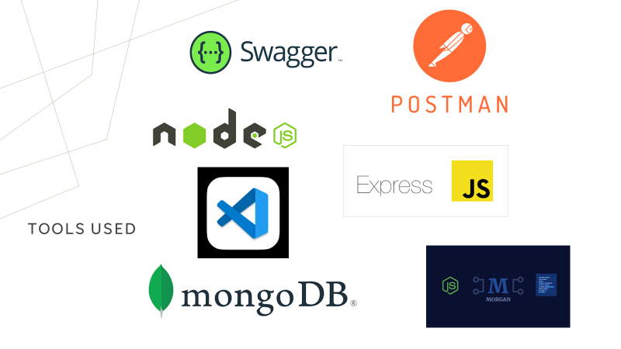
Tools and Technologies Required :

Slide 17
Thank you… Any Question?

