Slide 1

HTML
HYPER TEXT MARKUP LANGUAGE

Slide 2
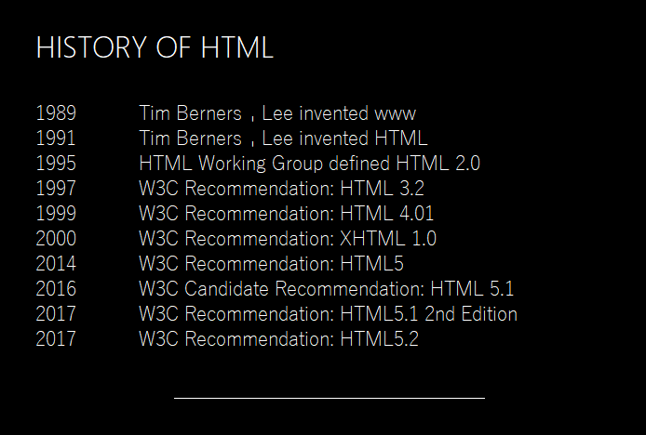

Slide 3

Information Source The massive traffic is on the web for data. WORLD MOST LEADING COMPANIES like Google, Microsoft and amazon are also digging information from the web nowadays.

