Slide 1
Detecting and Adjusting Images for Color Blindness
Kyle Turner-A20346759
Alena Hoxsey-A20384059

Slide 2
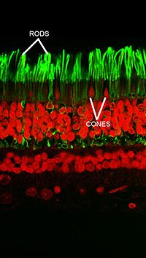
How Common is Color Blindness?
According to the National Institute of Health, 5-10% of the US population is color blind:
6% of Caucasian men
3% of Asian men
3% of Latino men
2% of African-American men
Less than .5% of women

Slide 3
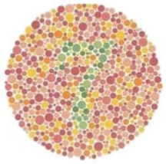
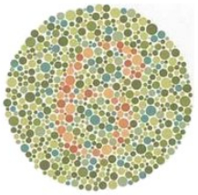
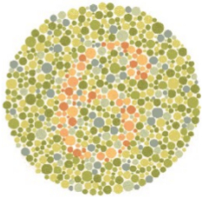
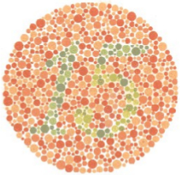

Training Data
The Ishihara test developed by Dr. Shinobu Ishihara at the University of Tokyo in 1917
Image 1-Number 7
Image 2-Number 6
Image 3-Number 6
Image 4-Number 15
Test data validated against other Ishihara tests

Slide 4
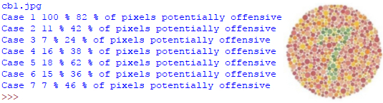
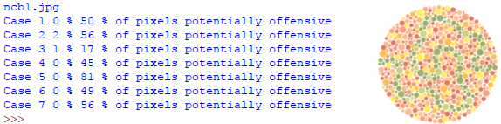
Evaluation Methods
Find pixels that are similar to those “typical” in the test images
Compare to similar colors to find “potentially offensive” colors
If an image is similar (even as small as 20%) to one of the test cases it should be corrected
Even if an image does not contain the exact colors, but has a number of “potentially offensive” pixels and should also be corrected
Left is training data (top) and validation data(bottom)

Slide 5
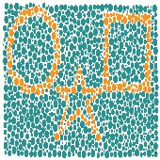
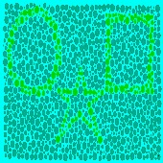
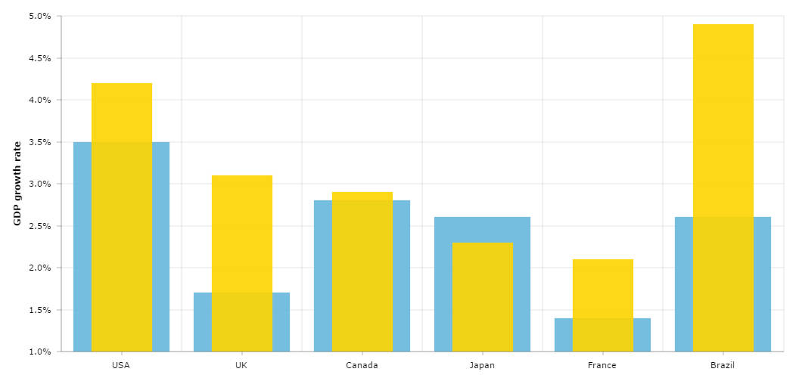
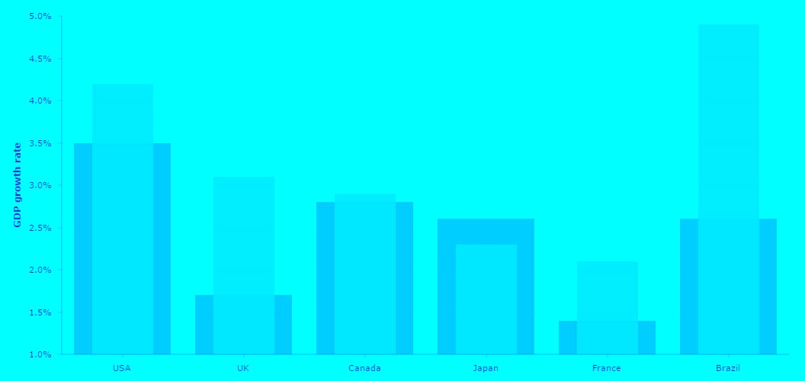
Adjusting Images
Image converted to CIEL*a*b*
Distances computed from image color set.
Set a for red/green or b for blue/yellow color blindness values to 0 to create initial new color set.
Simulated annealing to randomly step trying to reduce error of distances between colors in new set relative to distances in original image.
Map image to result color set and save.

Slide 6
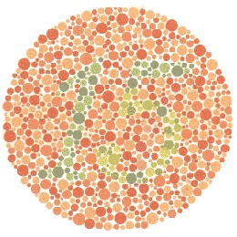
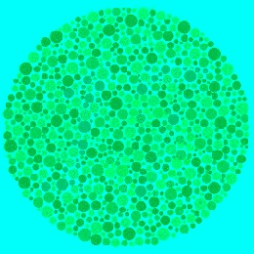
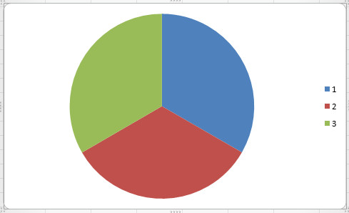
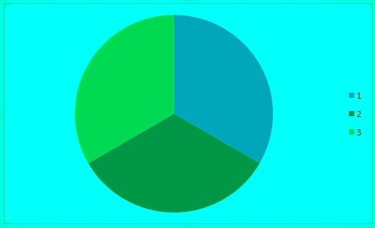
Adjustment Results
Run time is relative to the number of pixels in the image p, number of colors c in the image, and number of steps k in simulated annealing.
O(2p+c²+kc)
Best runtime for images with simple color sets.
Complexity of the color set has the biggest impact and a more complex color set requires larger k to restore image contrast during annealing.

Slide 7
Sources:
NIH Study:
https://www.cbsnews.com/news/race-gender-color-blindness-risk/
Ishihara tests:
https://colormax.org/color-blind-test/
Rod/Cone image:
https://nei.nih.gov/health/color_blindness/facts_about
Ishihara Biography:
http://fargblind.se/IshiharaFargblindhetstest.pdf

