Slide 1
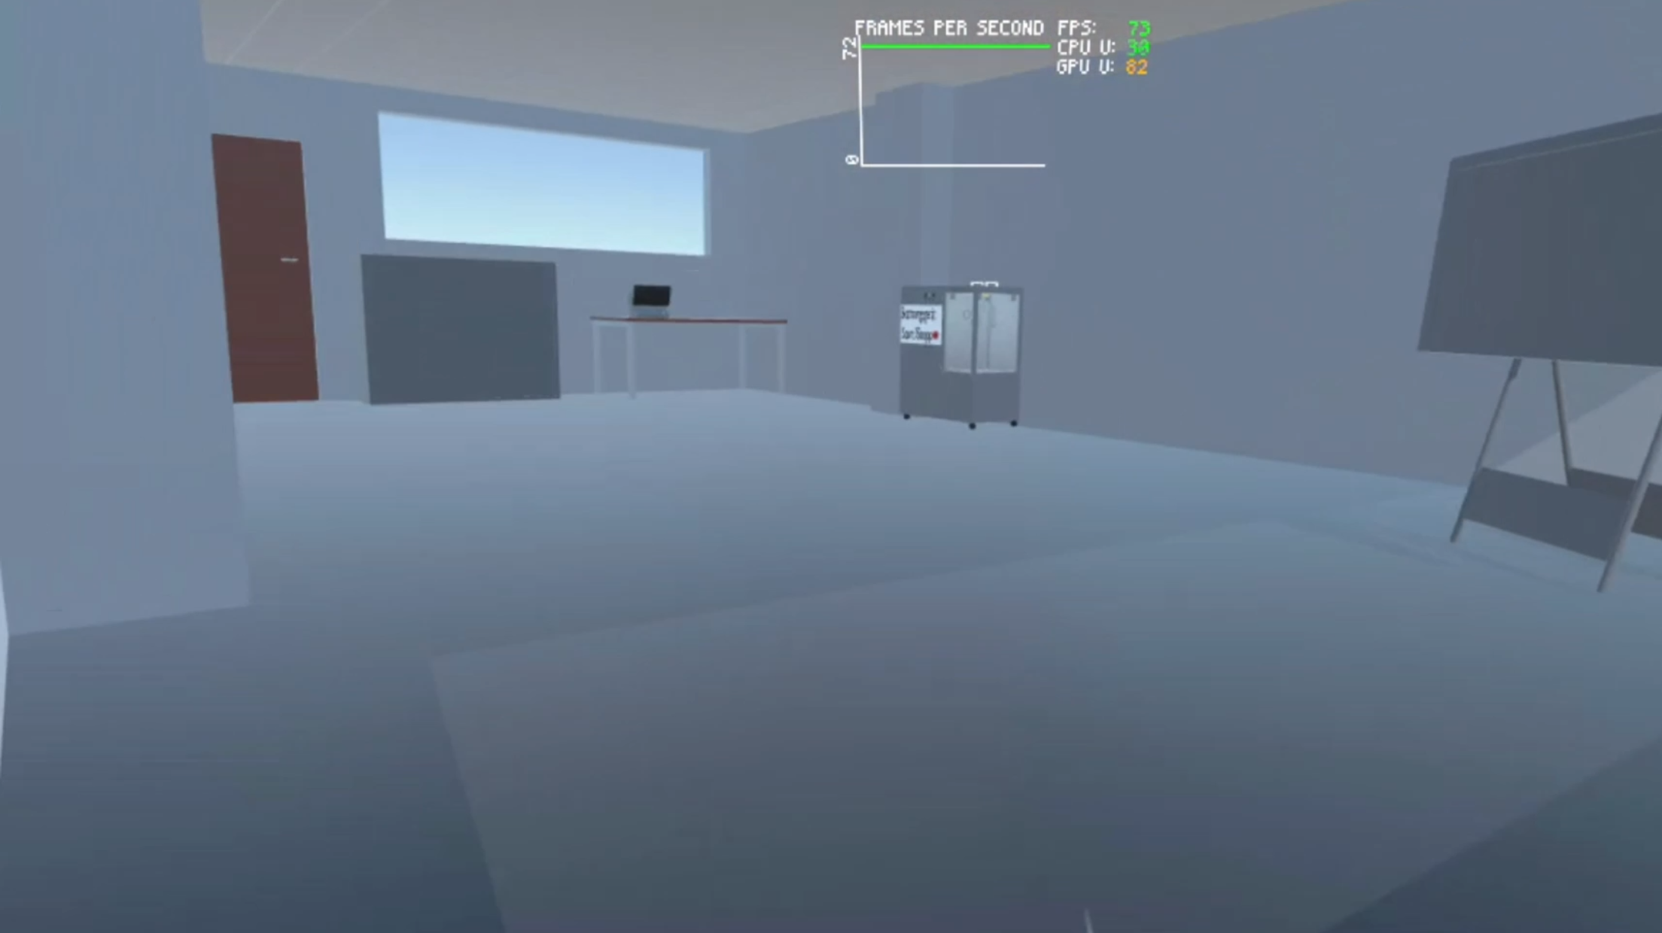
INNO2-ICU
Plachetzky Nicolai, Mohamed Nasr, Licina Edin, Kment Nicolas, Kiri Nertil

Slide 2

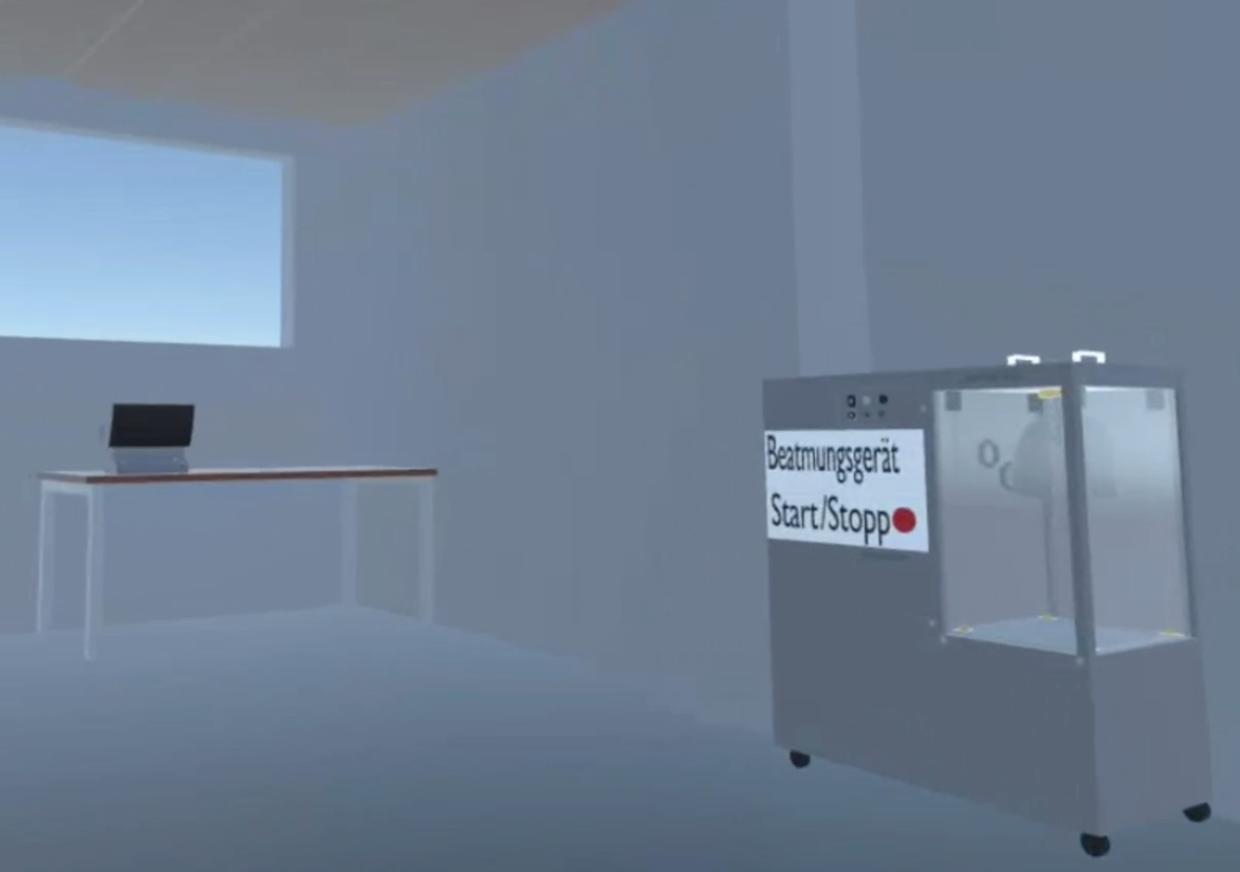
Goal
To create an immersive environment for the ICU (Intensive Care Unit) of the FH-Technikum in VR…
Certain simulations should be possible.
Focus:
Ventilator
Defibrillator

Slide 3
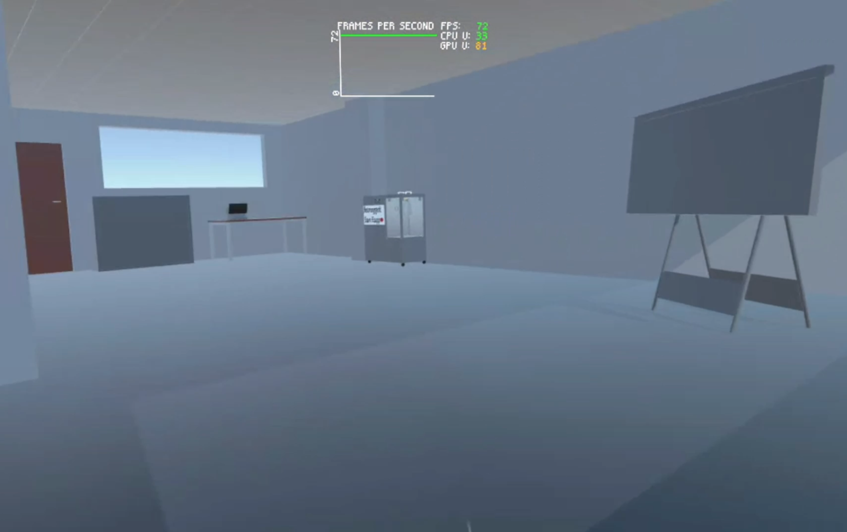
Current Status
Room + furniture & defibrillator + ventilator are in real proportions and have appropriate colours.

Slide 4
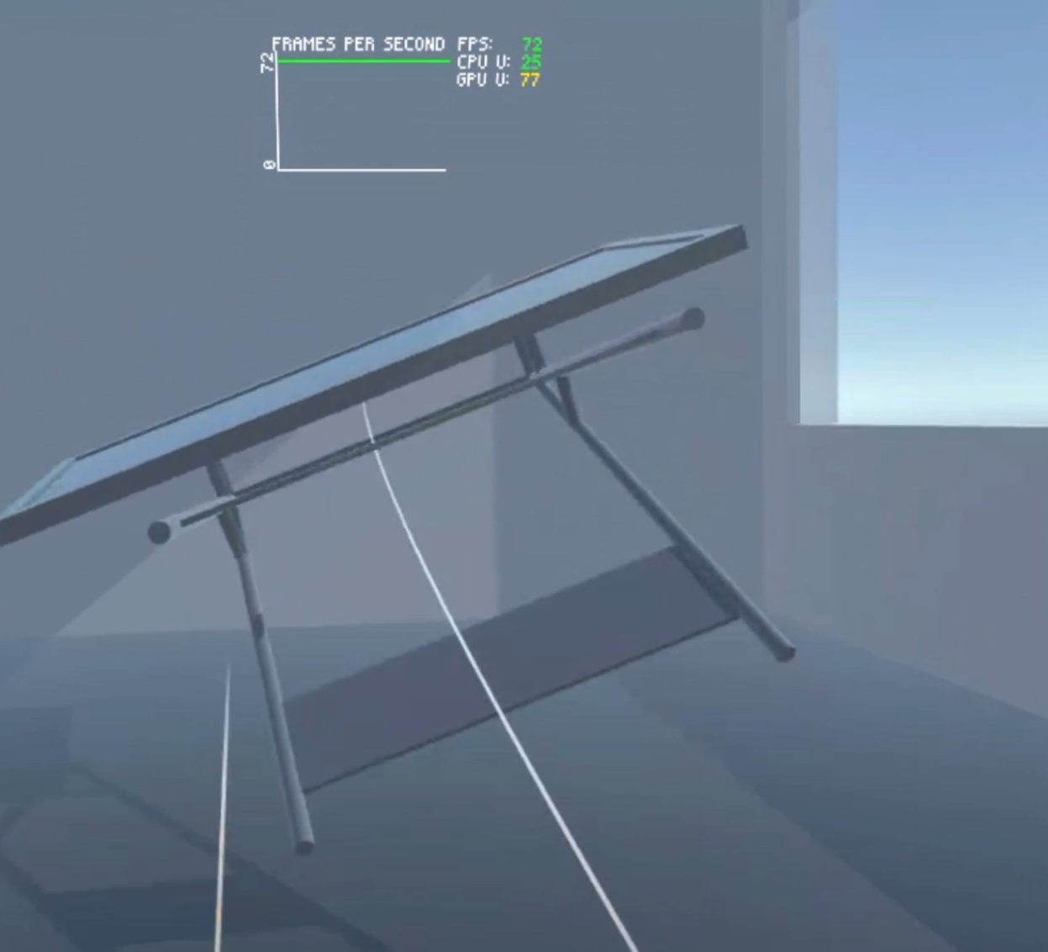
Grabbing
Objects can be picked up and moved.

Slide 5
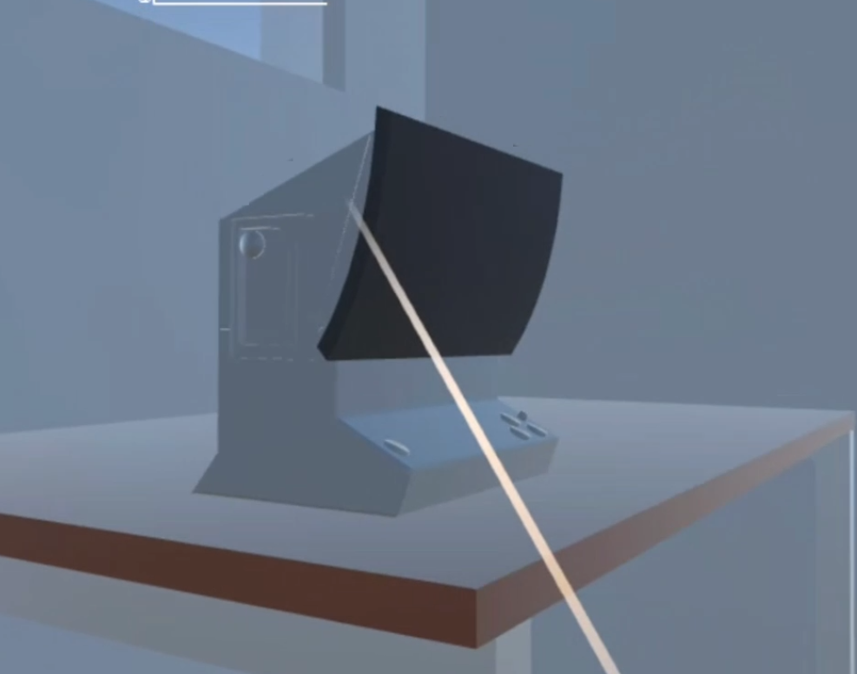
Defibrillator
Currently only as a movable object.

Slide 6
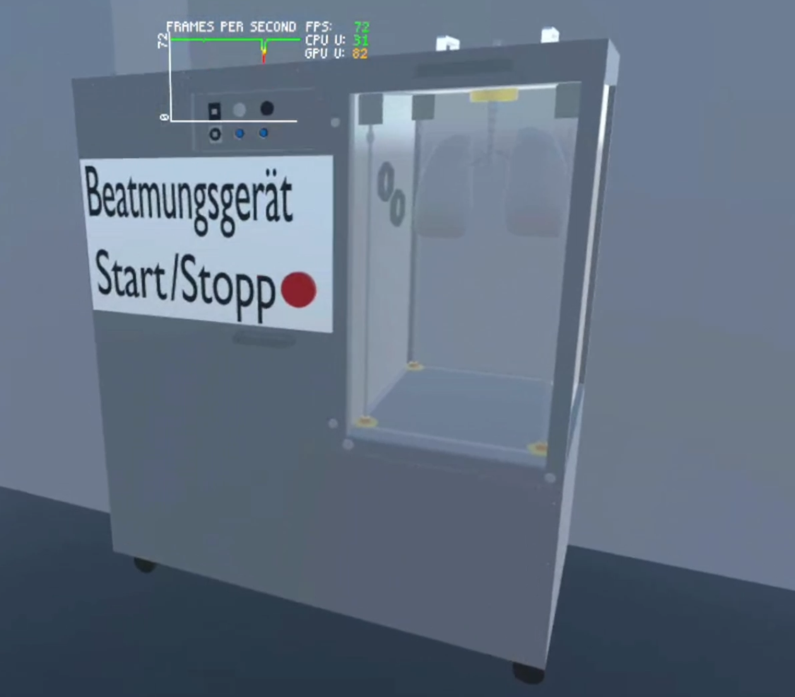
Ventilator
Finished!
Starts and stops the simulation at the push of a button
→ Next slide.

Slide 7
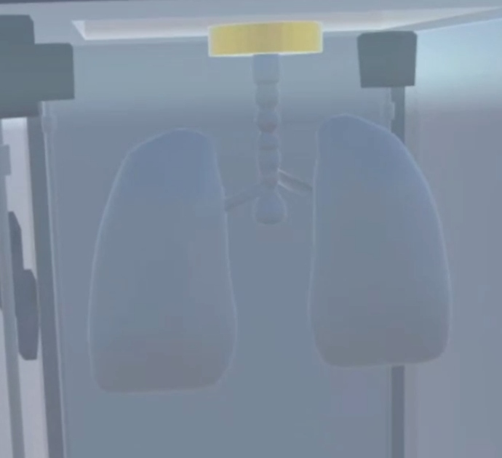
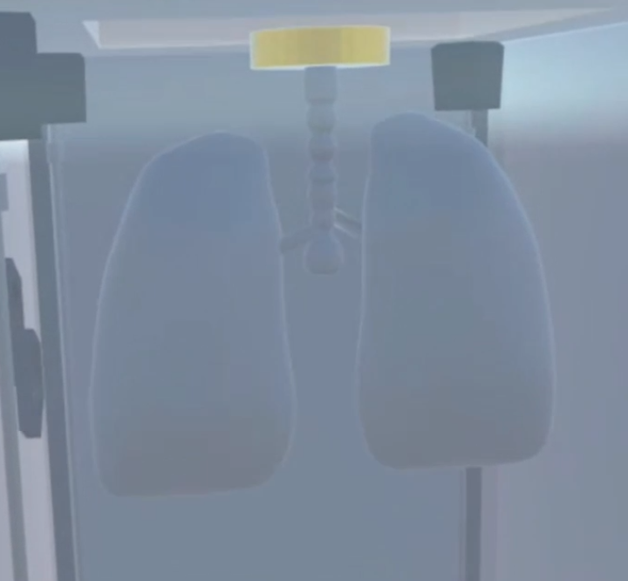
Lungs expand and contract... Better visible in the video.

Slide 8
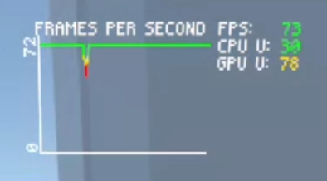
Performance
APK runs directly on the VR headset.
Runs consistently at maximum FPS (with a slight frame drop).

