Slide 1
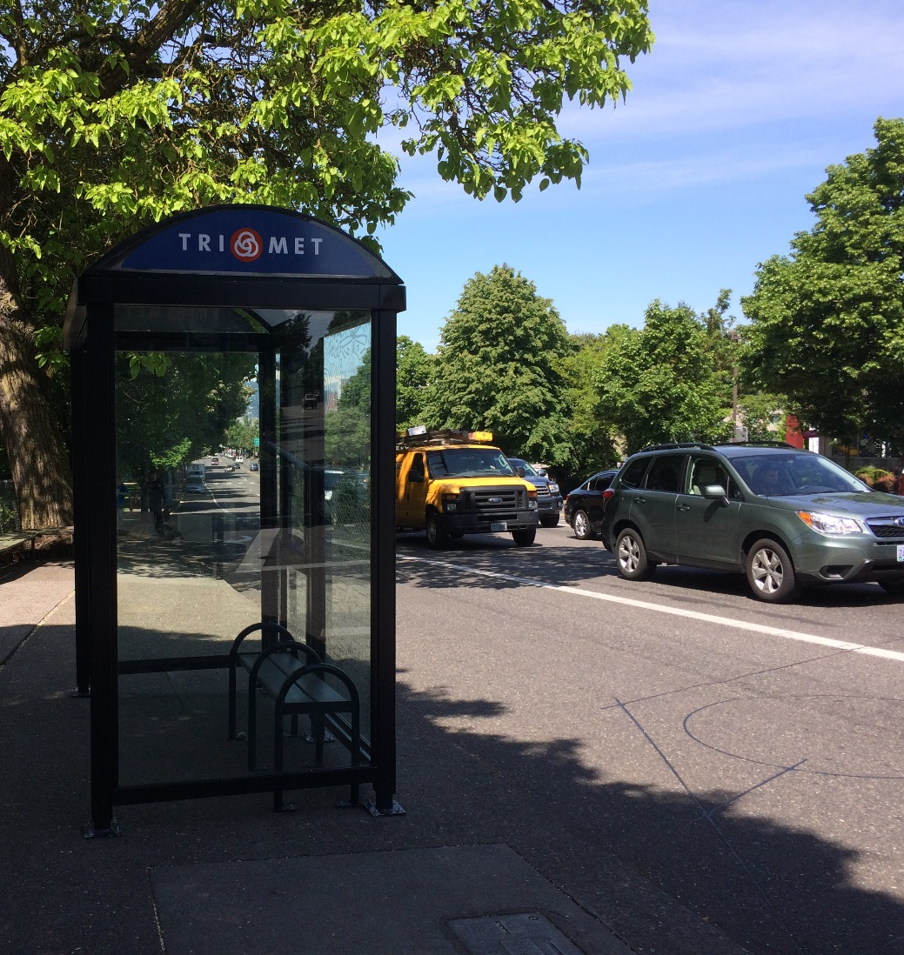
Understanding the Roadside Environment through Integrating Air Quality & Traffic-Related Data
Christine Kendrick

Slide 2
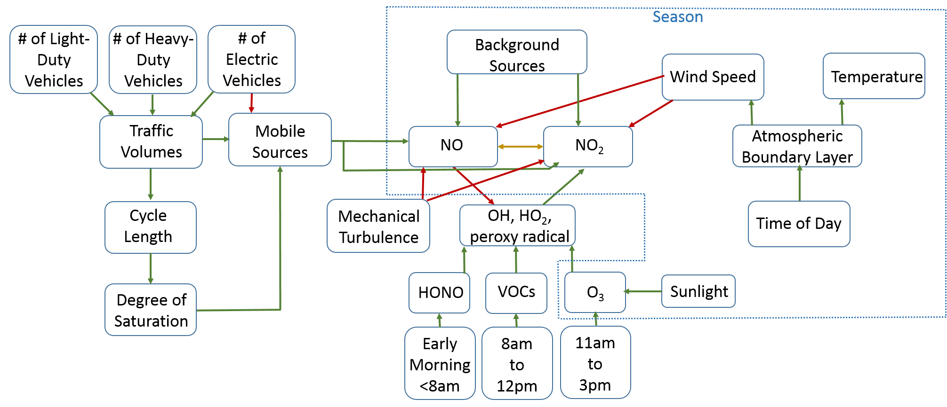

Slide 3
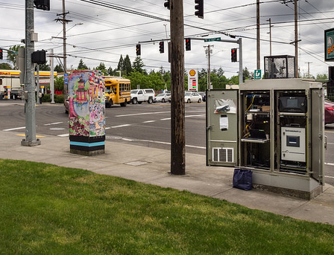
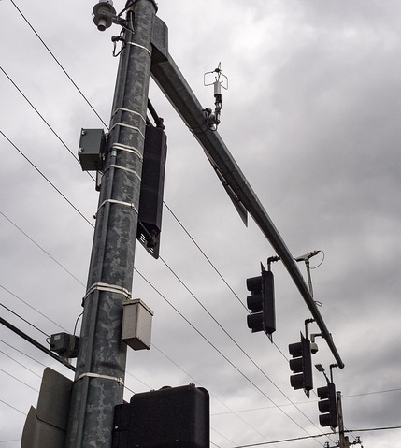
Roadside Data Collection

Slide 4
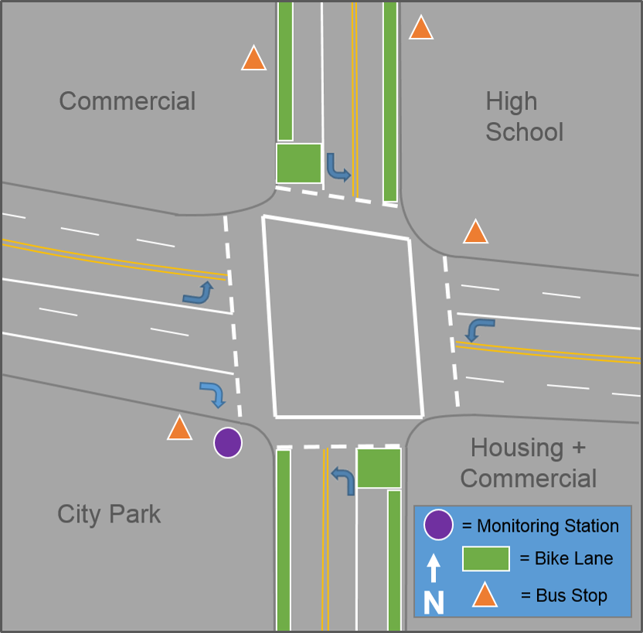
Roadside Data Collection
Continuous monitoring:
Teledyne T200 NO, NO₂, NOx chemiluminescence analyzer
TSI DustTrak DRX PM_{2.5}
Wind speed & direction
Temperature & relative humidity
Urban background data:
NO, NO₂, aerosols, meteorology
Sydney Coordinated Adaptive Traffic Signal System (SCATS)
traffic volumes
cycle lengths
green time, red time

Slide 5
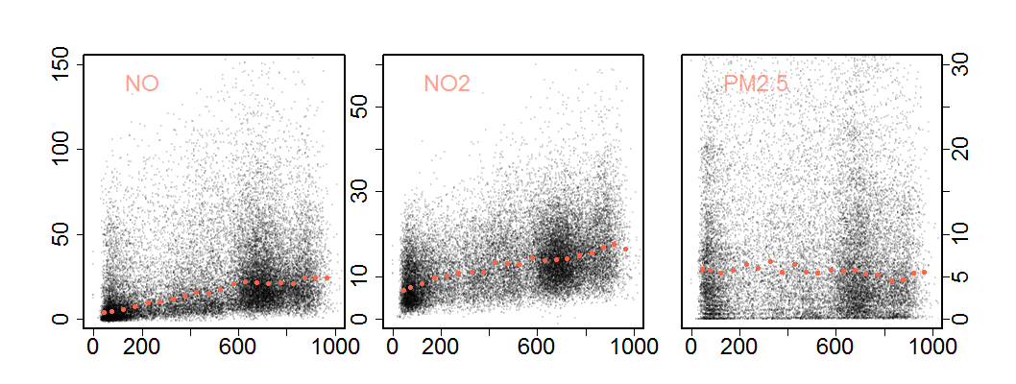
Pollutants vs Traffic Volumes
PM_{2.5} (µg/m³)
NOx (ppb)
Traffic Volumes (veh/15 mins)

Slide 6
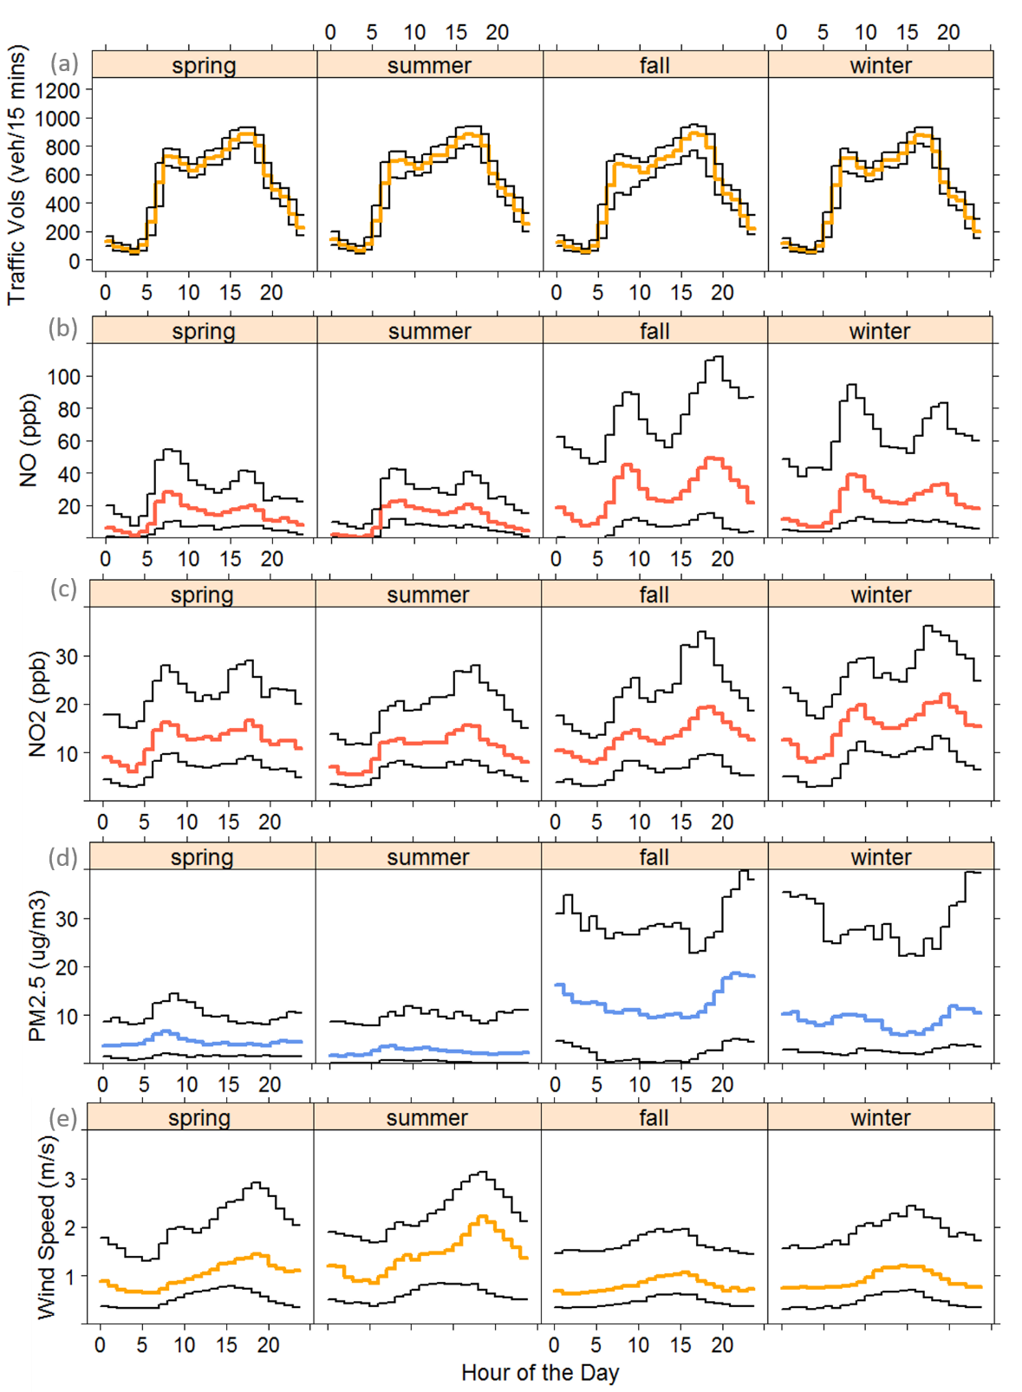
Seasonal Dirunal Patterns

Slide 7
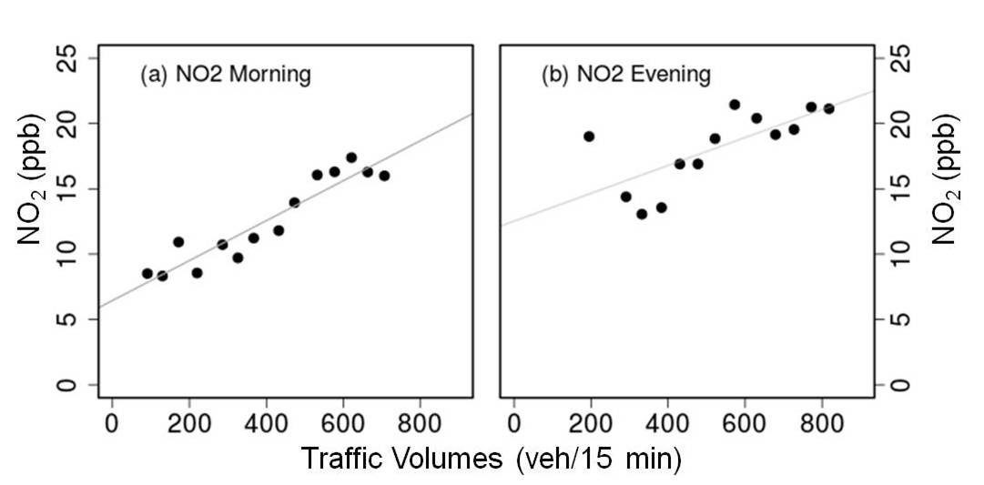
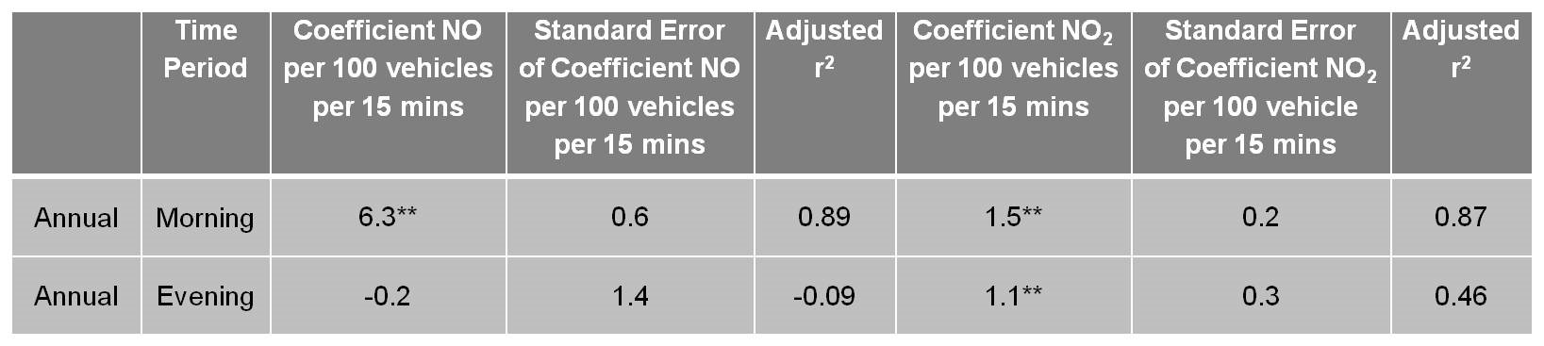
Findings- Annual Scale

Slide 8
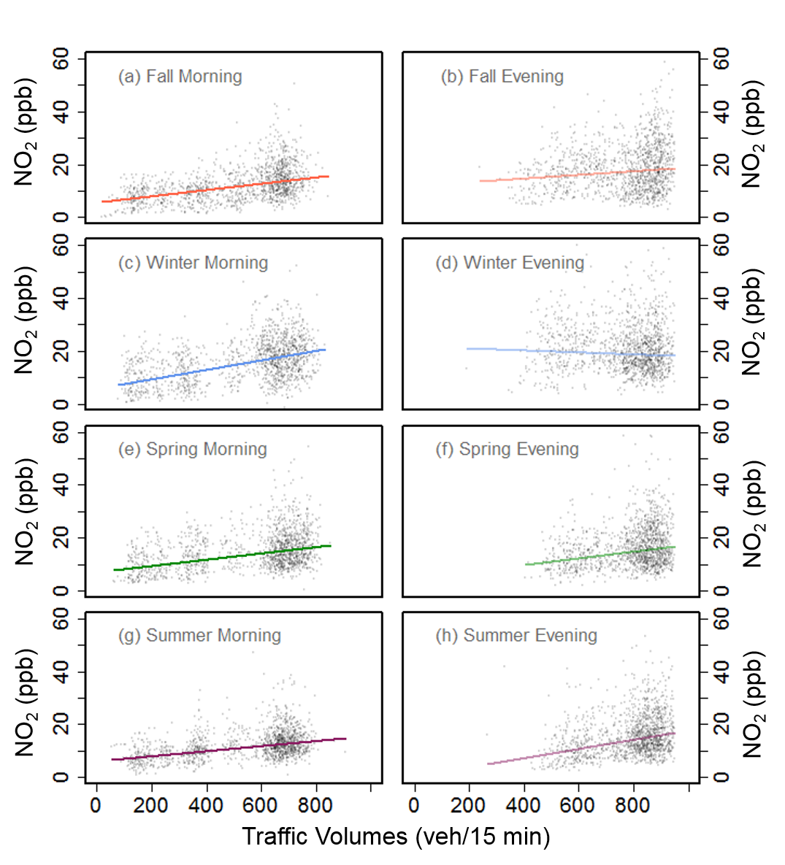
Findings
Morning periods across all seasons show significant linear relationship while evening periods do not
However, variability is high
Traffic volumes are not a good proxy at short-term time aggregations
Notes:
Mention random sampling method to deal with temporal autocorrelation

Slide 9
Findings
Season | Time Period | Coefficient NO per 100 vehicles per 15 mins | Standard Error of Coefficient NO per 100 vehicles per 15 mins | Adjusted r² | Coefficient NO₂ per 100 vehicles per 15 mins | Standard Error of Coefficient NO₂ per 100 vehicle per 15 mins | Adjusted r²
Fall | Morning | 6.3 ** (7.9)** | 1.4 (0.4) | 0.1 (0.16) | 1.2** (1.6)** | 2.3 (0.1) | 0.14 (0.24)
Winter | Morning | 9.4** (11.2)** | 1.4 (0.7) | 0.14 (0.24) | 1.5** (1.9)** | 0.4 (0.2) | 0.17 (0.26)
Spring | Morning | 6.3** (6.7)** | 0.8 (0.3) | 0.41 (0.43) | 2.5** (2.3)** | 0.3 (0.2) | 0.27 (0.28)
Summer | Morning | 4.6** (4.4)** | (0.4) (0.2) | (0.45) (0.37) | 1.3** (1.6)** | 0.3 (0.1) | 0.25 (0.23)
Fall | Evening | -1.3 (-1.6) | 2.5 (1.1) | <0.001 (0.005) | 1.2* (0.9) | 0.6 (0.2) | 0.05 (0.03)
Winter | Evening | -0.04 (0.09) | 2.6 (1.3) | 0.002 (0.001) | -0.4 (-0.08) | 0.8 (0.4) | 0.05 (0.03)
Spring | Evening | 2.1 (2.2)** | 1.1 (0.5) | 0.03 (0.04) | 0.9 (0.9)** | (0.8) (0.3) | 0.007 (0.02)
Summer | Evening | 2.1* (2.9)** | 0.8 (0.3) | 0.02 (0.07) | 1.6* (1.9)** | 0.7 (0.2) | 0.03 (0.05)

Slide 10
Implications of Findings
Morning time periods are more consistent input throughout the year for modeling transportation and air quality impacts
Modeling based on evening periods when traffic volumes are higher could be overestimating or underestimating exposure concentrations
Other measures besides PM_{2.5} mass may be needed at certain locations to capture the increased particulate exposure from traffic
As exposure assessment moves toward predicting exposures on shorter time scales, traffic volumes as a proxy is not a reliable method

Slide 11
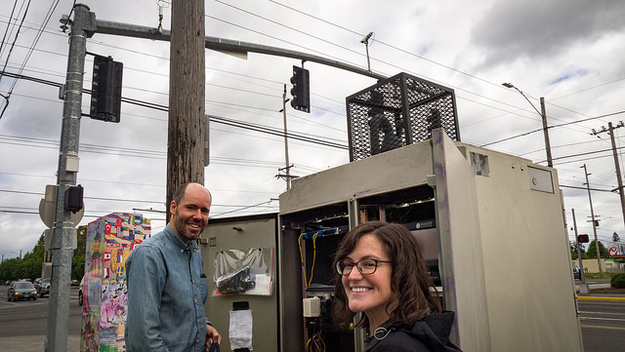
Questions?
Christine.Kendrick@portlandoregon.gov

Slide 12
Extra slides

Slide 13
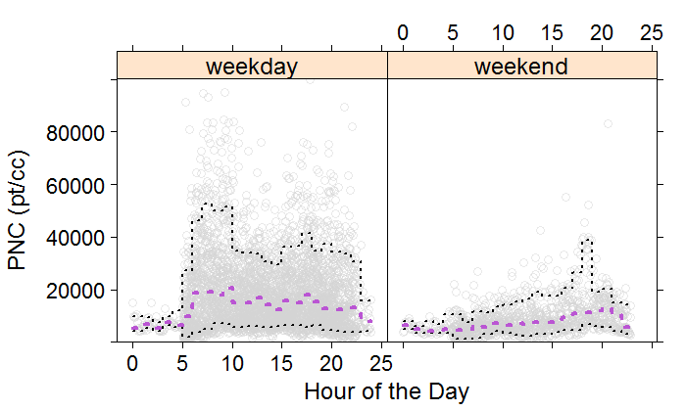
Findings

