Slide 1
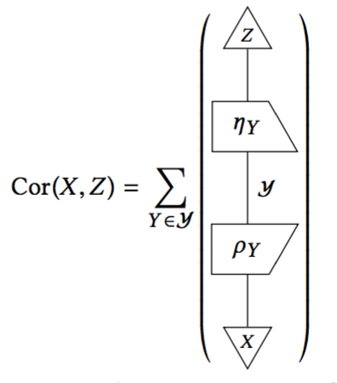
Indicator Frameworks
Joshua Tan (Oxford), Christine Kendrick (City of Portland), Abhishek Dubey (Vanderbilt), and Sokwoo Rhee (NIST)
SCOPE 2017, Carnegie Mellon University
April 21, 2017
Notes:
This is work that Sokwoo originally initiated.

Slide 2
Overarching question: how do we synthesize models with data?
Notes:
… in a way that preserves their usefulness. One idea: we could use models to address
Models are things like PDEs, dynamical systems, and even CPS. All the way to UML diagrams.
Typically, I mean this in the sense that models are typically not htat useful, unless you have

Slide 3
Towards a science of measuring systems
Cities are cyber-physical systems
Cities are systems of systems
These are mathematical descriptions. They do not measure anything, per se.
Other mathematical descriptions:
Network approaches
Economic models
Game theory
Notes:
This is part of CPS week, so we ought to reflect on CPS as a discipline…
When someone brings up the CPS aspects, it’s typically focused on the cyber part, largely because that’s where the “control” side of it lies. From this perspective, the physical side is just an abstraction: it’s what makes CPS a “bad” information-processing unit.
These are things are literally descriptions of computers. As computer scientists and engineers, no wonder we like these descriptions! Practically,

Slide 4
Towards a science of measuring cities
Problem: the models fail to describe the world perfectly.
Problem: the data doesn’t either.*
* cities are complex: there isn’t enough raw data to describe all the interactions
Notes:
*Buzzword: “complex”. Sociologists used to call this “embeddedness”.
Cities are run by people, in particular by decision-makers across the board.
If we had enough (good) data, we could build a giant correlation table between every indicator that we could imagine. Of course we don’t: that’s why we use models to infer these correlations (and other relations).

Slide 5
Indicator frameworks
They are simple.
They are concrete.
They are already being used.
Step 1: give a mathematical semantics for indicator frameworks.
Step 2: test whether indicator frameworks can be upgraded to synthesize models with data.
Notes:
Start by understanding what makes valuable data valuable… what do people do with it?
Instead of creating a solution out of thin air, we want to build on what people are already using to solve their problems.
Tradition: database management and BI tools. There are not your usual schema models.

Slide 6
This Talk
Background and Motivation
Operational Indicator Frameworks
Abstract Indicator Frameworks
Causal Diagrams
Future Work

Slide 7
Operational indicator frameworks
An indicator is a column of numeric data values. They are typically to used to measure inputs, immediate outcomes, and long-term impacts of city projects. We assume that all indicators are time-varying.
An operational indicator framework is just a list of indicators, sometimes organized hierarchically.
id,id_wasp,id_secret,frame_type,frame_number,sensor,value,timestamp,raw,parser_type 44637,city1,408414489,128,132,noise,50,"2016-08-10 06:00:29",noraw,0 44679,city1,408414489,128,138,noise,52,"2016-08-10 06:02:24",noraw,0 44742,city1,408414489,128,143,noise,51,"2016-08-10 06:04:00",noraw,0 44777,city1,408414489,128,149,noise,55,"2016-08-10 06:05:55",noraw,0 44819,city1,408414489,128,152,noise,60,"2016-08-10 06:06:53",noraw,0 44875,city1,408414489,128,160,noise,62,"2016-08-10 06:09:27",noraw,0
Notes:
This is definitely a limited view of operational indicator frameworks… more research pending.

Slide 8
Congestion | % in hours | Increase in overall travel times when compared to free flow situation (uncongested situation
Public transport use | #/cap/year | Annual number of public transport trips per capita
Net migration | #/1000 | Rate of population change due to migration per 1000 inhabitants
Population Dependency Ratio | #/100 | Number of economically dependent persons (net consumers) per 100 economically active persons (net producers),
International Events Hold | #/100.000 | The number of international events per 100.000 inhabitants
Tourism intensity | nights/100.000 | Number of tourist nights per year per 100.000 inhabitants
Attractiveness and competitiveness indicators, from CITYkeys, 2016

Slide 9
Topic | Day | Week | Month | QTR
311 CALL CENTER PERFORMANCE | 0.92 | 0.88 | 0.89 | 0.9
GRAFFITI ON-TIME % | 1.0 | 0.89 | 0.94 | 1.06
MISSED TRASH ON-TIME % | 1.14 | 1.19 | 1.2 | 1.19
PARKS MAINTENANCE ON-TIME % | 1.15 | 1.1 | 1.09 | 1.05
POTHOLE ON-TIME % | 0.83 | 0.97 | 0.77 | 0.83
SIGN INSTALLATION ON-TIME % | 0.83 | 1.01 | 1.14 | 1.07
SIGNAL REPAIR ON-TIME % | 1.04 | 1.11 | 1.18 | 1.14
STREETLIGHT ON-TIME % | 0.2 | 0.59 | 0.57 | 0.72
TREE MAINTENANCE ON-TIME % | 1.14 | 1.18 | 1.19 | 1.19
ON-TIME PERMIT REVIEWS | 0.98 | 0.97 | 0.91 | 0.99
LIBRARY USERS | 1.44 | 1.15 | 1.27 | 1.29
Selection of indicators from CityScore, Mayor’s Office, City of Boston, 2017

Slide 10
How do we construct operational indicator frameworks?
Expert input, Likert scales, but also…
We can refine old indicators by “cleaning” the data.
We can form combine sets of indicators into new indicators.
We can compute or infer correlations between indicators, then describe proxies.
Notes:
Its already problematic, however, since “pairs” of indicators are no longer numeric!

Slide 11
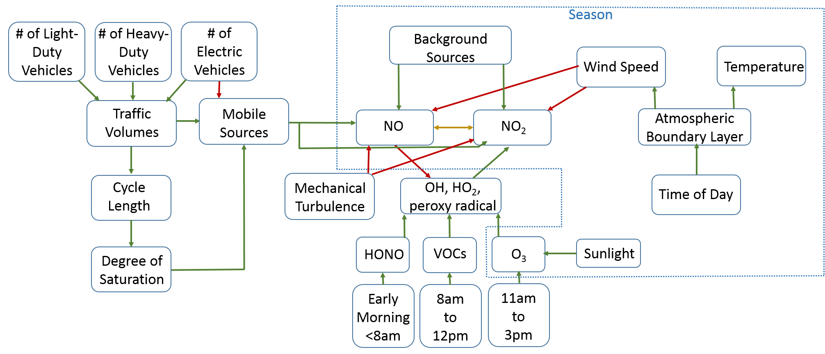
Adding structure

Slide 12
Abstract indicator frameworks, v1
An abstract indicator framework is composed of:
A R-valued matrix whose columns represent indicators and rows represent data
An inner product operation between indicators, understood as their sample correlation
The set of all abstract indicator frameworks forms something called a category

Slide 13
Mathematical background: category theory
Category theory was originally invented in the 1960s to integrate different aspects of mathematics, especially topology and algebra. It is now being tested by a variety of different agencies, like NIST and DARPA, as a language for modeling and integrating large, heterogeneous systems, e.g. Nextgen or CASCADE.
A category C is a collection of objects, called the objects of C, along with a collection of maps, called the morphisms of C, satisfying certain properties.
A functor F : C -> D between two categories is a map taking objects of C to objects of D, and morphisms of C to morphisms of D in a compatible way.

Slide 14
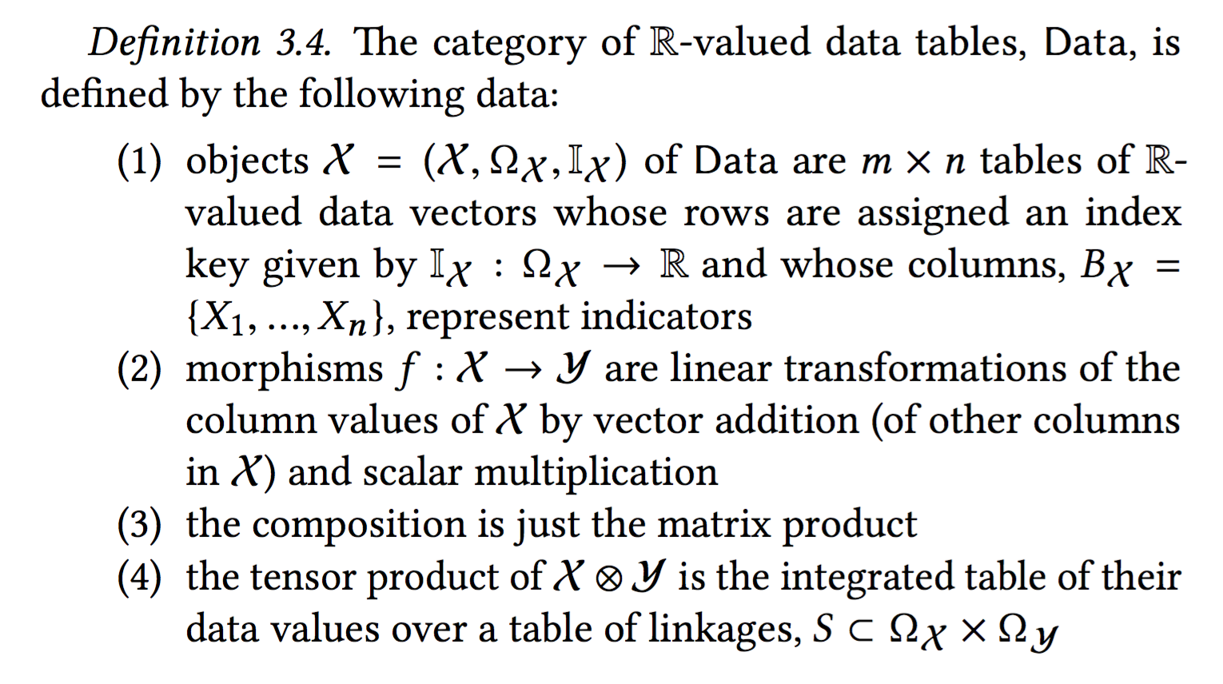

Slide 15
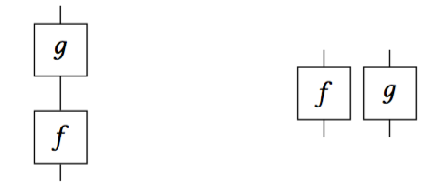
Mathematical background: monoidal categories
A category with a tensor operation ⊗ : C × C -> C, satisfying certain properties, is called a monoidal category.
Essentially the tensor allows you to compare morphisms in parallel, while composition allows you to compare morphisms in series.
Notes:
Bonus: monoidal categories have a convenient graphical representation: they essentially encode process diagrams.
Upshot: this is part of a generic strategy for capturing operational indicator frameworks: formalize part of the structure.

Slide 16
Abstract indicator frameworks, v2
We want to abstract from the data management aspect. It’s the choice of the indicators that is important, not the individual rows of data underneath.
Many of operations on indicators are purely statistical, e.g. correlation, so we would like to define them in a general context.
We especially want to emphasize correlation, because it emphasizes relations between indicators rather than the indicators themselves.
We want to set the stage for linking models to data.
This motivates the following definition:
Notes:
In particular: define them as random variables.

Slide 17
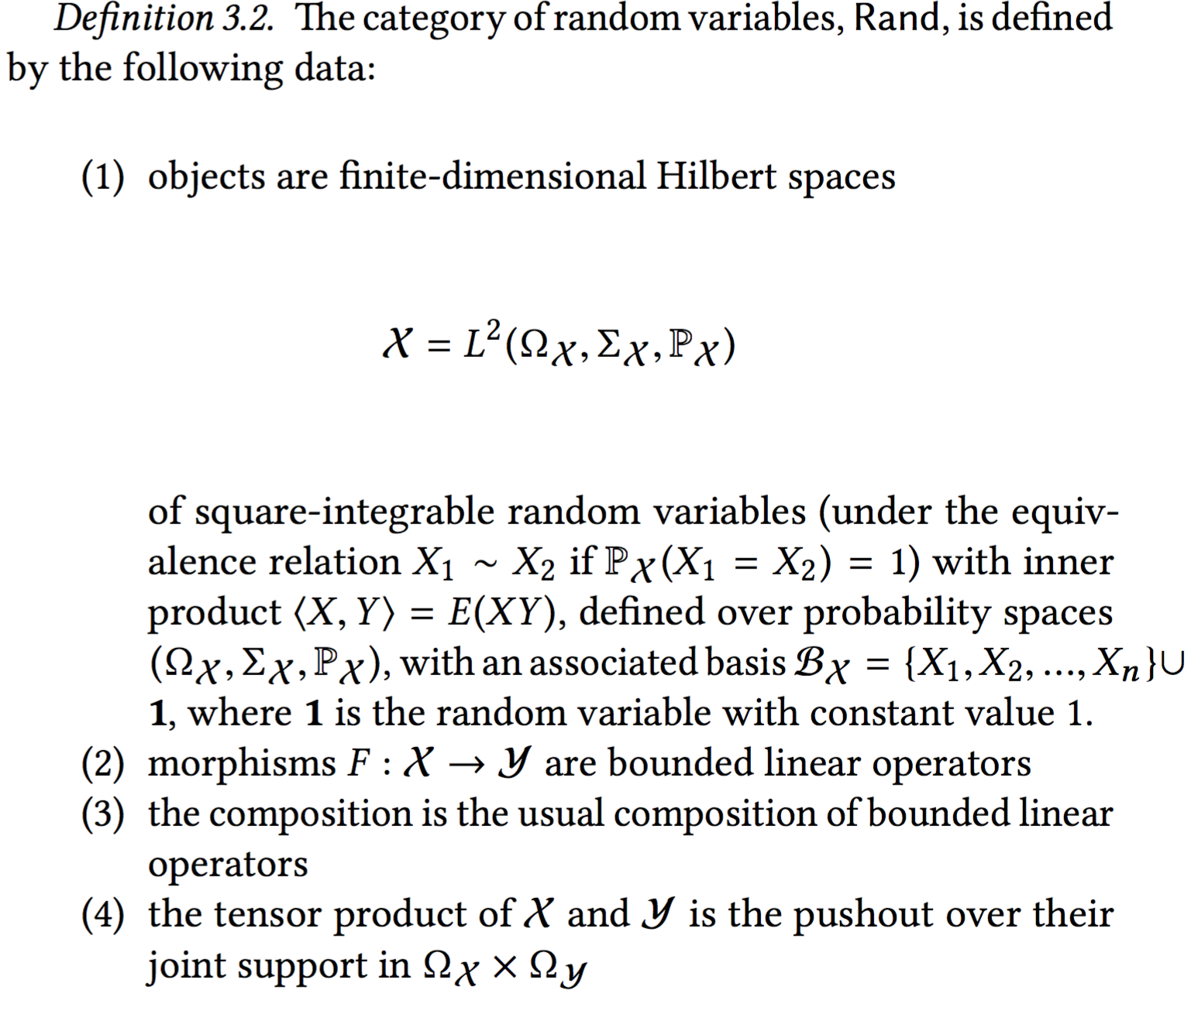
Notes:
You can ignore the details for now: in essence, this is a structure that encapsulates the typical things we want to do with data. It includes a language of constraints.
The strategy is to pass things into this category.

Slide 18
Defining new indicator frameworks in Rand
Given two indicator frameworks X and Z in Rand, one can write “formulas” in Rand that describe new indicator frameworks, exactly analogous to how one defines mediating (or confounding) variables in statistics. In the diagrammatic calculus, these look something like this:
Notes:
Recall: \rho_Y and \eta_Y represent computing the residuals.
The point: instead of constructing operational indicator frameworks expensively and internally, meaning indicator- by-indicator, we can specify them abstractly and externally, by means of their causal and statistical relationships to other, already- extant sets of indicators.

Slide 19
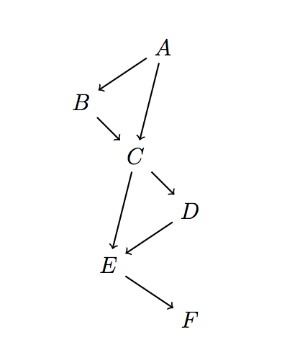
A simple model: causal diagrams
Causal diagrams are directed acyclic graphs, e.g.
Each causal diagram can be used to construct a monoidal category, called a causal theory [Fong ‘13].
Each graph, essentially, defines a procedure for computing mediating variables.

Slide 20
Abstract indicator frameworks, v3
The causal diagram serves as a primitive model of a given context.
The category Rand of random variables serves as a (still primitive) semantics of how we use data.
The idea: define constraints in Rand, and thus indicator frameworks, by mapping the causal theory into Rand; this creates a model of the causal theory in Rand., i.e. an indicator framework based on the causal theory.
Notes:
We can construct a functor from a causal theory C to the category of random variables, Rand.

Slide 21
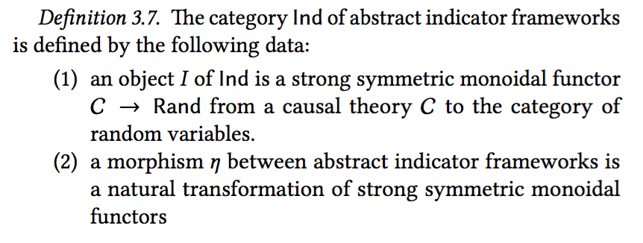

Slide 22
Future Work
More examples!
Constructions besides mediating frameworks
Improved semantics on Rand
True “hybrid indicator frameworks” for CPS models

Slide 23
Thank you.

Slide 24
Example: Shot Spot in South Bend
Courtesy of Santiago Garces, CIO of South Bend, Indiana
Target indicator: reduce crime
Target indicator: reduce gun crime and group-related activity
Target indicator: target interventions at specific group members
Means: Incorporate Shot Spot information with 911 dispatch calls. “Whenever, a shot incident is detected and a resident also calls 911 to inform of the incident, the dispatch is classified differently than when a signal is detected but not accompanied with a resident's call.”
Notes:
The point: putting together a set of indicators, and populating them, is not an easy task!

Slide 25
Example: Shot Spot in South Bend
Indicators Used
The total number of shootings involving a group member, compared to a 3 year rolling average;
the ratio of group member involved shootings, compared to the total number of criminal assault shootings;
Number of shooting incidents recorded both by Shot Spotter and residents
Number of direct interventions with group members, or close social relatives
Number of call-ins (large meetings where notorious group members are presented with the opportunity to get involved with social services, or communicated the enforcement action alternative)
Number of enforcement actions, interventions directed at executing warrants and investigations against the most violent group
Ratio of shots where a resident called as a shot is detected by Shot Spotter (proxy for community trust and collaboration with the Police Department)
Percentage/ s-value of number of complaints relative to calls for service

Slide 26
Example: Shot Spot in South Bend
Things we need to model:
Frameworks that draw on indicators from a number of different sources: ISO 37120 for overview, FBI uniform crime reporting program, 911 CAD system, Shot Spotter, internal databases for group activity and “interventions”
Comparisons of indicators as indicators, e.g. the total # of shootings compared to a 3 year rolling average
Logical operations on indicators, e.g. # of shootings recorded by Shot Spotter AND local residents, # of direct interventions with group members OR close relatives
Relationship between indicator and `sub-indicators’
Properties of indicators, like how difficult it is to supply that indicator

Slide 27
Example: Nextgen
Courtesy of John Baez and Metron
Nextgen: “Next Generation Air Transportation System”
From DARPA: “The DoD and urban infrastructure capabilities are increasingly based on the integration and coordination of heterogeneous systems using System-of-Systems (SoS) architectures. However, it is difficult to model and currently impossible to systematically design such complex systems using state-of-the-art tools, leading to inferior performance, unexpected problems, and weak resilience. This inadequacy in design capability results from the complexity of interactions between system structures and behaviors across multiple time and length scales that cannot be adequately modeled using conventional approaches.”

Slide 28
Non-temporal indicators
E.g., location-varying indicators like energy use per building:
Property Name | Reported | Property Type | Address | ZIP | Gross Area (sq ft) | Site EUI (kBTU/sf)
MEEI -Longwood | Yes | Ambulatory Surgical Center | 800 Huntington Ave | 02115 | 76,300 | 173.1
Prime Motor Group | Yes | Automobile Dealership | 1525-1607 VFW Parkway | 02132 | 150,000 | 28.7
New England Center for Homeless Veterans | Yes | Barracks | 17 Court St. | 02108 | 130,000 | 49.8

