Slide 1
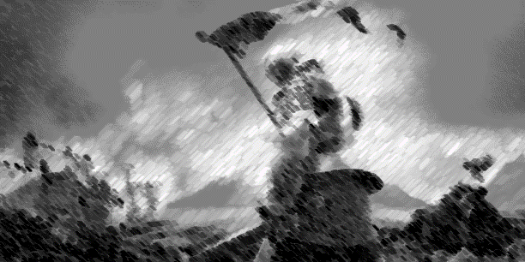
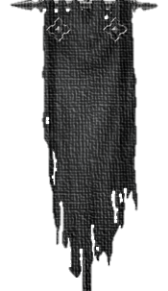











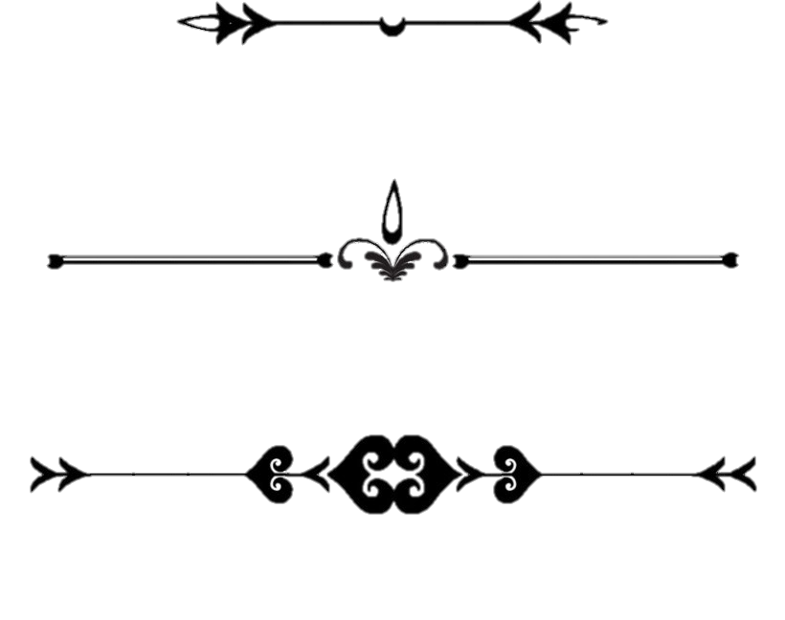


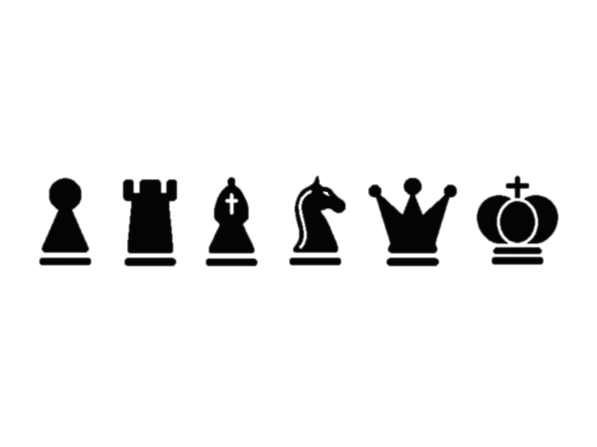


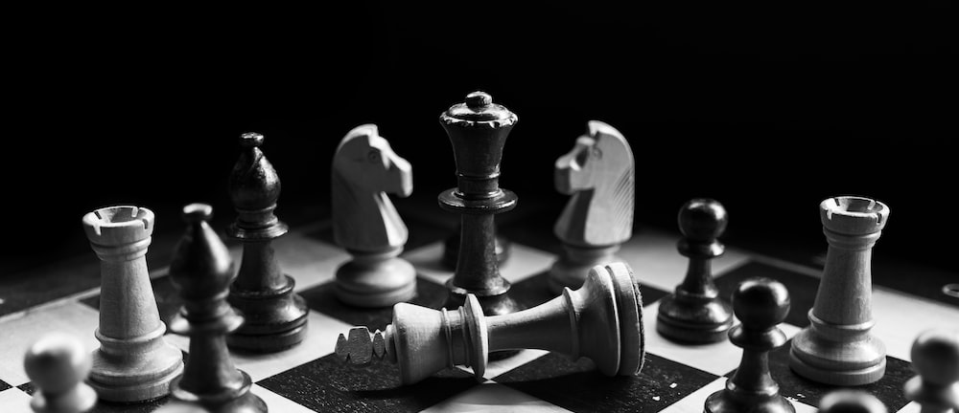
Chess
2
Ultimate
30
3+
The reimagined
strategy/rpg game.
Core mechanics
Rpg
Strategy
Action
points
Set
collection
Hand
management
Variable
power-up
Move a piece:
14
In a turn
A player can choose to make a move with many pieces (maximum 3) each turn. This affects the total they can use within that turn. Each activity a player performs costs a certain amount of .
Attack
1
Equip headgear
1
Each piece has an amount of and costs varying to move per square of movement. Pieces also vary in attack strength. A piece can attack an opposing piece in its legal move range; when the opponent piece’s is depleted, an automatic capture happens and the attacker moves to occupy the captured piece’s previous location.
Equip footgear
2
Equip bodygear
3
Move 2 pieces:
Draw
4
10
Consumables
5
1
3
1
1
1
A player can choose to draw from the bonus deck in their turn. This have a chance to give them a gear or a consumable, which will be held in the player’s hand until used. A player cannot hold more than 10 artefacts at a time.
1
5
3
5
5
5
Move 3 pieces:
1
1.5
1.25
3.5
2
3
6
Avatar & gear
Equipping and unequipping gear to/from a piece counts as a move with a piece, and cost the same .
Each piece has an Avatar, which can equip up to 4 items of different slots. Finishing a set of all 3 items will grant the player a choice between a defensive or offensive handgear, as well as unlock a one-time special ability.

